Slide 1


Denial of Services(DoS)
Its an attack to make a machine or network resource unavailable to its intended users.

Slide 2
Denial of Services(DoS)
Its an attack to make a machine or network resource unavailable to its intended users.

Slide 3

Distributed Denial-of-Service attack
Its an attack to make a machine or network resource unavailable to its intended users
by using others computer.
Network

Slide 4
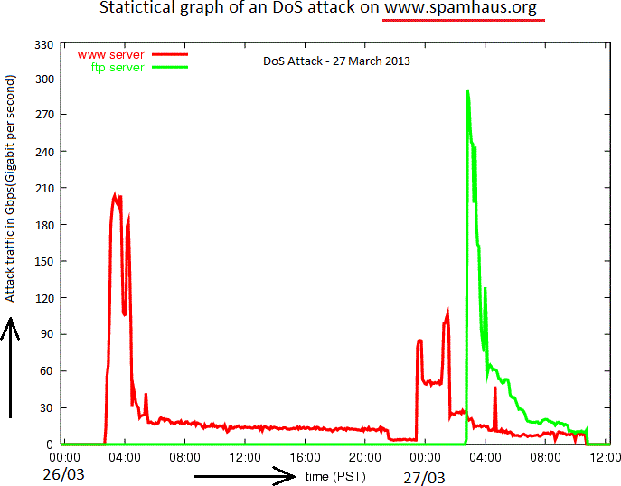
A big-bang of DDoSattack
The internet around the whole world was slowed down on 27th march.
Because that day DDoS attack took place with near about 300 Gbps.

Slide 5
Method of attack
ICMP flood
Teardrop attacks
Permanent denial-of-service attacks
Reflected / Spoofed attack
Low-rate Denial-of-Service attacks
Peer-to-peer attacks

Slide 6
Some best DDoS attack method
ICMP flood:
Sends packets to all computer hosts rather than a specific machine.
Teardrop attacks:
Fragmented over-sized pay-loads to be send to the target machine.
Permanent denial-of-service attacks:
It may cause replacement of hardware also.

Slide 7
Some best DoS Attack tools
LOIC (Low Orbit Ion Canon)
XOIC
DDOSIM—Layer 7 DDOS Simulator
R-U-Dead-Yet
Tor’s Hammer
PyLoris

Slide 8
How do we know an attack is happening?
unusually slow network performance (opening files or accessing websites)
unavailability of a particular website
inability to access any website
dramatic increase in the amount of spam you receive in your account

Slide 9
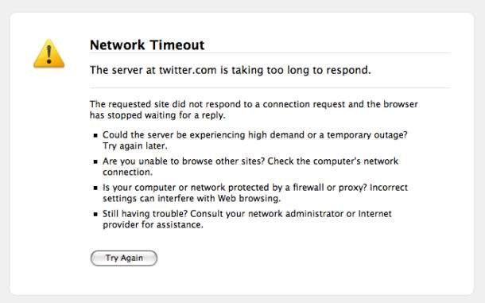
A common message after DoS

Slide 10
What to do if we are experiencing an attack?
contact your network administrators.
In case of home computer, consider contacting your internet service provider (ISP).
Immediatly get disconnected from internet.

Slide 11
How do we avoid being part of the problem?
Continually installing updates and patches for security updated
A well-set network infrastructure with proper installation of firewalls and routers with appropriate policies
Filters incoming traffic on routers or rate-limit certain types of traffic
Monitors continuously incoming and outgoing packets
Use Network Address Translation (NAT) to hide internal IP addresses.
Implement Honeypots systems, these are the systems in an organization with open security and are separated with internal network to know the attack pattern.
Egress and Ingress filtering (practice of monitoring and potentially restricting the flow of information outbound from one network to another)
Use a proxy server in between the network so that a request goes via proxy to server and proxy filters it according the rules implemented on it.

Slide 12
Conclusion
Susceptibility to attacks could be alleviated with better Internet.
Don’t leave all the decision making to the machines.
Provide ‘intelligent’ support along the path.
Create “Hardened” networks.

