Slide 1



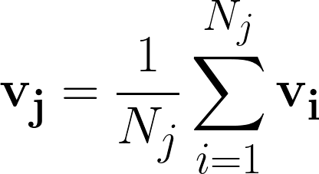
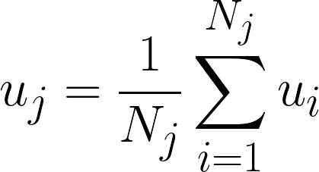
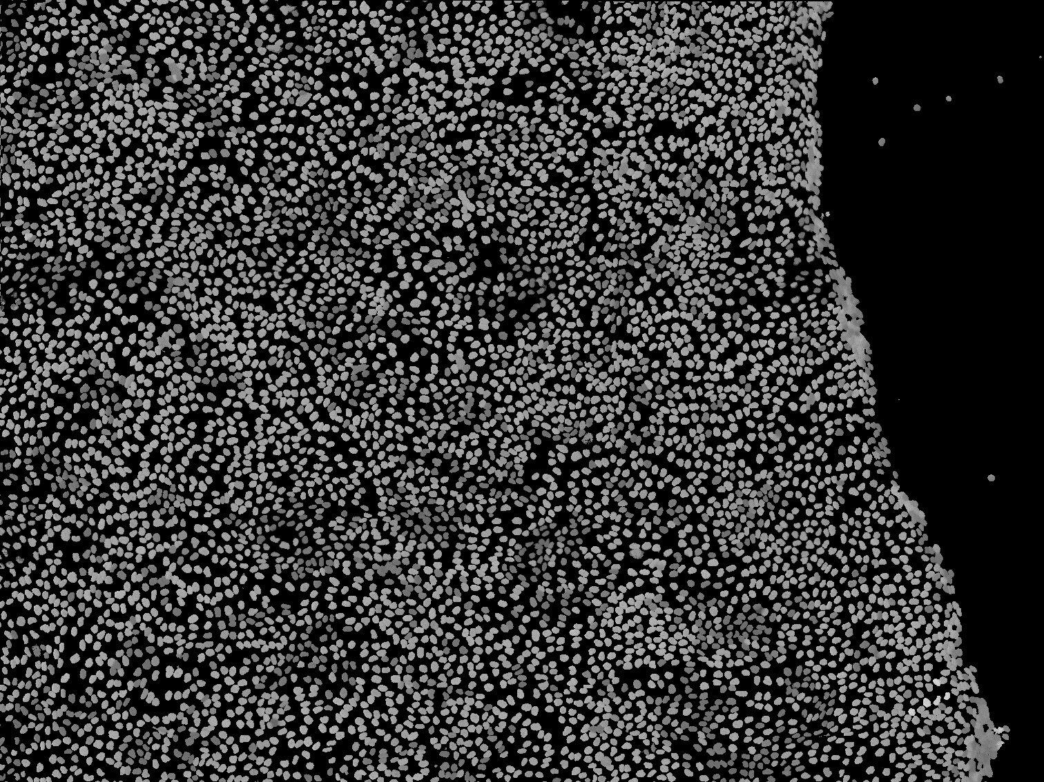
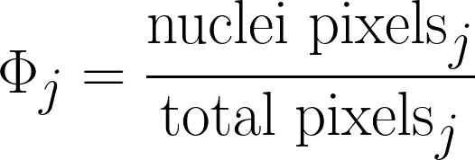
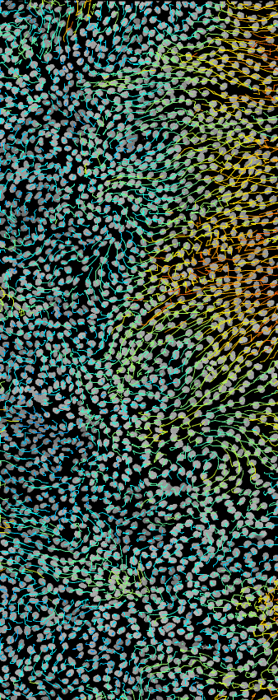
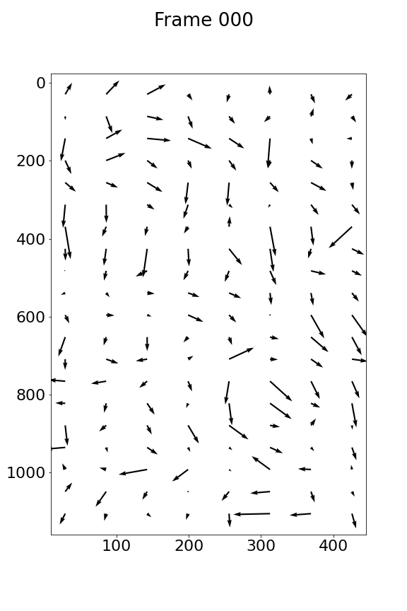
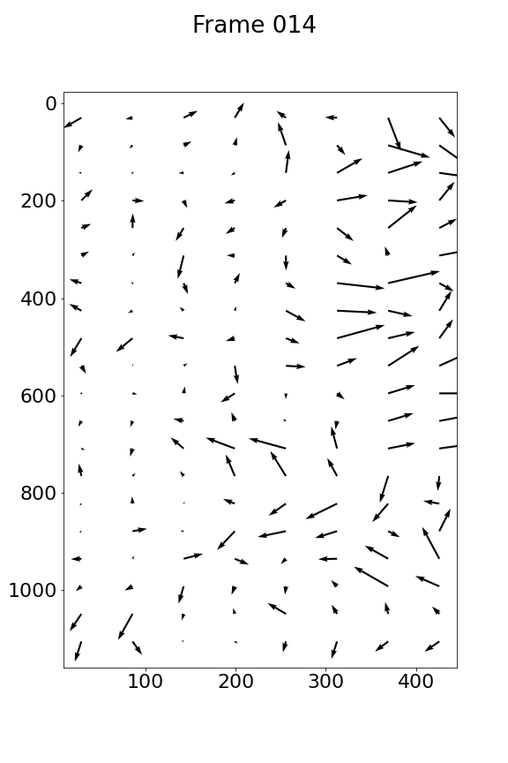
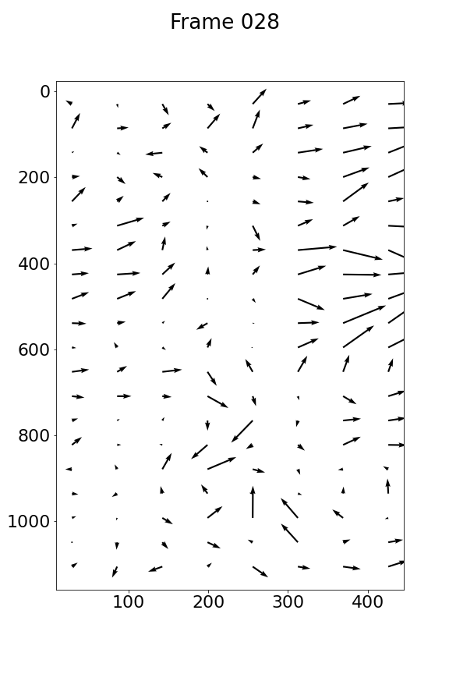
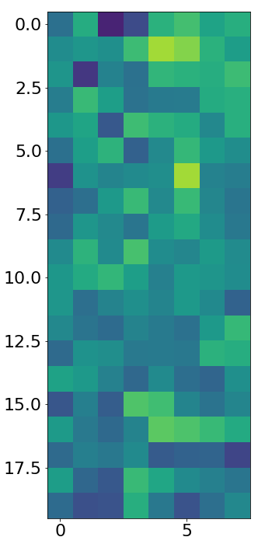
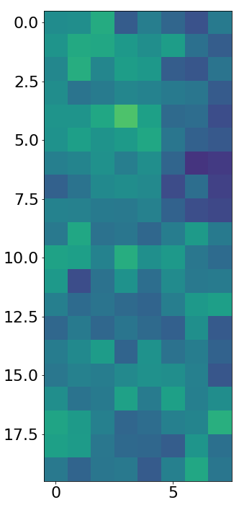
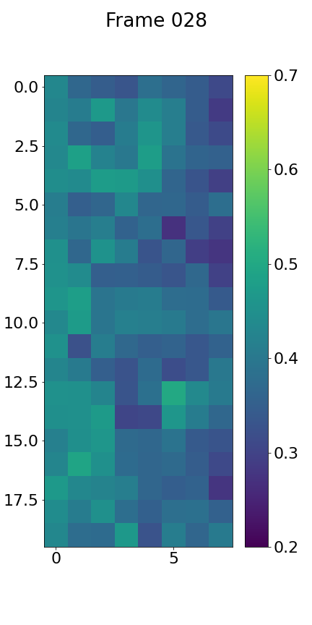
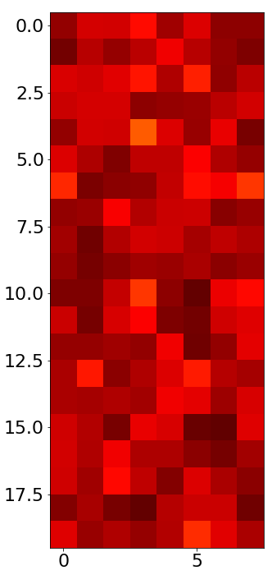
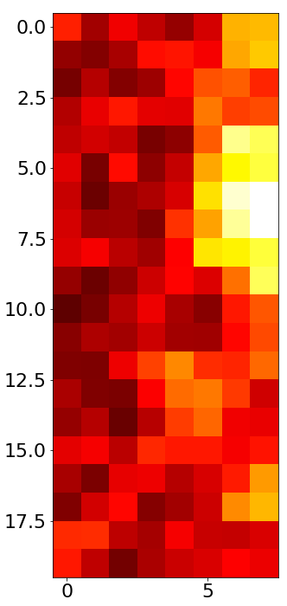
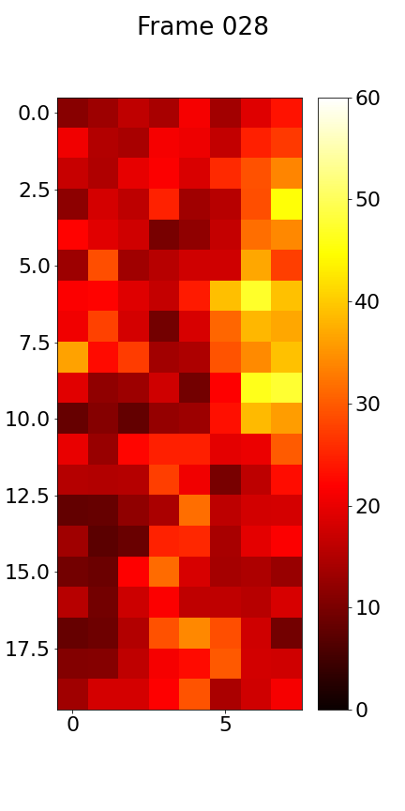
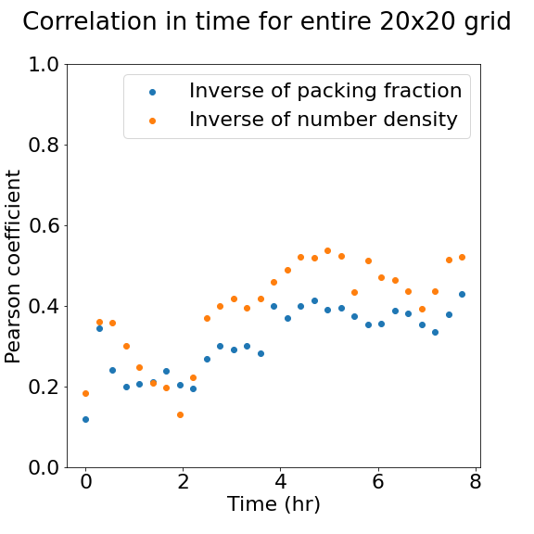
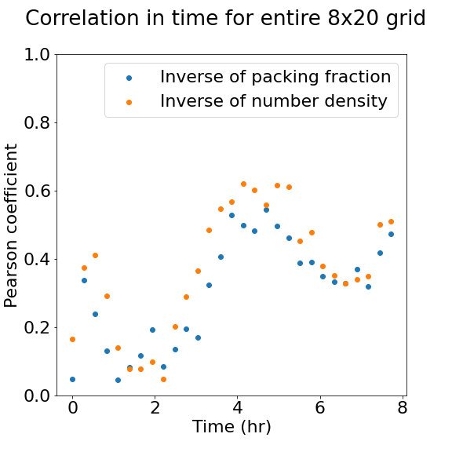
NUCLEI DYNAMICS IN EPITHELIAL MONOLAYER
Benjamín Alvial^{1,2,*}, Paulo C. Godolphim^{1,2,3}, Ignacio Bordeu¹.
1 - Departamento de Física, FCFM, Universidad de Chile, Santiago, Chile.
2 - Millennium Nucleus for Physics of Active Matter, Santiago, Chile.
3 - Instituto de Física, UFRGS, Porto Alegre, Brazil. *benjamin.alvial@ug.uchile.cl
INTRODUCTION
METHODS
In granular systems, a critical packing fraction induces a jamming phenomenon, where particle velocity approaches zero. In epithelial tissue systems, a similar jamming phenomenon has been observed. The relationship between nuclei velocity and nuclei packing fraction is studied for MDCK (Madin-Darby canine kidney) cell migration, an example of unjamming.
First, a correlation between these two variables is studied. Second, the same correlation is analyzed with a more traditional measure of density, number density. We aim to show that nuclei packing fraction can be used as an equivalent measure to number density, useful for more diverse cell morphologies.
The space is divided in a grid (Fig. 1). FIJI’s plugin TrackMate [1] is used to obtain the trajectories of each nucleus (Fig. 2). For each window j in the grid, an average velocity v_{j} and speed u_{j} is calculated for the nuclei contained within. Similarly, a packing fraction Φ_{j} for each window is calculated, as the quotient between nuclei pixels and total pixels.
For each frame:
Fig. 1: Data from Aoki et al. [2]. The data utilized is a sequence of 30 frames spanning 8 hours of MDCK cell migration after a scratch has been made on the right side, simulating a wound. Two regions are studied: a 20 x 20 square grid including most nuclei (in blue) and an 8 x 20 rectangular grid including only nuclei near the wound (in red).
,
,
.
A
For each time frame, the average local speeds and inverse packing fractions are used to calculate the Pearson correlation coefficient. This is also done for the inverse of number density and for both the 20 x 20 and 8 x 20 grid.
C
RESULTS AND DISCUSSION
Fig. 2: TrackMate tracks. A track is obtained for each nucleus.
All fields (Fig. 3) show the significant migration in the upper-right corner of the video. In this region, nuclei travel at great speeds and are less packed.
All correlation values are positive (Fig. 4), meaning speed increases as the packing of nuclei decreases, as is expected in an unjamming phenomenon.
Correlation becomes stronger as time passes, probably because the chemical activation wave signalling for migration propagates to the left and induces a drift and enhanced transport, which corresponds to the unjamming phenomenon. This wave might have a specific frequency, which would explain the fact that after 5 hours correlation gets weaker and after 7 hours correlation increases once again.
The correlations for the smaller grid show bigger fluctuations, probably due to being close to the wound.
Between packing fraction and number density, the latter seems to have better correlation values, which may be due to how the contribution of a nuclei to a given window in the grid is calculated.
(μm/h)
(a) 0 hours
(b) 4 hours
(c) 8 hours
20 x 20 grid
(b) 8 x 20 grid
Fig. 3: Fields for 8 x 20 grid. Videos of velocity, speed (in μm/h) and packing fraction fields were generated. Three time frames are showed, (a) at 0 hours, (b) at 4 hours, and (c) at 8 hours.
Fig. 4: Correlation in time. The Pearson correlation coefficient is calculated between speed and inverse of packing fraction (in blue) and between speed and inverse of number density (in orange). This is done for the original (a) 20 x 20 grid and for the (b) 8 x 20 grid next to the wound.
CONCLUSIONS
FUTURE WORK
Visual representations of the observables allowed for confirmation of expected results, and the Pearson coefficients calculated showed the existence of moderate correlation between speed and packing fraction, which varied with time. Number density seems to have better results, but not significant, than packing fraction. That is, packing fraction can still be useful as a more universal measure of density, considering nuclei of different morphologies.
In the future, it would be useful to explore different sizes for the grid’s windows because there might be a characteristic correlation distance at which nuclei behave similar to their neighbors, which may have not been coincidental with those studied in this experiment. Furthermore, it would be interesting to study the same phenomenon in confluent videos of healthy and cancerous tissues with dividing cells, as a model describing these systems could be useful in cancer detection.
REFERENCES
[1] Ershov, D., Phan, M.-S., Pylvänäinen, J. W., Rigaud, S. U., Le Blanc, L., Charles-Orszag, A., … Tinevez, J.-Y. (2022). TrackMate 7: integrating state-of-the-art segmentation algorithms into tracking pipelines. Nature Methods, 19(7), 829–832. doi:10.1038/s41592-022-01507-1.
[2] Aoki, K. et al. (2017). “Propagating wave of ERK activation orients collective cell migration,” Developmental Cell, 43(3). Available at: https://doi.org/10.1016/j.devcel.2017.10.016.
Fuente: Dreamstime

