Slide 1


Analyzing SAT & ACT Test Results
Benjamin Dornel – DSI 18
November 2020

Slide 2
ACT vs SAT: Which test is more popular?

Slide 3
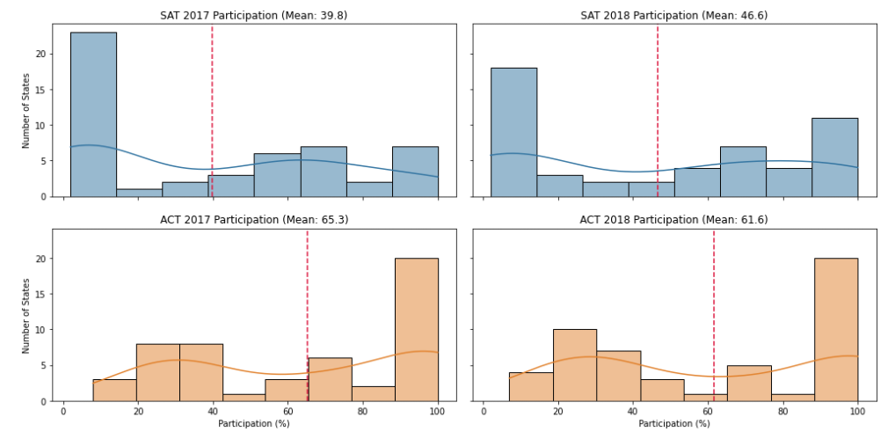
Clearly, the ACT is more popular than the SAT
Notes:
The ACT test has a higher median than the SAT test, indicating that the ACT participation rates are generally higher than SAT participation rates. The SAT participation rates are also skewed right, suggesting that there is strong support for the ACT test throughout the US.
However, from 2017 to 2018, we can observe that the median for SAT participation increased, while the median for ACT participation dropped slightly.
When looking at the SAT, we can see that only 4 states had participation rates of 100% in 2017. This increased to 5 states in 2018. In comparison, the ACT had 17 states with participation rates of 100% in 2017, with this number remaining unchanged in 2018. We can infer from this that the ACT has a larger baseline following than the SAT.

Slide 4
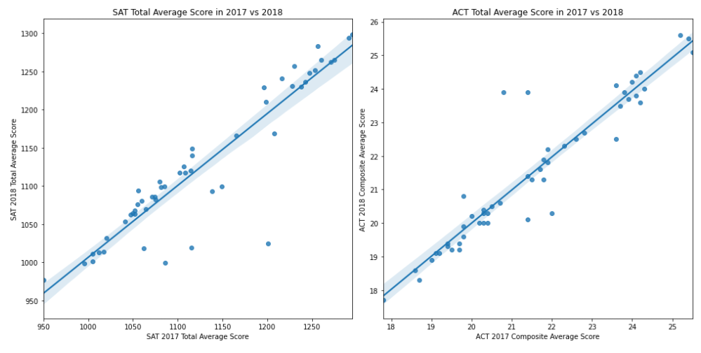
But why? Correlation of scores year-over-year is better for the ACT.

Slide 5
So how can we boost SAT participation rates?

Slide 6
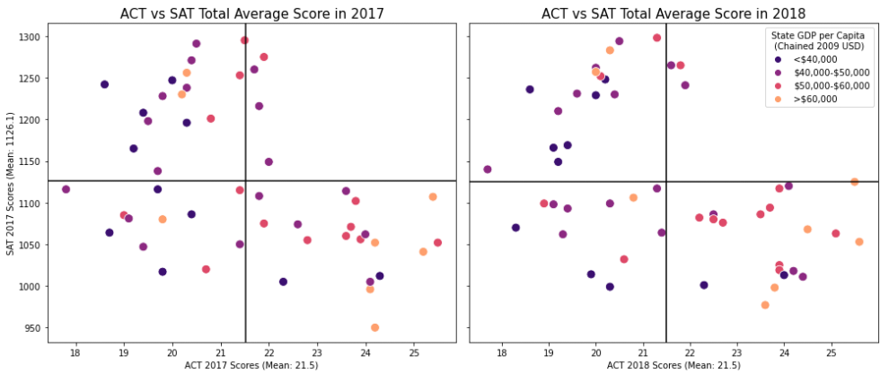
Looking at the data shows that poor states have relatively higher SAT scores and lower ACT scores.
States with high SAT scores
States with high ACT scores

Slide 7
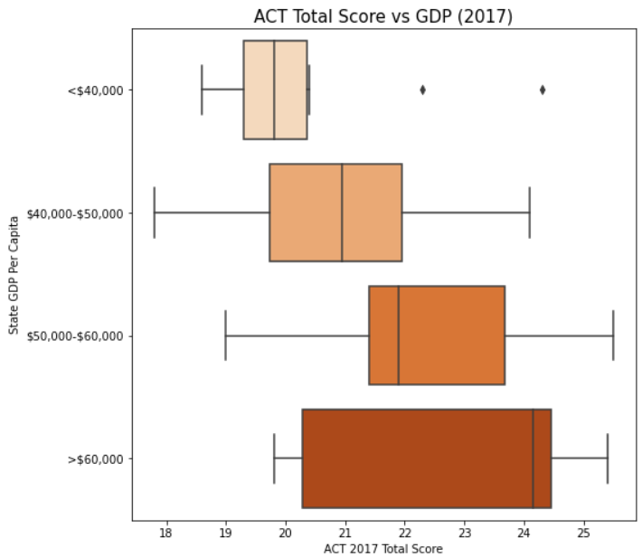
ACT Total Score vs GDP
States with a low GDP per Capita tend to have relatively poor ACT scores.
In comparison, states with a GDP per Capita of above $50,000 have higher ACT scores.

Slide 8
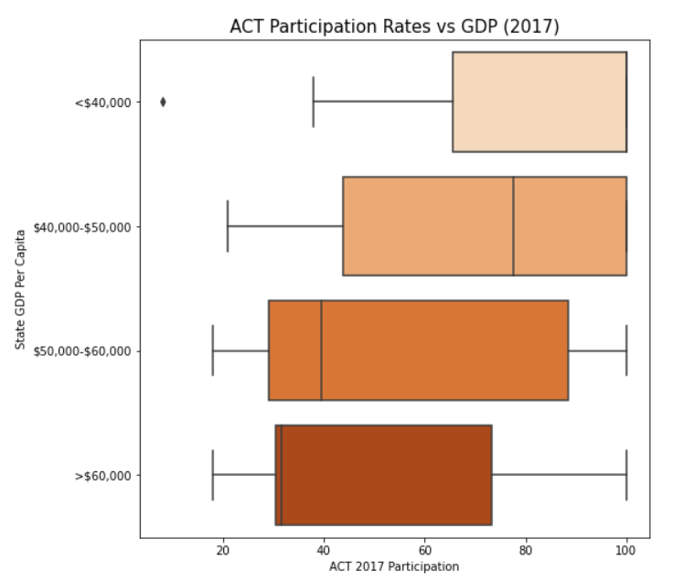
ACT Participation Rates vs GDP
Despite this, states with a low GDP per Capita have high ACT participation rates.
There are 19 states with: 1. Relatively low GDP per capita (>$50,000) 2. High ACT participation rates (>50%) 3. Below average ACT scores (>21.5)

Slide 9
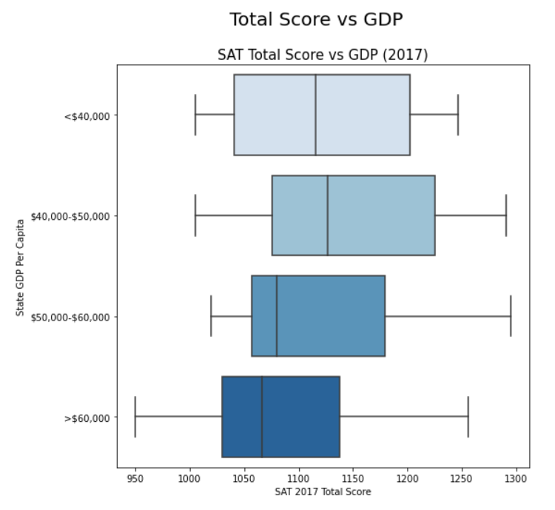
The SAT seems to be more equitable in comparison
This could be due to policies that support low-income students, such as the SAT Fee Waiver.
The SAT also assigns low-income students with Landscape, an adversity score system.
This suggests that lower income states can perform well on the SAT despite lower levels of educational funding.
Notes:
Landscape – offers colleges information on a candidate’s neighborhood and demographic characteristics, including crime rate and poverty

Slide 10
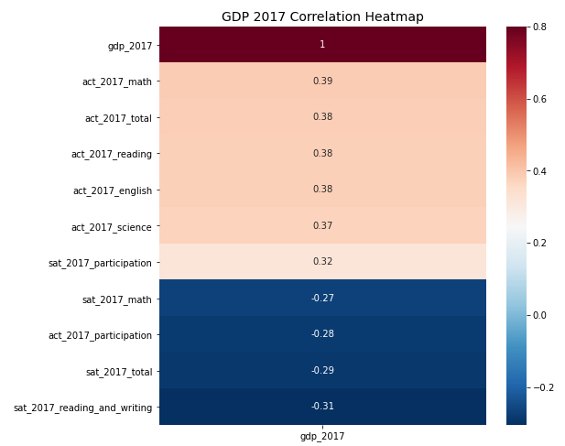
GDP is negatively correlated with SAT scores and participation.
GDP is positively correlated with ACT scores and participation.
Hence, the higher a state's GDP, the higher their ACT test scores.
The opposite is true for SAT test scores.

Slide 11
So, which state should the College Board target?

Slide 12
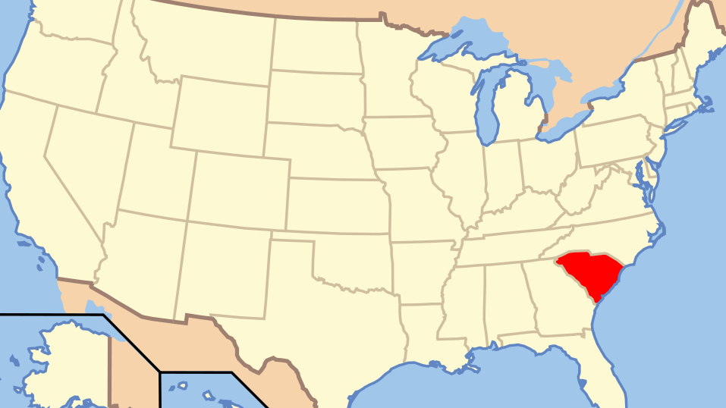
South Carolina
High ACT Participation Rate: 100%
Low GDP: <$40,000
Below Average ACT scores: 18.30

Slide 13
However, we need to keep in mind that correlation != causation.
While the SAT may be more socially equitable than the ACT due to the policies like the fee waivers for low-income students, research shows that standardized test measures generally show a negative correlation between socioeconomic status and test results (NC Gov 2017).
The College Board must continue to work with states to address this issue. This could mean incorporating other forms of testing such as portfolio-based assessment or adaptive testing.
With COVID-19 changing the landscape of standardized testing, the College Board must continue to adapt the SAT to the times we are now in.

Slide 14
Appendix

Slide 15
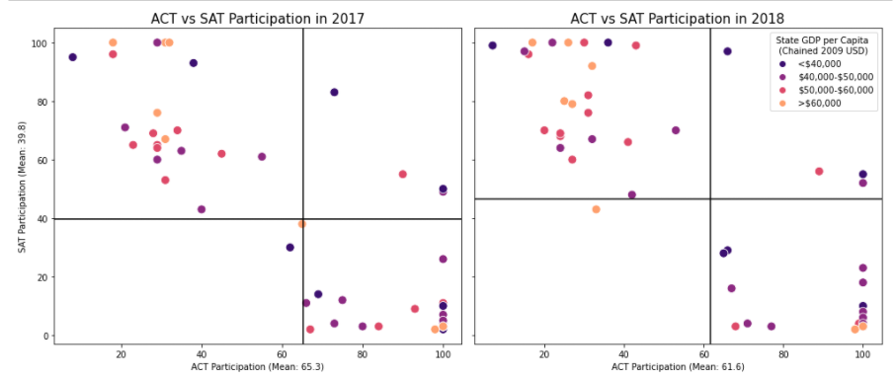

Slide 16
