Slide 1

Systems II Presentation
By: Ben Harki and Ben Chavez

Slide 2
Problem Summary
-O2 compiles a particular .cpp file that runs faster than –O3
-O2 and –O3 are collections of optimizations enabled by flags
Compiled with more recent compiler GCC 9.3 vs GCC 4.9
Compiled with –O2 flags and found an added flag from –O3 that slows runtime
Disassemble to assembly instructions
Created a Makefile to help organize output

Slide 3
Assembly Review
Suffixes of b,l,w,q are byte, word, double word, quad word
mov S, D is S -> D, move S into D
cmp S, D is D : S
je L is if cmp = 0 jump to L
jl L <
jle L <=
jne L !=0
cmov S, D is if comparison then mov
add S, D is D = D+S

Slide 4
Recreate Slow Runtime
Compiled with GCC 9.3, little difference between –O2, -O3
Downloaded GCC version 4.9
Tested on GCC 4.9 and reproduced the runtime difference
Look at assembly: -O2 vs –O3
Noticed differences in assembly in nested loop

Slide 5
Differences in Flags
Find Optimization flags added by –O3 on top of –O2
otwo.txt and othree.txt show enabled/disabled flags
Compiled with –ftree-vectorize vs all others added
Assembly shows this same issue

Slide 6
Compilation with –ftree-vectorize flag
Can we write code to force optimization and reduce issue in runtime, while using –O3?
Sorted (original file), unsorted, reverse sort, traverse list in reverse order

Slide 7
Vectorization
-ftree-vectorize attempts to perform “branchy” loops
-fopt-info-vec-missed outputs missed opportunities in vectorize optimization
vectorize.txt shows this output
CMOV causing slowdown

Slide 8
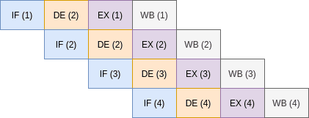
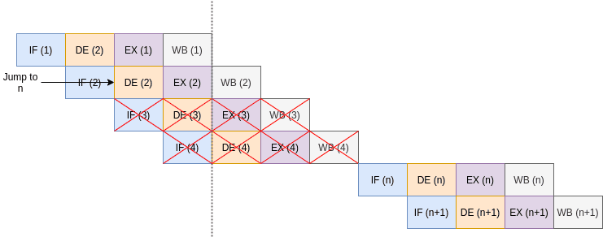
Branchy vs Branchless Code
Instruction pipelining: instruction-level parallelism on a single processor
Simple examples of brancy vs branchless

Slide 9
Findings
Can review assembly to see differences
Optimizations may not always work as intended depending on the code and compiler version
Can we write better code, to improve the optimization chance?
Did later versions of GCC fix this?

