Slide 1
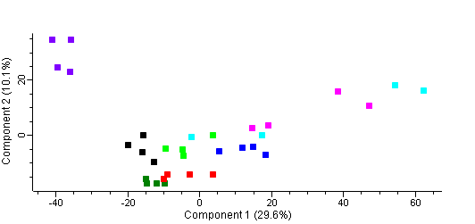
Principal components analysis
AMH
BPL
BAN
CMP
BED
CPI
BTT
CQC

Slide 2
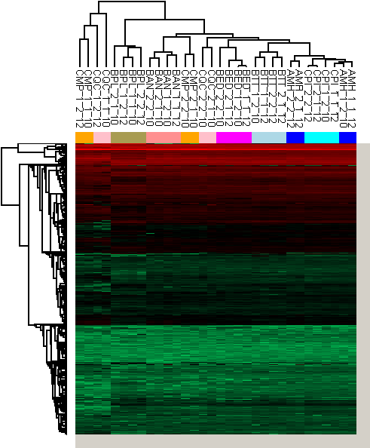
2-Dimensional hierarchical clustering

Slide 3
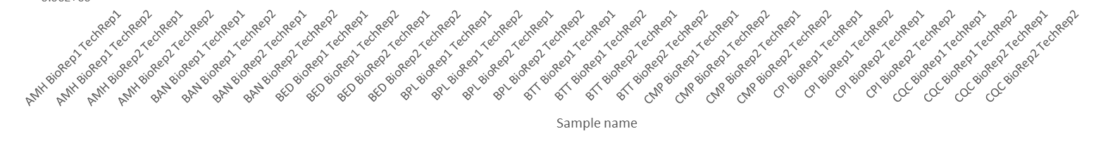
3-isopropylmalate dehydrogenase
D-lactate dehydrogenase [cytochrome] 1, mitochondrial

