Slide 1
Junior Frontend Challenge Review
Code Walkthrough

Slide 2
Table of contents
Problem
Separation of concern
Thinking in box-model
Implementation

Slide 3


Problem

Slide 4
Separation of concern
Separating the logic from the actual coding in frontend development is often referred to as "separation of concerns" or "separation of responsibilities."
This concept involves organizing your code in a way that different aspects of your application, such as the user interface (UI), data manipulation, and application logic, are clearly separated and do not unnecessarily overlap. This separation makes your codebase more maintainable, scalable, and easier to work with.

Slide 5
Thinking In Box Model
Everything in CSS has a box around it, and understanding these boxes is key to being able to create more complex layouts with CSS, or to align items with other items. In this lesson, we will take a look at the CSS Box Model.

Slide 6
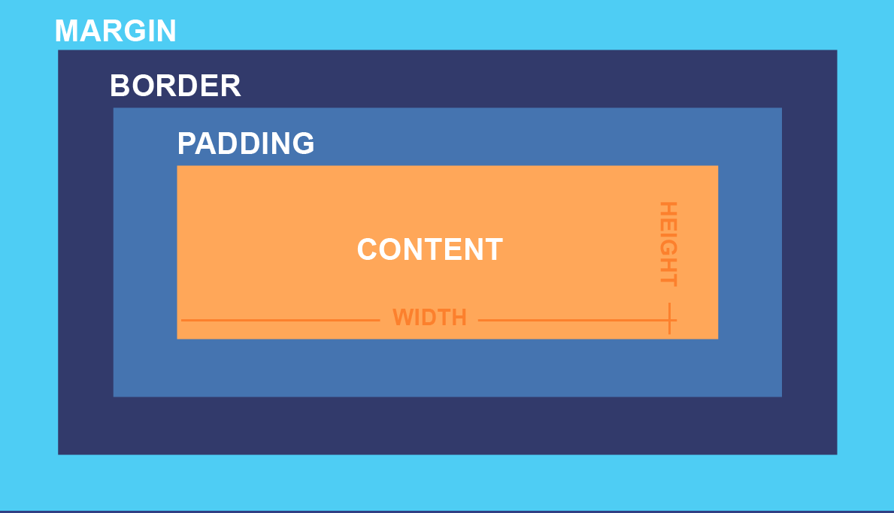

Thinking In Box Model

Slide 7
Implementation
HTML Structure:
Create an HTML file and start structuring your document. Create the basic HTML structure with a <!DOCTYPE>, <html>, <head>, and <body> tags

Slide 8
Implementation
CSS Styles:
Create a separate CSS file and link it to your HTML document using a <link> tag in the <head>. Begin writing your CSS styles.

Slide 9
Implementation
Javascript:
Create a separate JS file which would contain your interactions and dom manipulations and link it to your HTML document using a <script> tage just before the close tag of the <body>

