Slide 1
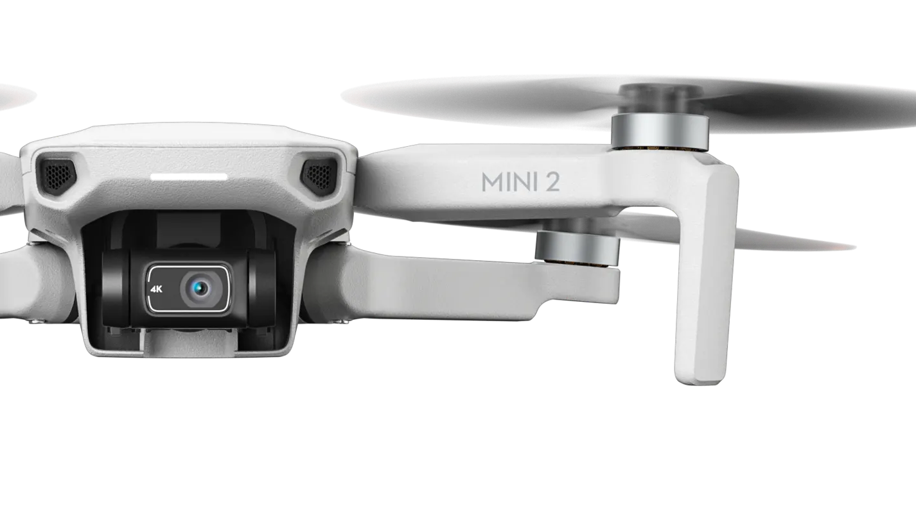
Baa Force One
Omar Faris, Benjamin Nicholls,
Jacob Swindell, and Dr. Rob Lloyd,
MINI 4 PRO
Provide the 'eye in the sky'.Develop the infrastructure for streaming the data from the provided drone, and automating the collection process to ensure the highest quality of data is available, surveying commercial solutions in the process.

Slide 2
Goal and Tasks
Primary Activity:
Real-Time Data Streaming – Utilising the DJI Mobile SDK v5, create an Android application to stream Video, GPS, Camera Information (EXIF/Pose), and Telemetry Data into the ROS2 system.
Secondary Activity:
Remote Tele-Operation – Developing the Android application further, integrate capabilities to send the drone to given coordinates, generating flight plans and risk assessments for manual approval.
Stretch Activity:
Autonomous Planning – With the positions of detected targets received, develop an approach to autonomously manoeuvring the drone to keep the targets within the frame, making considerations to battery lifetime and hot-swapping drones.

Slide 3




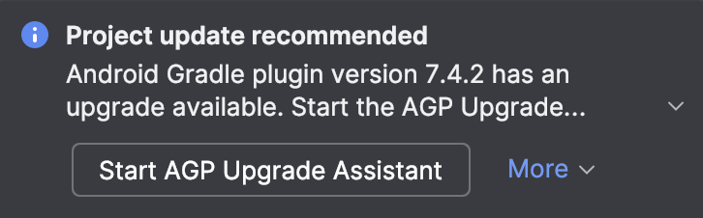
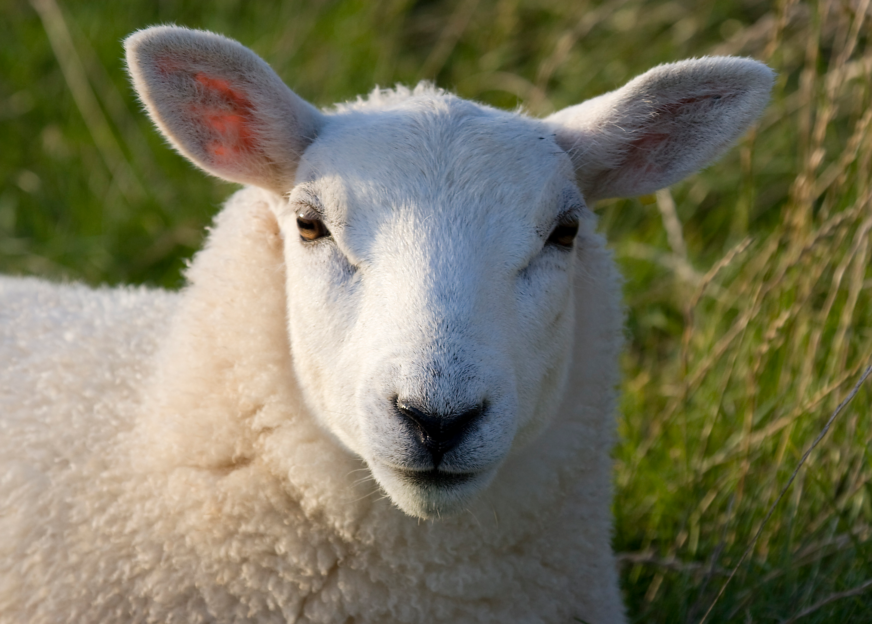
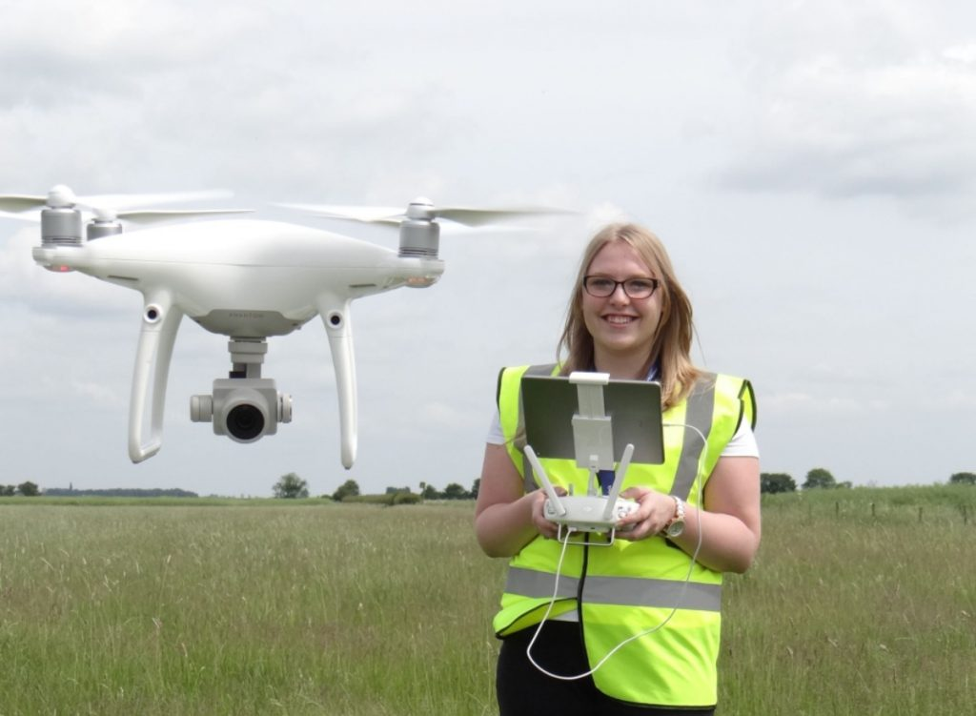
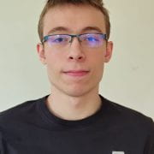
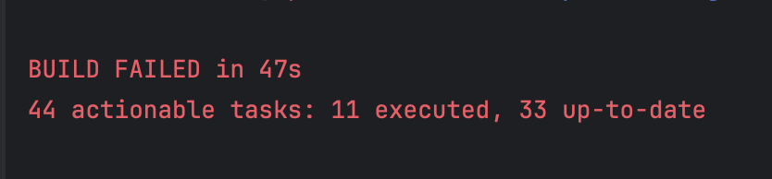
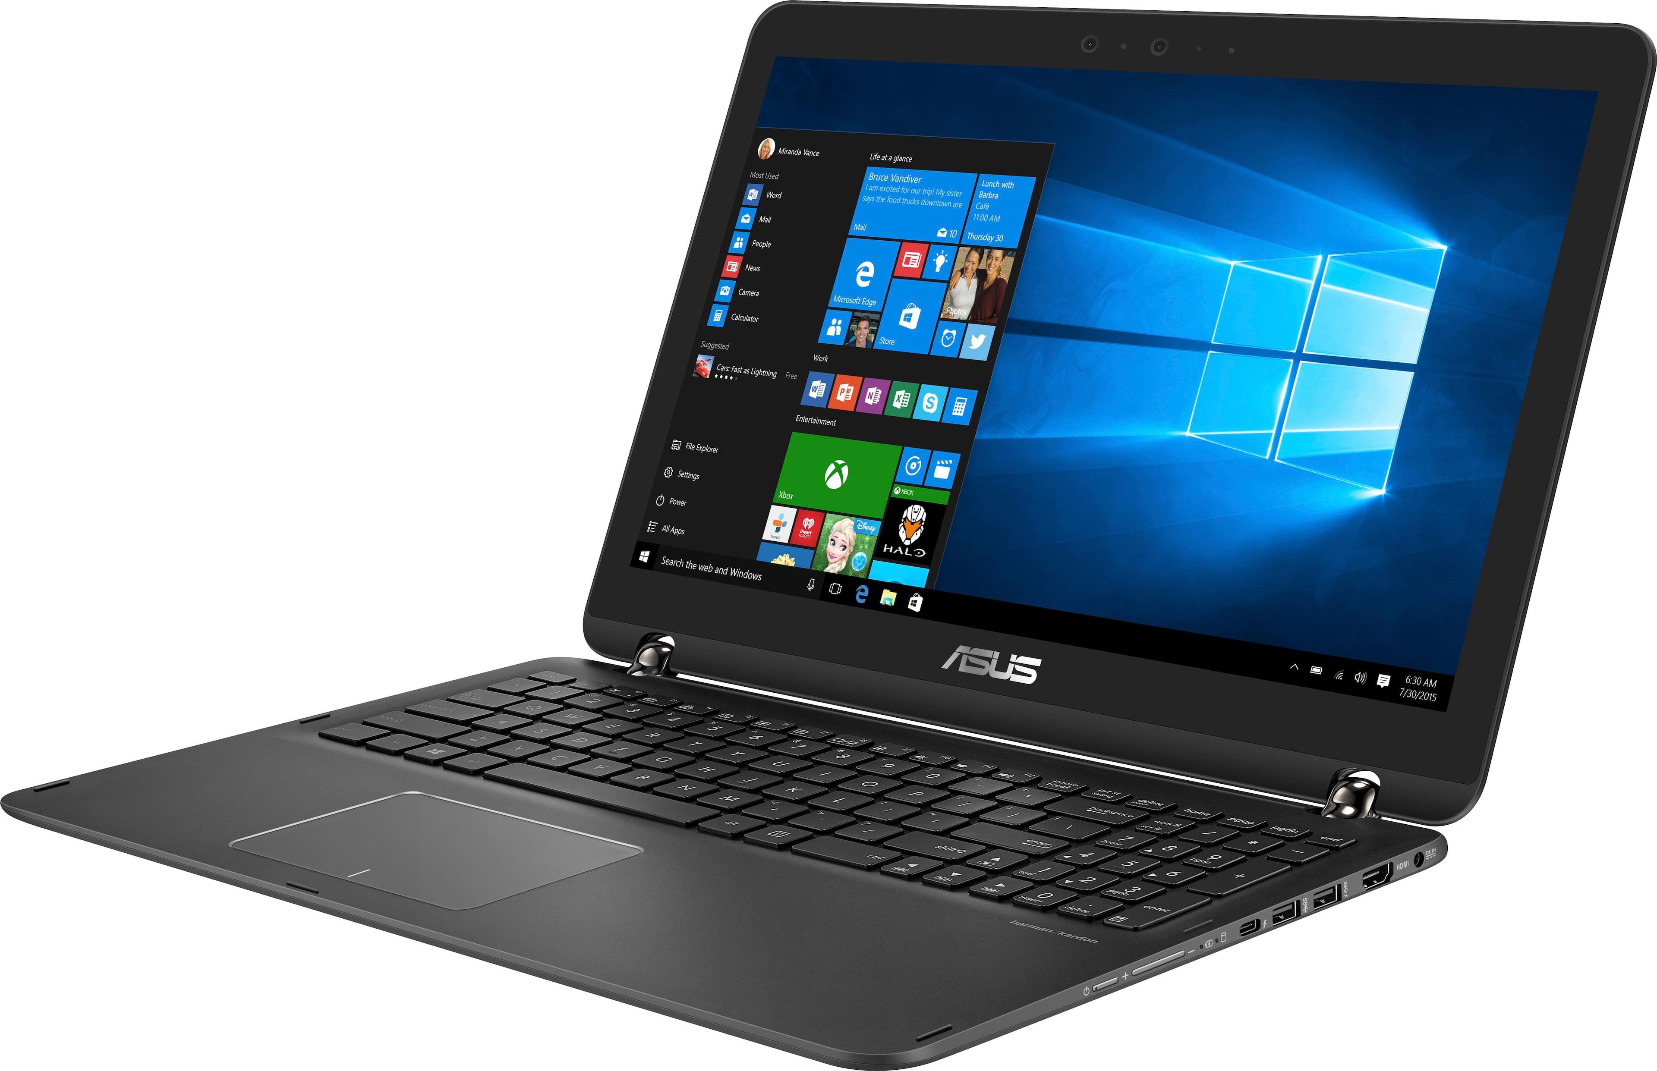
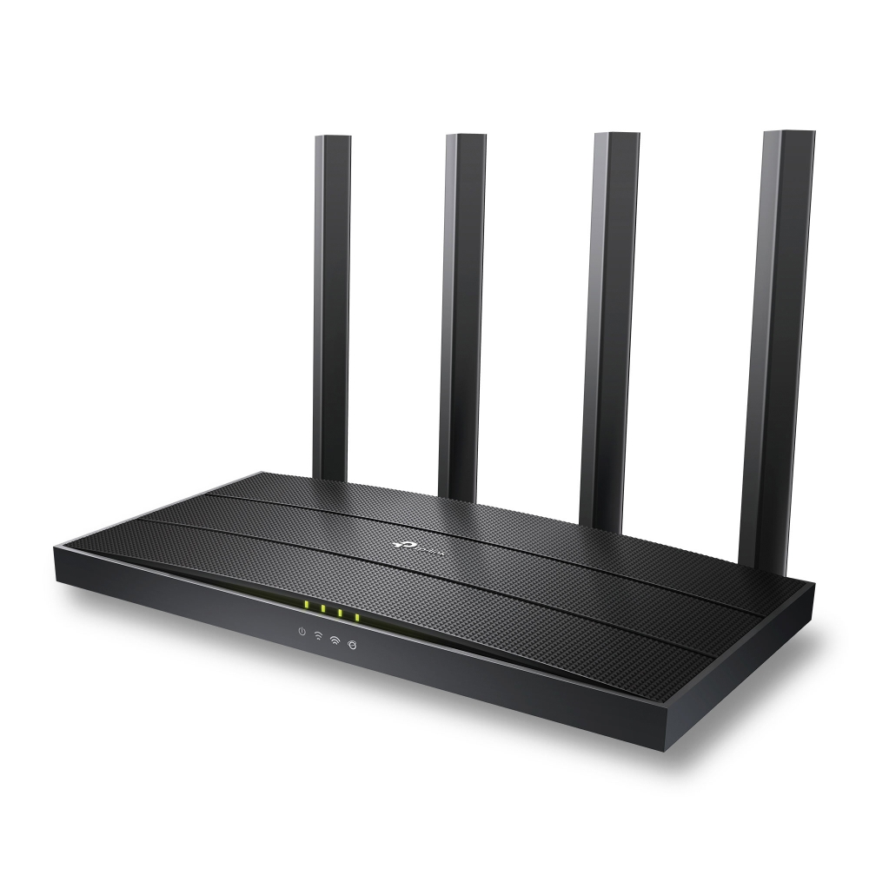

Making an Android application

Slide 4
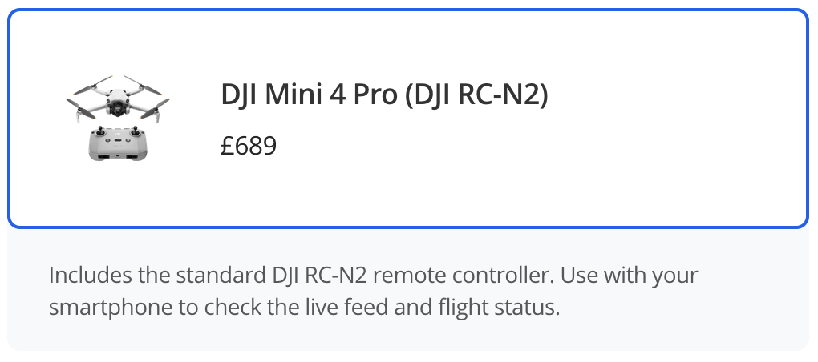
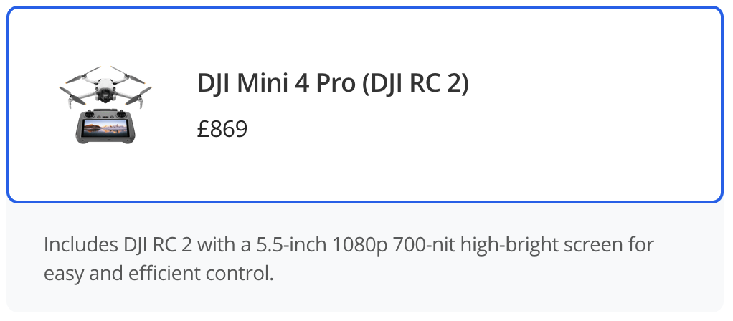
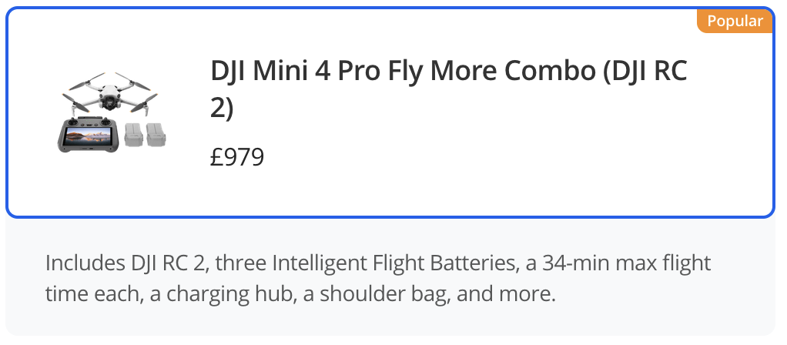

Slide 5
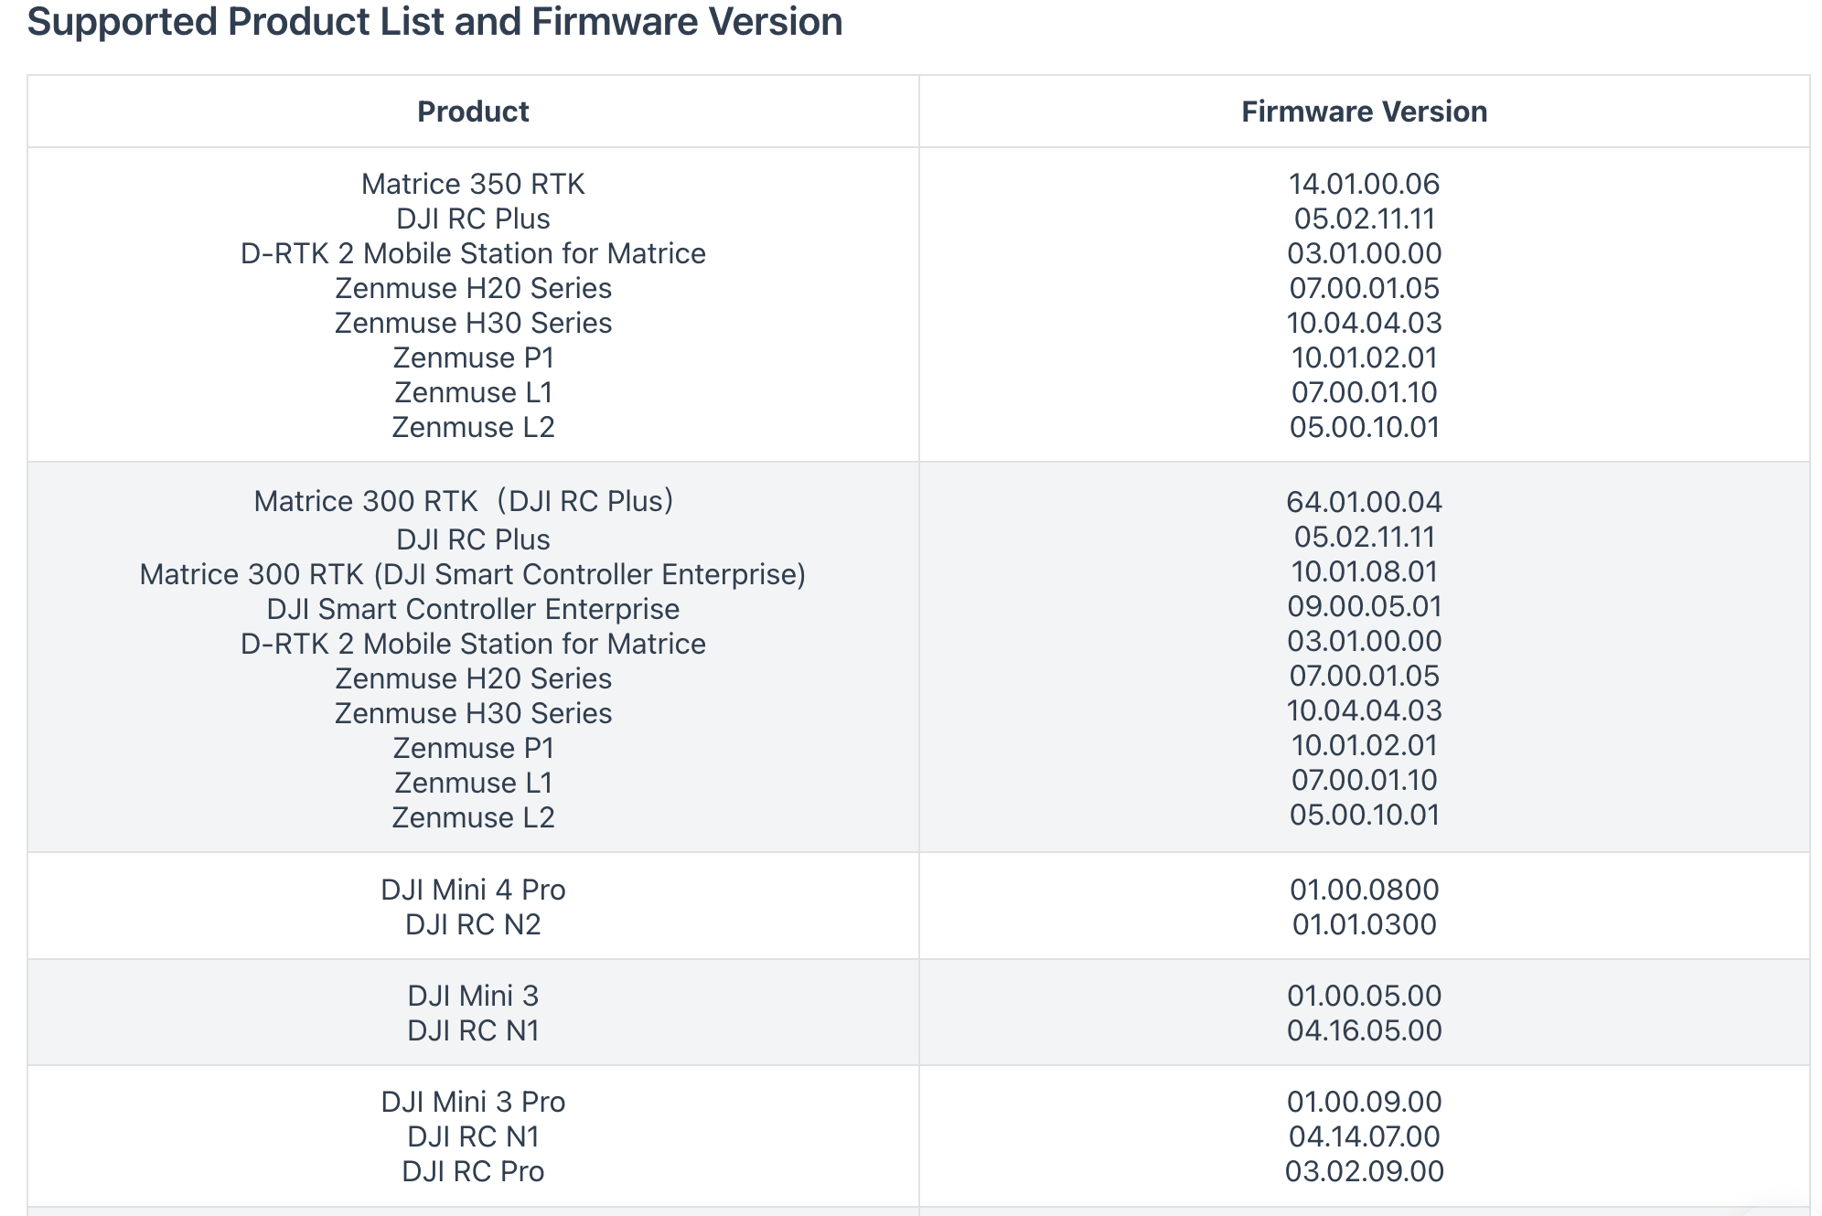
SDK Compatibility

Slide 6
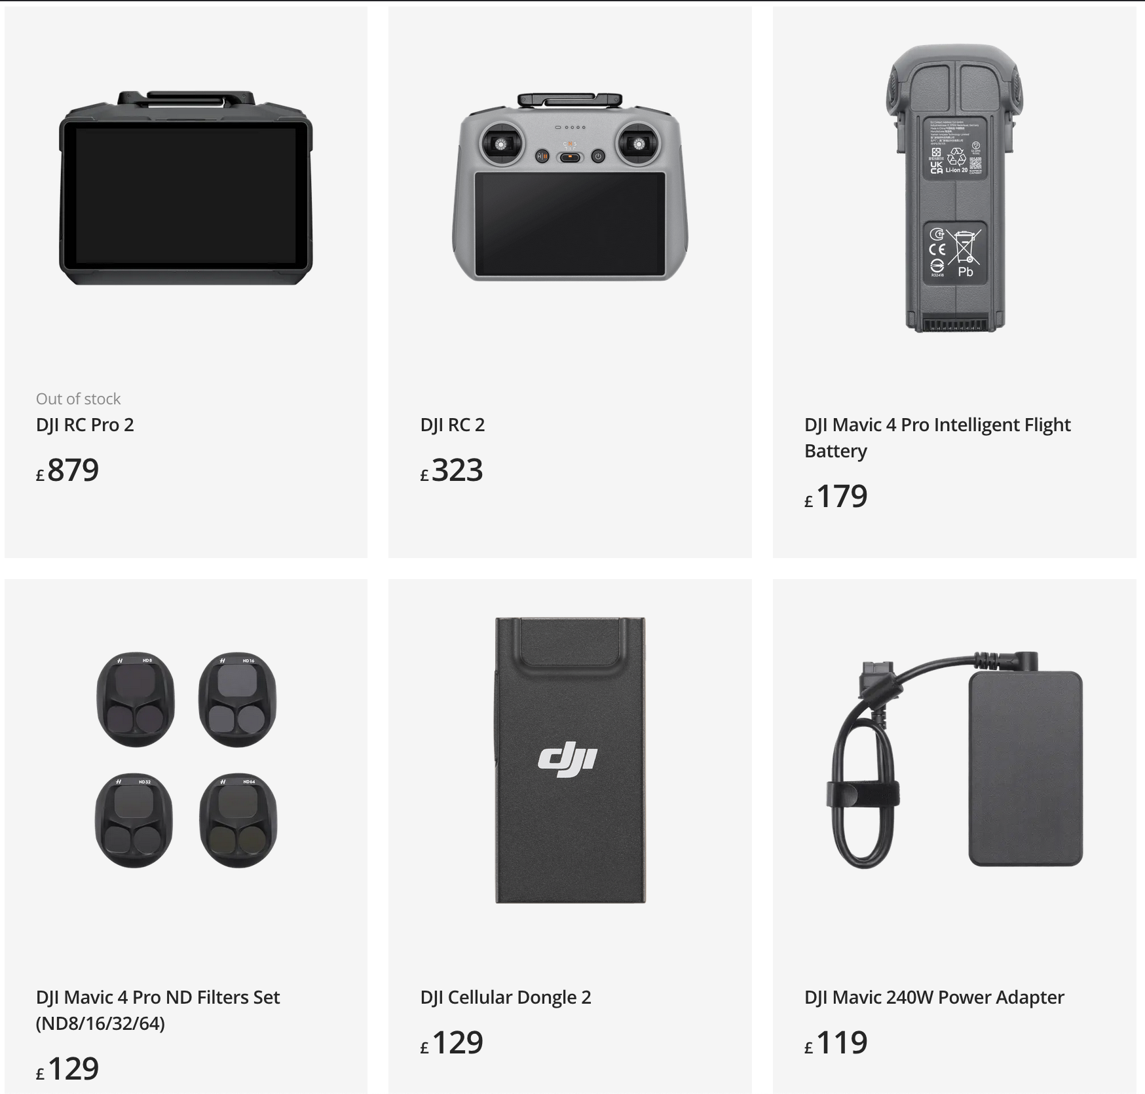
Just buy the correct controller...

Slide 7
Topology
DRONE
GPS
ROUTER
RTMP
CONTROLLER
LAPTOP

Slide 8
RTMP (Real-Time Messaging Protocol)
DJI Mini 4 Pro and DJI RC 2 have inbuilt RTMP capability.
RTMP stream is directed to a RTMP server (a laptop).
Process this video and publish on a ROS topic.
Difficulties:
  Latency
  Dropped frames/packets
  Camera information data

Slide 9
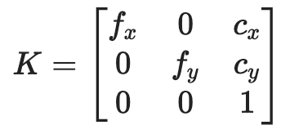
Camera Information
Intrinsic matrix (K)
  3x3 matrix containing the focal lengths and optical centre of the camera. It is defined as the following:
fx​: Focal length in pixels along the x-axis.
fy​: Focal length in pixels along the y-axis.
cx​: x-coordinate of the optical center (principal point).
cy​: y-coordinate of the optical center (principal point).
Calculate field of view (FOV) and aperture from K.

Slide 10
Topology
DRONE
GPS
XYZ
ROUTER
RTMP
CONTROLLER
LAPTOP

Slide 11
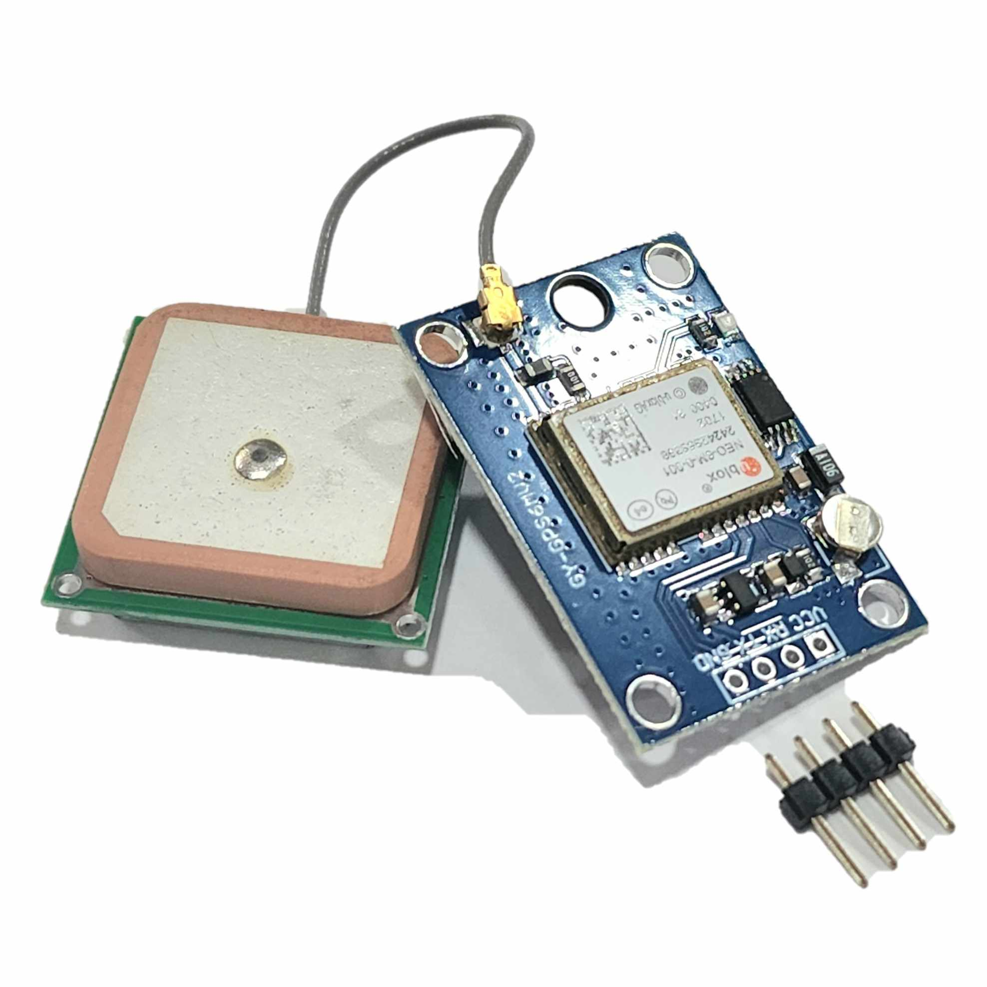
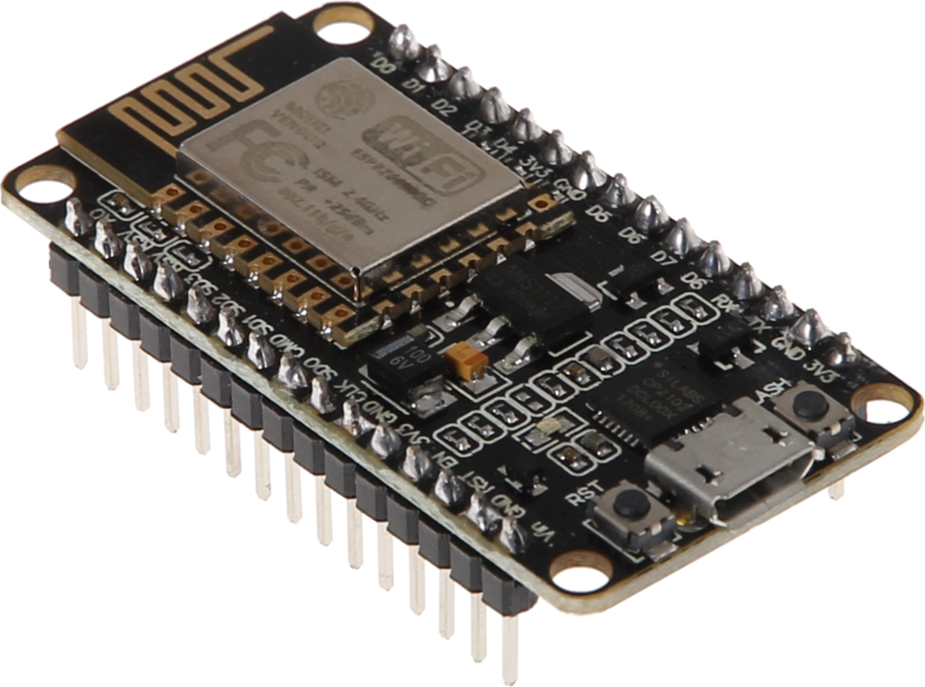
Using an ESP8266 with a GPS submodule
Socket Communication
GPS Sensor
ESP8266
ROUTER
Laptop
ROS2

Slide 12
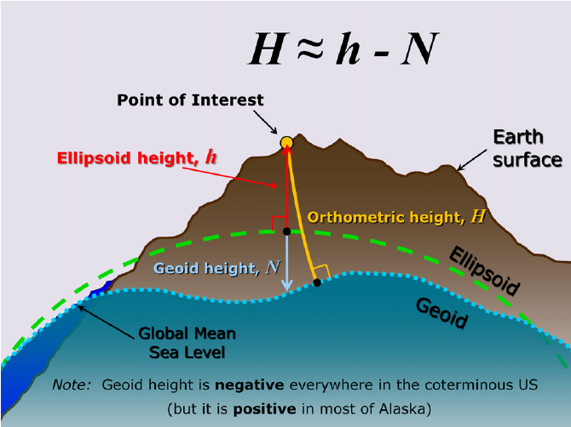
Interpreting GPS data
Apparently, we get the altitude with respect to sea level...
But the reading is 88m! No clue what that is!
At least longitude and latitude are correct…
And relative altitude seems okayish...

Slide 13
Topology
DRONE
ROS topics
/uav_image
/uav_camera
/uav_gps
/uav_direction
/field_boundary
GPS
XYZ
ROUTER
RTMP
CONTROLLER
LAPTOP

Slide 14
Goal and Tasks
Primary Activity: ✅
Real-Time Data Streaming – Utilising the DJI Mobile SDK v5, create an Android application to stream Video, GPS, Camera Information (EXIF/Pose), and Telemetry Data into the ROS2 system.
Secondary Activity: ❌
Remote Tele-Operation – Developing the Android application further, integrate capabilities to send the drone to given coordinates, generating flight plans and risk assessments for manual approval.
Stretch Activity: ❌
Autonomous Planning – With the positions of detected targets received, develop an approach to autonomously manoeuvring the drone to keep the targets within the frame, making considerations to battery lifetime and hot-swapping drones.

