Slide 1
Machine Learning in Trading III

Slide 2
Student Questions

Slide 3
Does My Strategy Need to use Machine Learning?
Absolutely not!
Machine learning has not “solved” trading
The process is what is critical for building successful strategy
Good hypothesis testing

Slide 4
IT seems like ML only really works on intraday Trading
For ML more data is usually helpful
Garbage data or heavily biased data will hurt your model
A singular time series is not the only thing we can observe.
“Improving Factor-Based Quantitative Investing by Forecasting Company Fundamentals” Alberg and Lipton (2017) https://arxiv.org/abs/1711.04837
11,000 companies over 40 years
“We suggest that the long-term success of an investment should depend on the how well-priced the stock currently is with respect to its future fundamentals.”

Slide 5
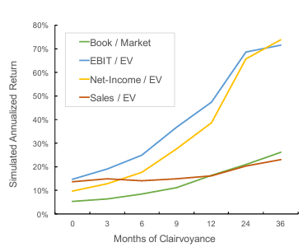
With Oracle Access N Months into the future
Some type of Factor Model

Slide 6
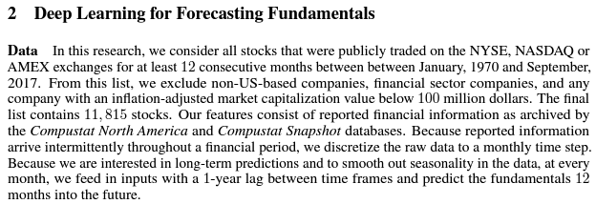
Data

Slide 7
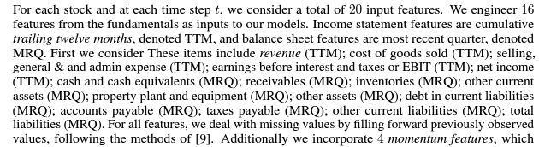
Features

Slide 8
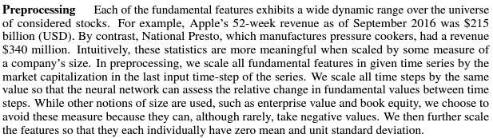
Preprocessing

Slide 9
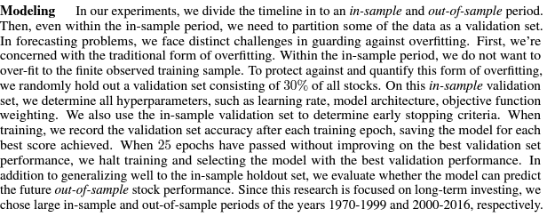
Training and overfitting

Slide 10
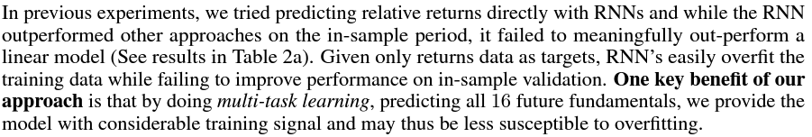
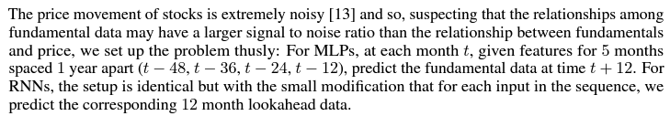
Predicting Things besides returns

Slide 11
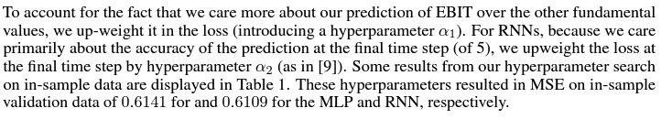
Hyperparameters for guiding the model

Slide 12
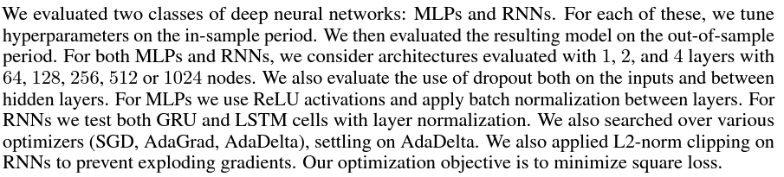
Limits on Parameters
1024 nodes * 4 layers ~ 4,000 parameters

Slide 13
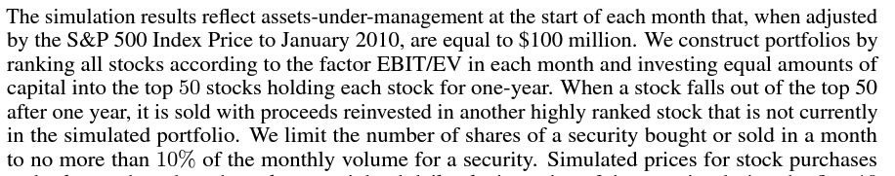
Rebalancing and constraints

Slide 14
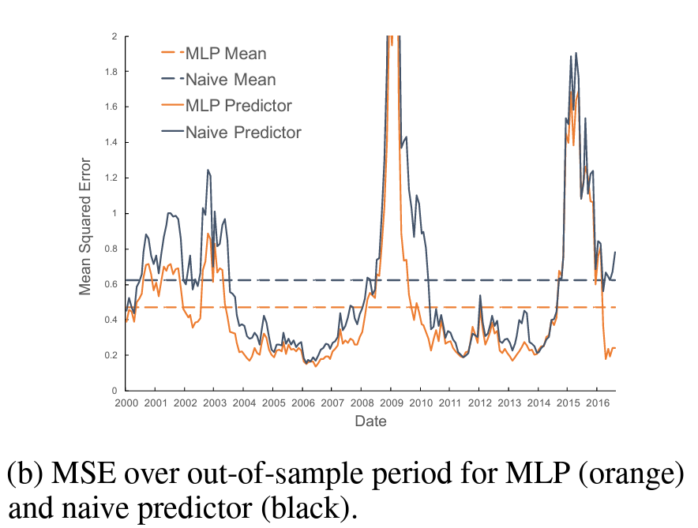
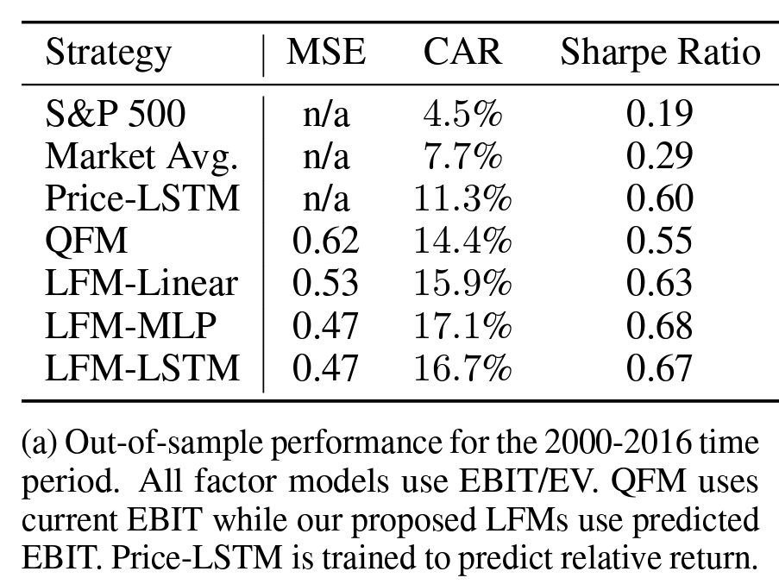
Evaluation

Slide 15
Goals
Identify some of the many uses of ML models in practical financial models
Discuss patterns of problem construction that can be useful
Expand on areas where these types of model patterns break
We don’t have time to explain each model in detail, that would take years!
Goal here is to build some intuition, and
Give guidance on where to start a literature search for more information

Slide 16
Fundamental Investors
invest by making decisions on the fundamentals of specific assets
build a portfolio of assets to reflect fundamental views
Machine Learning Implications:
can be partially treated as a classification problem for
industry sub-groupings
factor importance
NLP for sentiment on social media and press
a regression problem for multi-factor predictions
an optimization problem focused on portfolio allocation and risk mitigation

Slide 17
Liquidity Provision
OTC liquidity is provided based on relationships, and typically results from private networks
On Exchange liquidity is showing resting orders on lit markets. If it is two sided (bids and offers), it is traditionally called market making.
Machine Learning Ideas:
regression and classification for short term predictions
inference for constructing a fair price
optimization for risk management

Slide 18
Momentum
An object in motion will remain in motion unless acted upon by an external and unbalanced force - Newton’ s first law
Time Series Momentum is the predicted direction of a market based on past price change
Cross Sectional Momentum is the predicted direction based on other related instruments
Machine Learning Ideas:
fundamentally a regression problem, treating this as a classification problem routinely leads to overfitting
optimization for parameterization

Slide 19
Relative Value/Mean Reversion
trade on the relative strength of two or more instruments
construct mean reverting pair or basket relationships to aid prediction of the basket
Machine Learning Ideas:
regression and clustering to construct your basket or pair
regression to evaluate the reversion probabilities
optimization for parameterization

Slide 20
Factor Investing
factor models influence much of modern finance, both in and out of investing and trading
academic literature has studied descriptive and predictive risk factors for over thirty years
much of the more recent literature on factor “anomalies” may be overfit (Harvey, Liu, and Zhu 2015)
factors, if predictive/persistent, can be used to support a wide variety of trading styles
Machine Learning Ideas:
factors are features for other ML models
traditional factor models may be improved by using ML regression
inference to extract meaning from factors that may not be obviously related

Slide 21
Statistical Arbitrage & HFT
high frequency trading (HFT) is rapid buying and selling while taking minimal risk per trade, sometimes called scalping
statistical arbitrage is a strategy utilizing many features or factors to construct baskets of assets that trade in a predictable way, potentially changing the composition of that basket dynamically
Machine Learning Ideas:
regression and classification for short term predictions
inference for analysis of hundreds or thousands of features
classification to make short term predictions on factors
optimization for risk management

Slide 22
Patterns for Different Problems

Slide 23
Classification / Clustering Introduction
separation of observations into groups or states is classification or clustering (Japkowicz and Shah 2011)
many ML models are used as classifiers
proceeding from simple models is usually advisable
key goal is typically to label the observed data or state
so that some other model can take action based on that label/state

Slide 24
Clustering Example - Dimension Reduction
Principal Component Analysis (PCA) is the standard mechanism for statistical dimension reduction.
Independent Component Analysis (ICA) is similar to PCA that is widely used in financial problems
K-means clustering is a widely used clustering model that separates observations into a fixed number of clusters based mostly on correlation
t-distributed Stochastic Neighbor Embedding (t-SNE) and the more efficient Uniform Manifold Approximation and Projection (UMAP) use maximizing similarity instead of maximizing difference to reduce the dimensionality of a data set (McInnes, Healy, and Melville 2018)

Slide 25
Classification Example I - Regime Switching Models
regime models seek to separate data into different regimes
this is a classification problem
most common are volatility regimes
also used are so-called “turning points” models, see James and Matteson (2014)
turning points models actually classify different distinct distributions of data into a regime
the example on the next slide is a Markov Switching GARCH model using Ardia et al. (2019)
it seeks to classify the probability that the market is in a high-volatility regime

Slide 26
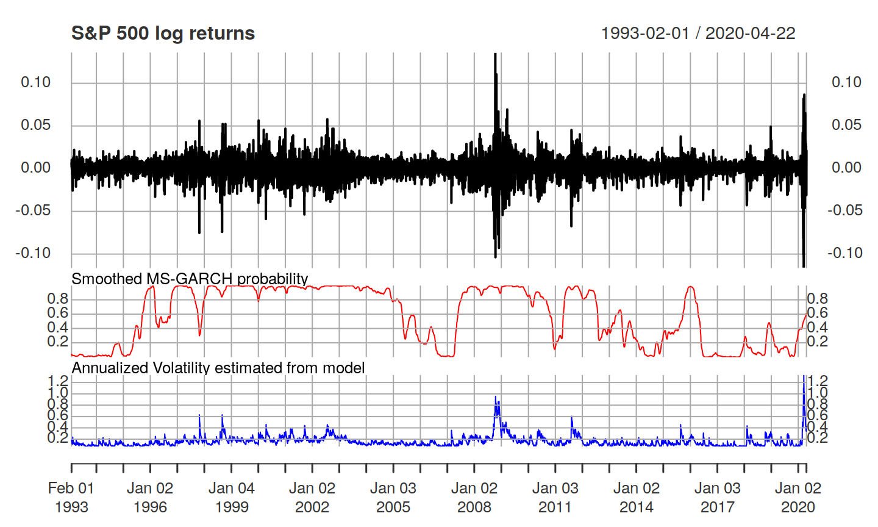
Markov Switching GARCH model

Slide 27
Collab Example
Collab Markov Switching

Slide 28
Regression
regression results may be the most common uses of machine learning
you want the algorithm to estimate the value (mean/median), slope, etc. of some variable
you may do this directly (e.g. logistic regression, Bayesian regression, Random Forest)
or indirectly (MCMC, gradient descent, state space model, optimization model with the correct objective)

Slide 29
Regression Example - LASSO
use the Ames Iowa Real Estate data from De Cock (2011)
the data set contains:
2,930 observations
each observation includes 23 nominal, 23 ordinal, 14 discrete, and 20 continuous explanatory variables
What does this have to do with Trading?
if you are valuing REIT or MBS contracts, or working for Zillow, this example is perfectly relevant
in any model where you have large numbers of explanatory variables and want to predict price, this approach is relevant
analysis which follows is courtesy of Lander (2019) - Many Ways to LASSO

Slide 30
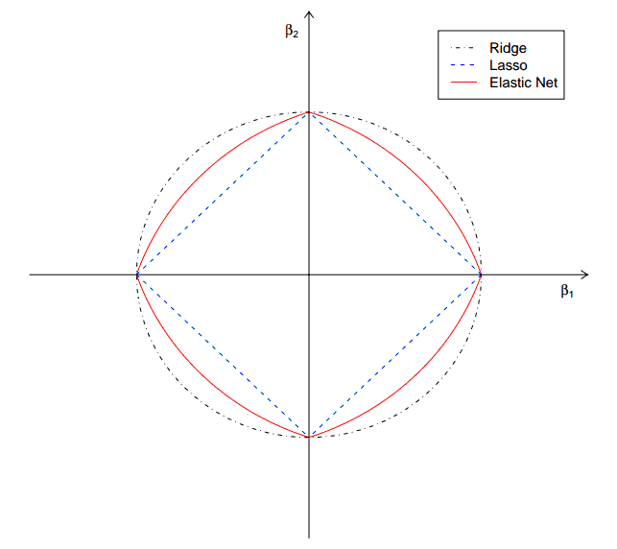
Regression Example - LASSO and other regression shrinkage
LASSO, or Ridge, or Elastic Net are all regression shrinkage techniques
by discounting some observations, they decrease the likelihood of certain types of overfitting
LASSO utilizes the most aggressive shrinkage
statsmodels.regression.linear_model.OLS.fit_regularized
sklearn.linear_model.Lasso

Slide 31
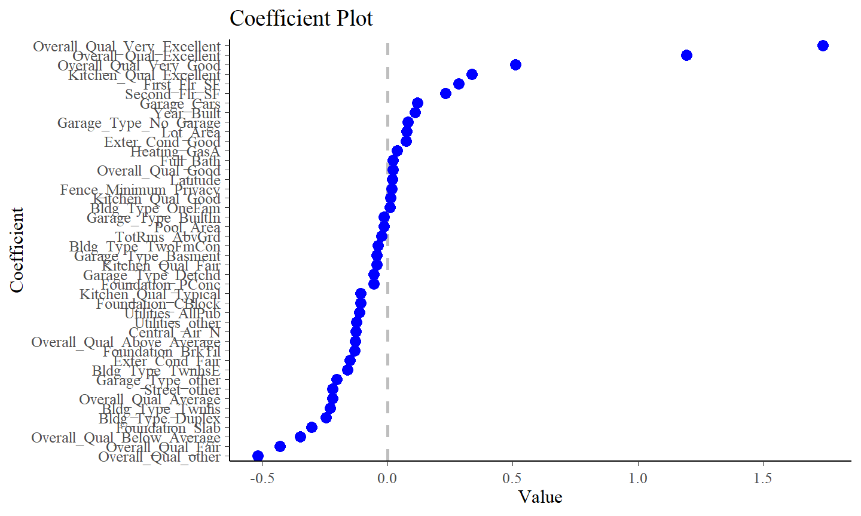
Regression Example - LASSO feature selection
LASSO is often used for automatic feature selection, effectively shrinking the feature set as well.
sklearn.feature_selection.SelectFromModel
Recursive feature
Elimination (is another option)

Slide 32
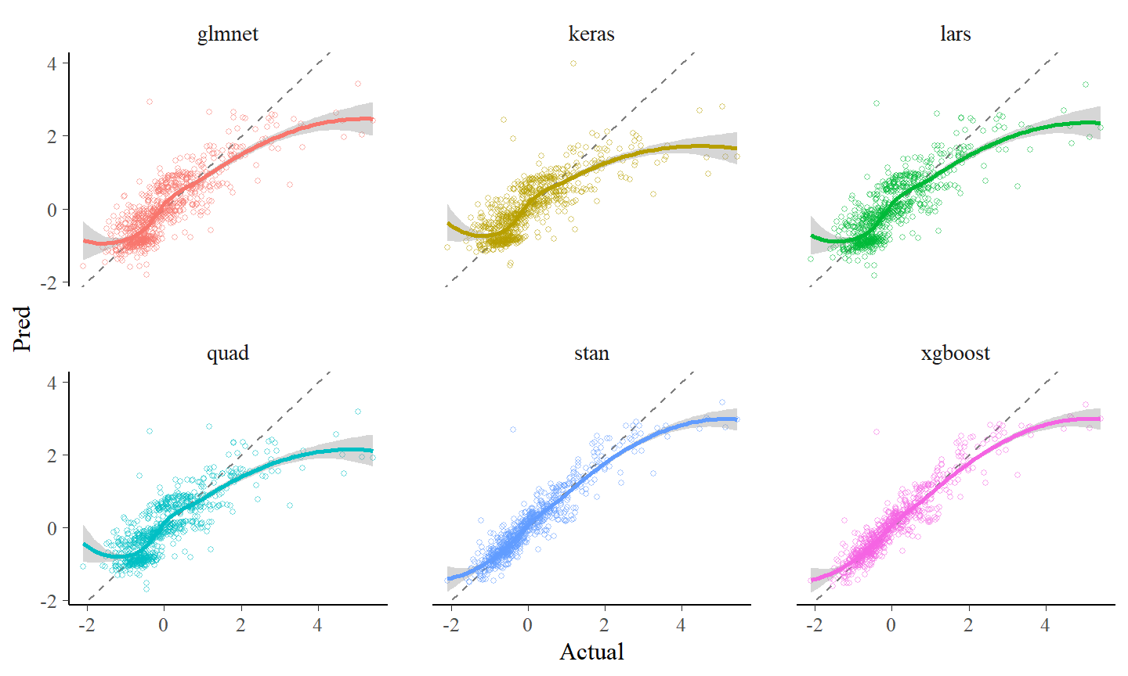
Regression Example - effectiveness of various LASSO approaches
Lander(2019) demonstrates many ways to construct the LASSO model, and compares their effectiveness

Slide 33
optimization

Slide 34
Optimization Example - Capital, Portfolio Allocation, and Risk
the Markowitz (1952) mean/variance portfolio is the basis of modern portfolio theory
most investors have more complex objectives and constraints than the Markowitz portfolio
if we add non-linear objectives like tail-loss minimization
or non-smooth constraints like a max Drawdown constraint to avoid risk of ruin in a leveraged portfolio
we have a global (stochastic) optimization problem which can be solved
See colab notebook

Slide 35
Conclusion
ML is in the boom part of the cycle right now
advanced statistical learning models can add value to traditional trading strategy problems
Feature Engineering is important (more important than model choice)
even for non-ML models
Build these systems in a modular fashion
understanding what problem you are trying to solve is key to model selection
Compare with simpler models

