Slide 1
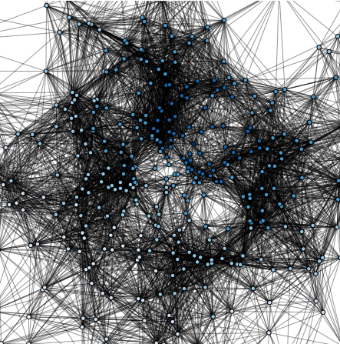
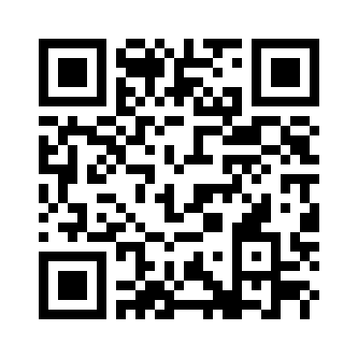



STAR Workshop on Random Graphs 2017 26-27 January Utrecht University
Speakers Include:
Scientific Organizers:
Marián Boguñá (Barcelona)
Mihyun Kang (Graz)
Vincent Tassion (Zürich)
Shariefuddin Pirzada (Kashmir)
Daniel Valesin (Groningen)
Nick Wormald (Melbourne)
Ben Hansen (Utrecht)
Ross Kang (Nijmegen) Tobias Müller (Utrecht)
Markus Schepers (Utrecht)
For More Information Visit: https://www.math.uu.nl/stochsem/WorkshopRGs2017/

