Slide 1

Welcome to CSI-230/SYS-320
Linux/Unix Programming, Automation and Scripting
1. Introduction to Bash and PowerShell

Slide 2
Contents
Introductions
Course and Syllabus Review
Lecture Part-1: Review of Operating Systems and Intro to Bash and PowerShell
Lecture Part-2: PowerShell Basics

Slide 3
Introductions
Who am I?

Slide 4
Introductions
Who are you?
Name?
Major?
What are you hoping to gain from this course?
Anything else you would like to share?

Slide 5
Course Introduction
Syllabus Review

Slide 6
Course Topics Summary
How to integrate scripting into operating system management.
How to automate systems administration functions and connectivity testing.
PowerShell and Linux shell scripting will be explored to manage and monitor operating system processes and functions.

Slide 7
Part-1 Review of Operating Systems

Slide 8




Operating Systems
User
Application
Operating System
Hardware

Slide 9
Linux
Linux is a generic term that refers to different open-source operating systems that are based on the Linux kernel.
The Linux kernel was originally created by Linus Torvalds in 1991, and open sourced in 1996.
A kernel is a piece of software that is designed to act as an intermediate layer between low-level hardware and high-level software, such as an operating system.

Slide 10




Linux
One of the more well-known Linux distributions
Ubuntu is based on the Debian distribution family.
Kali is also based on the Debian distribution family.
Another prominent Linux distribution
Fedora, is based on the Red Hat family.
Other notable distribution families include
SUSE, Gentoo, and Arch.

Slide 11
Bash
The most commonly used shell in Linux systems is the Bourne-again shell, or Bash. The Bash shell is based on the Bourne shell, known as sh
A shell is, in essence, a user interface. Most often, it is used to refer to a text-based interface, also called a command-line interface (CLI).

Slide 12
Shell Script
A shell script is nothing more than multiple Bash commands in sequence.
Scripts are often used to automate repetitive tasks. They can be run interactively or non-interactively (meaning with or without user input) and can be shared with others.

Slide 13
Windows
Windows is a group of user-friendly mostly graphical operating system families developed by Microsoft.
Microsoft developed the NT kernel and based its OS on DOS. That is why writing commands for Windows differs from Unix-based systems.

Slide 14
Windows PowerShell
PowerShell is a cross-platform task automation and configuration solution that is made up of a command-line shell, a scripting language, and a configuration management framework.
Windows PowerShell is the new Microsoft shell that combines the old CMD functionality with a new scripting/cmdlet instruction set

Slide 15
Part-2 PowerShell Basics

Slide 16
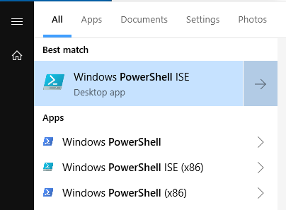
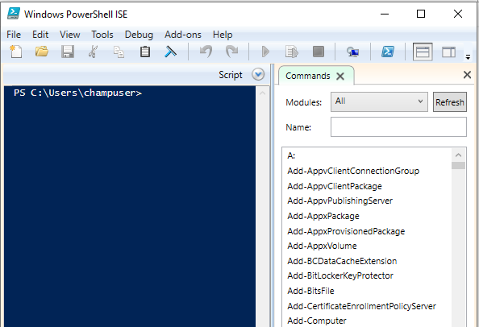
Integrated Scripting Environment (ISE)
All the commands available
Run as administrator

Slide 17
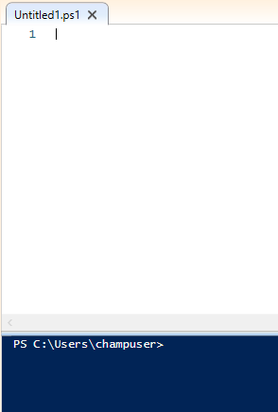
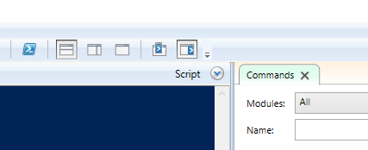
Integrated Scripting Environment (ISE)

Slide 18
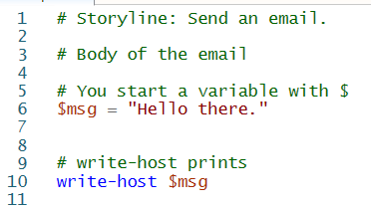


PowerShell Variables
$ is used for defining and accessing variables in PowerShell

Slide 19
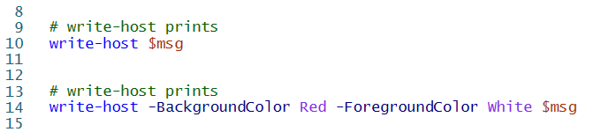
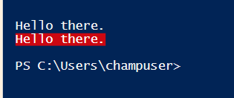
PowerShell Variables

Slide 20
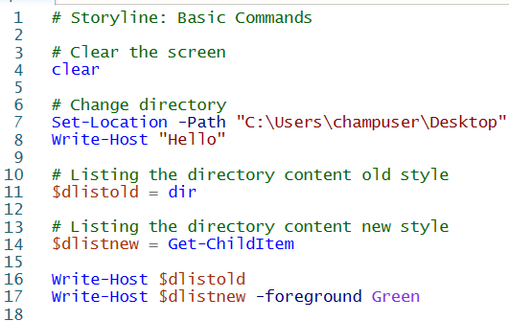
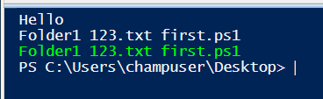
PowerShell Basic Commands
Old style CMD commands and new style PowerShell commands both work in PowerShell

Slide 21
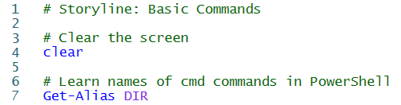
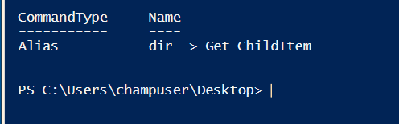
PowerShell & CMD Commands
Get-Alias gives the new style PowerShell command name of old style CMD command names.

Slide 22
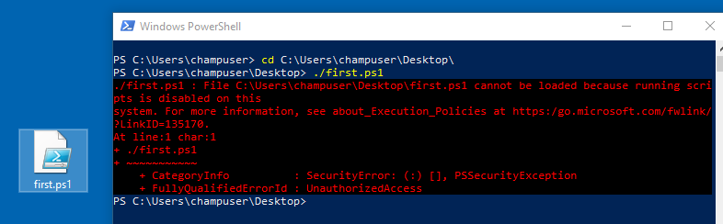
Execution Policies
PowerShell's execution policy is a safety feature that controls the conditions under which PowerShell loads configuration files and runs scripts. It helps prevent the execution of malicious scripts.
https://learn.microsoft.com/en-us/powershell/module/microsoft.powershell.core/about/about_execution_policies?view=powershell-7.4

Slide 23
Execution Policies
AllSigned
Requires that all scripts and configuration files be signed by a trusted publisher,
Prompts you before running scripts from publishers that you haven't yet classified as trusted or untrusted.
Risks running signed, but malicious, scripts.
Bypass
Nothing is blocked and there are no warnings or prompts.
RemoteSigned
Requires a digital signature from a trusted publisher on scripts and configuration.
Doesn't require digital signatures on scripts that are written on the local computer

Slide 24
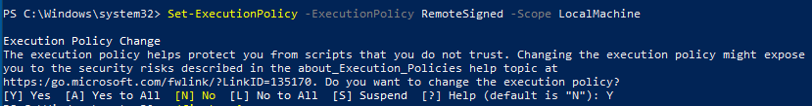

RemoteSigned Execution Policy
Doesn't require digital signatures on scripts that are written on the local computer

Slide 25
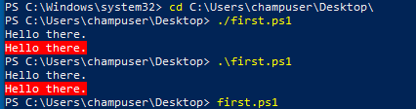
Executing Scripts
Both\ or / as a path separator works. However, one way to be cross-platform is to always use /

Slide 26
Class Activities Today
Git Repository Labs
First PowerShell Script

