Slide 1

Welcome to CSI-230/SYS-320
Linux/Unix Programming, Automation and Scripting
2. PowerShell Cmdlets and Members

Slide 2
PowerShell cmdlets
Cmdlets are native PowerShell commands, not stand-alone executables. Cmdlets perform an action and typically return a Microsoft .NET object
PowerShell uses a Verb-Noun name pair to name cmdlets.
The verb identifies the action that the cmdlet performs, and the noun identifies the resource on which the cmdlet performs its action
Get-Help
Get-Process
Get-Service
…

Slide 3
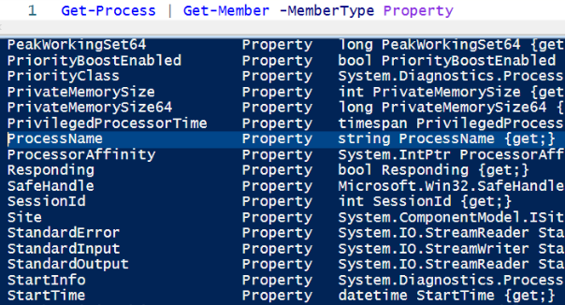
PowerShell cmdlet Properties
Properties are members of the class that contain data. Different types of objects have different properties.
To get the properties of an object, use the Get-Member cmdlet.
The object Process returned from Get-Process cmdlet has a property called ProcessName which is a String type property.

Slide 4
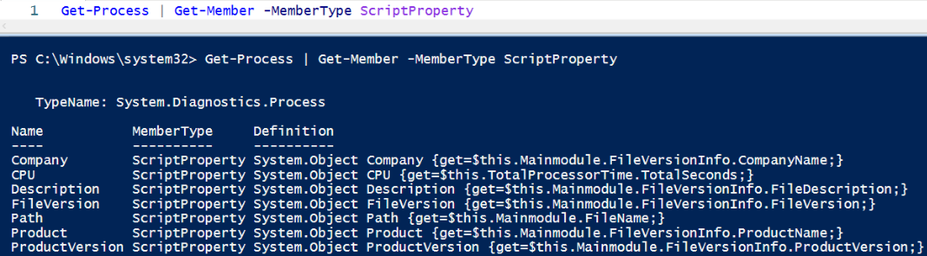
PowerShell Extended Properties
ScriptProperty: A property defined by script language whose value is the output of a script
AliasProperty: Defines a new name for an existing property
NoteProperty: Defines a property that has a static value

Slide 5
PowerShell Extended Properties
To read more about other types of extended properties:
https://learn.microsoft.com/en-us/powershell/scripting/developer/cmdlet/extending-properties-for-objects?view=powershell-7.4

Slide 6
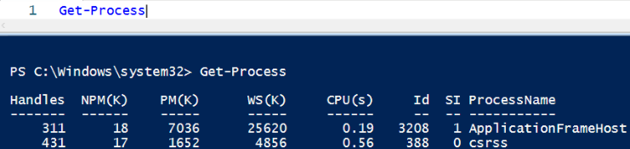
PowerShell cmdlet Properties
Do not expect the default view of a cmdlet to include every property.
Get-Process displays only 7 properties (and extended properties)

Slide 7
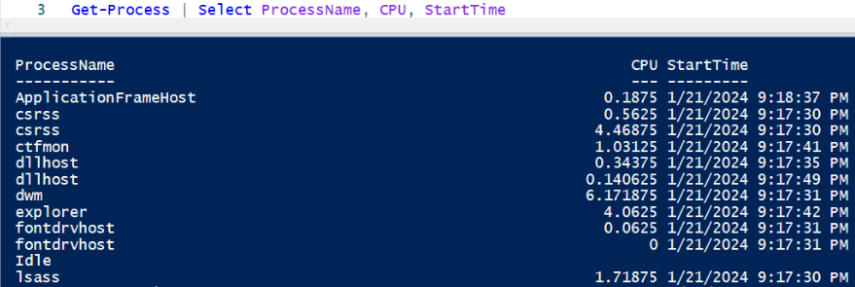
PowerShell cmdlet Properties
To see the properties you want, you can use “Select”

Slide 8
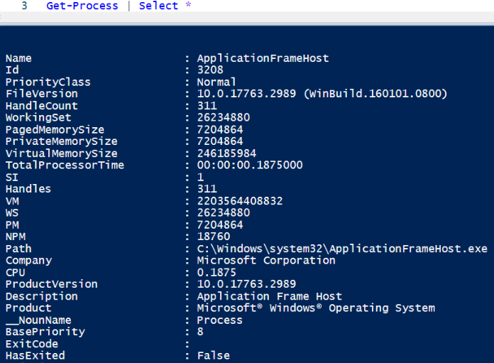
To all the properties you, you can use “Select *”

Slide 9
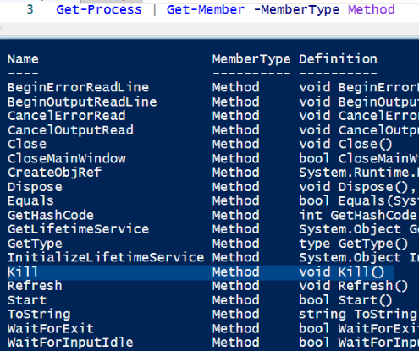
PowerShell cmdlet Methods
A "method" is a set of instructions that specify an action you can perform on the object returned by the cmdlet.
Kill method for a Process Object returned by Get-Process cmdlet, terminates a process.

Slide 10
PowerShell cmdlet Methods
A "method" is a set of instructions that specify an action you can perform on the object returned by the cmdlet.
Kill method for a Process Object returned by Get-Process cmdlet, terminates a process.
$notepad = Get-Process notepad
$notepad.Kill()

Slide 11

PowerShell Methods
A method belongs an object. Not necessarily returned by a cmdlet. Consider the string object:
The method “Replace” for the string object “This is CSI-230 course” is executed above.

Slide 12
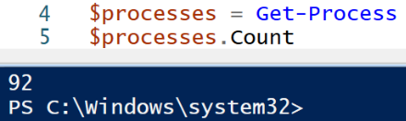
PowerShell Methods
Cmdlets return a list of objects. This list on its own has methods and properties such as Count

Slide 13
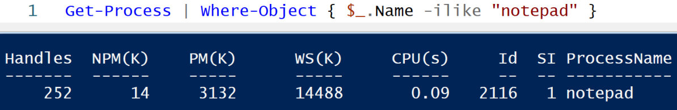
PowerShell Where-Object
PowerShell includes the $PSItem variable and its alias, $_, as automatic variables in script blocks that process the current object, such as in the pipeline.
The $_ automatic variable represents each object that's passed to the Where-Object cmdlet. The first command uses the script block format, the second command uses the comparison statement format.

Slide 14
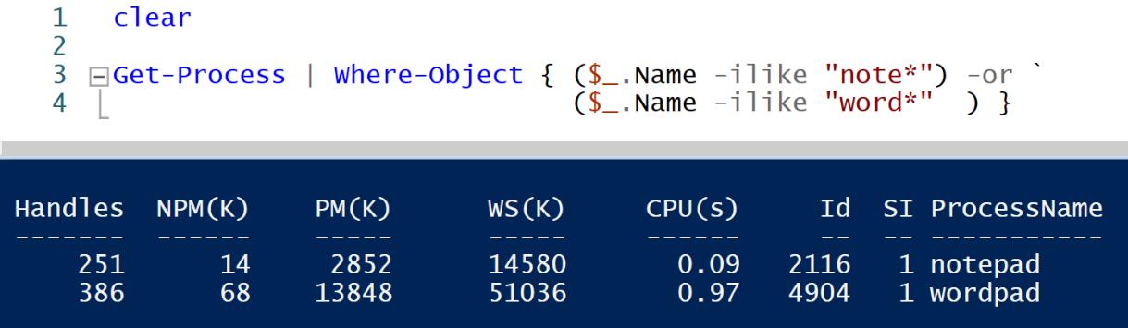
PowerShell Where-Object
To clear the screen
Script will continue in the next line
Or logic

Slide 15
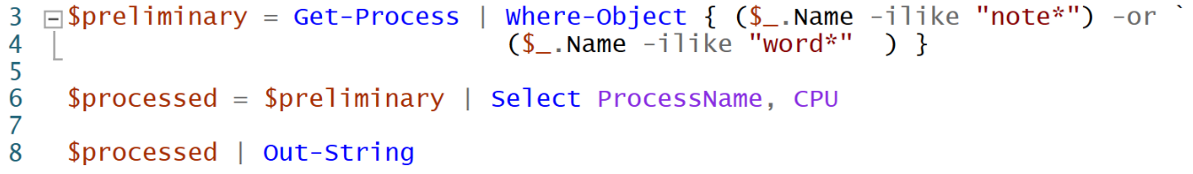
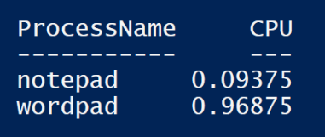
PowerShell Where-Object
Save to variable first
Prevents output to be merged with other outputs

Slide 16
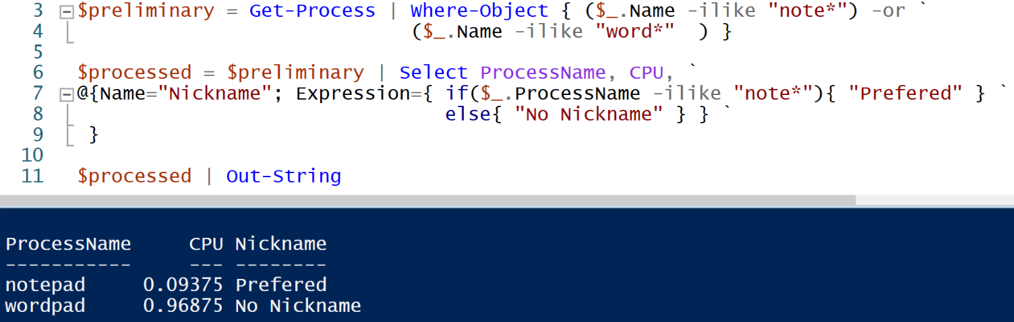
Custom Attributes for Output
Check for each ProcessName and output accordingly

Slide 17

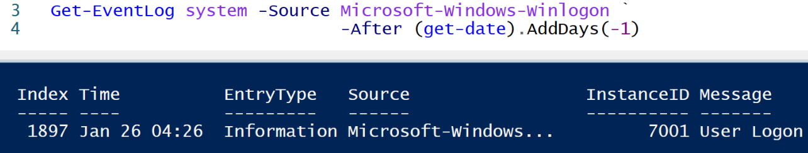
PowerShell Switches (- )
PowerShell has commands for controlling the flow of execution within your scripts. One of those statements is the switch statement
Check for suggestions

Slide 18
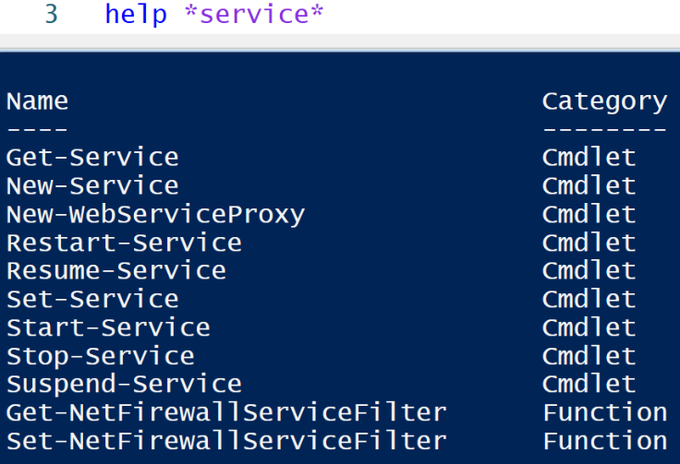
Help
Help command lets you get information:
help *service* this will give you a list of items on "help" that contains the word "service"

Slide 19
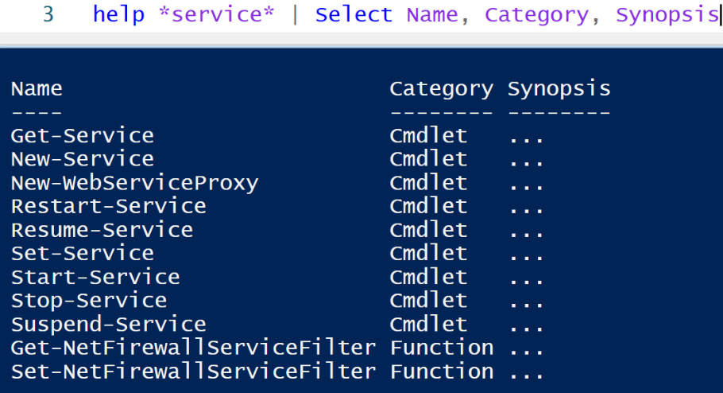

Slide 20
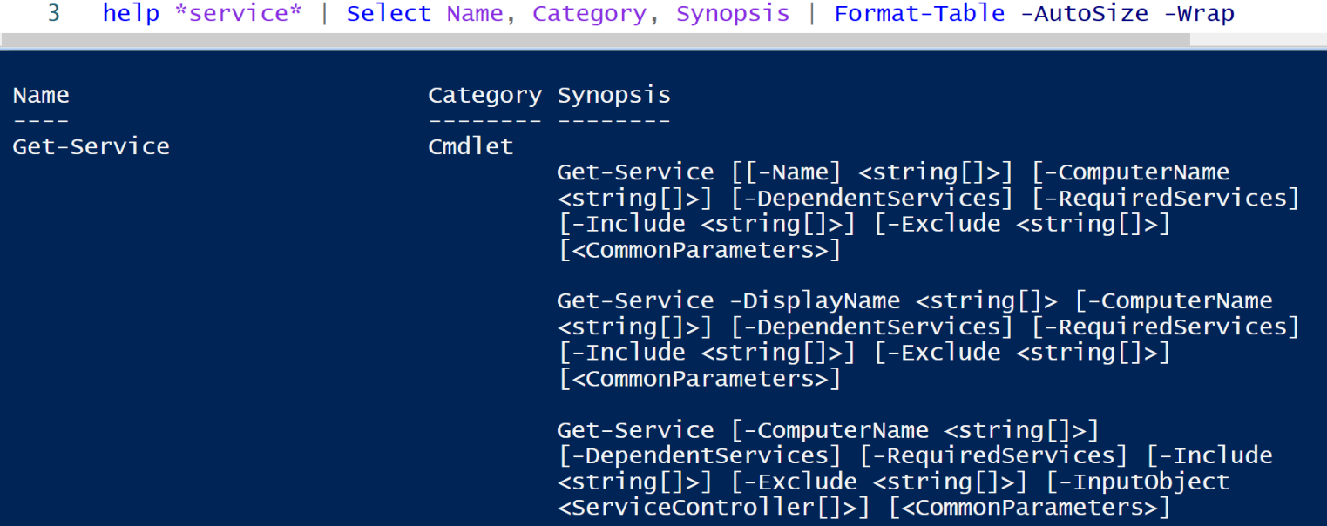
Turnication

Slide 21
Class Activities Today
PowerShell Basic Lab - 1
Process Management

