Slide 1
High Performance Parallel Programming
Dirk van der Knijff
Advanced Research Computing
Information Division

Slide 2
High Performance Parallel Programming
Lecture 5: Parallel Programming Methods and Matrix Multiplication

Slide 3
Performance
Remember Amdahls Law
  speedup limited by serial execution time
Parallel Speedup:
  S(n, P) = T(n,1)/T(n, P)
Parallel Efficiency:
E(n, P) = S(n, P)/P = T(n, 1)/PT(n, P)
Doesn’t take into account the quality of algorithm!

Slide 4
Total Performance
Numerical Efficiency of parallel algorithm
T_{best}(n)/T(n, 1)
Total Speedup:
S’(n, P) = T_{best}(n)/T(n, P)
Total Efficiency:
E’(n, P) = S’(n, P)/P = T_{best}(n)/PT(n, P)
But, best serial algorithm may not be known or not be easily parallelizable. Generally use good algorithm.

Slide 5
Performance Inhibitors
Inherently serial code
Non-optimal Algorithms
Algorithmic Overhead
Software Overhead
Load Imbalance
Communication Overhead
Synchronization Overhead

Slide 6
Writing a parallel program
Basic concept:
First partition problem into smaller tasks.
  (the smaller the better)
  This can be based on either data or function.
  Tasks may be similar or different in workload.
Then analyse the dependencies between tasks.
  Can be viewed as data-oriented or time-oriented.
Group tasks into work-units.
Distribute work-units onto processors

Slide 7
Partitioning
Partitioning is designed to expose opportunities for parallel execution.
The focus is to obtain a fine-grained decomposition.
A good partition divides into small pieces both the computation and the data
  data first - domain decomposition
  computation first - functional decomposition
These are complimentary
  may be applied to different parts of program
  may be applied to same program to yield alternative algorithms

Slide 8
Decomposition
Functional Decomposition
  Work is divided into tasks which act consequtively on data
  Usual example is pipelines
  Not easily scalable
  Can form part of hybrid schemes
Data Decomposition
  Data is distributed among processors
  Data collated in some manner
  Data needs to be distributed to provide each processor with equal amounts of work
  Scalability limited by size of data-set

Slide 9
Dependency Analysis
Determines the communication requirements of tasks
Seek to optimize performance by
  distributing communications over many tasks
  organizing communications to allow concurrent execution
Domain decomposition often leads to disjoint easy and hard bits
  easy - many tasks operating on same structure
  hard - changing structures, etc.
Functional decomposition usually easy

Slide 10
Trivial Parallelism
No dependencies between tasks.
  Similar to Parametric problems
  Perfect (mostly) speedup
  Can use optimal serial algorithms
  Generally no load imbalance
  Not often possible...
  ... but it’s great when it is!
Won’t look at again

Slide 11
Aside on Parametric Methods
Parametric methods usually treat program as “black-box”
No timing or other dependencies so easy to do on Grid
May not be efficient!
  Not all parts of program may need all parameters
  May be substantial initialization
  Algorithm may not be optimal
  There may be a good parallel algorithm
Always better to examine code/algorithm if possible.

Slide 12
Group Tasks
The first two stages produce an abstract algorithm.
Now we move from the abstract to the concrete.
  decide on class of parallel system
    fast/slow communication between processors
    interconnection type
  may decide to combine tasks
    based on workunits
    based on number of processors
    based on communications
  may decide to replicate data or computation

Slide 13
Distribute tasks onto processors
Also known as mapping
Number of processors may be fixed or dynamic
  MPI - fixed, PVM - dynamic
Task allocation may be static (i.e. known at compile- time) or dynamic (determined at run-time)
Actual placement may be responsibility of OS
Large scale multiprocessing systems usually use space-sharing where a subset of processors is exclusively allocated to a program with the space possibly being time-shared

Slide 14
Task Farms
Basic model
  matched early architectures
  complete
Model is made up of three different process types
  Source - divides up initial tasks between workers. Allocates further tasks when initial tasks completed
  Worker - recieves task from Source, processes it and passes result to Sink
  Sink - recieves completed task from Worker and collates partial results. Tells source to send next task.

Slide 15
The basic task farm
Source
Worker
Worker
Worker
Worker
Sink
Note: the source and sink process may be located on the same processor

Slide 16
Task Farms
Variations
  combine source and sink onto one processor
  have multiple source and sink processors
  buffered communication (latency hiding)
  task queues
Limitations
  can involve a lot of communications wrt work done
  difficult to handle communications between workers
  load-balancing

Slide 17
Load balancing
P1
P2
P3
P4
P1
P2
P3
P4
vs
time

Slide 18
Load balancing
Ideally we want all processors to finish at the same time
If all tasks same size then easy...
If we know the size of tasks, can allocate largest first
Not usually a problem if #tasks >> #processors and tasks are small
Can interact with buffering
  task may be buffered while other processors are idle
  this can be a particular problem for dynamic systems
Task order may be important

Slide 19
What do we do with Supercomputers?
Weather - how many do we need
Calculating π - once is enough
etc.
Most work is simulation or modelling
Two types of system
  discrete
    particle oriented
    space oriented
  continuous
    various methods of discretising

Slide 20
discrete systems
particle oriented
  sparse systems
  keep track of particles
  calculate forces between particles
  integrate equations of motion
  e.g. galactic modelling
space oriented
  dense systems
  particles passed between cells
  usually simple interactions
  e.g. grain hopper

Slide 21
Continuous systems
Fluid mechanics
Compressible vs non-compressible
Usually solve conservation laws
  like loop invariables
Discretization
  volumetric
  structured or unstructured meshes
e.g. simulated wind-tunnels

Slide 22
Introduction
Particle-Particle Methods are used when the number of particles is low enough to consider each particle and it’s interactions with the other particles
Generally dynamic systems - i.e. we either watch them evolve or reach equilibrium
Forces can be long or short range
Numerical accuracy can be very important to prevent error accumulation
Also non-numerical problems

Slide 23
Molecular dynamics
Many physical systems can be represented as collections of particles
Physics used depends on system being studied:
there are different rules for different length scales
  10⁻¹⁵-10⁻⁹m - Quantum Mechanics
    Particle Physics, Chemistry
  10⁻¹⁰-10¹²m - Newtonian Mechanics
    Biochemistry, Materials Science, Engineering, Astrophysics
  10⁹-10¹⁵m - Relativistic Mechanics
    Astrophysics

Slide 24
Examples
Galactic modelling
  need large numbers of stars to model galaxies
  gravity is a long range force - all stars involved
  very long time scales (varying for universe..)
Crack formation
  complex short range forces
  sudden state change so need short timesteps
  need to simulate large samples
Weather
  some models use particle methods within cells

Slide 25
General Picture
Models are specified as a finite set of particles interacting via fields.
The field is found by the pairwise addition of the potential energies, e.g. in an electric field:
The Force on the particle is given by the field equations

Slide 26
Simulation
Define the starting conditions, positions and velocities
Choose a technique for integrating the equations of motion
Choose a functional form for the forces and potential energies. Sum forces over all interacting pairs, using neighbourlist or similar techniques if possible
Allow for boundary conditions and incorporate long range forces if applicable
Allow the system to reach equilibrium then measure properties of the system as it involves over time

Slide 27
Starting conditions
Choice of initial conditions depends on knowledge of system
Each case is different
  may require fudge factors to account for unknowns
  a good starting guess can save equibliration time
  but many physical systems are chaotic..
Some overlap between choice of equations and choice of starting conditions

Slide 28
Integrating the equations of motion
This is an O(N) operation. For Newtonian dynamics there are a number of systems
Euler (direct) method - very unstable, poor conservation of energy

Slide 29
Last Lecture
Particle Methods solve problems using an iterative like scheme:
If the Force Evaluation phase becomes too expensive approximation methods have to be used
Initial Conditions
Force Evaluation
Integrate
Final

Slide 30
e.g. Gravitational System
To calculate the force on a body we need to perform
operations
For large N this operation count is to high

Slide 31
An Alternative
Calculating the force directly using PP methods is too expensive for large numbers of particles
Instead of calculating the force at a point, the field equations can be used to mediate the force
From the gradient of the potential field the force acting on a particle can be derived without having to calculate the force in a pairwise fashion
Φ
x

Slide 32
Using the Field Equations
Sample field on a grid and use this to calculate the force on particles
Approximation:
  Continuous field - grid
  Introduces coarse sampling, i.e. smooth below grid scale
  Interpolation may also introduce errors
Φ
x

Slide 33
What do we gain
Faster: Number of grid points can be less than the number of particles
  Solve field equations on grid
  Particles contribute charge locally to grid
  Field information is fed back from neighbouring grid points
Operation count: O(N²) -> O(N) or O(NlogN)
=> we can model larger numbers of bodies
...with an acceptable error tolerance

Slide 34
Requirements
Particle Mesh (PM) methods are best suited for problems which have:
  A smoothly varying force field
  Uniform particle distribution in relation to the resolution of the grid
  Long range forces
Although these properties are desirable they are not essential to profitably use a PM method
e.g. Galaxies, Plasmas etc

Slide 35
Procedure
The basic Particle Mesh algorithm consists of the following steps:
  Generate Initial conditions
  Overlay system with a covering Grid
  Assign charges to the mesh
  Calculate the mesh defined Force Field
  Interpolate to find forces on the particles
  Update Particle Positions
  End

Slide 36
High Performance Parallel Programming
Matrix Multiplication

Slide 37
Optimizing Matrix Multiply for Caches
Several techniques for making this faster on modern processors
  heavily studied
Some optimizations done automatically by compiler, but can do much better
In general, you should use optimized libraries (often supplied by vendor) for this and other very common linear algebra operations
  BLAS = Basic Linear Algebra Subroutines
Other algorithms you may want are not going to be supplied by vendor, so need to know these techniques

Slide 38
Matrix-vector multiplication y = y + A*x
for i = 1:n
for j = 1:n
y(i) = y(i) + A(i,j)*x(j)
A(i,:)
=
+
*
y(i)
y(i)
x(:)

Slide 39
Matrix-vector multiplication y = y + A*x
{read x(1:n) into fast memory}
{read y(1:n) into fast memory}
for i = 1:n
{read row i of A into fast memory}
for j = 1:n
y(i) = y(i) + A(i,j)*x(j)
{write y(1:n) back to slow memory}
m = number of slow memory refs = 3*n + n^2
f = number of arithmetic operations = 2*n^2
q = f/m ~= 2
Matrix-vector multiplication limited by slow memory speed

Slide 40
Matrix Multiply C=C+A*B
for i = 1 to n
for j = 1 to n
for k = 1 to n
C(i,j) = C(i,j) + A(i,k) * B(k,j)
C(i,j)
C(i,j)
A(i,:)
=
+
*
B(:,j)

Slide 41
Matrix Multiply C=C+A*B (unblocked, or untiled)
for i = 1 to n
{read row i of A into fast memory}
for j = 1 to n
{read C(i,j) into fast memory}
{read column j of B into fast memory}
for k = 1 to n
C(i,j) = C(i,j) + A(i,k) * B(k,j)
{write C(i,j) back to slow memory}
C(i,j)
C(i,j)
A(i,:)
=
+
*
B(:,j)

Slide 42
Matrix Multiply aside
Classic dot product:
do i = i,n
do j = i,n
c(i,j) = 0.0
do k = 1,n
c(i,j) = c(i,j) + a(i,k)*b(k,j)
enddo
saxpy:
c = 0.0
do k = 1,n
do j = 1,n
do i = 1,n
c(i,j) = c(i,j) + a(i,k)*b(k,j)
enddo

Slide 43
Matrix Multiply (unblocked, or untiled)
Number of slow memory references on unblocked matrix multiply
m = n^3 read each column of B n times
+ n^2 read each column of A once for each i
+ 2*n^2 read and write each element of C once
= n^3 + 3*n^2
So q = f/m = (2*n^3)/(n^3 + 3*n^2)
~= 2 for large n, no improvement over matrix-vector multiply
C(i,j)
C(i,j)
A(i,:)
=
+
*
B(:,j)

Slide 44
Matrix Multiply (blocked, or tiled)
Consider A,B,C to be N by N matrices of b by b subblocks where b=n/N is called the blocksize
for i = 1 to N
for j = 1 to N
{read block C(i,j) into fast memory}
for k = 1 to N
{read block A(i,k) into fast memory}
{read block B(k,j) into fast memory}
C(i,j) = C(i,j) + A(i,k) * B(k,j) {do a matrix multiply on blocks}
{write block C(i,j) back to slow memory}
C(i,j)
C(i,j)
A(i,k)
=
+
*
B(k,j)

Slide 45
Matrix Multiply (blocked or tiled)
Why is this algorithm correct?
Number of slow memory references on blocked matrix multiply
m = N*n^2 read each block of B N^3 times (N^3 * n/N * n/N)
+ N*n^2 read each block of A N^3 times
+ 2*n^2 read and write each block of C once
= (2*N + 2)*n^2
So q = f/m = 2*n^3 / ((2*N + 2)*n^2)
~= n/N = b for large n

Slide 46
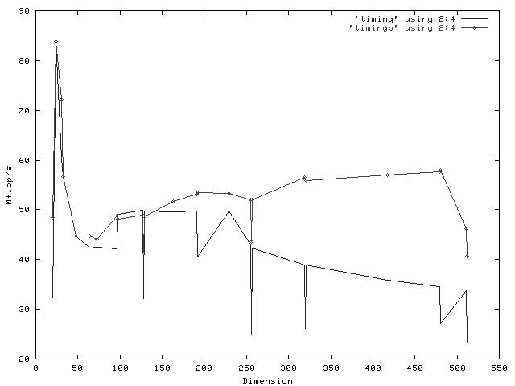
PW600au - 600MHz, EV56

Slide 47
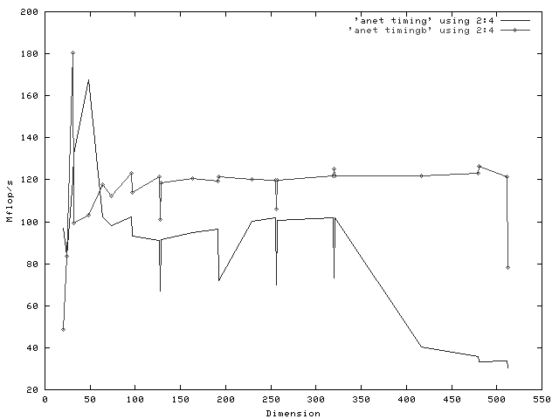
DS10L - 466MHz, EV6

Slide 48
Matrix Multiply (blocked or tiled)
So we can improve performance by increasing the blocksize b
Can be much faster than matrix-vector multiplty (q=2)
Limit: All three blocks from A,B,C must fit in fast memory (cache), so we cannot make these blocks arbitrarily large: 3*b^2 <= M, so q ~= b <= sqrt(M/3)
Theorem (Hong, Kung, 1981): Any reorganization of this algorithm
(that uses only associativity) is limited to q =O(sqrt(M))

Slide 49
Strassen’s Matrix Multiply
The traditional algorithm (with or without tiling) has O(n^3) flops
Strassen discovered an algorithm with asymptotically lower flops
  O(n^2.81)
Consider a 2x2 matrix multiply, normally 8 multiplies
Let M = [m11 m12] = [a11 a12] * [b11 b12]
[m21 m22] [a21 a22] [b21 b22]
Let p1 = (a12 - a22) * (b21 + b22) p5 = a11 * (b12 - b22)
p2 = (a11 + a22) * (b11 + b22) p6 = a22 * (b21 - b11)
p3 = (a11 - a21) * (b11 + b12) p7 = (a21 + a22) * b11
p4 = (a11 + a12) * b22
Then m11 = p1 + p2 - p4 + p6 m12 = p4 + p5
m21 = p6 + p7 m22 = p2 - p3 + p5 - p7

Slide 50
Strassen (continued)
T(n) = cost of multiplying nxn matrices
= 7*T(n/2) + 18(n/2)^2
= O(n^log₂7)
= O(n^2.81)
Available in several libraries
Up to several time faster if n large enough (100s)
Needs more memory than standard algorithm
Can be less accurate because of roundoff error
Current world’s record is O(n^2.376..)

Slide 51
Parallelizing
Could use task farm with blocked algorithm
Allows for any number of processors
Usually doesn’t do optimal data distribution
Scalability limited to n-1 (bad for small n)
Requires tricky code in master to keep track of all the blocks
Can be improved by double buffering

Slide 52
Better algorithms
Based on block algorithm
Distribute control to all processors
Usually written with fixed number of processors
Can assign a block of the matrix to each node then cycle the blocks of A and B (A row-wise, B col-wise) past each processor
Better to assign “column blocks” to each processor as this only requires cycling B matrix (less communication)

Slide 53
High Performance Parallel Programming
Thursday: back to Raj…

