Slide 1

Simulated Annealing with Classification and Regression
Benjamin Pommer

Slide 2
Datasets : Loan
Task type | Classification
Number of instances | 10 000
Number of features | 90
Number of classes | 7
Feature types | Interval, Categorical
This is a classification dataset used to predict the score (grade) of a loan application
Preprocessing done:
Log- normalization
One-hot encoding
Feature selection
Source: https://www.kaggle.com/competitions/184702-tu-ml-ws-23-loan

Slide 3
Datasets : Diabetes Health Indicators
Task Type | Classification
Number of instances | 70 692
Number of features | 22
Number of classes | 2
Feature types | Interval, Categorical
This is a classification dataset created from Behavioral Risk Factor Surveillance System (BRFSS) used to predict whether an individual has diabetes. The dataset is 50/50 balanced.
Preprocessing done:
One-hot encoding
Source: https://www.kaggle.com/datasets/alexteboul/diabetes-health-indicators-dataset/data

Slide 4
Datasets : Residential Buildings
Task Type | Regression
Number of instances | 372
Number of features | 107
Feature types | Interval
This is a Regression data set that includes construction cost, sale prices, project variables, and economic variables corresponding to real estate single-family residential apartments in Tehran, Iran.
Source: https://archive.ics.uci.edu/dataset/437/residential+building+data+set

Slide 5
Neuronal Network with Simulated Annealing
Optimizer: “Adam”
Epochs: 10, Batch size: 32
Parameters
temp = 10
size = [1, 3] (for regression; for classification)
n_iterations = [10, 20] (for classification; for regression)
Bounds
activation_functions = ['relu', 'tanh', 'sigmoid', 'leaky_relu', 'elu']
layer_ranges = range(1, 11) # Searching between 1 and 10 hidden layers
node_ranges for hidden layers = range(1, 121) # Different for each dataset starting at ~ 80% of input layer nodes. Example for loan dataset with input layer having 153 nodes.
Classification
Output layer - Activation function: "Softmax"
Loss: categorical_crossentropy
Metrics: Accuracy
Regression
Output layer - Activation function: none
Loss: mean_squared_error
Metrics: MSE

Slide 6
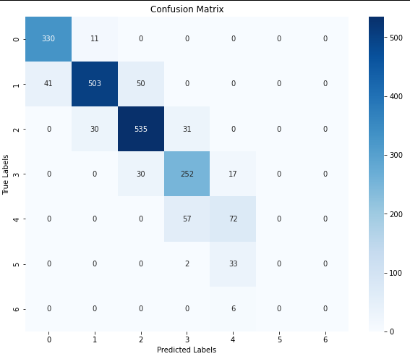
Neural Network with Simulated Annealing: Loan
Best configuration:
Activation: sigmoid
Num_layers: 4
Nodes_per_layer: 68
Accuracy Score: 0.86

Slide 7
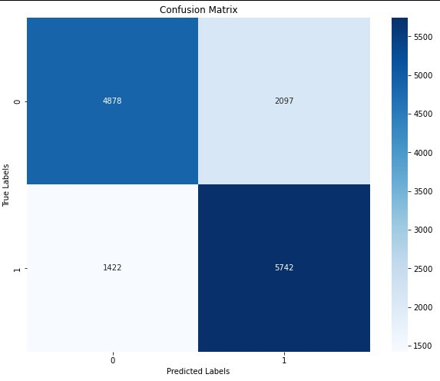
Neural Network with Simulated Annealing: Diabetes Health Indicators
Best configuration:
Activation: elu
Num_layers: 4
Nodes_per_layer: 7
Accuracy Score: 0.75

Slide 8
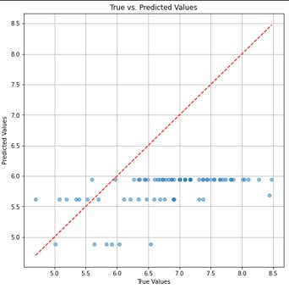
Neural Network with Simulated Annealing: Residential Buildings
Best configuration:
Activation: tanh
Num_layers: 3
Nodes_per_layer: 17
MSE: 2.3977

Slide 9
Conclusions
Custom Simulated Annealing results in Performance Gains:
The application of simulated annealing for the three-dimensional hyperparameter space was extremely expensive in terms of computational costs.
Simulated Annealing for the three-dimensional hyperparameter space required again the tuning of three parameters and is therefore questionable.
For Regression purposes, Simulated Annealing did not lead to satisfactory optimum state of tuning parameters for the data sets "Residential Buildings" and "Diabetes Health Indicators".
Consideration of Training Time and Resource Allocation:
The neural network's training time posed challenges, especially with large datasets, necessitating consideration of computational resources.

