Slide 1

CLINICAL DECISION SUPPORT FOR EARLY IDENTIFICATION OF OBESITY-RELATED COMPLICATION RISK
Group 5 – Frederick Damptey & Benjamin Odoom Asomaning
SAT 5141 – Clinical Decision Support & AI Modeling

Slide 2
Background & Motivation
Obesity is a major global public-health challenge driving T2DM, hypertension, and cardiovascular disease [1].
Early identification of high-risk individuals can reduce long-term morbidity and mortality [1], enable targeted prevention and lifestyle interventions.
Clinicians often have limited time and may under-recognize obesity risk in busy primary-care settings.
Clinical Decision Support Systems (CDSS) assist clinicians to make complex, data-rich decisions [2] using multiple patient information.

Slide 3
AI & CDSS for Obesity
CDSS can integrate multiple risk factors and provide consistent, evidence-based recommendations [2].
AI-driven CDSSs can augment human judgement in diagnosis, risk prediction and treatment planning [2,8].
Recent work shows strong performance of ML for obesity risk prediction and monitoring [3,7].
However, many models are “black boxes”, limiting clinician trust and adoption [4,5,7].

Slide 4
Population and Justification
Target population:
Adults at high risk of obesity-related complications.
Justification:
High disease burden and modifiable risk factors.
Opportunity for early intervention during routine visits.
Supports over-loaded clinicians by highlighting patients needing closer follow-up.

Slide 5
Prior Obesity ML Studies - Literature Review
Machine-learning models have shown strong performance in predicting obesity risk and related outcomes.
Helforoush & Sayyad (2024) used a hybrid metaheuristic ML approach, improving precision of obesity risk prediction [3].
Shen et al. (2024) developed a visualization-based obesity prediction system, emphasizing interpretability for clinicians [4].
Nguyen et al. (2023) systematic review: AI methods consistently outperform traditional statistical models in obesity prediction tasks [7].

Slide 6
Literature Review Cont’d
Shortliffe & Sepúlveda (2018) highlight how CDSS, when combined with AI, can enhance but not replace clinician judgment [2].
Esteva et al. (2019) showed deep learning’s potential in healthcare but stress transparency and clinical validation [8].
Lee et al. (2025) used ensemble ML models on survey data to predict obesity in T2DM patients, achieving high performance and demonstrating real-world utility [5].
Gap: Many AI models are not packaged into usable CDSS tools with clinician-in-the-loop workflows.

Slide 7
Aim and Objectives
Aim:
Build an AI-enabled CDSS that predicts obesity-related complication risk and supports clinician decision-making.
Objectives:
  Train and validate ML models to classify patients into 7 obesity-risk categories.
  Evaluate performance using accuracy, AUC, F1-score, sensitivity, and specificity.
  Use SHAP explainability to identify key predictors and improve clinical trust.
  Prototype a clinician-in-the-loop Streamlit interface for real-time use.

Slide 8
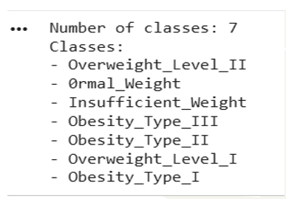
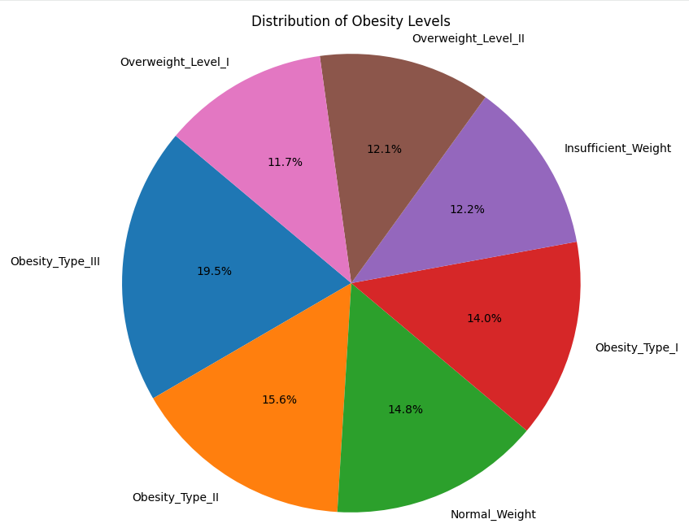
Dataset & Population
Data source: Obesity Risk Dataset from Kaggle (20,758 samples, 18 features) [6].
Variables: age, gender, height, weight, physical activity level, caloric intake, family history, and lifestyle behaviors.
Target variable: Obesity_Risk, 7 obesity weight_based classes.
Insufficient_Weight, Normal_Weight, Overweight_Level I & II, Obesity_Type I–III.
De-identified, no missing values, suitable for secondary analysis in research.

Slide 9
Data Quality & Validation
Data exploration:
  Completeness (no missing values), feature relevance, spelling.
Used tratified k-fold cross-validation to preserve class distribution and improve generalizability.

Slide 10
Modeling Pipeline Overview
Data Ingestion and exploration: Loaded and inspected dataset structure
Preprocessing:
Cleaned data
Defined features and target.
Train_test_split (80/20)
3. AutoGluon Tabular: Automated model selection and stacking.
4. Evaluation: Accuracy, AUC, F1, confusion matrix.
5. Explainability: SHAP, local XAI and contrastive ecplanable AI to rank features and visualize impact.
6. Clinician-in-the-Loop Interface: Streamlit tool for real-time use.

Slide 11
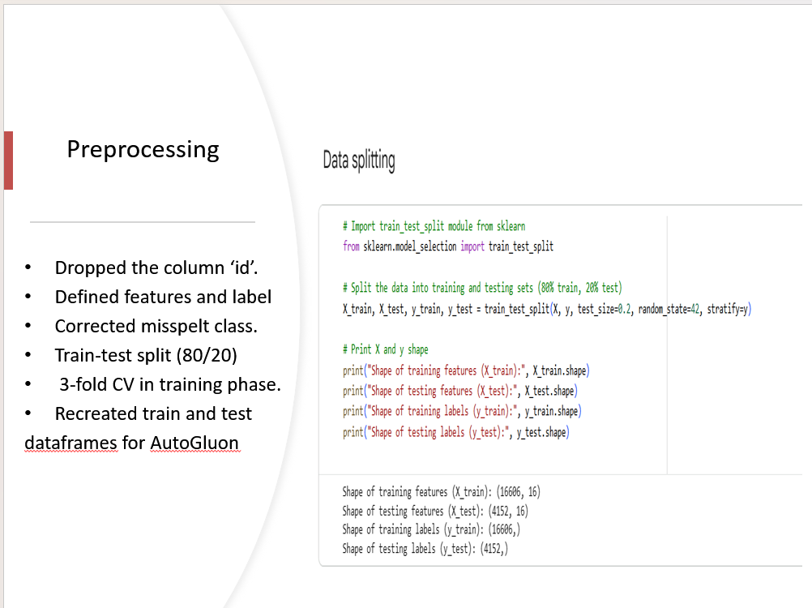

Slide 12

AutoGluon & Model Details
AutoGluon explored multiple algorithms:
Derivatives of Random Forest, XGBoost, CatBoost, LightGBM, neural networks, etc.
Metric prioritized: Balanced accuracy to handle class imbalance in training.
Best model: AutoGluon using top-performing base learners.

Slide 13
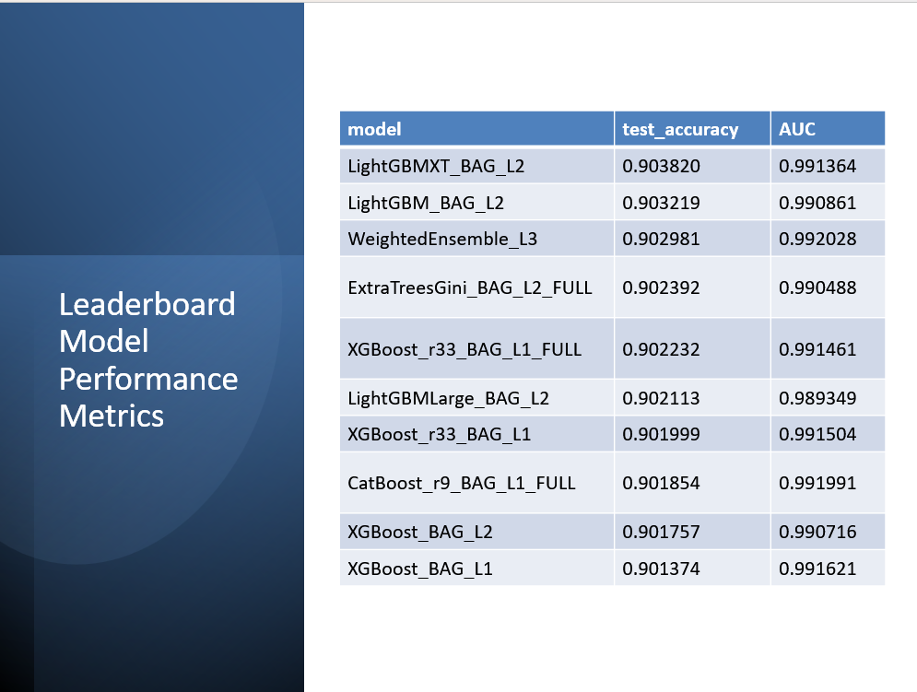
Top Performing Model Performance

Slide 14
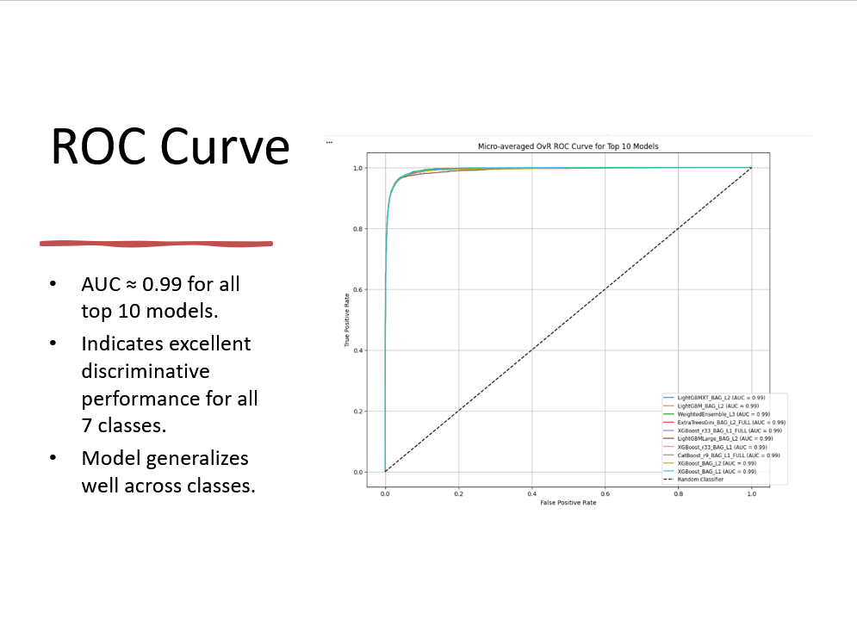

Slide 15
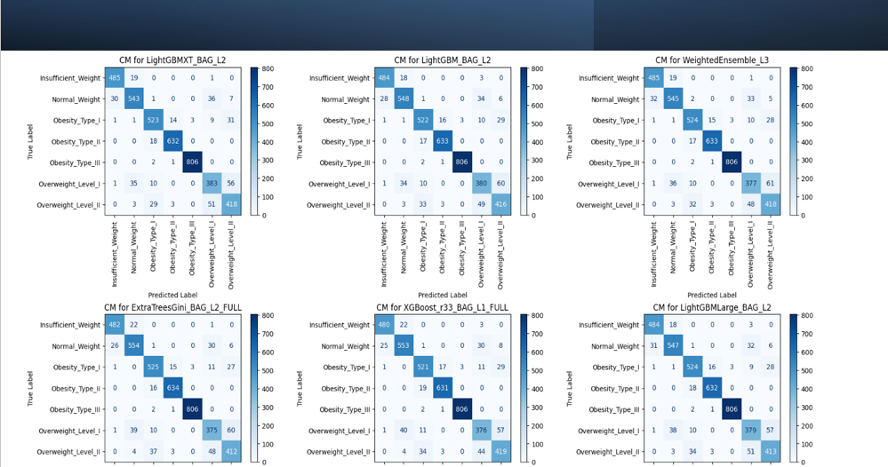

Slide 16
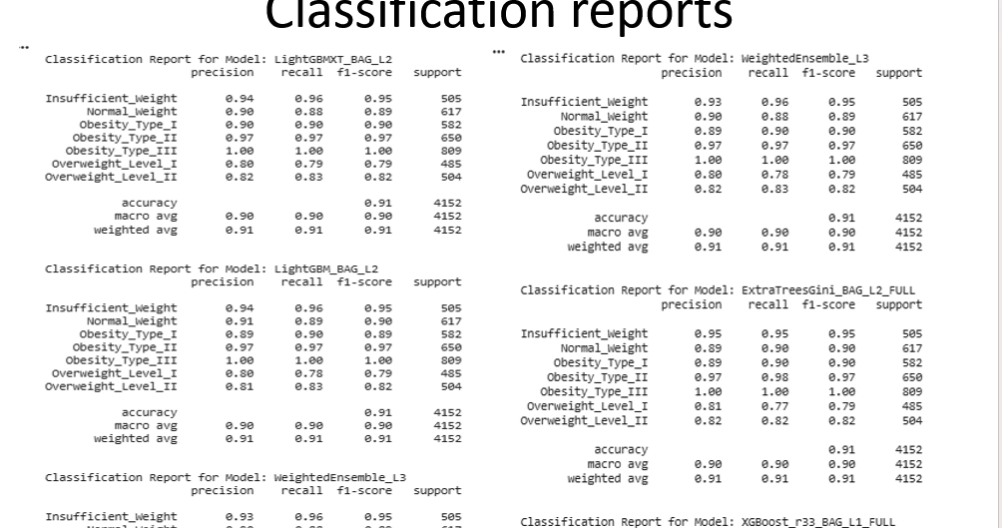

Slide 17
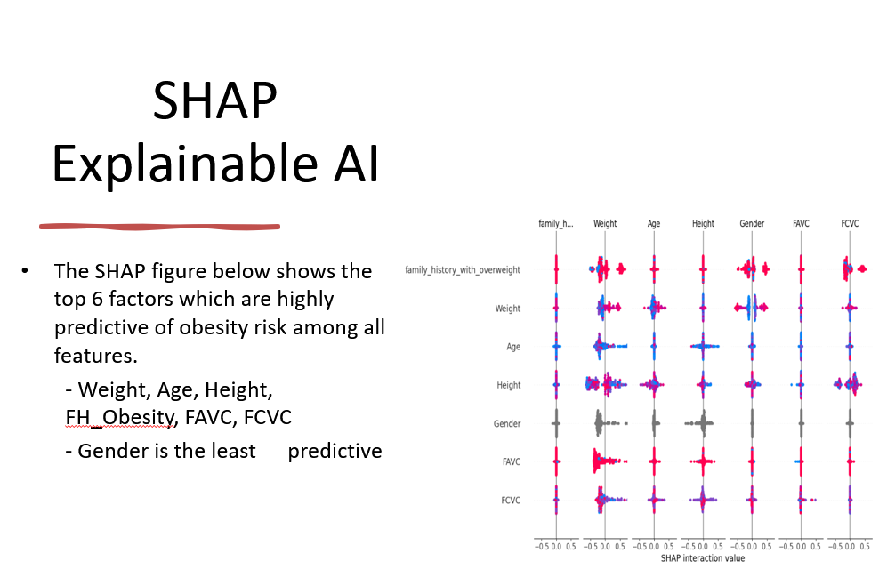

Slide 18
CDSS Prototype & Clinical Workflow
Implemented a Streamlit clinician-in-the-loop interface:
Input - case.
Output - CDSS returns predicted obesity-risk class + XAI explanation.
Feedback - Clinician can accept, reject or override the suggestion and assign reason if necessary.
Justification - Justification text and timestamps logged for auditability.

Slide 19
CDSS Prototype & Clinical Workflow
Data are de-identified; no direct patient identifiers [6].
Aligns with key principles from HIPAA deidentification stipulations and healthcare AI guidelines.
Transparency: SHAP explanations and clinician-override logs.
CDSS is designed to support, not replace, clinician judgment [2].

Slide 20
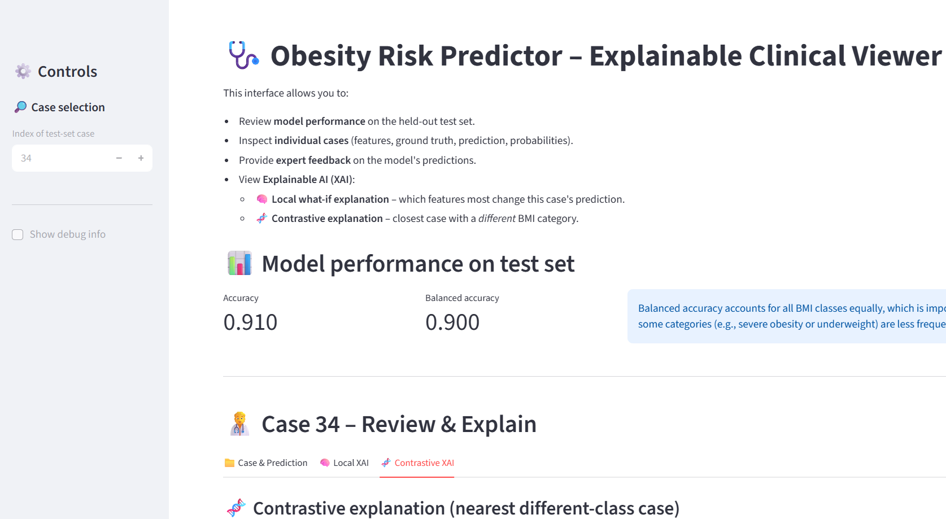
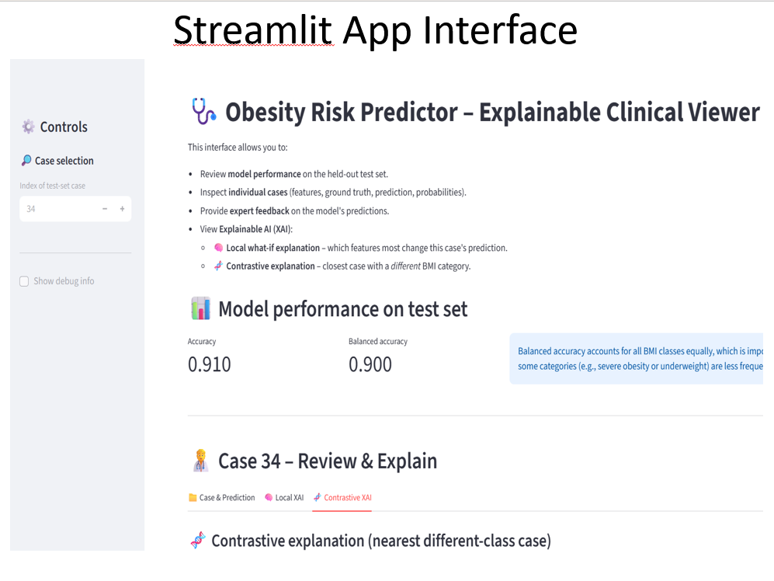
Prototype & Clinical Workflow

Slide 21
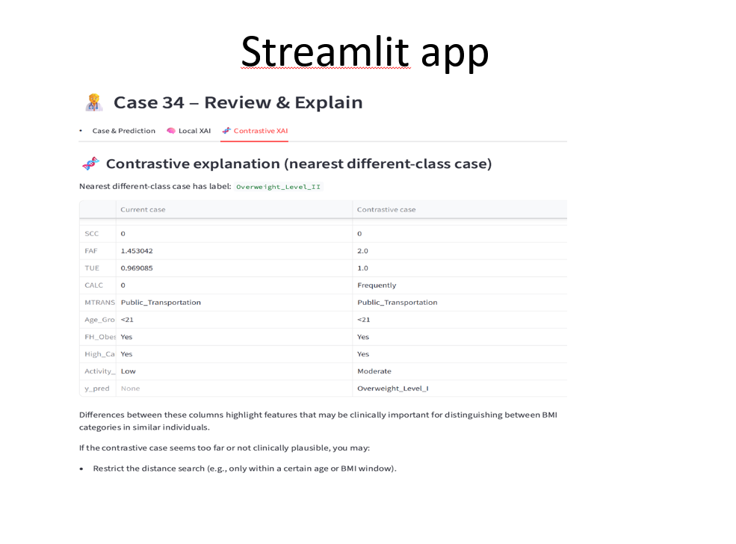
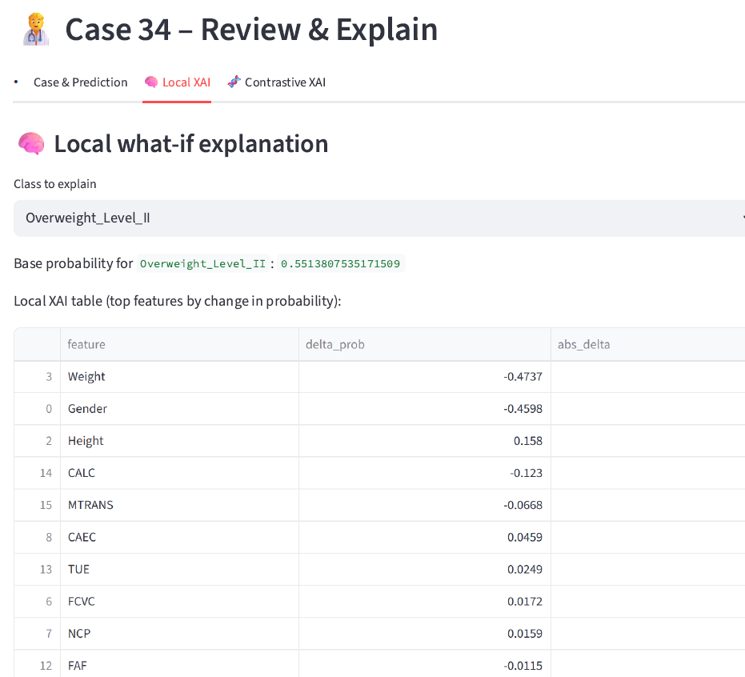
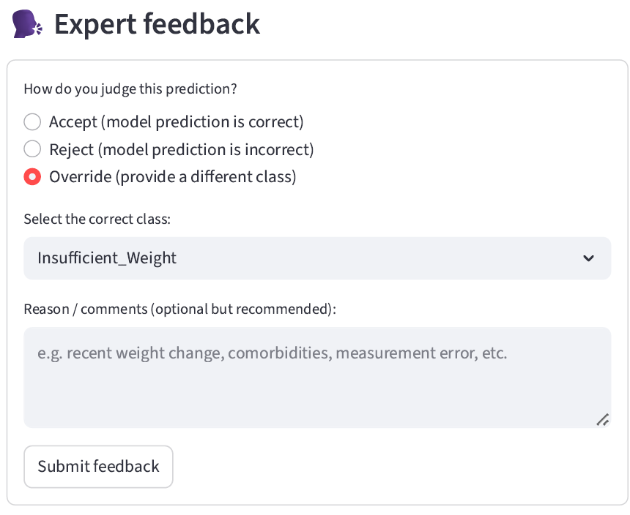

Slide 22
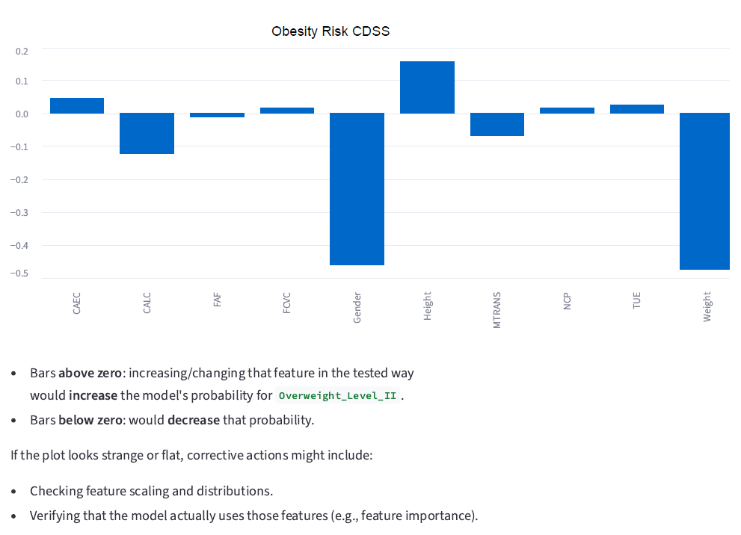
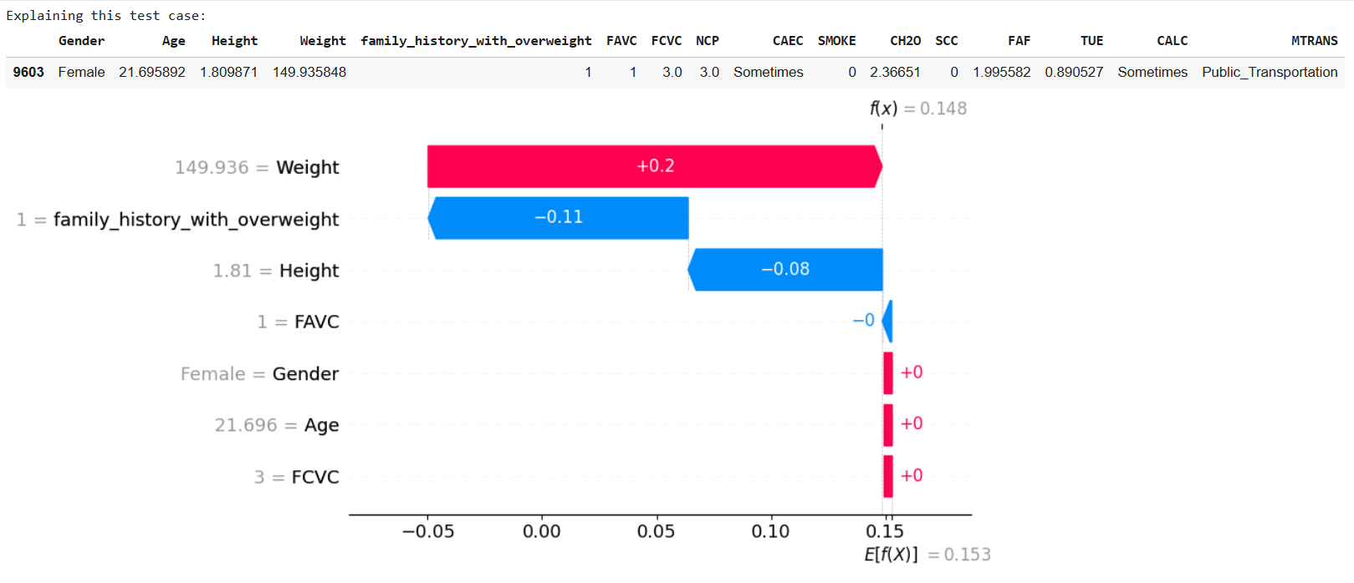

Slide 23
Challenges
Limitations with Autogluon model.
Streamlit app development was a challenge.
The 7 multiclass task posed challenges with computing class performances and outputting results.
The raw data, including categorical values fed into Autogluon made SHAP computation and plot very challenging.
Integrated LIME and perturbation analysis plots XAI in streamlit may not be ideal for clinical deployment.
Time constraints for robust development.

Slide 24
Conclusions & Impact
Developed a good-performing, explainable CDSS for obesity-risk prdiction.
Models achieved accuracy >0.90 and 0.99 AUC across seven risk classes.
SHAP explanations and clinician-in-the-loop design enhanced transparency and reduced automation bias.
Potential impact on targeted population:
Earlier identification of high-risk patients.
More personalized counseling and resource allocation.
Support for population-level prevention strategies.

Slide 25
References
H. C. Whitlock, L. M. Williams, and D. M. Colditz, “Obesity as a global public health challenge: Epidemiology, risk factors, and prevention,” The Lancet, vol. 387, no. 10026, pp. 231–243, 2016.
E. H. Shortliffe and M. J. Sepúlveda, “Clinical decision support in the era of artificial intelligence,” JAMA, vol. 320, no. 21, pp. 2199–2200, 2018.
Z. Helforoush and H. Sayyad, “Prediction and classification of obesity risk based on a hybrid metaheuristic machine learning approach,” Frontiers in Big Data, 2024.
J. Shen et al., “Visualization obesity risk prediction system based on machine learning techniques,” Scientific Reports, 2024.
C. Lee et al., “A machine learning model for predicting obesity risk in patients with T2DM using health survey data,” Diabetes & Metabolism Journal, 2025.
J. P. Kochar, “Obesity Risk Dataset,” Kaggle, 2024.
Q. T. Nguyen, H. T. Vo, and T. M. Le, “Artificial intelligence applications in obesity prediction: A systematic review,” Healthcare Analytics, vol. 5, no. 2, pp. 101–118, 2023.
A. Esteva et al., “A guide to deep learning in healthcare,” Nature Medicine, vol. 25, no. 1, pp. 24–29, 2019.

Slide 26

Thank You

