Slide 2


Slide 3


Slide 4







COINS
COLORSPACE
PAUSE
SHOP
SCORE
BEST SCORE
GAME OVER

Slide 5





Slide 6







Slide 8


Slide 10


Slide 11


Slide 17
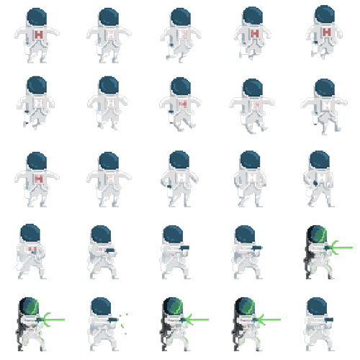

Slide 18



Slide 19


Slide 21

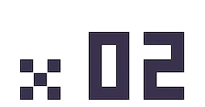

Slide 22
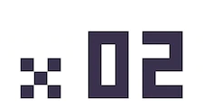

+200
+200
+200
+200
+200
+200
+200
+200

Slide 23







Slide 24



