Slide 2


Slide 3


Slide 4







COINS
COLORSPACE
PAUSE
SCORE
BEST SCORE
GAME OVER

Slide 5





Slide 6







Slide 8


Slide 10


Slide 11


Slide 14
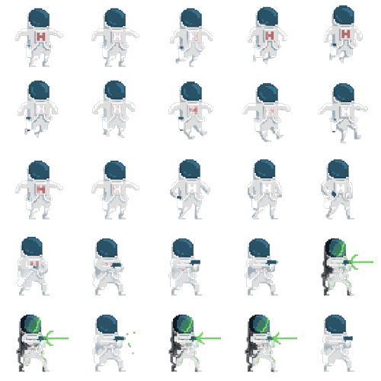

Slide 15



Slide 16


Slide 18

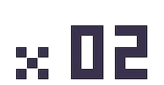

Slide 19
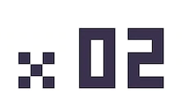

+200
+200
+200
+200
+200
+200
+200
+200

Slide 20







