Slide 1
COLORSPACE
MERCI
Benjamin Ban & Marine Bayet

Slide 2


Slide 3


Slide 4
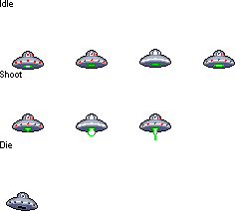






COINS
COLORSPACE
PAUSE
SHOP
SCORE
BEST SCORE
GAME OVER

Slide 5





Slide 6







Slide 7

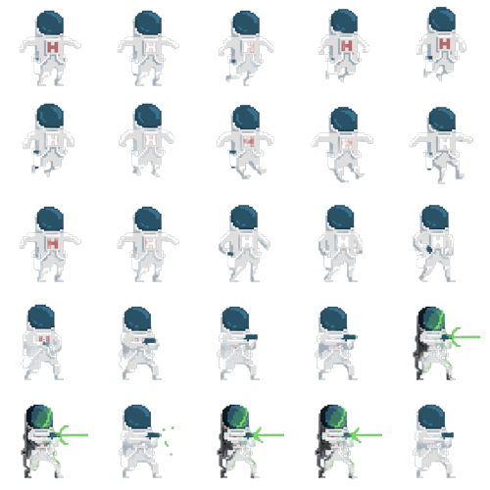
COLORSPACE

Slide 8


COLORSPACE

Slide 9

COLORSPACE

Slide 10
COLORSPACE

Slide 11
COLORSPACE

Slide 12
COLORSPACE

Slide 13
COLOR
SPACE

Slide 14
COLOR
SPACE

Slide 15
COLOR
SPACE

Slide 16
COLOR
SPACE

Slide 21


Slide 28


Slide 29


Slide 31


Slide 32


+200
+200
+200
+200
+200
+200
+200
+200

Slide 33







Slide 34
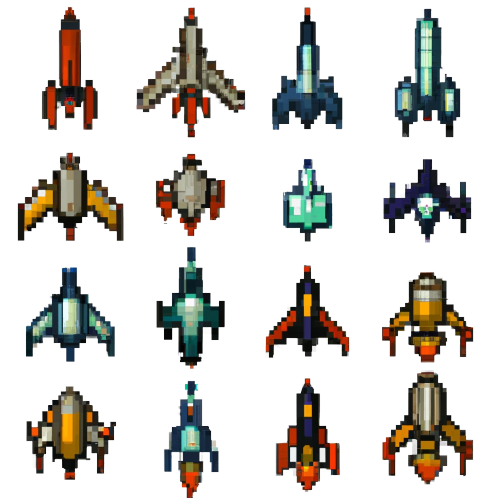


Slide 36
COLOR
SPACE

Slide 37
COLOR
SPACE

Slide 38
MERCI

Slide 39


Slide 40
COLOR
SPACE

