Slide 1
Chapter 03 Data Exploration
Dr. Steffen Herbold
herbold@cs.uni-goettingen.de

Slide 2
Outline
Overview
Summary Statistics
Visualization for Data Exploration
Summary

Slide 3

Goal of Data Exploration
Goal:
Understand the basic characteristics of the data
Examples for characteristics:
Structure
Size
Completeness
Relationships

Slide 4
Methods for Data Exploration
Usually interactive and semi-automated
Text editors, system calls (head/more/less), etc. to look at raw data directly
Helps to understand the structure
Statistics and visualizations to learn about distributions and relationships
Exploration should also include meta data
Feature names, trace links, etc.

Slide 5
Outline
Overview
Summary Statistics
Visualization for Data Exploration
Summary

Slide 6
Descriptive Statistics
Summarize data through single value
Do not predict anything about the data (→ inductive statistics)
Common statistics covered in this course
Central tendency (mean/median/mode)
Variability (standard deviation, interquartile range)
Range of data (min/max)
Other important statistics
Kurtosis and skewness for the shape of distributions
More measures for central tendency, e.g., trimmed means, harmonic mean

Slide 7
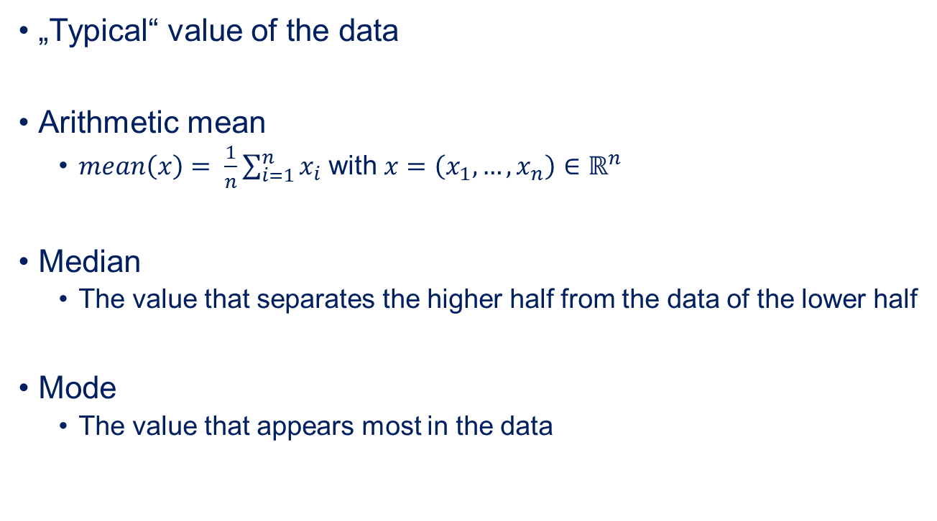
Central Tendency
„Typical“ value of the data
Arithmetic mean
$mean\left(x\right)= \frac{1}{n}\sum_{i=1}^{n}{x_{i}}$ with $x=\left(x_{1},…, x_{n}\right)∈ℝ^{n}$
Median
The value that separates the higher half from the data of the lower half
Mode
The value that appears most in the data

Slide 8

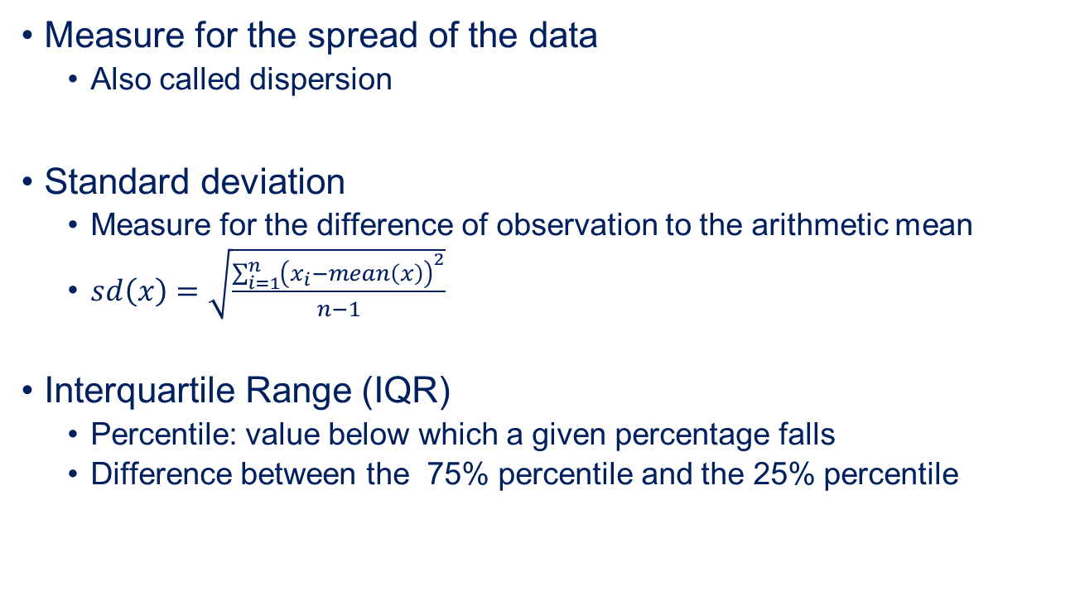
Variability
Measure for the spread of the data
Also called dispersion
Standard deviation
Measure for the difference of observation to the arithmetic mean
$sd\left(x\right)=\sqrt{\frac{\sum_{i=1}^{n}{{\left(x_{i}−mean\left(x\right)\right)}^{2}}}{n−1}}$
Interquartile Range (IQR)
Percentile: value below which a given percentage falls
Difference between the 75% percentile and the 25% percentile
The median is the 50% percentile

Slide 9
Range of data
Range for which values are observed
Can be infinite!
Minimum
Smallest observed value
Maximum
Largest observed value
May be strongly distorted by invalid data
Makes it also a good tool to discover invalid data

Slide 10
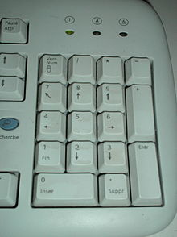
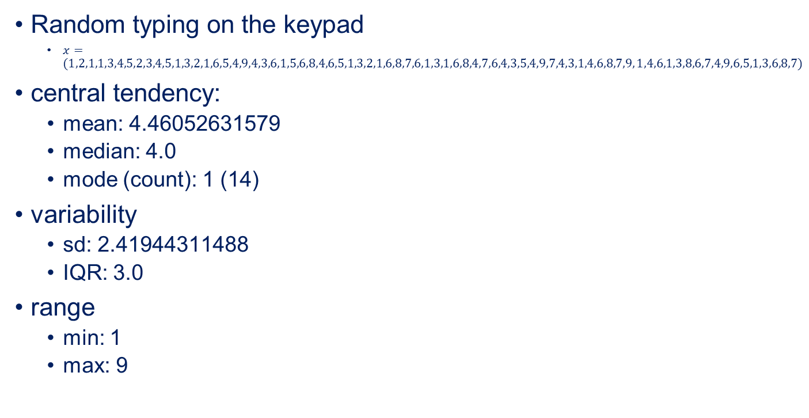
Example
Random typing on the keypad
$x=(1,2,1,1,3,4,5,2,3,4,5,1,3,2,1,6,5,4,9,4,3,6,1,5,6,8,4,6,5,1,3,2,1,6,8,7,6,1,3,1,6,8,4,7,6,4,3,5,4,9,7,4,3,1,4,6,8,7,9, 1,4,6,1,3,8,6,7,4,9,6,5,1,3,6,8,7)$
central tendency:
mean: 4.46052631579
median: 4.0
mode (count): 1 (14)
variability
sd: 2.41944311488
IQR: 3.0
range
min: 1
max: 9

Slide 11
Outline
Overview
Summary Statistics
Visualization for Data Exploration
Summary

Slide 12
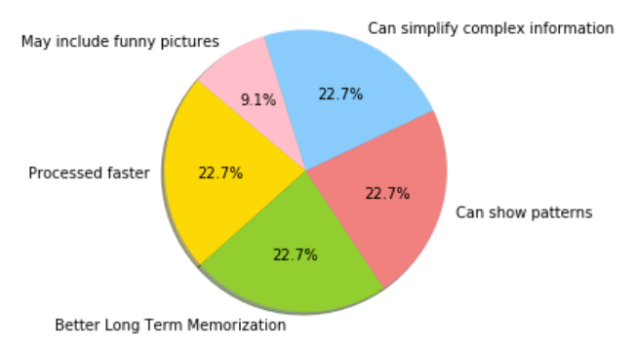
A Picture Says More than 1000 Words
Numbers are made up and pie charts should actually be avoided

Slide 13
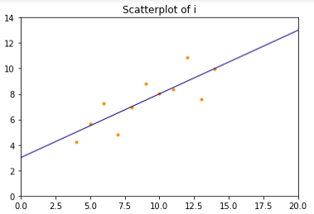
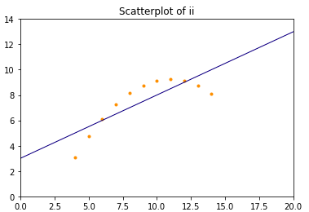
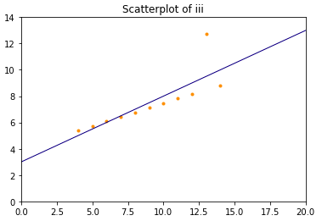
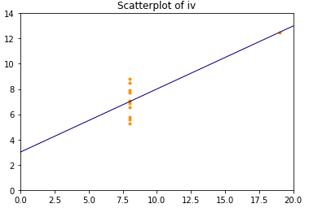
DescriptiveDeceptive Statistics
i
X | y
10.00 | 8.04
8.00 | 6.95
13.00 | 7.58
9.00 | 8.81
11.00 | 8.33
14.00 | 9.96
6.00 | 7.24
4.00 | 4.26
12.00 | 10.84
7.00 | 4.82
5.00 | 5.68
ii
x | y
10.00 | 9.14
8.00 | 8.14
13.00 | 8.74
9.00 | 8.77
11.00 | 9.26
14.00 | 8.10
6.00 | 6.13
4.00 | 3.10
12.00 | 9.13
7.00 | 7.26
5.00 | 4.74
Anscombe‘s Quartet
Have the same
Mean
standard deviation
correlation between x and y
linear regression
iii
x | y
10.00 | 7.46
8.00 | 6.77
13.00 | 12.74
9.00 | 7.11
11.00 | 7.81
14.00 | 8.84
6.00 | 6.08
4.00 | 5.39
12.00 | 8.15
7.00 | 6.42
5.00 | 5.73
iv
x | y
8.00 | 6.58
8.00 | 5.76
8.00 | 7.71
8.00 | 8.84
8.00 | 8.47
8.00 | 7.04
8.00 | 5.25
19.00 | 12.50
8.00 | 5.56
8.00 | 7.91
8.00 | 6.89

Slide 14
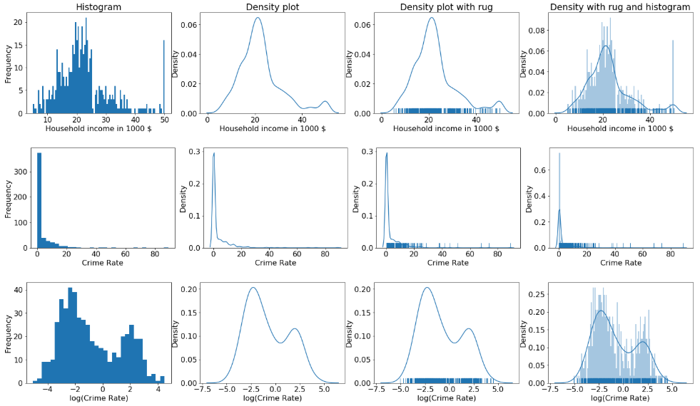
Exploring Single Features
Looks like an artificially high value
→ Groups all higher incomes
Extremley skewed
Mixture of two normals after taking the logarithm
Plots of the Boston house prices data set
http://archive.ics.uci.edu/ml/machine-learning-databases/housing/

Slide 15
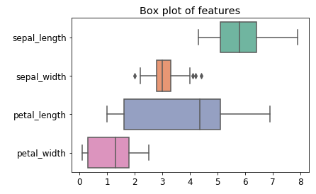
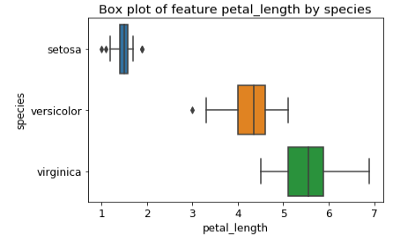
Boxplots
Outlier
25% percentile
Median
75% percentile
Range of data except outliers
The outlier definition can change. We used „more than 1.5 times the IQR away from the 25%/75% percentile.”
You should always check this in the package you use.

Slide 16
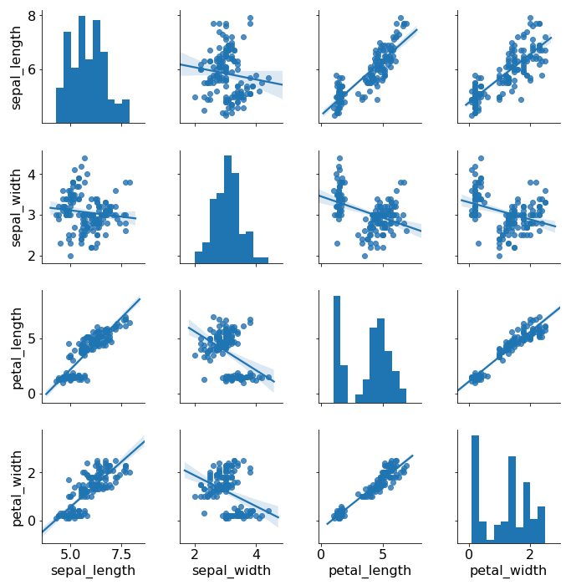
Pairwise Scatterplots with Regressions
No correlation visible
Strong linear correlation
Histogram of data in the column

Slide 17
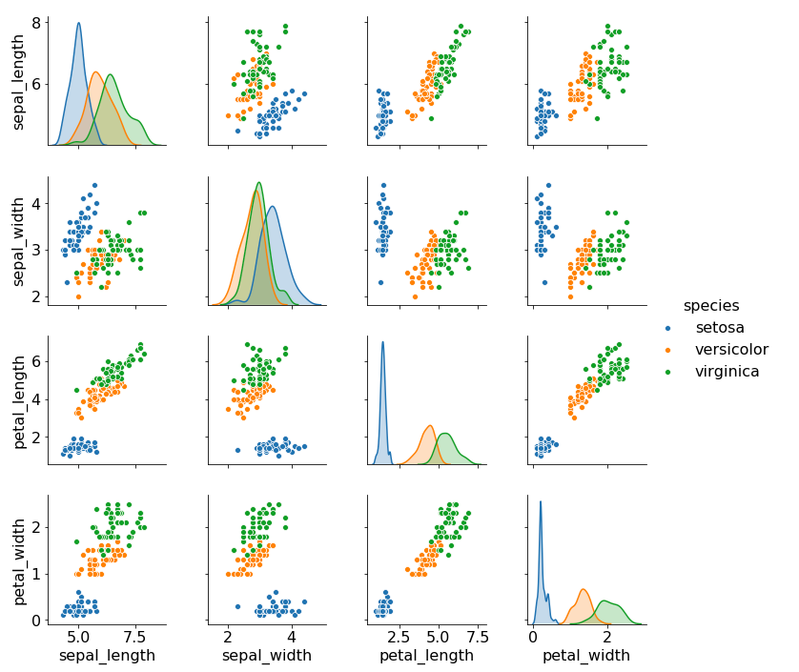
Pairwise Plots with Classes
Good separation of blue, but green and orange are overlapping
Good separation of all three classes
Density plots of data in the column separated by classes

Slide 18
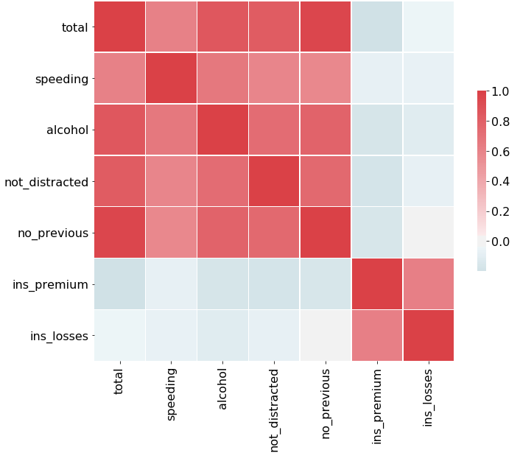
Correlation Heatmap
There are different correlation coefficients. We used Pearson‘s coefficient, which measures linear correlations.
Correlation between reasons for accidents
Colors show strength of correlation
Correlation between premiums and losses

Slide 19
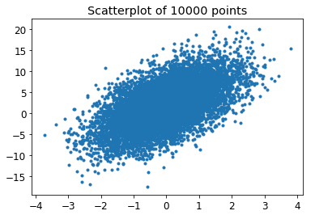
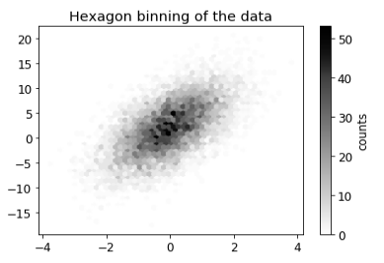
Hexbin Plots for Many Instances
Cannot see structure due to amount of data
Hexagonal bins reveal the structure

Slide 20
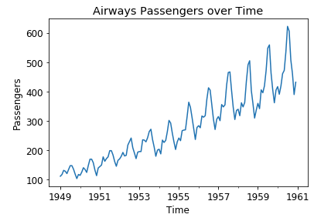
Line Plots for Timeseries
Range of values
Regular noise pattern → Seasonal?
Linear trend

Slide 21
Outline
Overview
Summary Statistics
Visualization for Data Exploration
Summary

Slide 22
Summary
Important to understand the data available
Summary statistics provide a good overview
Can be deceptive!
Visualization is a powerful way to understand data
Understanding of meta data and how domain experts understand data equally important!

