Slide 1
Chapter 07 Classification
Dr. Steffen Herbold
herbold@cs.uni-goettingen.de

Slide 2
Outline
Overview
Classification Models
Comparison of Classification Models
Summary

Slide 3
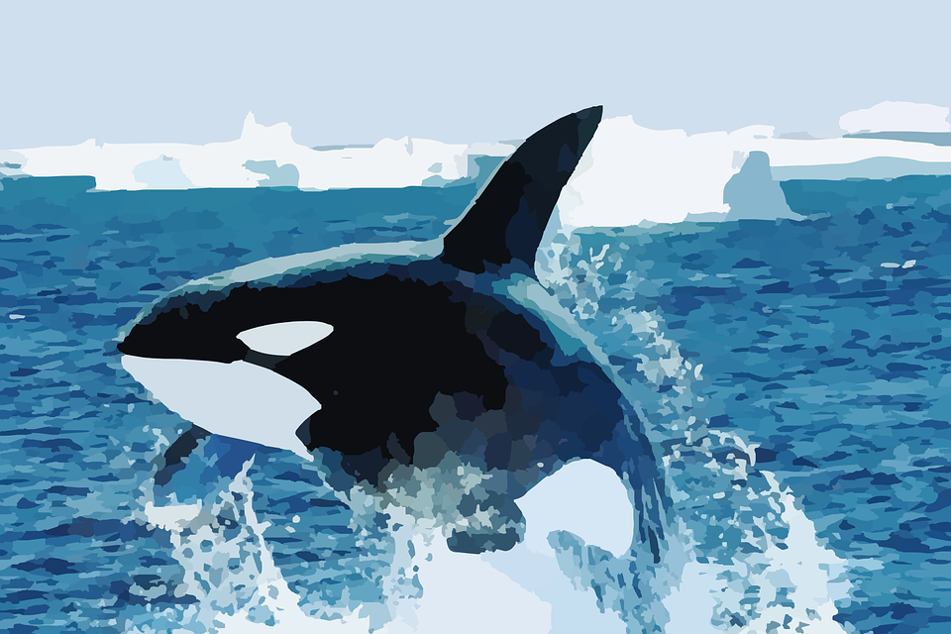

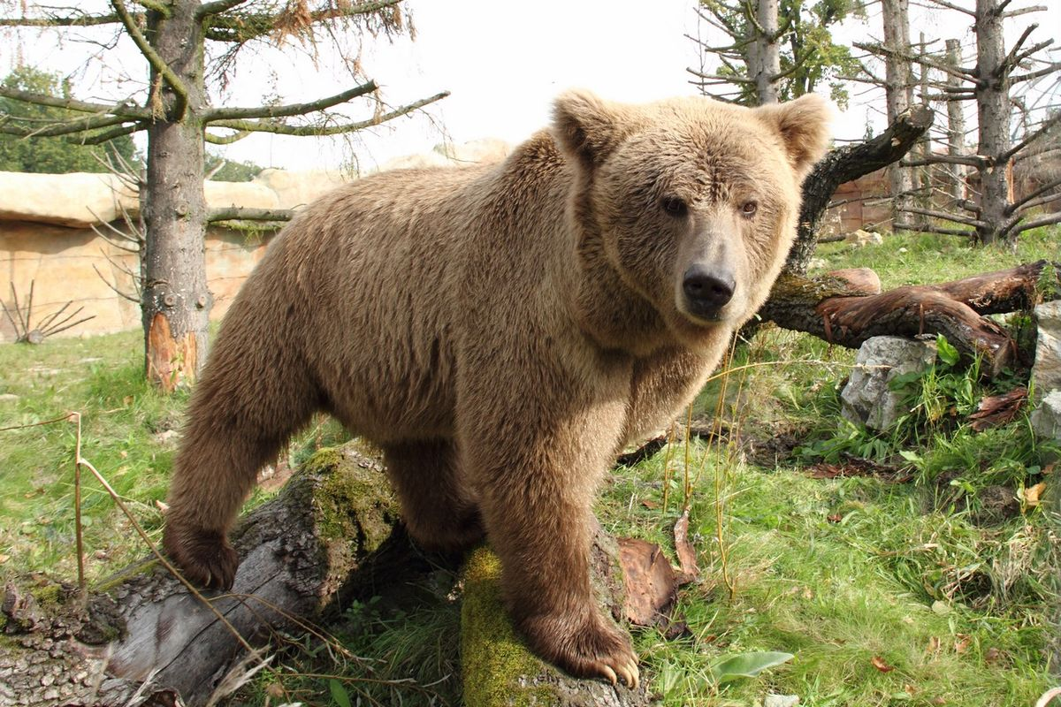
Example of Classification
This is a whale
This is a bear

Slide 4

The General Problem
Object 1
Class of object 1
Object 2
Concept
Class of object 2

Slide 5

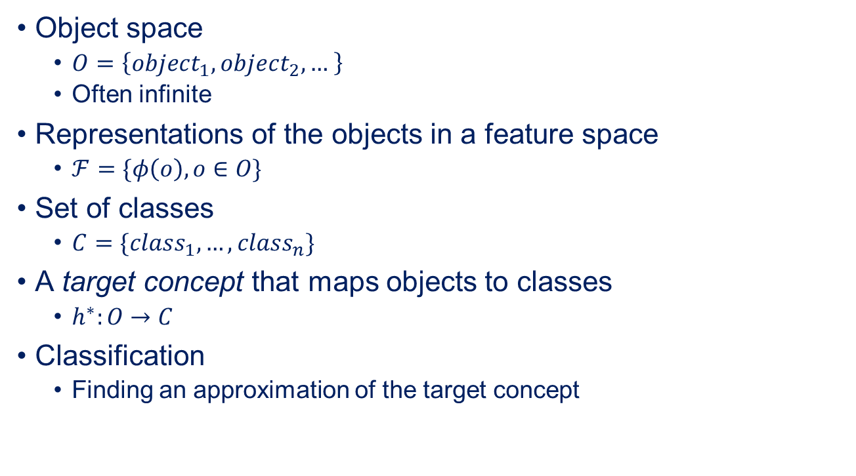
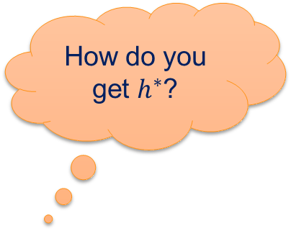
The Formal Problem
Object space
$O=\left\{object_{1},object_{2},… \right\}$
Often infinite
Representations of the objects in a feature space
$ℱ=\{φ\left(o\right), o∈O\}$
Set of classes
$C=\{class_{1},…, class_{n}\}$
A target concept that maps objects to classes
$h^{∗}:O→C$
Classification
Finding an approximation of the target concept
How do you get $h^{∗}$?

Slide 6
The „Whale“ Hypothesis
Why do we know this is a whale?
Has a fin
Blue background
Oval body
Black top, white bottom
Hypothesis:
Objects with fins, an oval general shape that are black on top and white on the bottom in front of a blue background are whales.

Slide 7
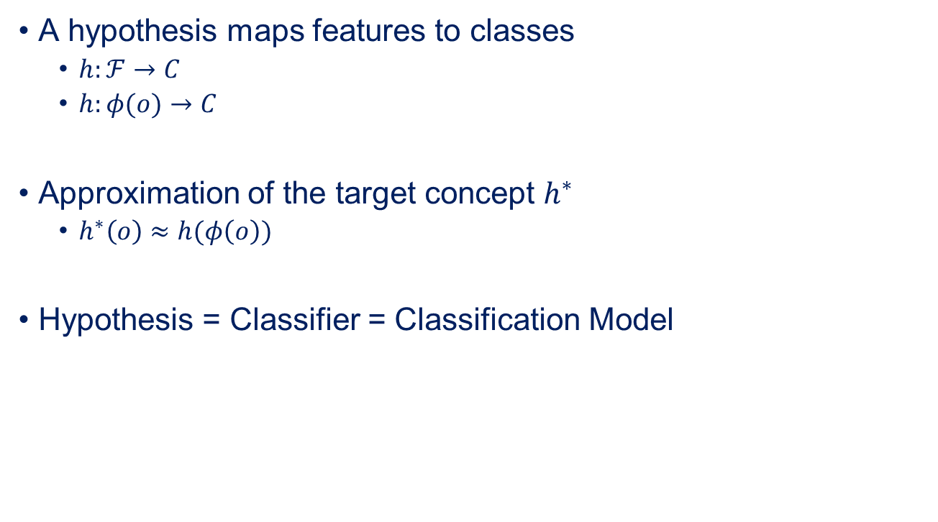
The Hypothesis
A hypothesis maps features to classes
$h:ℱ→C$
$h:φ(o)→C$
Approximation of the target concept $h^{∗}$
$h^{∗}\left(o\right)≈h(φ\left(o\right))$
Hypothesis = Classifier = Classification Model
What if I am not sure about the class?

Slide 8
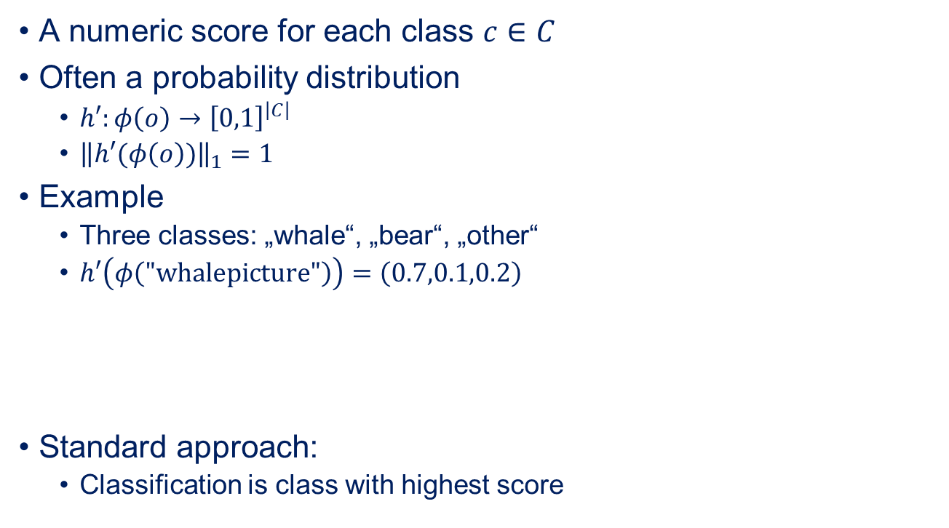
Classification using Scores
A numeric score for each class $c∈C$
Often a probability distribution
$h′:φ\left(o\right)→{\left[0,1\right]}^{\left|C\right|}$
${\left\|h′(φ\left(o\right))\right\|}_{1}=1$
Example
Three classes: „whale“, „bear“, „other“
$h′\left(φ\left("\text{whalepicture}\text{"}\right)\right)=\left(0.7,0.1,0.2\right)$
Standard approach:
Classification is class with highest score
score whale
score bear
score other

Slide 9
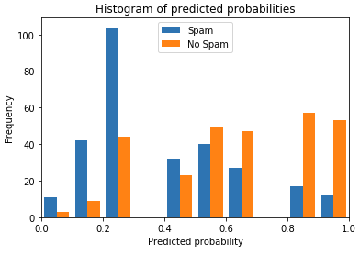
Thresholds for Scores
Different thresholds also possible
Threshold of 0.2 would miss “Spam” but better identify “No Spam”
Many “No Spam” incorrectly detected as spam if “highest” score is used

Slide 10
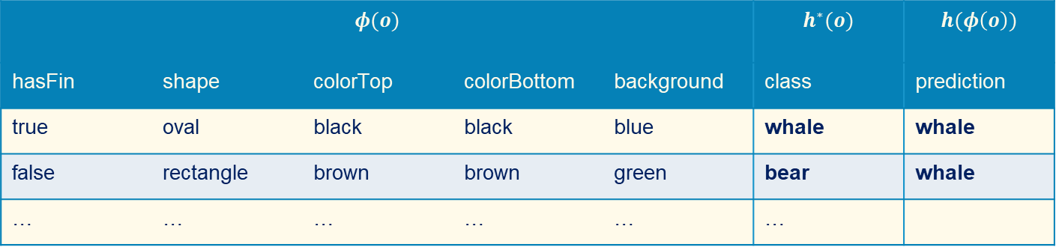

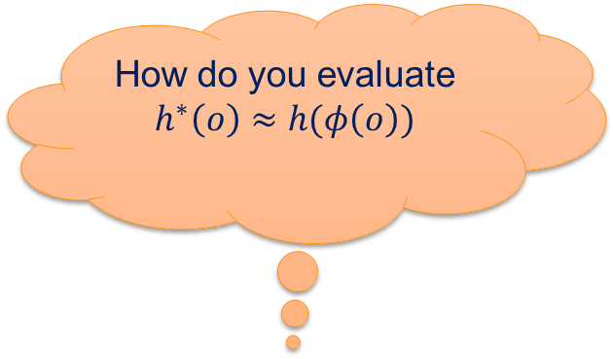
Quality of Hypothesis
How do you evaluate
$h^{∗}\left(o\right)≈h(φ\left(o\right))$
Goal: Approximation of the target concept
$h^{∗}\left(o\right)≈h(φ\left(o\right))$
→ Use Test Data
Structure is the same as training data
Apply hypothesis
$$φ(o)$$ |  |  |  |  | $$h^{∗}(o)$$ | $$h(φ\left(o\right))$$
hasFin | shape | colorTop | colorBottom | background | class | prediction
true | oval | black | black | blue | whale | whale
false | rectangle | brown | brown | green | bear | whale
… | … | … | … | … | …

Slide 11
The Confusion Matrix
Table of actual values versus prediction
Actual class
 | whale | bear | other
whale | 29 | 1 | 3
bear | 2 | 22 | 13
other | 4 | 11 | 51
Predicted Class
Two whales were incorrectly predicted as bears

Slide 12
Binary Classification
Many problems are binary
Will I get my money back?
Is this credit card fraud?
Will my paper be accepted?
…
Can all be formulated as either being in a class or not
→Labels true and false

Slide 13
The Binary Confusion Matrix
Actual class
False positives are also called Type I error
False negatives are also called Type II error
 | true | false
true | True Positives (TP) | False Positives (FP)
false | False Negatives (FN) | True Negatives (TN)
Predicted Class

Slide 14
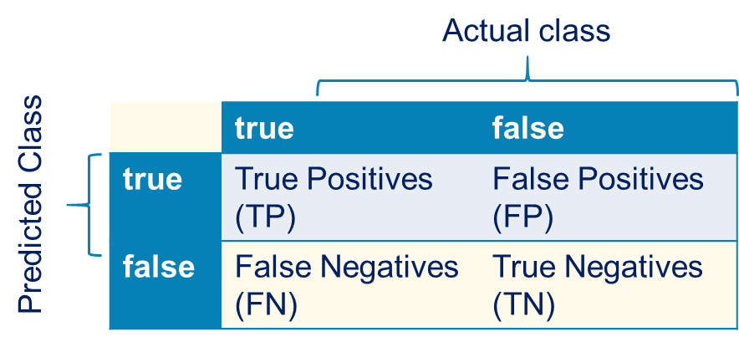
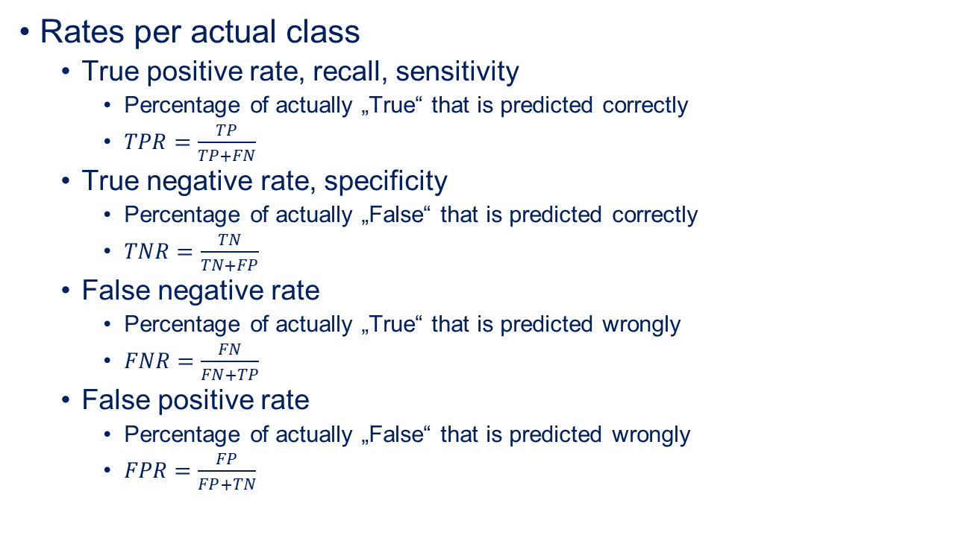
Binary Performance Metrics (1)
Rates per actual class
True positive rate, recall, sensitivity
Percentage of actually „True“ that is predicted correctly
$TPR=\frac{TP}{TP+FN}$
True negative rate, specificity
Percentage of actually „False“ that is predicted correctly
$TNR=\frac{TN}{TN+FP}$
False negative rate
Percentage of actually „True“ that is predicted wrongly
$FNR=\frac{FN}{FN+TP}$
False positive rate
Percentage of actually „False“ that is predicted wrongly
$FPR=\frac{FP}{FP+TN}$

Slide 15
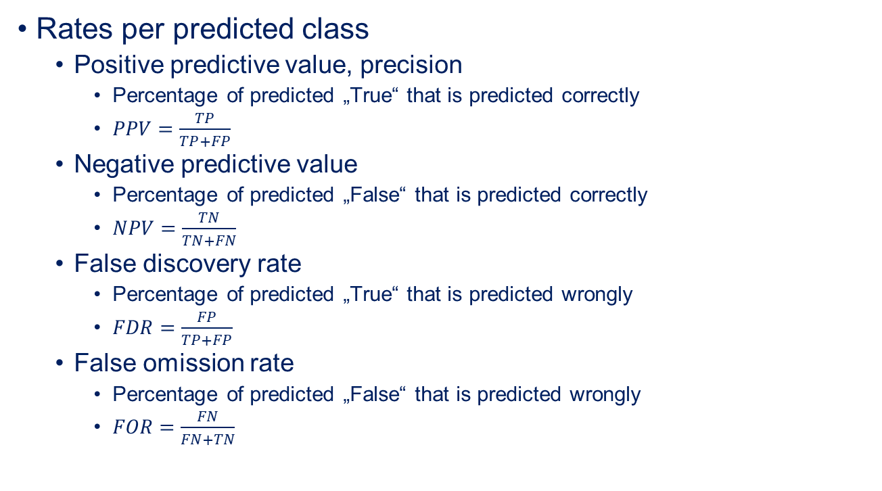
Binary Performance Metrics (2)
Rates per predicted class
Positive predictive value, precision
Percentage of predicted „True“ that is predicted correctly
$PPV=\frac{TP}{TP+FP}$
Negative predictive value
Percentage of predicted „False“ that is predicted correctly
$NPV=\frac{TN}{TN+FN}$
False discovery rate
Percentage of predicted „True“ that is predicted wrongly
$FDR=\frac{FP}{TP+FP}$
False omission rate
Percentage of predicted „False“ that is predicted wrongly
$FOR=\frac{FN}{FN+TN}$

Slide 16
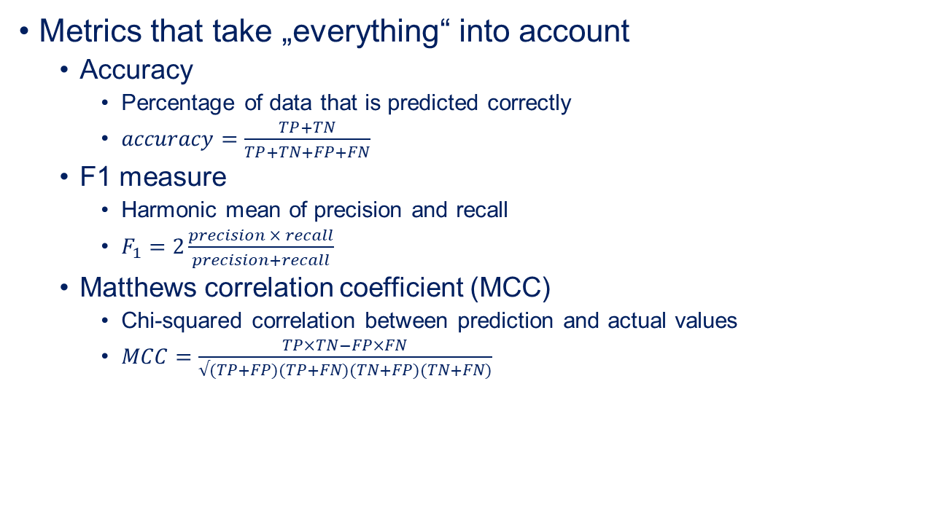
Binary Performance Metrics (3)
Metrics that take „everything“ into account
Accuracy
Percentage of data that is predicted correctly
$accuracy=\frac{TP+TN}{TP+TN+FP+FN}$
F1 measure
Harmonic mean of precision and recall
$F_{1}=2\frac{precision × recall}{precision+recall}$
Matthews correlation coefficient (MCC)
Chi-squared correlation between prediction and actual values
$MCC=\frac{TP×TN−FP×FN}{√(TP+FP)(TP+FN)(TN+FP)(TN+FN)}$

Slide 17
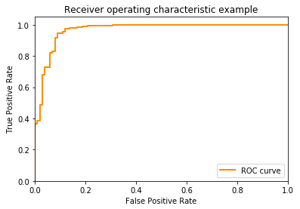
Receiver Operator Characteristics (ROC)
Plot of true positive rate (TPR) versus false positive rate (FPR)
Different TPR/FPR values possible due to thresholds for scores

Slide 18
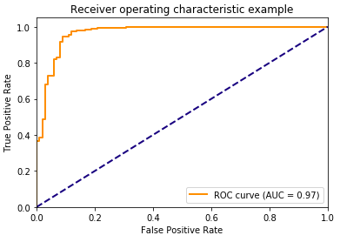
Area Under the Curve (AUC)
Large Area = Good Performance
Accounts for tradeoffs between TPR and FPR

Slide 19
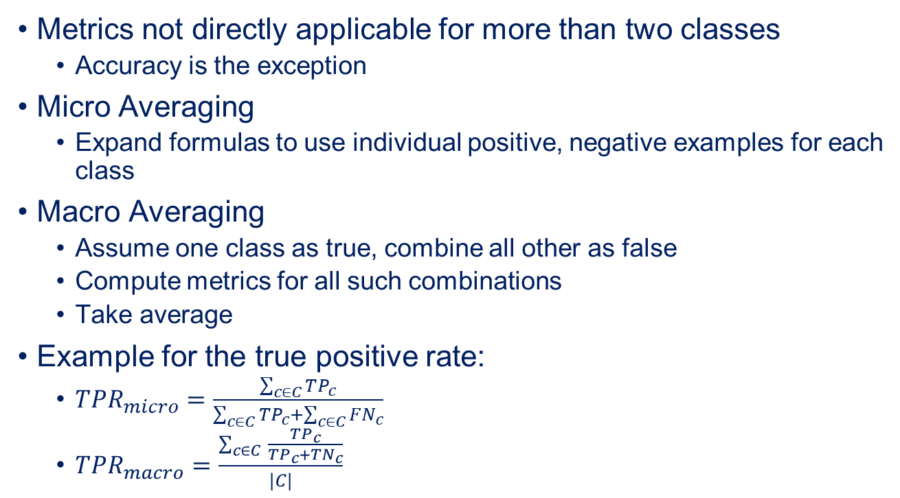
Micro and Macro Averaging
Metrics not directly applicable for more than two classes
Accuracy is the exception
Micro Averaging
Expand formulas to use individual positive, negative examples for each class
Macro Averaging
Assume one class as true, combine all other as false
Compute metrics for all such combinations
Take average
Example for the true positive rate:
$TPR_{micro}=\frac{\sum_{c∈C}{TP_{c}}}{\sum_{c∈C}{TP_{c}}+\sum_{c∈C}{{FN}_{c}}}$
$TPR_{macro}=\frac{\sum_{c∈C}{ \frac{TP_{c}}{TP_{c}+TN_{c}}}}{|C|}$

Slide 20
Outline
Overview
Classification Models
Comparison of Classification Models
Summary

Slide 21
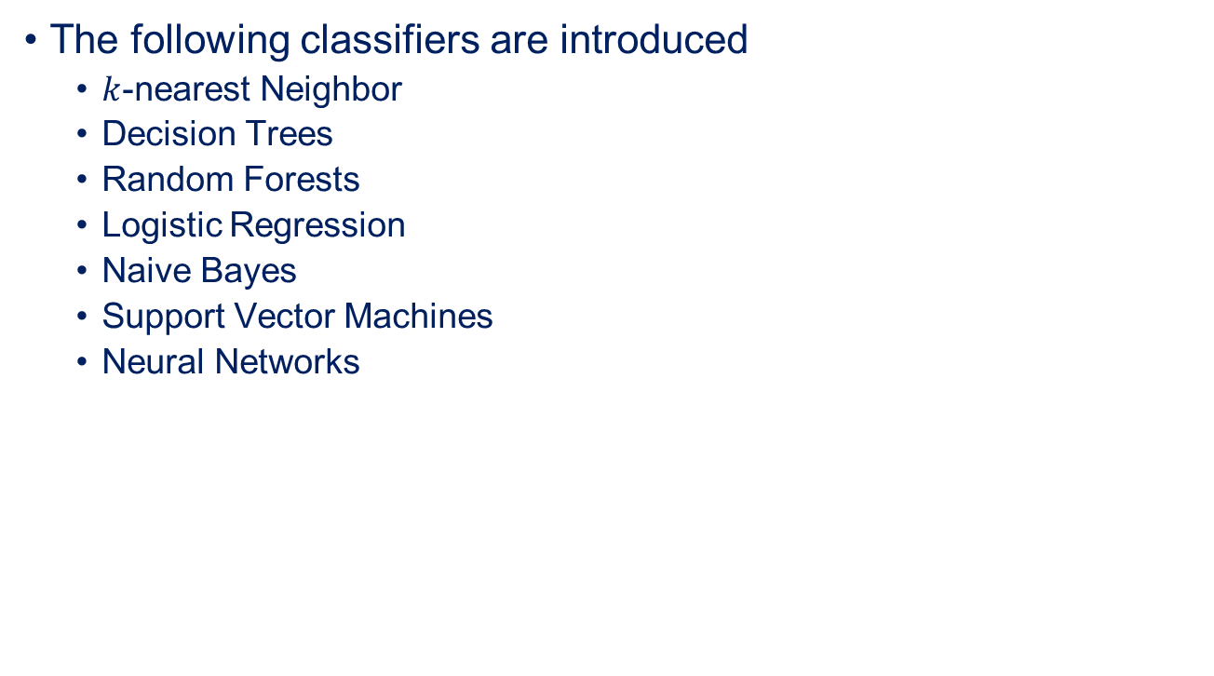
Overview of Classifiers
The following classifiers are introduced
$k$-nearest Neighbor
Decision Trees
Random Forests
Logistic Regression
Naive Bayes
Support Vector Machines
Neural Networks

Slide 22
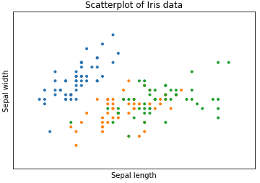
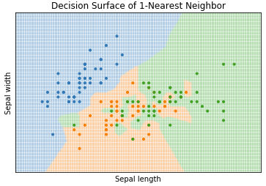


$k$-nearest Neighbor
Basic Idea
Instances with similar feature values should have the same class
Class can be determined by looking at instances that are similar
→ Assign each instance the mode of its $k$ nearest instances

Slide 23
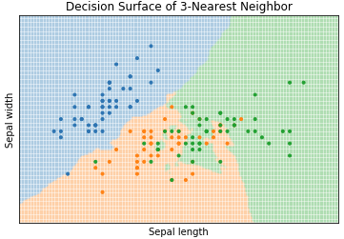
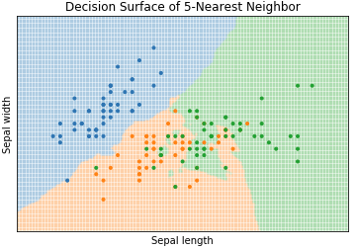
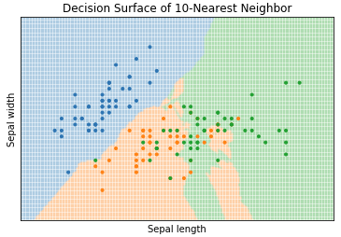

Impact of $k$

Slide 24
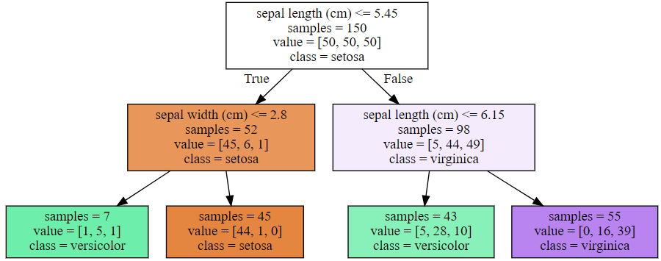
Decision Trees
Basic Idea
Make decisions based on logical rules about features
Organize rules as a tree

Slide 25
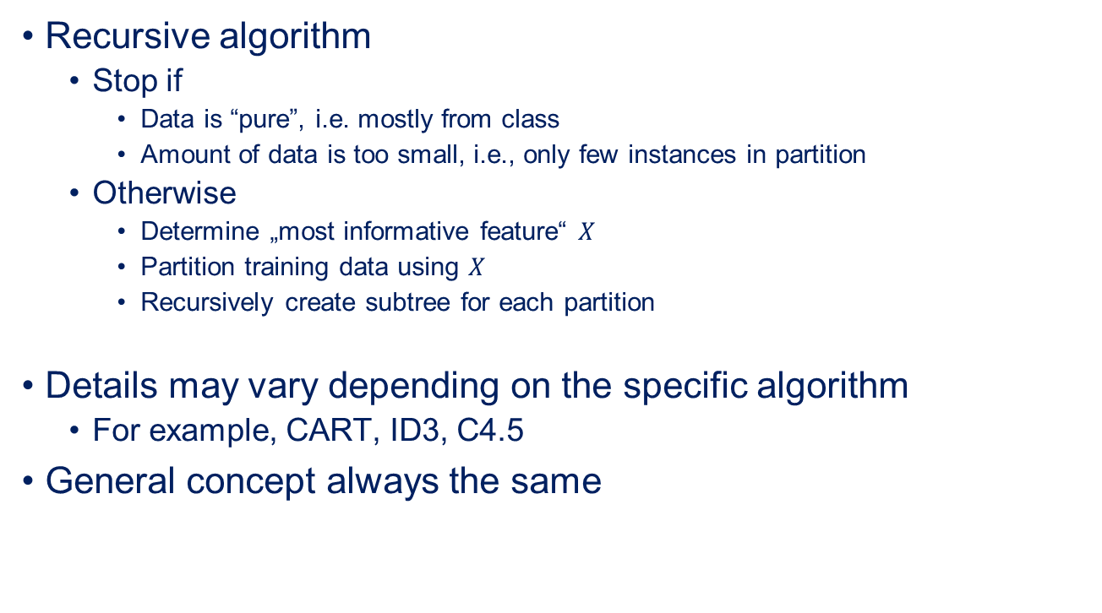
Basic Decision Tree Algorithm
Recursive algorithm
Stop if
Data is “pure”, i.e. mostly from class
Amount of data is too small, i.e., only few instances in partition
Otherwise
Determine „most informative feature“ $X$
Partition training data using $X$
Recursively create subtree for each partition
Details may vary depending on the specific algorithm
For example, CART, ID3, C4.5
General concept always the same

Slide 26
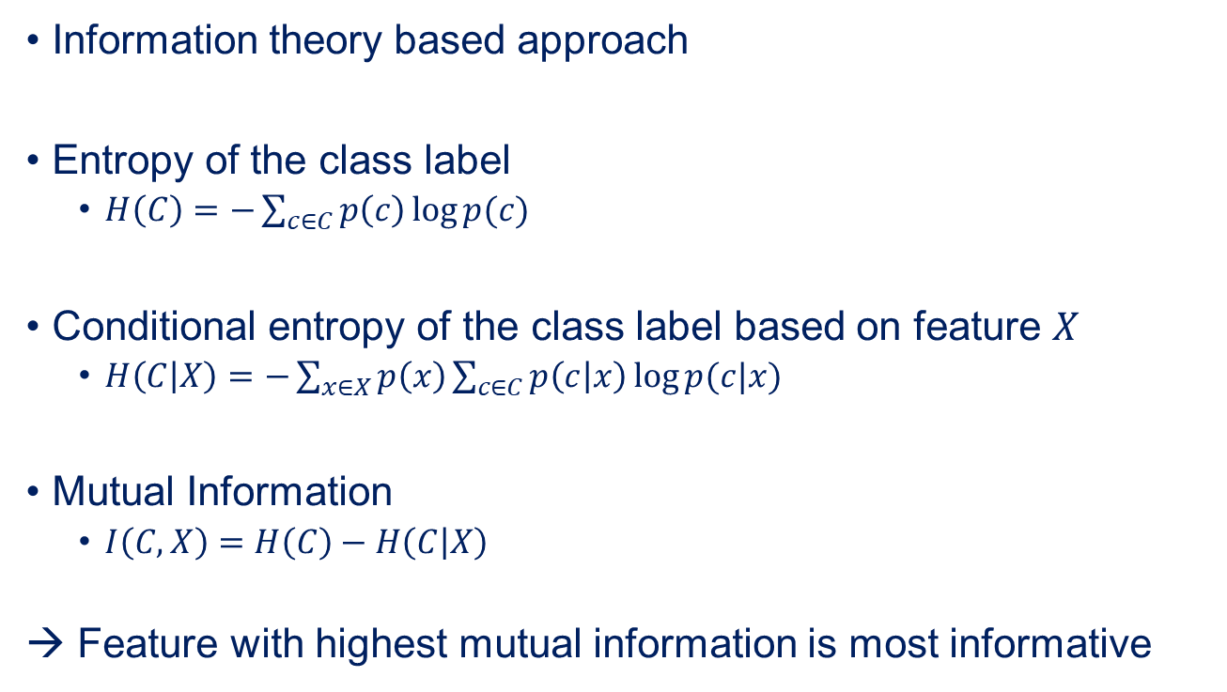
The „Most Informative Feature“
Information theory based approach
Entropy of the class label
$H\left(C\right)=−\sum_{c∈C}{p\left(c\right)\log{p(c)}}$
Conditional entropy of the class label based on feature $X$
$H\left(C | X\right)=−\sum_{x∈X}{p\left(x\right)\sum_{c∈C}{p\left(c | x\right)\log{p(c|x)}}}$
Mutual Information
$I\left(C, X\right)=H\left(C\right)−H\left(C | X\right)$
→ Feature with highest mutual information is most informative
Can be used as measure for purity
Interpret each dimension as random variable

Slide 27
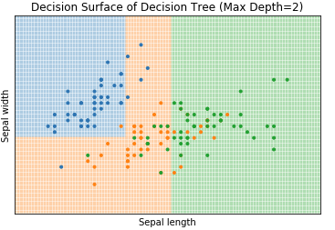
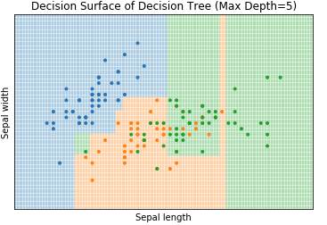
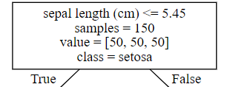
Decision Surface of Decision Trees
All decisions are axis-aligned
Overfitting

Slide 28
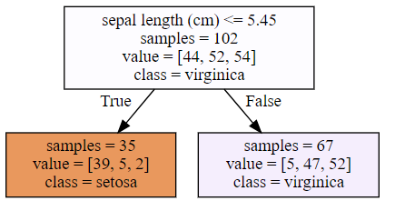
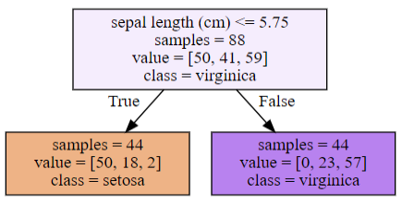
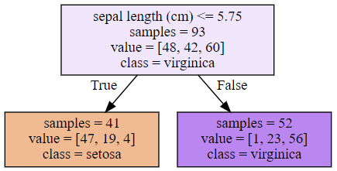
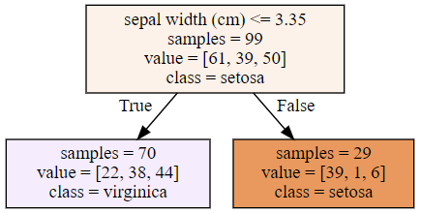
Random Forest
Randomized attributes
Basic Idea
Ensemble of randomized decision trees
Randomized subset
Classification as majority vote of random trees

Slide 29
Bagging as Ensemble Learner
Bagging is short for bootstrap aggregating
Randomly draw subsamples of training data
Build model for each subsample → ensemble of models
Voting to create class
Can be weighted, e.g., using quality of ensemble models
Random Forests combine Bagging with
Short decision trees, i.e., low depth
Allowing only a random subset of features for each decision

Slide 30
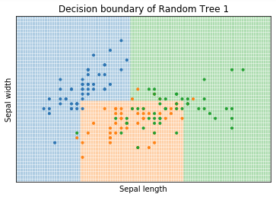
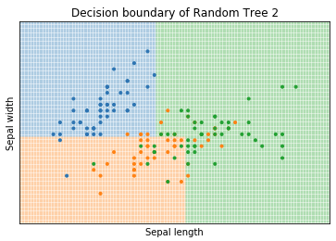
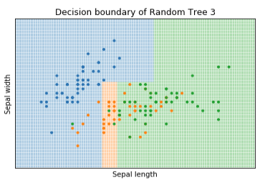
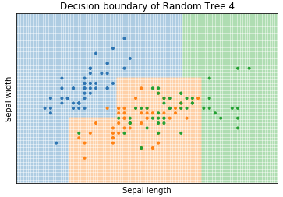
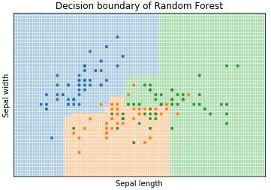
Decision Surface of Random Forests

Slide 31
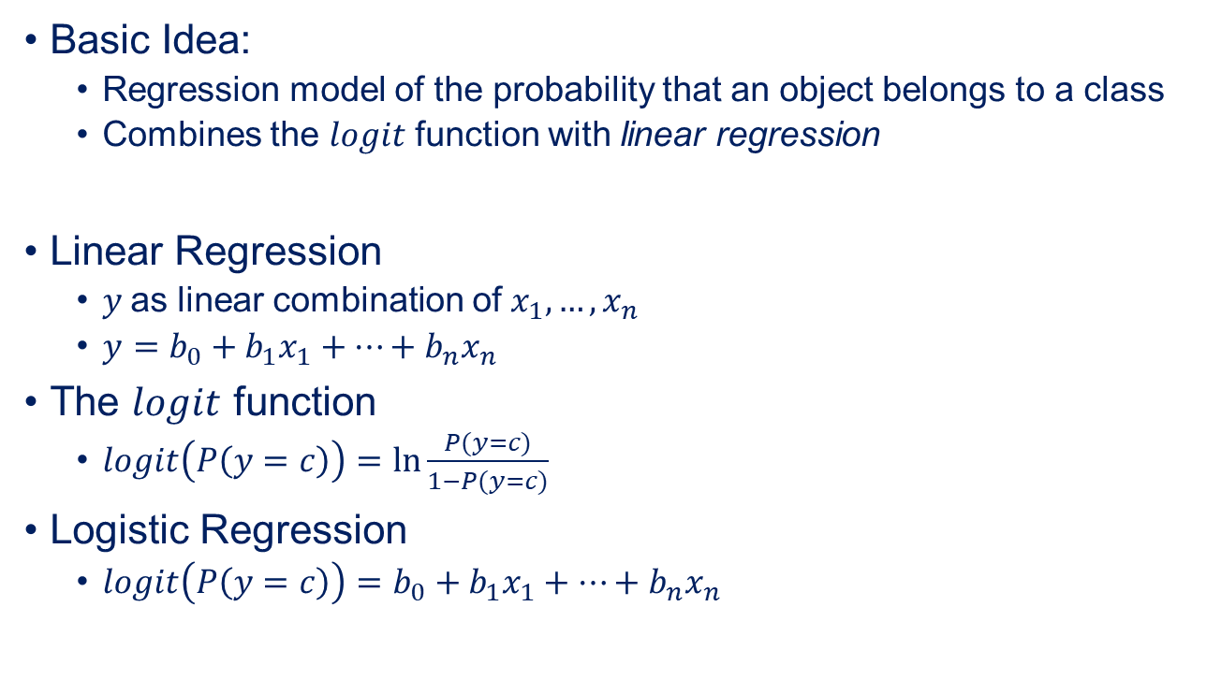
Logistic Regression
Basic Idea:
Regression model of the probability that an object belongs to a class
Combines the $logit$ function with linear regression
Linear Regression
$y$as linear combination of $x_{1},…, x_{n}$
$y=b_{0}+b_{1}x_{1}+…+b_{n}x_{n}$
The $logit$ function
$logit\left(P\left(y=c\right)\right)=\ln{\frac{P(y=c)}{1−P(y=c)}}$
Logistic Regression
$logit\left(P\left(y=c\right)\right)=b_{0}+b_{1}x_{1}+…+b_{n}x_{n}$

Slide 32
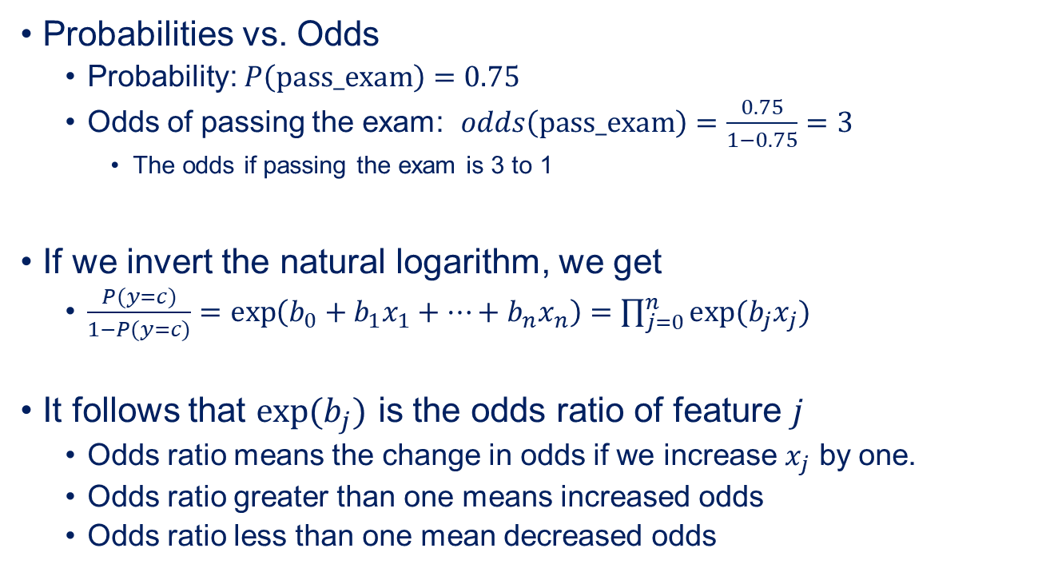
Odds Ratios
Probabilities vs. Odds
Probability: $P\left(\text{pass}\text{_}\text{exam}\right)=0.75$
Odds of passing the exam: $odds\left(\text{pass}\text{_}\text{exam}\right)=\frac{0.75}{1−0.75}=3$
The odds if passing the exam is 3 to 1
If we invert the natural logarithm, we get
$\frac{P(y=c)}{1−P(y=c)}=\exp\left(b_{0}+b_{1}x_{1}+…+b_{n}x_{n}\right)=\prod_{j=0}^{n}{exp⁡(b_{j}x_{j})}$
It follows that $exp⁡(b_{j})$ is the odds ratio of feature $j$
Odds ratio means the change in odds if we increase $x_{j}$ by one.
Odds ratio greater than one means increased odds
Odds ratio less than one mean decreased odds
Definition of odds

Slide 33
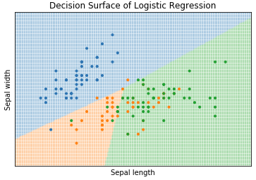
Decision Surface of Logistic Regression
Decision boundaries are linear

Slide 34
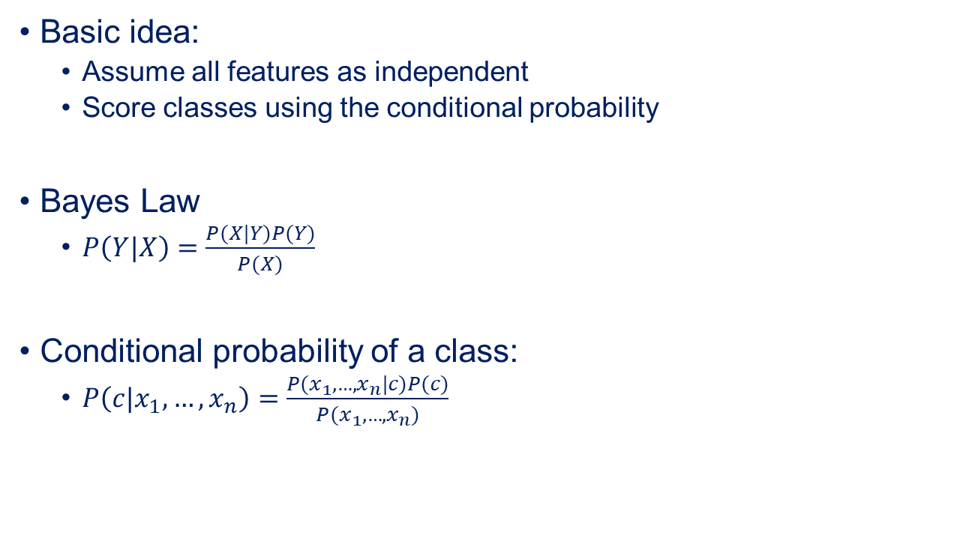
Naive Bayes
Basic idea:
Assume all features as independent
Score classes using the conditional probability
Bayes Law
$P\left(Y|X\right)=\frac{P(X|Y)P(Y)}{P(X)}$
Conditional probability of a class:
$P\left(c|x_{1},…, x_{n}\right)=\frac{P(x_{1},…, x_{n}|c)P(c)}{P(x_{1},…, x_{n})}$

Slide 35
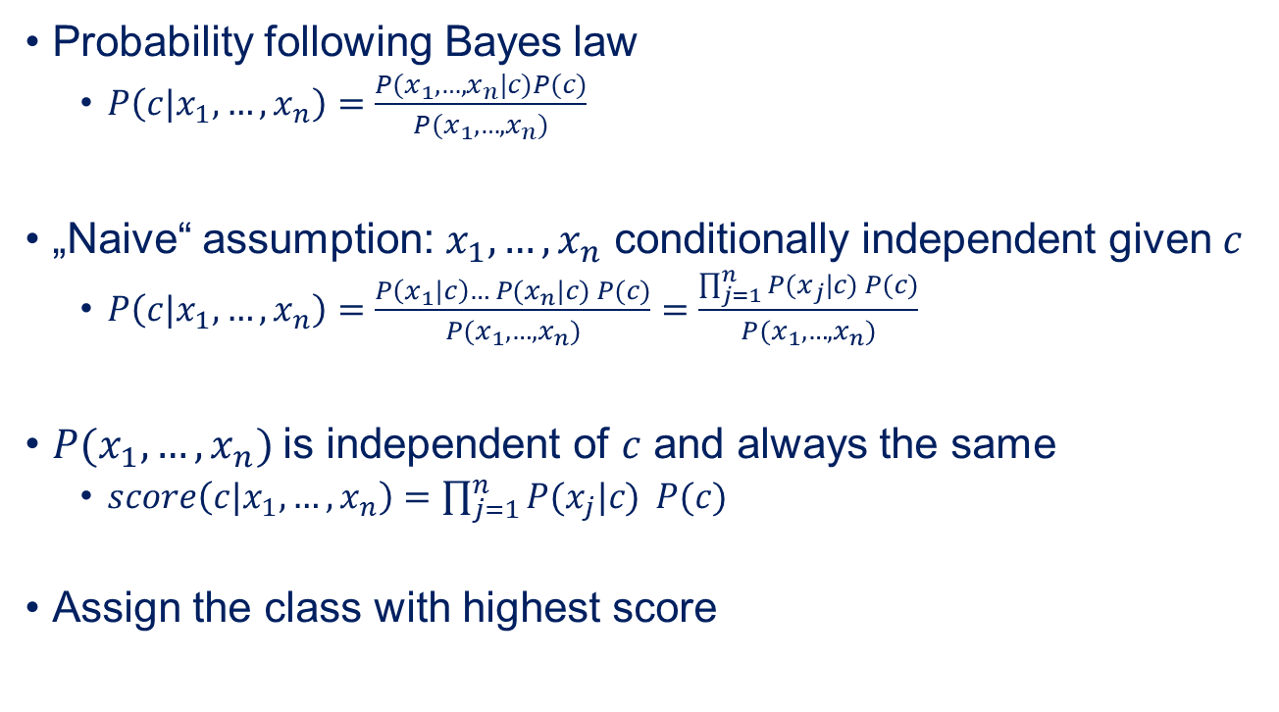
From Bayes Law to Naive Bayes
Probability following Bayes law
$P\left(c|x_{1},…, x_{n}\right)=\frac{P(x_{1},…, x_{n}|c)P(c)}{P(x_{1},…, x_{n})}$
„Naive“ assumption: $x_{1},…, x_{n}$ conditionally independent given $c$
$P\left(c|x_{1},…, x_{n}\right)=\frac{P\left(x_{1}|c\right)… P(x_{n}|c) P(c)}{P(x_{1},…, x_{n})}=\frac{\prod_{j=1}^{n}{P(x_{j}|c)} P(c)}{P(x_{1},…, x_{n})}$
$P(x_{1},…, x_{n})$is independent of $c$ and always the same
$score\left(c|x_{1},…, x_{n}\right)=\prod_{j=1}^{n}{P(x_{j}|c)} P(c)$
Assign the class with highest score

Slide 36
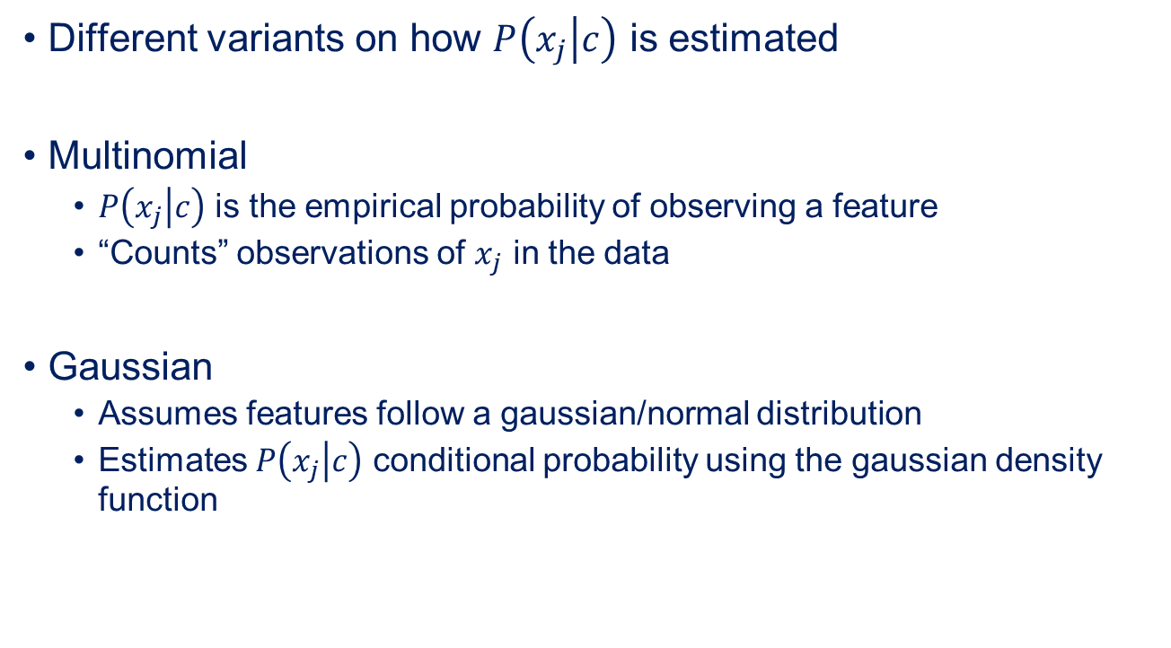
Multinomial and Gaussian Naive Bayes
Different variants on how $P\left(x_{j} | c\right)$ is estimated
Multinomial
$P\left(x_{j} | c\right)$ is the empirical probability of observing a feature
“Counts” observations of $x_{j}$ in the data
Gaussian
Assumes features follow a gaussian/normal distribution
Estimates $P\left(x_{j} | c\right)$ conditional probability using the gaussian density function

Slide 37
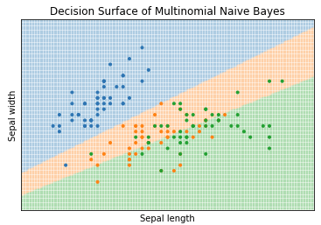
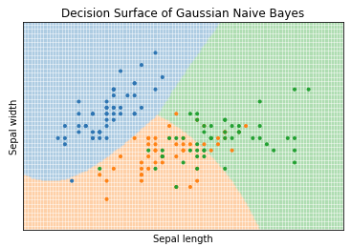
Decision Surface of Naive Bayes
Multinomial has linear decision boundaries
Gaussian has piecewise quadratic decision boundaries

Slide 38
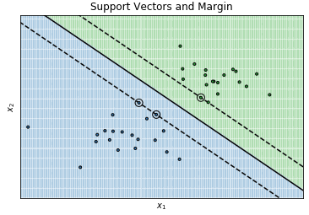
Support Vector Machines (SVM)
Basic Idea:
Calculate decision boundary such that it is “far away” from data
Linear decision boundary
Support vectors
= Instances with minimal distance to decision bounday
Margin
Margin is maximized

Slide 39
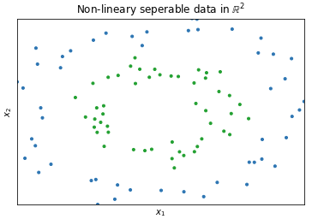
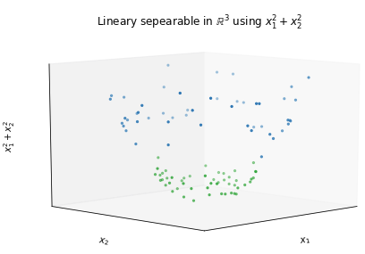
Non-linear SVMs through Kernels
Expand features using kernels to separate non-linear data
Transformation into high-dimensional kernel space
Can be infinite (e.g., Gaussian kernel, RBF kernel) !
Calculate linear separation in kernel space
Use kernel trick to avoid actual expansion
Quadractic kernel

Slide 40



Decision Surface of SVMs
Shape of decision surface depends on kernel

Slide 41
Neural Networks
Basic Idea:
Network of neurons with different layers and communication between neurons
Input layer feeds data into the network
Hidden layers “correlate” data
Output layer gives computation results
Input Layer
Output Layer
Two hidden layers

Slide 42

Multilayer Perceptron (MLP)
First weighted sum of inputs
Then activation function, e.g, $sigmoid\text{/}tanh$
Each feature gets an input neuron
Single output neuron with the classification
Multiple fully connected hidden layers

Slide 43

Decision Surface of MLP
Shape of decision boundary depends on
Activation function
Number of hidden layers
Number of neurons in the hidden layers

Slide 44
Outline
Overview
Classification Models
Comparison of Classification Models
Summary

Slide 45

General Approach
Different approaches behind all covered classifiers
$k$-nearest Neighbor → Instance based
Decision Trees → Rule based + information theory
Random Forests → Randomized ensemble
Logistic Regression → Regression
Naive Bayes → Conditional probability
Support Vector Machines → Margin maximization + kernels
Neural Networks → (Very complex) Regression

Slide 46

Comparison of Decision Surfaces IRIS Data
Results may vary with hyper parameter tuning

Slide 47

Comparison of Decision Surfaces Non-linear separable
Results may vary with hyper parameter tuning

Slide 48

Comparison of Decision Surfaces Circles within circles
Results may vary with hyper parameter tuning

Slide 49


Comparison of Execution Times
Times taken using GWDG Jupyter Hub and scikit-learn implementations of the algorithms.
Data randomly generated with using scikit-learn.datasets.make_moons (July 2018)

Slide 50
Strengths and Weaknesses
 | Explanatory value | Consise representation | Scoring | Categorical features | Missing features | Correlated features
𝑘-nearest Neighbor | o | - | - | - | + | -
Decision Tree | + | + | + | + | o | +
Random Forest | - | o | + | + | o | +
Logistic Regression | + | + | + | o | - | o
Naive Bayes | o | o | + | + | - | -
SVM | - | o | - | o | - | -
Neural Network | - | o | + | o | - | +

Slide 51
Outline
Overview
Classification Models
Comparison of Classification Models
Summary

Slide 52
Summary
Classification is the task of assigning labels to objects
Many evaluation criteria
Confusion matrix commonly used
Lots of classification algorithms
Rule based, instance based, ensembles, regressions, …
Different algorithms may be best in different situations

