Slide 1
Chapter 09 Time Series Analysis
Dr. Steffen Herbold
herbold@cs.uni-goettingen.de

Slide 2
Outline
Overview
Methods for Time Series Analysis
Summary

Slide 3



Example of Time Series Analysis
420 in January
431 in February
Our sales in the next two months will be …
415 in March
…
Time Series Analysis
509 in July
Data over time
Sales
Passengers
Traffic
…
…

Slide 4
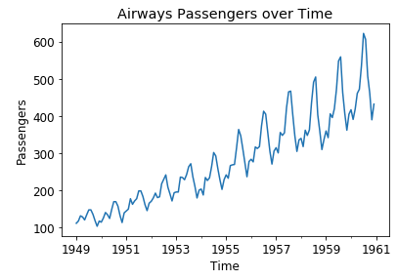
The General Problem
Data over time
Value at time point 1
Value at time point 2
Value at time point 3
Value at time point 4
Value at time point 5
Value at time point 6
Value at time point 7
Value at time point 8
Value at time point 9
…
Time Series Analysis

Slide 5
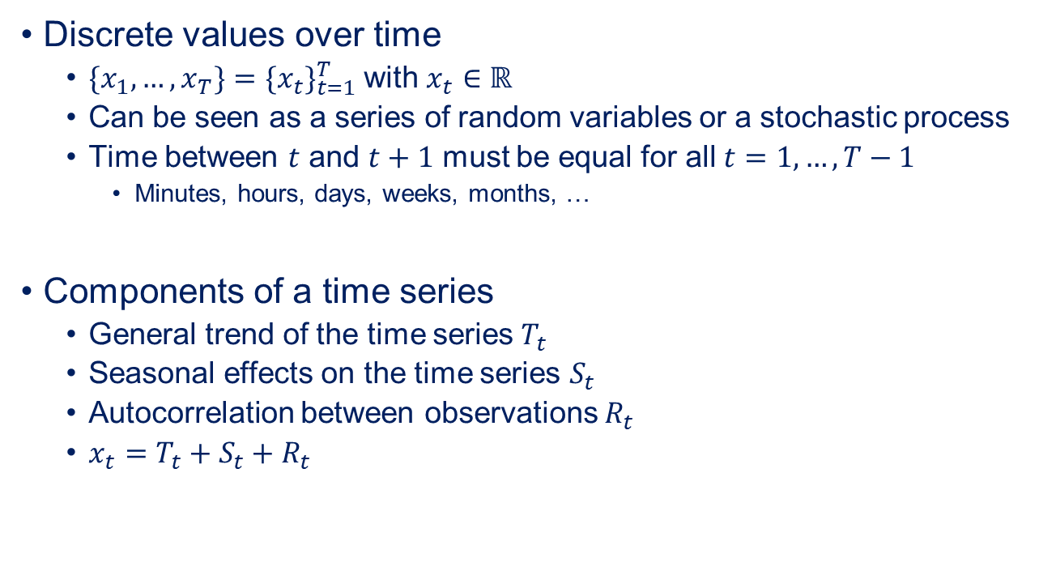
The Formal Problem
Discrete values over time
${{\{x}_{1}, …, x_{T}\}=\{x_{t}\}}_{t=1}^{T}$ with $x_{t}∈ℝ$
Can be seen as a series of random variables or a stochastic process
Time between $t$ and $t+1$ must be equal for all $t=1, …, T−1$
Minutes, hours, days, weeks, months, …
Components of a time series
General trend of the time series$T_{t}$
Seasonal effects on the time series $S_{t}$
Autocorrelation between observations $R_{t}$
$x_{t}=T_{t}+S_{t}+R_{t}$

Slide 6
Outline
Overview
Methods for Time Series Analysis
Summary

Slide 7
Time Series Analysis with Box-Jenkins
For stationary data
Stationary means constant mean value and variance
Requires de-trending and seasonal adjustment
Models autocorrelation as a stochastic process
Observations depend on past observation and a random component
Tries to model time series with only few parameters
Goal are simple models

Slide 8
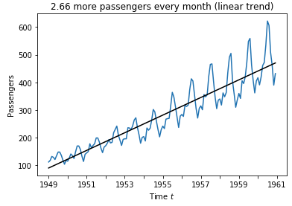
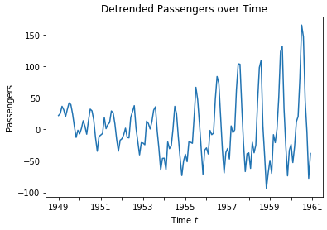
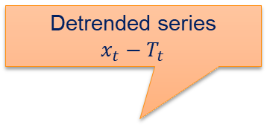
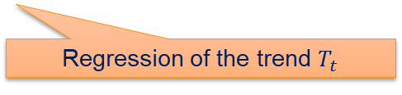
Detrending Through Regression
Detrended series
$$x_{t}−T_{t}$$
Non-linear regression for non-linear trends
Regression of the trend $T_{t}$

Slide 9
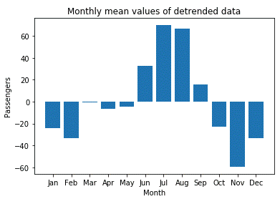
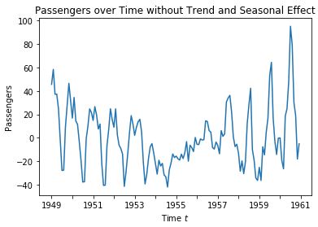
Seasonal Adjustment through the Mean
Seasonal effect:
A regularly repeating pattern
Monthly, weekly, …
Seasonal adjustment through the seasonal mean value

Slide 10
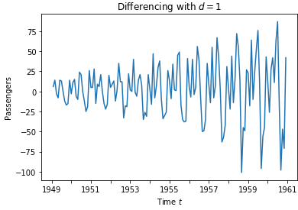
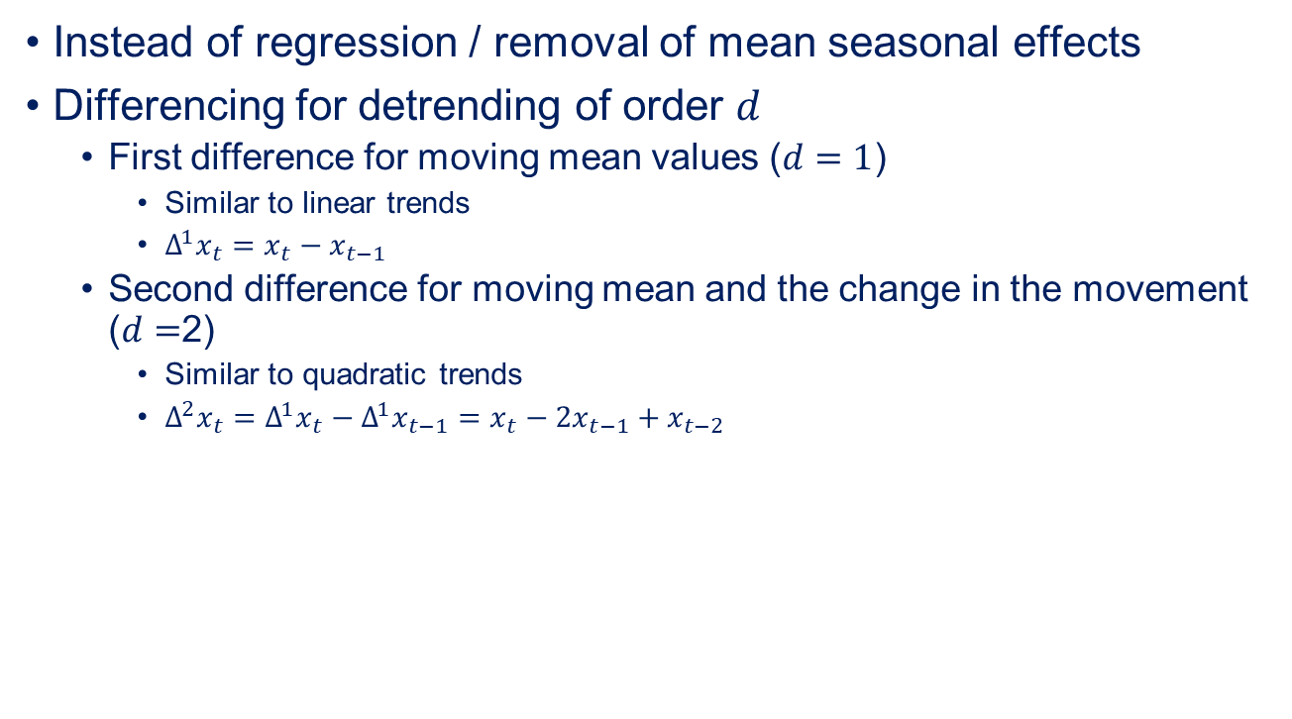
Differencing for Detrending
Instead of regression / removal of mean seasonal effects
Differencing for detrending of order $d$
First difference for moving mean values ($d=1$)
Similar to linear trends
$Δ^{1}x_{t}=x_{t}−x_{t−1}$
Second difference for moving mean and the change in the movement ($d=$2)
Similar to quadratic trends
$Δ^{2}x_{t}=Δ^{1}x_{t}−Δ^{1}x_{t−1}=x_{t}−2x_{t−1}+x_{t−2}$

Slide 11
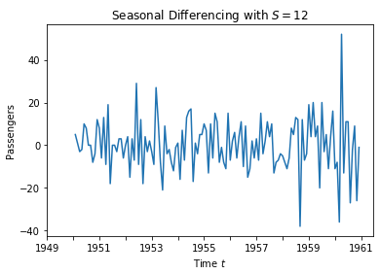

Differencing for Seasonal Adjustment
Seasonal differencing for seasons of periodicity $S$
$Δ_{S}^{}x_{t}=x_{t}−x_{t−S}$
$Δ_{12}^{}x_{t}=x_{t}−x_{t−12}$ would be seasonal differencing for monthly data

Slide 12
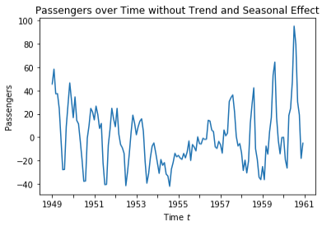


Comparison of Adjustments

Slide 13
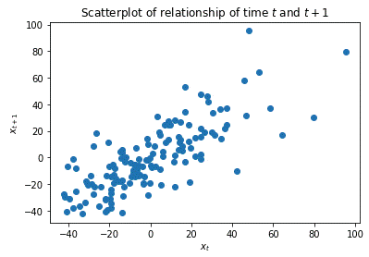
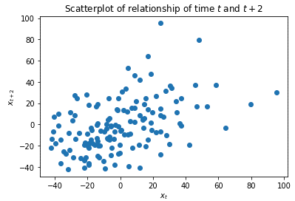
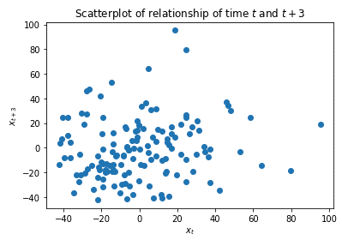
Autocorrelation
Relationship between time series values with other time series values
Fairly linear relationship
Spread increasing
More or less random

Slide 14
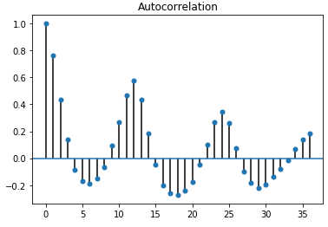
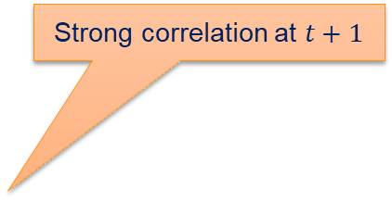
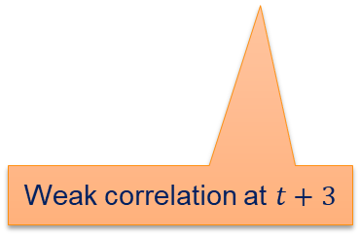
Autocorrelation over Time
Strong correlation at $t+1$
Some seasonal effect remaining, weakening every year
Weak correlation at $t+3$

Slide 15
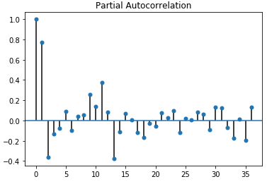

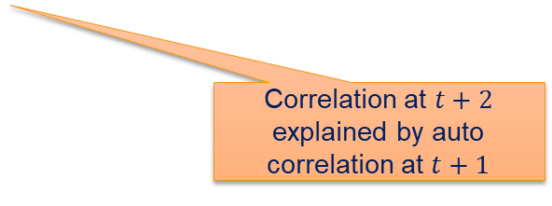
Partial Autocorrelation
Autocorrelation that is not explained by „carrying over“
$x_{t}$ and $x_{t+1}$ are correlated
$x_{t+1}$ and${ x}_{t+2}$ are correlated
How much of the correlation between $x_{t}$ and $x_{t+2}$ is not explained by the above correlations?
In other words, how much of the correlation between $x_{t}$ and $x_{t+2}$ is independent of the correlation between $x_{t}$ / $x_{t+1}$ and $x_{t+1}$ /${ x}_{t+2}$?
Correlation at $t+2$ explained by auto correlation at $t+1$

Slide 16
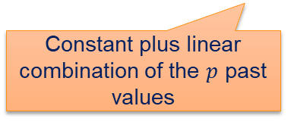

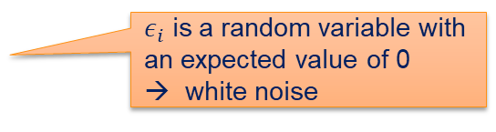
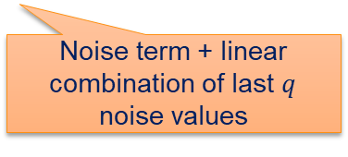
ARMA Time Series Models
Requires detrended and seasonally adjusted data
Model for the autocorrelation part $R_{T}$ of a time series
$x_{t}=a_{0}+\sum_{i=1}^{p}{a_{i}x_{t−i}}+ε_{t}+\sum_{j=1}^{q}{b_{j}ε_{t−j}}$
$ε_{i}$ is a random variable with an expected value of 0
→ white noise
Autoregressive (AR)
Moving Average (MA)
Constant plus linear combination of the $p$ past values
Noise term + linear combination of last $q$ noise values

Slide 17


Picking $p$ and $q$
Analyze (partial) autocorrelation function
$p=1$ would model everything except the missing seasonal effect
$p=13$ would capture missing seasonal effect at the cost of a more complex model
$q=0$ or $q=1$ to account for low random fluctuations

Slide 18
Outline
Overview
Methods for Time Series Analysis
Summary

Slide 19
Summary
Time series analysis considers data over time
Equal intervals
More than just regression
Seasonal effects
Autocorrelation
Complex topic with many options for modelling
Trend detection
Seasonal adjustment
Autocorrelation modelling
Completely different approaches, e.g., based on neural networks

