Slide 1
Chapter 10 Text Mining
Dr. Steffen Herbold
herbold@cs.uni-goettingen.de

Slide 2
Outline
Overview
Challenges for Text Mining
Summary

Slide 3


Example for Textual Data
Oct 4, 2018 08:03:25 PM Beautiful evening in Rochester, Minnesota. VOTE, VOTE, VOTE! https://t.co/SyxrxvTpZE [Twitter for iPhone]
Oct 4, 2018 07:52:20 PM Thank you Minnesota - I love you! https://t.co/eQC2NqdIil [Twitter for iPhone]
Oct 4, 2018 05:58:21 PM Just made my second stop in Minnesota for a MAKE AMERICA GREAT AGAIN rally. We need to elect @KarinHousley to the U.S. Senate, and we need the strong leadership of @TomEmmer, @Jason2CD, @JimHagedornMN and @PeteStauber in the U.S. House! [Twitter for iPhone]
Oct 4, 2018 05:17:48 PM Congressman Bishop is doing a GREAT job! He helped pass tax reform which lowered taxes for EVERYONE! Nancy Pelosi is spending hundreds of thousands of dollars on his opponent because they both support a liberal agenda of higher taxes and wasteful spending! [Twitter for iPhone]
Oct 4, 2018 02:29:27 PM “U.S. Stocks Widen Global Lead” https://t.co/Snhv08ulcO [Twitter for iPhone]
Oct 4, 2018 02:17:28 PM Statement on National Strategy for Counterterrorism: https://t.co/ajFBg9Elsj https://t.co/Qr56ycjMAV [Twitter for iPhone]
Oct 4, 2018 12:38:08 PM Working hard, thank you! https://t.co/6HQVaEXH0I [Twitter for iPhone]
Oct 4, 2018 09:17:01 AM This is now the 7th. time the FBI has investigated Judge Kavanaugh. If we made it 100, it would still not be good enough for the Obstructionist Democrats. [Twitter for iPhone]
Oct 4, 2018 09:01:13 AM RT @ChatByCC: While armed with the power of our Vote, we proudly & peacefully revolted Never doubt this was an American revolution #MAGA… [Twitter for iPhone]
Oct 4, 2018 08:54:58 AM This is a very important time in our country. Due Process, Fairness and Common Sense are now on trial! [Twitter for iPhone]
Oct 4, 2018 08:34:16 AM Our country’s great First Lady, Melania, is doing really well in Africa. The people love her, and she loves them! It is a beautiful thing to see. [Twitter for iPhone]
Oct 4, 2018 07:16:41 AM The harsh and unfair treatment of Judge Brett Kavanaugh is having an incredible upward impact on voters. The PEOPLE get it far better than the politicians. Most importantly, this great life cannot be ruined by mean & despicable Democrats and totally uncorroborated allegations! [Twitter for iPhone]
How do you analyze this?

Slide 4
Text Mining in General
Inferring information from textual data
Techniques for text mining as diverse as the texts themselves!
The following demonstrates a relatively standard workflow for processing text data
Create corpus
Pre-process contents
Define bag-of-words

Slide 5
Documents and Corpus
Create documents to create a corpus
Each tweet a document
Oct 4, 2018 08:03:25 PM Beautiful evening in Rochester, Minnesota. VOTE, VOTE, VOTE! https://t.co/SyxrxvTpZE [Twitter for iPhone]
Oct 4, 2018 07:52:20 PM Thank you Minnesota - I love you! https://t.co/eQC2NqdIil [Twitter for iPhone]
Oct 4, 2018 05:58:21 PM Just made my second stop in Minnesota for a MAKE AMERICA GREAT AGAIN rally. We need to elect @KarinHousley to the U.S. Senate, and we need the strong leadership of @TomEmmer, @Jason2CD, @JimHagedornMN and @PeteStauber in the U.S. House! [Twitter for iPhone]
Oct 4, 2018 05:17:48 PM Congressman Bishop is doing a GREAT job! He helped pass tax reform which lowered taxes for EVERYONE! Nancy Pelosi is spending hundreds of thousands of dollars on his opponent because they both support a liberal agenda of higher taxes and wasteful spending! [Twitter for iPhone]
Oct 4, 2018 02:29:27 PM “U.S. Stocks Widen Global Lead” https://t.co/Snhv08ulcO [Twitter for iPhone]
Oct 4, 2018 02:17:28 PM Statement on National Strategy for Counterterrorism: https://t.co/ajFBg9Elsj https://t.co/Qr56ycjMAV [Twitter for iPhone]
Oct 4, 2018 12:38:08 PM Working hard, thank you! https://t.co/6HQVaEXH0I [Twitter for iPhone]
Oct 4, 2018 09:17:01 AM This is now the 7th. time the FBI has investigated Judge Kavanaugh. If we made it 100, it would still not be good enough for the Obstructionist Democrats. [Twitter for iPhone]
All tweets together the corpus

Slide 6
Unstructured Data → Structured Data
Identify relevant content
→ Remove irrelevant content
Drop shortened links
Drop device
Oct 4, 2018 08:03:25 PM Beautiful evening in Rochester, Minnesota. VOTE, VOTE, VOTE! https://t.co/SyxrxvTpZE [Twitter for iPhone]
Oct 4, 2018 07:52:20 PM Thank you Minnesota - I love you! https://t.co/eQC2NqdIil [Twitter for iPhone]
Oct 4, 2018 05:58:21 PM Just made my second stop in Minnesota for a MAKE AMERICA GREAT AGAIN rally. We need to elect @KarinHousley to the U.S. Senate, and we need the strong leadership of @TomEmmer, @Jason2CD, @JimHagedornMN and @PeteStauber in the U.S. House! [Twitter for iPhone]
Oct 4, 2018 05:17:48 PM Congressman Bishop is doing a GREAT job! He helped pass tax reform which lowered taxes for EVERYONE! Nancy Pelosi is spending hundreds of thousands of dollars on his opponent because they both support a liberal agenda of higher taxes and wasteful spending! [Twitter for iPhone]
Oct 4, 2018 02:29:27 PM “U.S. Stocks Widen Global Lead” https://t.co/Snhv08ulcO [Twitter for iPhone]
Oct 4, 2018 02:17:28 PM Statement on National Strategy for Counterterrorism: https://t.co/ajFBg9Elsj https://t.co/Qr56ycjMAV [Twitter for iPhone]
Oct 4, 2018 12:38:08 PM Working hard, thank you! https://t.co/6HQVaEXH0I [Twitter for iPhone]
Oct 4, 2018 09:17:01 AM This is now the 7th. time the FBI has investigated Judge Kavanaugh. If we made it 100, it would still not be good enough for the Obstructionist Democrats. [Twitter for iPhone]
Drop timestamp

Slide 7
Punctuation and cases
Usually do not carry information
→ Can be removed
beautiful evening in rochester minnesota vote vote vote
thank you minnesota i love you
just made my second stop in minnesota for a make america great again rally we need to elect karinhousley to the us senate and we need the strong leadership of tomemmer jason2cd jimhagedornmn and petestauber in the us house
congressman bishop is doing a great job he helped pass tax reform which lowered taxes for everyone nancy pelosi is spending hundreds of thousands of dollars on his opponent because they both support a liberal agenda of higher taxes and wasteful spending
us stocks widen global lead
statement on national strategy for counterterrorism
working hard thank you
this is now the 7th time the fbi has investigated judge kavanaugh if we made it 100 it would still not be good enough for the obstructionist democrats

Slide 8
Stop words
Most common words in a language (a, the, I, we, to, too, …)
→ Can be removed
beautiful evening rochester minnesota vote vote vote
thank minnesota love
just made second stop minnesota make america great again rally need elect karinhousley senate need strong leadership tomemmer jason2cd jimhagedornmn petestauber house
congressman bishop doing great job helped pass tax reform lowered taxes everyone nancy pelosi spending hundreds thousands dollars opponent both support liberal agenda higher taxes wasteful spending
stocks widen global lead
statement national strategy counterterrorism
working hard thank
now 7th time fbi investigated judge kavanaugh made 100 would still good enough obstructionist democrats

Slide 9
Stemming and Lemmatization
Stemming: reduce terms to common stem (spending → spend)
Lemmatization: use common term for synonyms (better → good)
beautiful evening rochester minnesota vote vote vote
thank minnesota love
just make second stop minnesota make america great again rally need elect karinhousley senate need strong leadership tomemmer jason2cd jimhagedornmn petestauber house
congressman bishop do good job help pass tax reform lower tax everyone nancy pelosi spend hundred thousand dollar opponent both support liberal agenda high tax waste spend
stock wide global lead
statement national strategy counterterrorism
work hard thank
now 7th time fbi investigate judge kavanaugh make 100 would still good enough obstruct democrat

Slide 10
Bag-of-Words
Every term one dimension
beauti-ful | evening | roches-ter | minne-sota | vote | thank | love | just | make | second | stop | amer-ica | great | …
1 | 1 | 1 | 1 | 3 | 0 | 0 | 0 | 0 | 0 | 0 | 0 | 0 | …
0 | 0 | 0 | 1 | 0 | 1 | 1 | 0 | 0 | 0 | 0 | 0 | 0 | …
0 | 0 | 0 | 1 | 0 | 0 | 0 | 0 | 2 | 1 | 1 | 1 | 1 | …
0 | 0 | 0 | 0 | 0 | 0 | 0 | 0 | 0 | 0 | 0 | 0 | 0 | …
0 | 0 | 0 | 0 | 0 | 0 | 0 | 0 | 0 | 0 | 0 | 0 | 0 | …
0 | 0 | 0 | 0 | 0 | 1 | 0 | 0 | 0 | 0 | 0 | 0 | 0 | …
0 | 0 | 0 | 0 | 0 | 0 | 0 | 0 | 1 | 0 | 0 | 0 | 0 | …
… | … | … | … | … | … | … | … | … | … | … | … | … | …
Number of occurences in document

Slide 11
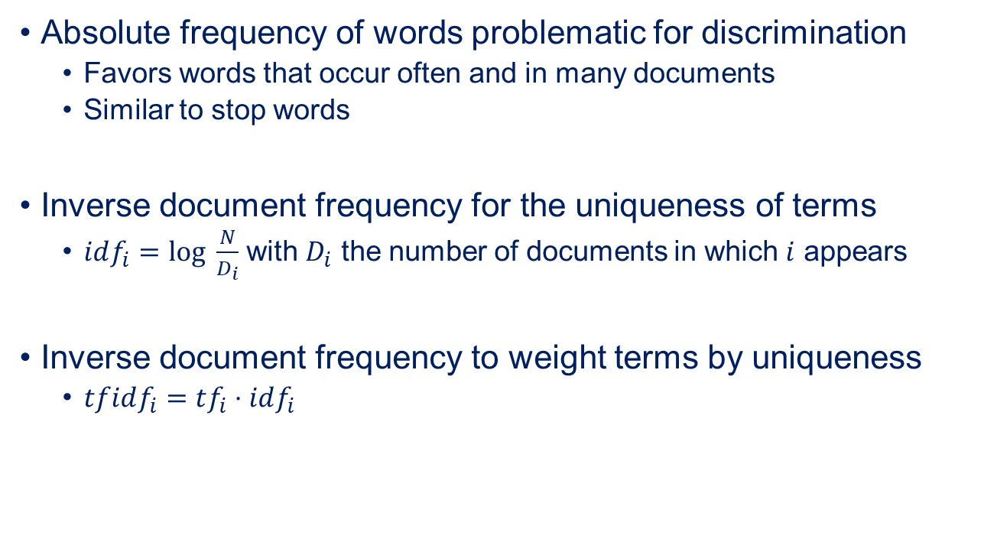
Inverse Document Frequency
Absolute frequency of words problematic for discrimination
Favors words that occur often and in many documents
Similar to stop words
Inverse document frequency for the uniqueness of terms
$idf_{i}=log \frac{N}{D_{i}}$ with $D_{i}$ the number of documents in which $i$ appears
Inverse document frequency to weight terms by uniqueness
$tfidf_{i}=tf_{i}⋅idf_{i}$

Slide 12
Downstream Analysis
Bag of words base structure
Allows many approaches for analysis
Classification
Usually requires manual labeling of data
Clustering
Sentiment analysis
Based on word counts
Information retrieval
Identification of related documents
Visualizations

Slide 13
Outline
Overview
Challenges for Text Mining
Summary

Slide 14
High Dimensional Data
Bag of words gets high dimensional extremely fast
Still over sixty different words after stemming/lemmatization in the tweet example
Can also have a huge amount of documents
>39000 tweets by donald trump in total
High dimension+many documents → very high runtime
Requires
Very efficient algorithms
Often only possible through massive parallelization
Naive Bayes is a popular choice

Slide 15
Ambiguities
Homonyms
break (take a break, break something)
Will all be grouped together by a bag of words
Semantic changes in interpretation of the same sentences
I hit the man with a stick. (Used a stick to hit the man)
I hit the man with a stick (I hit the man who was holding a stick)
Can often only be inferred from a greater context
→ Often impossible to resolve and leads to noise in the analysis

Slide 16
Capturing Syntax
Bag of words ignores syntax
Nine sentences with different meanings and the same words
Only he told his mistress that he loved her. (Nobody else did)
He only told his mistress that he loved her. (He didn't show her)
He told only his mistress that he loved her. (Kept it a secret from everyone else)
He told his only mistress that he loved her. (Stresses that he had only ONE!)
He told his mistress only that he loved her. (Didn't tell her anything else)
He told his mistress that only he loved her. ("I'm all you got, nobody else wants you.")
He told his mistress that he only loved her. (Not that he wanted to marry her.)
He told his mistress that he loved only her. (Yeah, don't they all...).
He told his mistress that he loved her only. (Similar to above one).
Capturing word orders and other relationships greatly increases the dimension
E.g., n-grams
(bag of words over n-tuples)

Slide 17
And the list goes on
Bad spelling
Slang
Synonyms not captured by lemmatization
Encodings and special characters
…

Slide 18
Outline
Overview
Challenges for Text Mining
Summary

Slide 19
Summary
Text mining is the analysis of textual data
Requires imposing a structure upon the unstructured texts
Bag of words
There are some standard techniques
Removing punctuation, cases, stopwords
Stemming/Lemmatization
Often also removing numbers and special characters
→ Depends on context!
Many problems due to noise in the textual data

