Slide 1
Chapter 04 Data Analysis Overview
Dr. Steffen Herbold
herbold@cs.uni-goettingen.de

Slide 2
Outline
Overview
Foundational Concepts
Summary

Slide 3



No Free Lunch Theorem
$d_{m}^{y}$ ordered sets of size $m$ of cost values for $y∈Y$
$f:X→Y$ a function that is optimized
$P(d_{m}^{y}|f,m,a)$ the conditional probability of getting $d_{m}^{y}$ by $m$ times running algorithm $a$ on the function $f$
Theorem: For any pair of algorithms $a_{1}$ and $a_{2}$
$\sum_{f}{P\left(d_{m}^{y} | f,m,a_{1}\right)=\sum_{f}{P(d_{m}^{y}|f,m,a_{2})}}$
All algorithms are equal

Slide 4
Implication of the NFL Theorem
“if an algorithm does particularly well on average for one class of problems then it must do worse on average over the remaining problems”
David H. Wolpert and William G. Macready: No Free Lunch Theorems for Optimization, IEEE Transactions on Evolutionary Computation, 1(1):67-82

Slide 5

No Silver Bullet
There is no „one way“ to do data analysis
But there are some standard techniques that often perform well
Many factors influence the suitable techniques
Data
Problem to be solved
Available resources
…
→ Broad portfolio of data analysis techniques required

Slide 6
Categories of Data Analysis Techniques
Category | Techniques Covered | Problem to be solved
Association Rules | Apriori | Relationships between items
Clustering | K-Means Clustering DB Scan | Grouping of similar items Identification of structures
Classification | K-nearest Neighbor Decision Trees Random Forests Logistic Regression Naive Bayes Support Vector Machines Neural Networks | Assignment of labels to objects
Regression | Linear Regression Ridge Lasso | Relationship between outcome and inputs
Time Series Analysis | ARMA | Identification of temporal structures Forecasting of temporal processes
Text Mining | Bag-of-Words Stemming/Lemmatization TF-IDF | Analysis of textual data

Slide 7
Outline
Overview
Foundational Concepts
Summary

Slide 8
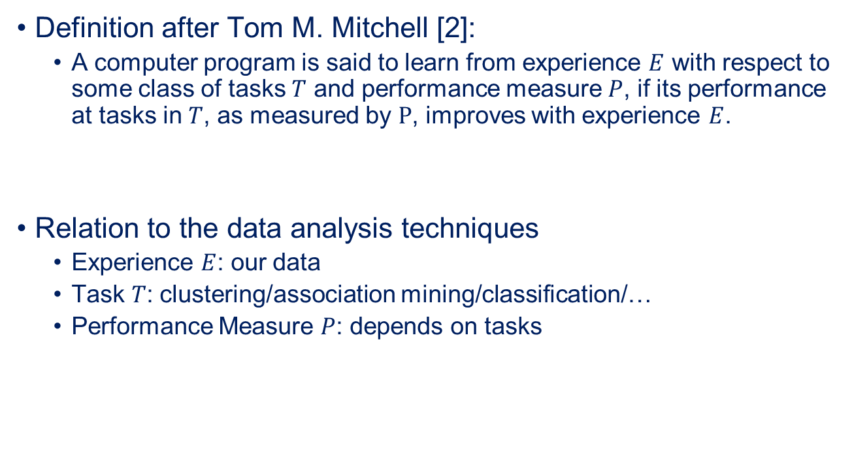
Machine Learning
Definition after Tom M. Mitchell [2]:
A computer program is said to learn from experience $E$ with respect to some class of tasks $T$ and performance measure $P$, if its performance at tasks in $T$, as measured by $P$, improves with experience $E$.
Relation to the data analysis techniques
Experience $E$: our data
Task $T$: clustering/association mining/classification/…
Performance Measure $P$: depends on tasks
T. M. Mitchel: Machine Learning, McGraw Hill, 1997

Slide 9

Description of a „Whale“ Picture
How would you describe this picture with general concepts?
Has a fin
Blue background
Oval body
Black top, white bottom

Slide 10
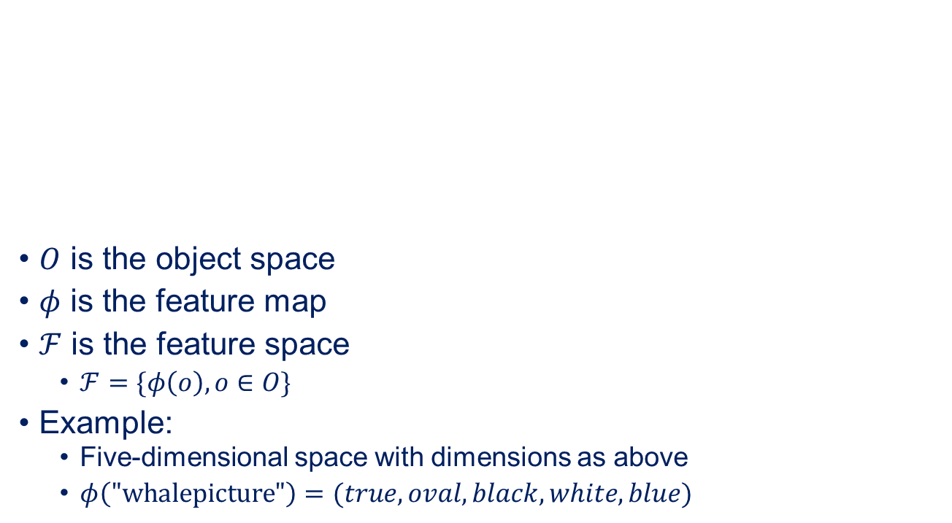
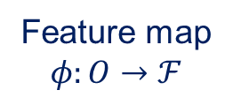
Features of Objects
Object
$O$ is the object space
$φ$ is the feature map
$ℱ$ is the feature space
$ℱ=\{φ\left(o\right), o∈O\}$
Example:
Five-dimensional space with dimensions as above
$φ\left("\text{whalepicture}\text{"}\right)=(true, oval, black, white, blue)$
Features
Feature map
$$φ:O→ℱ$$
hasFin
shape
colorTop
colorBottom
background
=
=
=
=
=
true
oval
black
white
blue

Slide 11
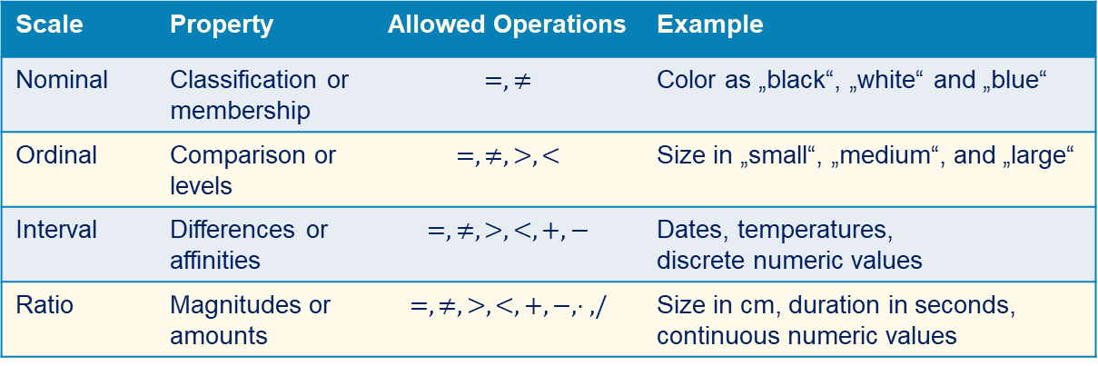
Scales of Features
Stevens‘ levels of measurement
Scale | Property | Allowed Operations | Example
Nominal | Classification or membership | $$=, ≠$$ | Color as „black“, „white“ and „blue“
Ordinal | Comparison or levels | $$=, ≠, >, <$$ | Size in „small“, „medium“, and „large“
Interval | Differences or affinities | $$=, ≠, >, <, +, −$$ | Dates, temperatures, discrete numeric values
Ratio | Magnitudes or amounts | $$=, ≠, >,<, +, −, ⋅ ,/$$ | Size in cm, duration in seconds, continuous numeric values
Categorical
S. S. Stevens: On the Theory of Scales of Measurement, Science, 103(2684):677-680

Slide 12
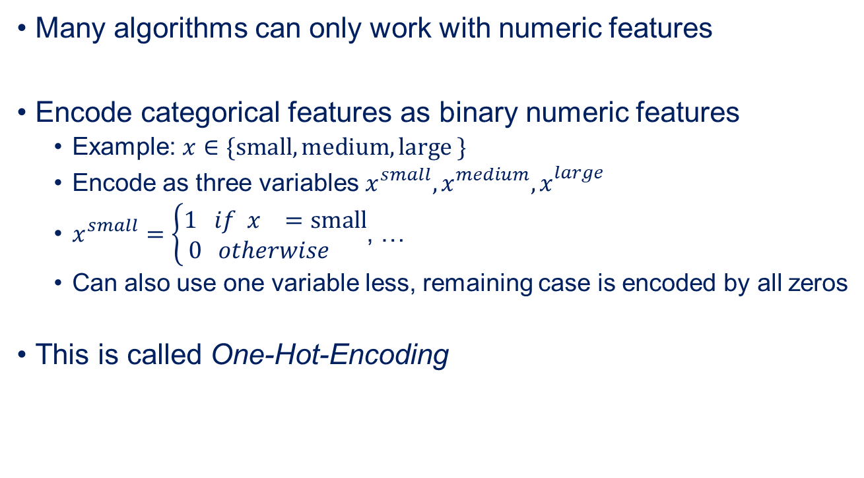
Encoding Categorical Features
Many algorithms can only work with numeric features
Encode categorical features as binary numeric features
Example: $x∈\{\text{small}, \text{medium}, \text{large} \}$
Encode as three variables $x_{}^{small}, x_{}^{medium}, x_{}^{large}$
$x_{}^{small}=\left\{\begin{aligned}1 if x_{}=\text{small} \\ 0 otherwise \end{aligned}\right.$, …
Can also use one variable less, remaining case is encoded by all zeros
This is called One-Hot-Encoding

Slide 13
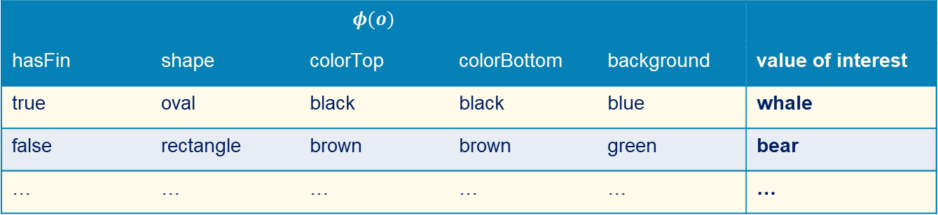
Training Data
Instances of objects described by their features
Supervised learning if the value of interest is known
→ Classification, regression
Otherwise unsupervised learning
→ Clustering, Association Rule Mining
$φ(o)$
hasFin | shape | colorTop | colorBottom | background | value of interest
true | oval | black | black | blue | whale
false | rectangle | brown | brown | green | bear
… | … | … | … | … | …

Slide 14

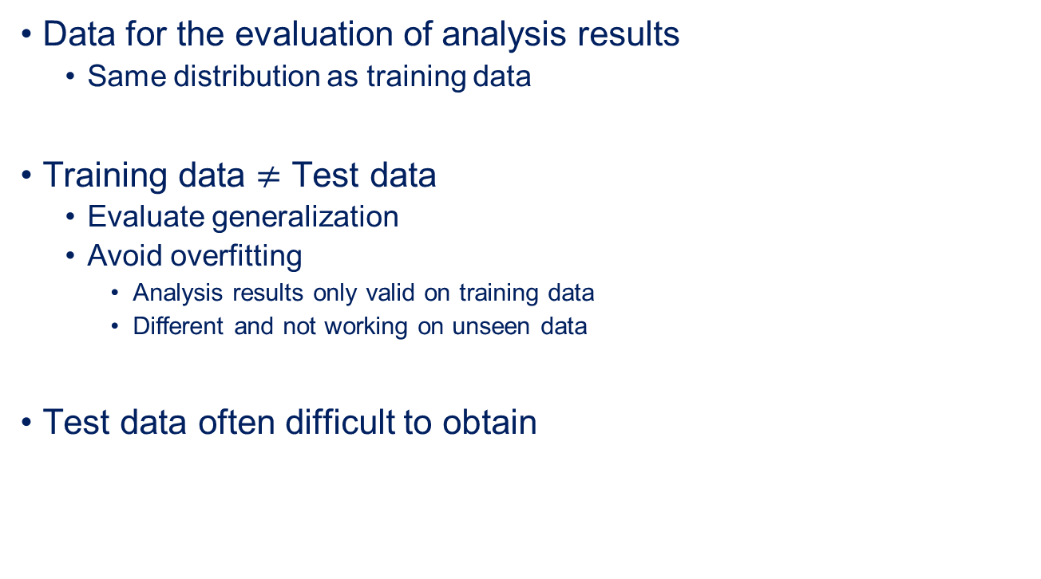
The Test Data
Data for the evaluation of analysis results
Same distribution as training data
Training data $≠$ Test data
Evaluate generalization
Avoid overfitting
Analysis results only valid on training data
Different and not working on unseen data
Test data often difficult to obtain
And where do I get the test data?

Slide 15
Hold-out Data
Data not used for training at all
Commonly used hold out data sizes
50% of all data
33% of all data
25% of all data in case a validation set is used
Example:
Nine months of customer transactions available
First six months as training data
Last three months as test data
Depends a lot on available data!

Slide 16


$k$-fold Cross Validation
Create $k$ partitions of available data
One partition for testing, all others for training
Estimate performance by averaging over the iterations
Test data
Training data
Iteration 1
Partition 1
Partition 2
Partition 3
Partition 4
Partition 5
Iteration 2
Partition 1
Partition 2
Partition 3
Partition 4
Partition 5
Iteration 3
Partition 1
Partition 2
Partition 3
Partition 4
Partition 5
Iteration 3
Partition 1
Partition 2
Partition 3
Partition 4
Partition 5
Iteration 5
Partition 1
Partition 2
Partition 3
Partition 4
Partition 5
Available data

Slide 17
Outline
Overview
Foundational Concepts
Summary

Slide 18
Summary
No generic algorithm for all problems
Objects are described by features
Features are used for learning about objects
Data usually split into different sets for different purposes

