Slide 1
Chapter 05 Association Rule Mining
Dr. Steffen Herbold
herbold@cs.uni-goettingen.de

Slide 2
Outline
Overview
The Apriori Algorithm
Summary

Slide 3



Example of Association Rules
Items already in basket
+
Available items
Item likely to be added

Slide 4


The General Problem
Set of Transactions
item1,item2,item3
item2,item4
item1,item5
item6,item7
item2,item3,item4,item7
item2,item3,item4,item8
item2,item4,item5
item2,item3,item4
item4,item5
…
Association Rules
item2 → item3
item2 → item4
item2,item3 → item4
…
Association Rule Mining
Rules describe „interesting relationships“

Slide 5

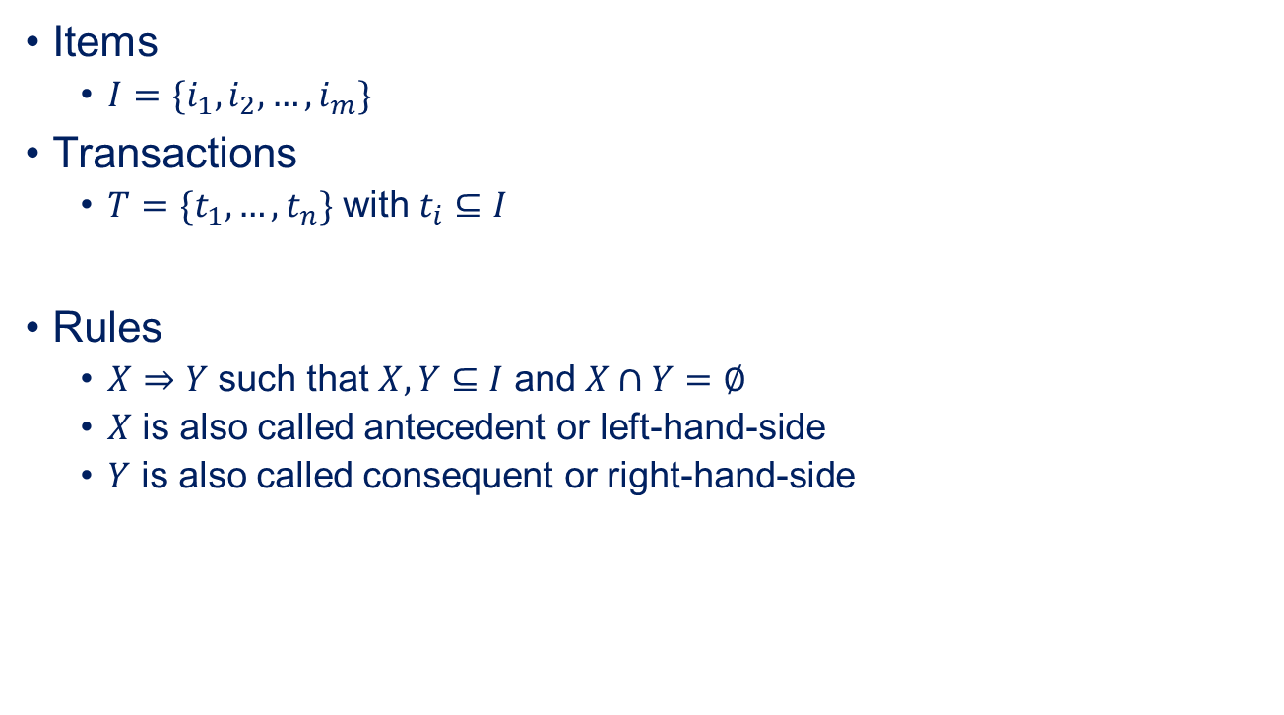
The Formal Problem
Items
$I=\{i_{1},i_{2},…, i_{m}\}$
Transactions
$T=\{t_{1},…, t_{n}\}$ with $t_{i}⊆I$
Rules
$X⇒Y$ such that $X,Y⊆I$ and $X∩Y=∅$
$X$ is also called antecedent or left-hand-side
$Y$ is also called consequent or right-hand-side
How do you get good rules?

Slide 6
Defining „Interesting Relationships“
item2, item3, item4 occur often together
Set of Transactions
item1,item2,item3
item2,item4
item1,item5
item6,item7
item2,item3,item4,item7
item2,item3,item4,item8
item2,item4,item5
item2,item3,item4
item4,item5
…
Interesting == often together

Slide 7
Outline
Overview
The Apriori Algorithm
Summary

Slide 8
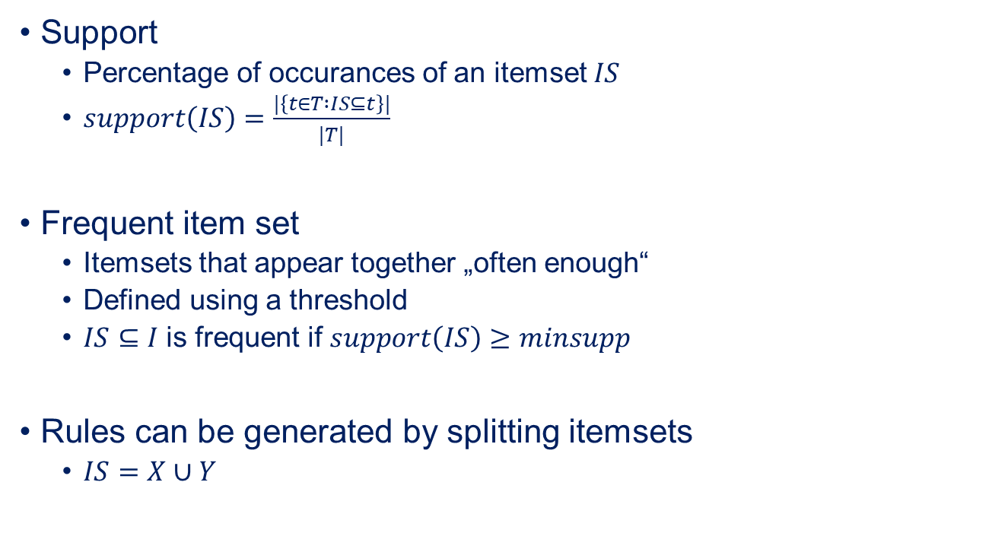
Support and Frequent Item Sets
Support
Percentage of occurances of an itemset $IS$
$support\left(IS\right)=\frac{|\left\{t∈T :IS⊆t\right\}|}{|T|}$
Frequent item set
Itemsets that appear together „often enough“
Defined using a threshold
$IS⊆I$ is frequent if $support\left(IS\right)≥minsupp$
Rules can be generated by splitting itemsets
$IS=X∪Y$

Slide 9

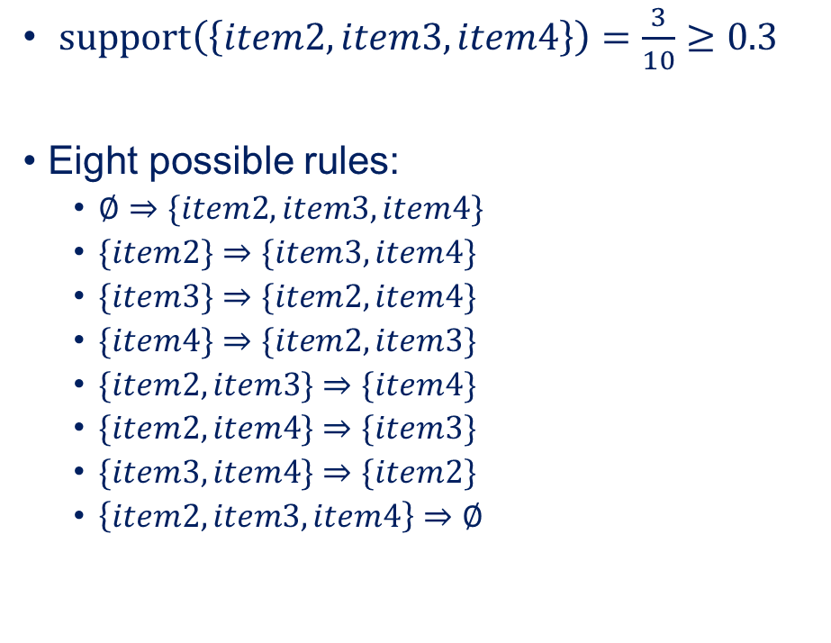
Example for Generating Rules
$$minsupp=0.3$$
$support\left(\left\{item2,item3,item4\right\}\right)=\frac{3}{10}≥0.3$
Eight possible rules:
$∅⇒\{item2,item3,item4\}$
$\{item2\}⇒\{item3,item4\}$
$\{item3\}⇒\{item2,item4\}$
$\{item4\}⇒\{item2,item3\}$
$\{item2,item3\}⇒\{item4\}$
$\{item2,item4\}⇒\{item3\}$
$\{item3,item4\}⇒\{item2\}$
$\left\{item2, item3,item4\right\}⇒∅$
Set of Transactions
item1,item2,item3
item2,item4
item1,item5
item6,item7
item2,item3,item4,item7
item2,item3,item4,item8
item2,item4,item5
item2,item3,item4
item4,item5
item6,item7
Are all rules interesting?

Slide 10
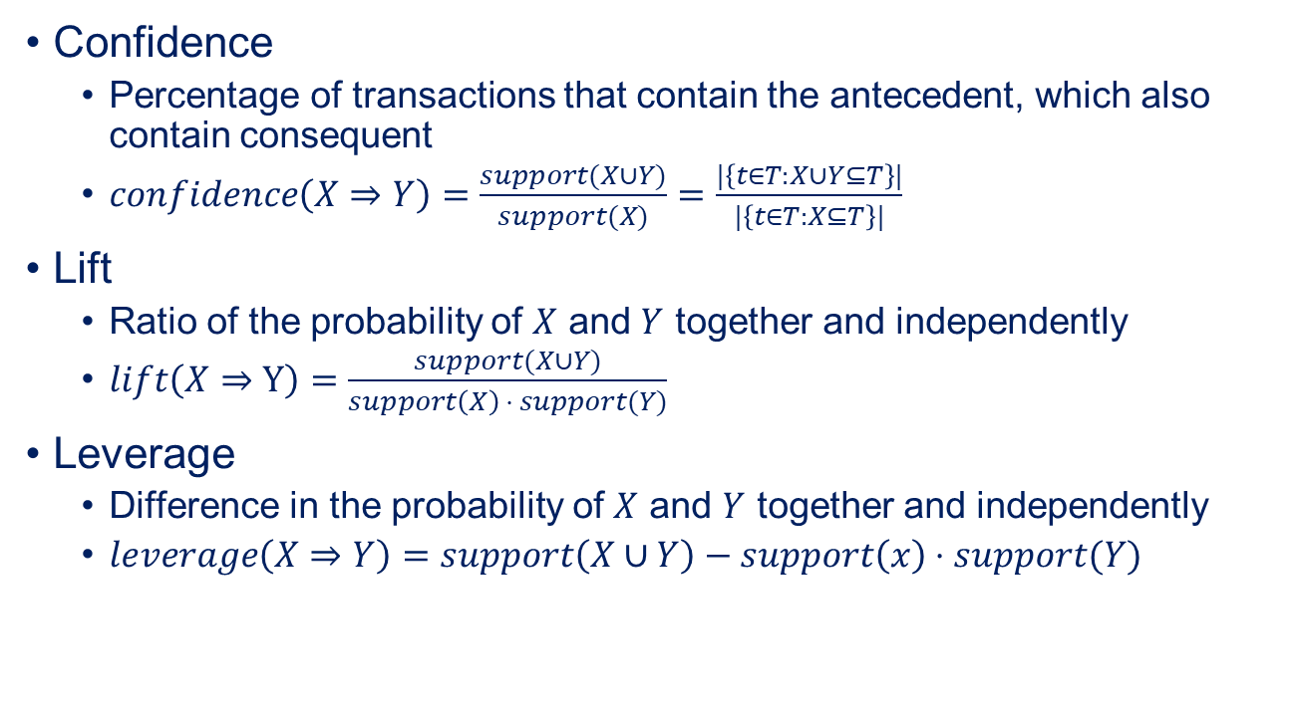
Confidence, Lift, and Leverage
Confidence
Percentage of transactions that contain the antecedent, which also contain consequent
$confidence\left(X⇒Y\right)=\frac{support(X∪Y)}{support(X)}=\frac{|\left\{t∈T:X∪Y⊆T\right\}|}{|\left\{t∈T:X⊆T\right\}|}$
Lift
Ratio of the probability of $X$ and $Y$ together and independently
$lift\left(X⇒Y\right)=\frac{support(X∪Y)}{support\left(X\right) ⋅ support(Y)}$
Leverage
Difference in the probability of $X$ and $Y$ together and independently
$leverage\left(X⇒Y\right)=support\left(X∪Y\right)−support\left(x\right)⋅support(Y)$
Usually, lift favors itemsets with lower support, leverage with higher support

Slide 11
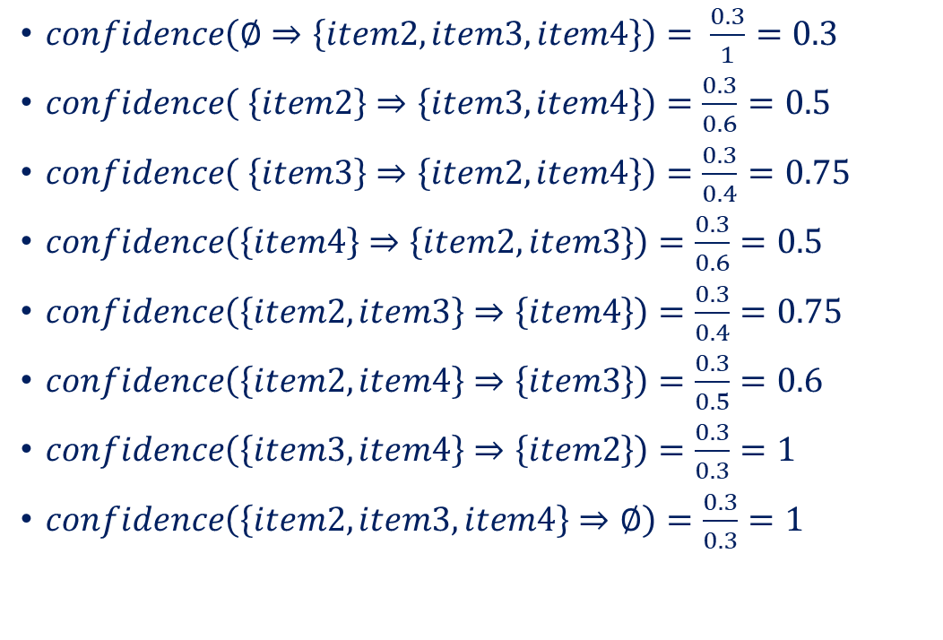
Confidence for the Example Rules
$confidence\left(∅⇒\left\{item2,item3,item4\right\}\right)= \frac{0.3}{1}=0.3$
$confidence\left( \left\{item2\right\}⇒\left\{item3,item4\right\}\right)=\frac{0.3}{0.6}=0.5$
$confidence\left( \left\{item3\right\}⇒\left\{item2,item4\right\}\right)=\frac{0.3}{0.4}=0.75$
$confidence\left(\left\{item4\right\}⇒\left\{item2,item3\right\}\right)=\frac{0.3}{0.6}=0.5$
$confidence\left(\left\{item2,item3\right\}⇒\left\{item4\right\}\right)=\frac{0.3}{0.4}=0.75$
$confidence\left(\left\{item2,item4\right\}⇒\left\{item3\right\}\right)=\frac{0.3}{0.5}=0.6$
$confidence\left(\left\{item3,item4\right\}⇒\left\{item2\right\}\right)=\frac{0.3}{0.3}=1$
$confidence\left(\left\{item2, item3,item4\right\}⇒∅\right)=\frac{0.3}{0.3}=1$
Set of Transactions
item1,item2,item3
item2,item4
item1,item5
item6,item7
item2,item3,item4,item7
item2,item3,item4,item8
item2,item4,item5
item2,item3,item4
item4,item5
item6,item7

Slide 12
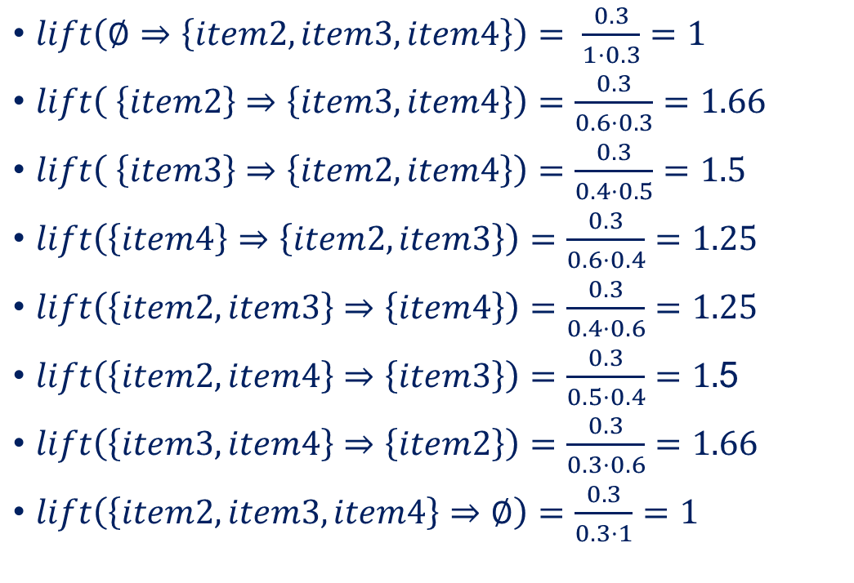
Lift for the Example Rules
$lift\left(∅⇒\left\{item2,item3,item4\right\}\right)= \frac{0.3}{1⋅0.3}=1$
$lift\left( \left\{item2\right\}⇒\left\{item3,item4\right\}\right)=\frac{0.3}{0.6⋅0.3}=1.66$
$lift\left( \left\{item3\right\}⇒\left\{item2,item4\right\}\right)=\frac{0.3}{0.4⋅0.5}=1.5$
$lift\left(\left\{item4\right\}⇒\left\{item2,item3\right\}\right)=\frac{0.3}{0.6⋅0.4}=1.25$
$lift\left(\left\{item2,item3\right\}⇒\left\{item4\right\}\right)=\frac{0.3}{0.4⋅0.6}=1.25$
$lift\left(\left\{item2,item4\right\}⇒\left\{item3\right\}\right)=\frac{0.3}{0.5⋅0.4}=1.$5
$lift\left(\left\{item3,item4\right\}⇒\left\{item2\right\}\right)=\frac{0.3}{0.3⋅0.6}=1.66$
$lift\left(\left\{item2, item3,item4\right\}⇒∅\right)=\frac{0.3}{0.3⋅1}=1$
Set of Transactions
item1,item2,item3
item2,item4
item1,item5
item6,item7
item2,item3,item4,item7
item2,item3,item4,item8
item2,item4,item5
item2,item3,item4
item4,item5
item6,item7

Slide 13
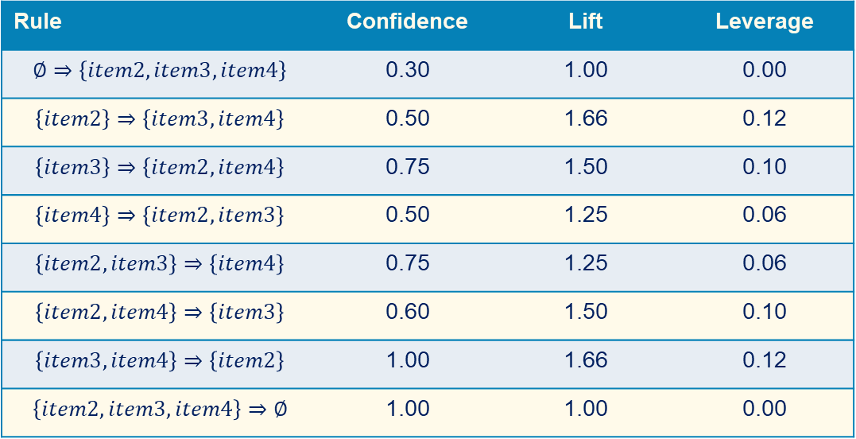
Overview of Scores for Example
Rule | Confidence | Lift | Leverage
$$∅⇒\left\{item2,item3,item4\right\}$$ | 0.30 | 1.00 | 0.00
$$\left\{item2\right\}⇒\left\{item3,item4\right\}$$ | 0.50 | 1.66 | 0.12
$$\left\{item3\right\}⇒\left\{item2,item4\right\}$$ | 0.75 | 1.50 | 0.10
$$\left\{item4\right\}⇒\left\{item2,item3\right\}$$ | 0.50 | 1.25 | 0.06
$$\left\{item2,item3\right\}⇒\left\{item4\right\}$$ | 0.75 | 1.25 | 0.06
$$\left\{item2,item4\right\}⇒\left\{item3\right\}$$ | 0.60 | 1.50 | 0.10
$$\left\{item3,item4\right\}⇒\left\{item2\right\}$$ | 1.00 | 1.66 | 0.12
$$\left\{item2, item3,item4\right\}⇒∅$$ | 1.00 | 1.00 | 0.00
Perfect confidence, and 1.66 times more likely than randomness
Perfect confidence, but no gain over randomness

Slide 14
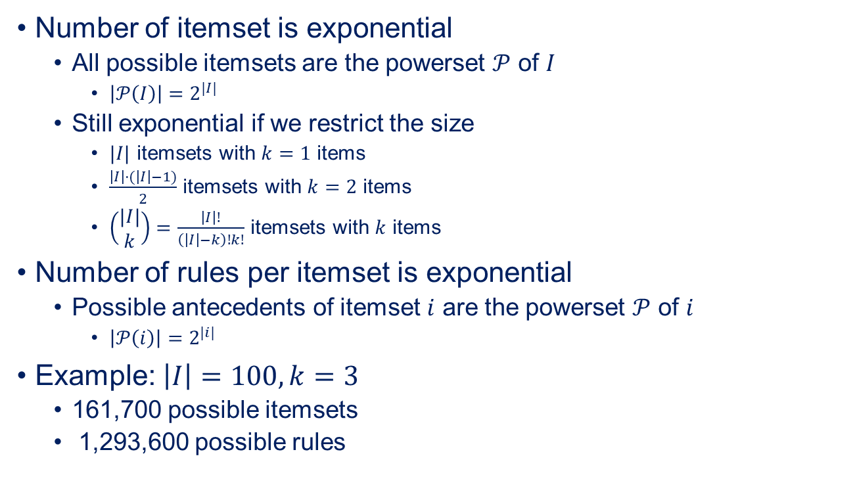
Itemsets and Rules = Exponential
Number of itemset is exponential
All possible itemsets are the powerset $𝒫$ of $I$
$\left|𝒫\left(I\right)\right|=2^{|I|}$
Still exponential if we restrict the size
$|I|$ itemsets with $k=1$ items
$\frac{\left|I\right|⋅(\left|I\right|−1)}{2}$ itemsets with $k=2$ items
$\left(\begin{matrix}|I| \\ k\end{matrix}\right)=\frac{\left|I\right|!}{\left(\left|I\right|−k\right)!k!}$ itemsets with $k$ items
Number of rules per itemset is exponential
Possible antecedents of itemset $i$ are the powerset $𝒫$ of $i$
$\left|𝒫\left(i\right)\right|=2^{|i|}$
Example: $\left|I\right|=100, k=3$
161,700 possible itemsets
1,293,600 possible rules
How do we restrict the search space?

Slide 15
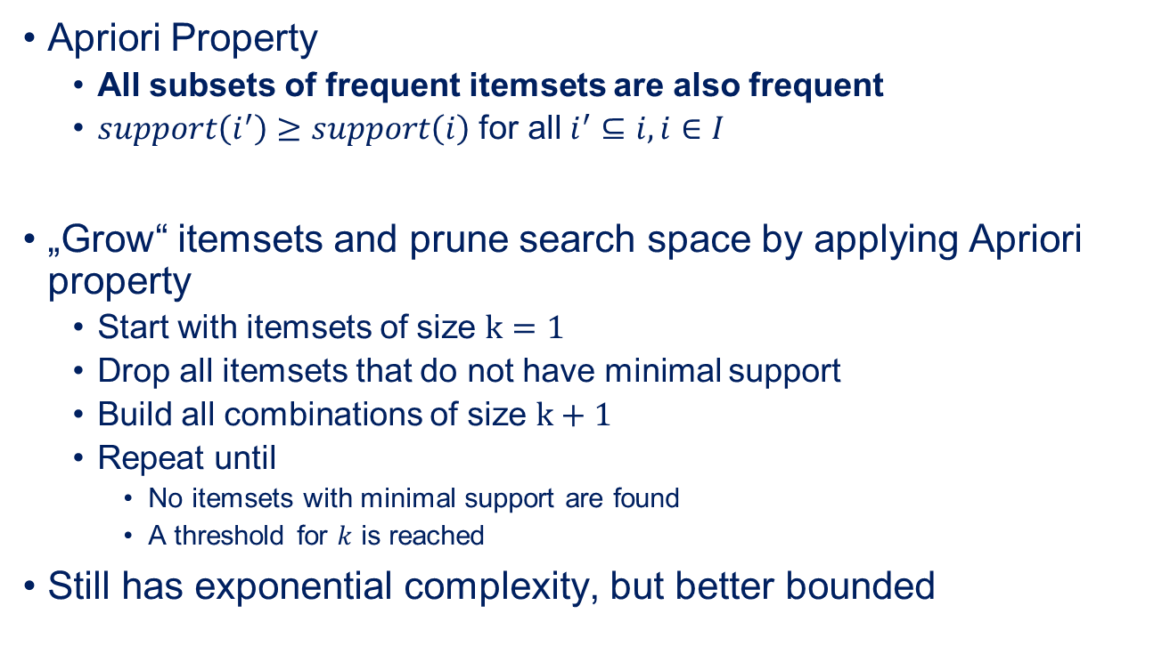
Pruning the Search Space
Apriori Property
All subsets of frequent itemsets are also frequent
$support\left(i^{′}\right)≥support\left(i\right)$ for all $i^{′}⊆i, i∈I$
„Grow“ itemsets and prune search space by applying Apriori property
Start with itemsets of size $k=1$
Drop all itemsets that do not have minimal support
Build all combinations of size $k+1$
Repeat until
No itemsets with minimal support are found
A threshold for $k$ is reached
Still has exponential complexity, but better bounded

Slide 16
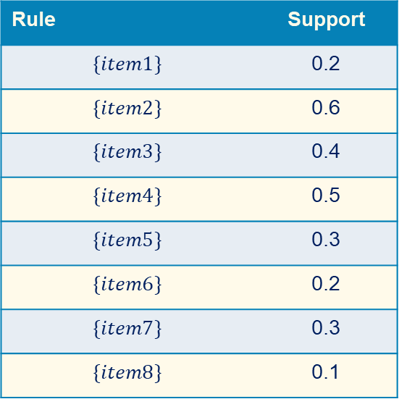
Example for Growing Itemsets (k=1)
$$minsupp=0.3$$
Set of Transactions
item1,item2,item3
item2,item4
item1,item5
item6,item7
item2,item3,item4,item7
item2,item3,item4,item8
item2,item4,item5
item2,item3,item4
item4,item5
item6,item7
Rule | Support
$$\{item1\}$$ | 0.2
$$\{item2\}$$ | 0.6
$$\{item3\}$$ | 0.4
$$\{item4\}$$ | 0.5
$$\{item5\}$$ | 0.3
$$\{item6\}$$ | 0.2
$$\{item7\}$$ | 0.3
$$\{item8\}$$ | 0.1
Drop
Drop
Drop

Slide 17
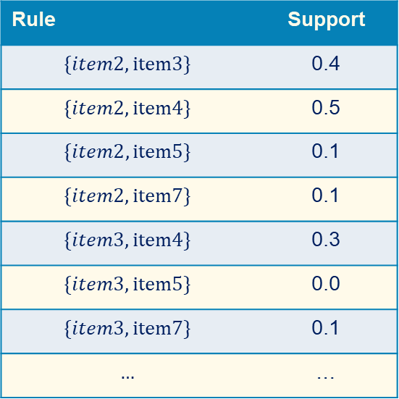
Example for Growing Itemsets (k=2)
$$minsupp=0.3$$
Set of Transactions
item1,item2,item3
item2,item4
item1,item5
item6,item7
item2,item3,item4,item7
item2,item3,item4,item8
item2,item4,item5
item2,item3,item4
item4,item5
item6,item7
Rule | Support
$$\{item2,item3\}$$ | 0.4
$$\{item2,item4\}$$ | 0.5
$$\{item2,item5\}$$ | 0.1
$$\{item2,item7\}$$ | 0.1
$$\{item3,item4\}$$ | 0.3
$$\{item3,item5\}$$ | 0.0
$$\{item3,item7\}$$ | 0.1
$$…$$ | …
Drop
Drop
Drop
Drop
Drop

Slide 18

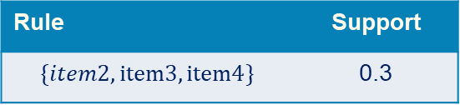
Example for Growing Itemsets (k=3)
$$minsupp=0.3$$
Found the following frequent itemsets with at least two items:
$\left\{item2, item3\right\}, \left\{item2, item4\right\}, \left\{item3,item4\right\}$
$\{item2, item3, item4\}$
Set of Transactions
item1,item2,item3
item2,item4
item1,item5
item6,item7
item2,item3,item4,item7
item2,item3,item4,item8
item2,item4,item5
item2,item3,item4
item4,item5
item6,item7
Rule | Support
$$\{item2,item3,item4\}$$ | 0.3
Only itemset remaining, growing terminates.

Slide 19

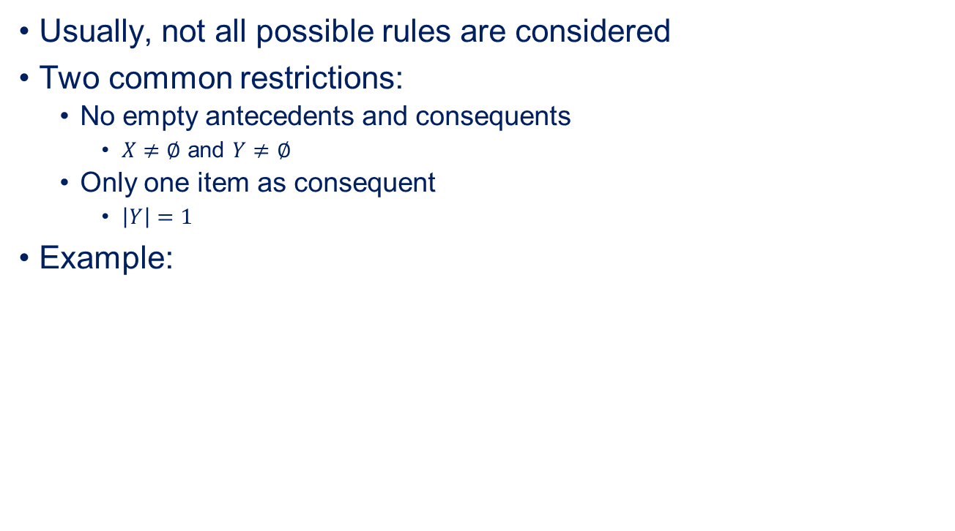
Candidates for Rules
Usually, not all possible rules are considered
Two common restrictions:
No empty antecedents and consequents
$X≠∅$ and $Y≠∅$
Only one item as consequent
$\left|Y\right|=1$
Example:
$$∅⇒\{item2,item3,item4\}$$
$$\{item2\}⇒\{item3,item4\}$$
$$\{item3\}⇒\{item2,item4\}$$
$$\{item4\}⇒\{item2,item3\}$$
$$\{item2,item3\}⇒\{item4\}$$
$$\{item2,item4\}⇒\{item3\}$$
$$\{item3,item4\}⇒\{item2\}$$
$$\left\{item2, item3,item4\right\}⇒∅$$

Slide 20
Evaluating Association Rules
Use different criteria, not just support and confidence
Lift and leverage can tell you if rules are coincidental
Validate if rules hold on test data
Check if the rules would also be found on the test data
For basket prediction, use incomplete itemsets on test data
Example: remove item4 from all itemsets and see if the rules would correctly predict where it is associated
Manually inspect rules
Do they make sense?
Ask domain experts

Slide 21
Outline
Overview
The Apriori Algorithm
Summary

Slide 22
Summary
Associations are interesting relationships between items
Interesting usually means appear together and not coincidental
Number of possible itemsets/rules exponential
Apriori property for bounding itemsets
Restrictions on rule structures
Test data and manual inspections for validation

