Slide 1
Chapter 06 Clustering
Dr. Steffen Herbold
herbold@cs.uni-goettingen.de

Slide 2
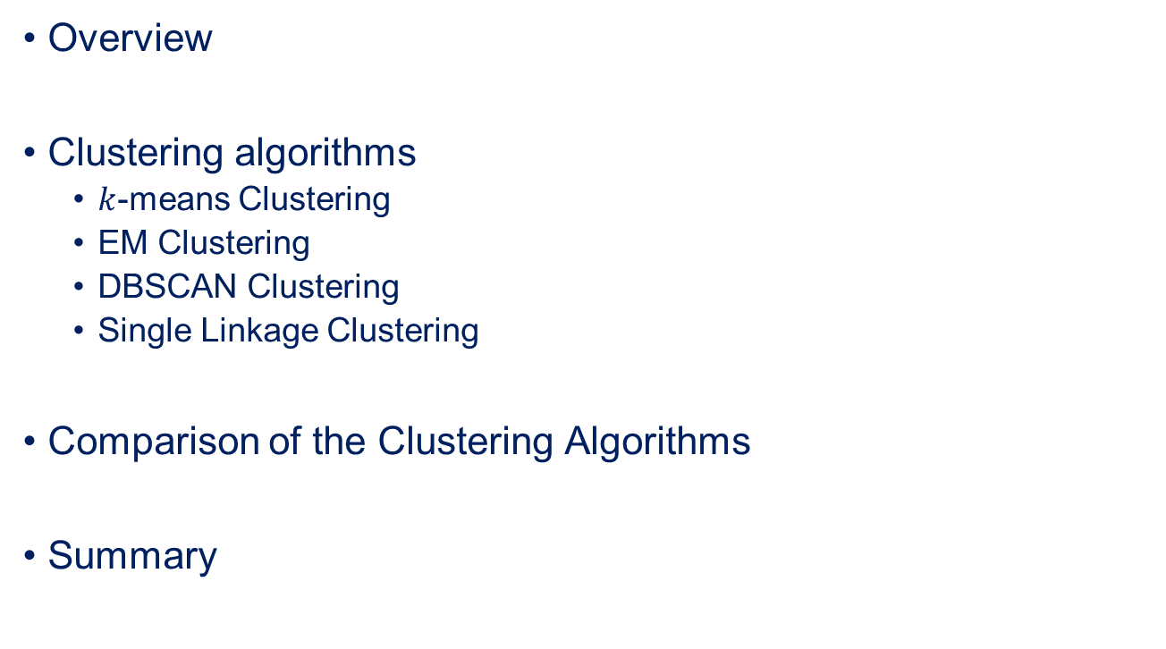
Outline
Overview
Clustering algorithms
$k$-means Clustering
EM Clustering
DBSCAN Clustering
Single Linkage Clustering
Comparison of the Clustering Algorithms
Summary

Slide 3





Example of Clustering
Clustering

Slide 4
The General Problem
Object 1
Object 1
Object 2
Object 3
Object 3
Object 4
Object 4
Clustering
…
Object 2
Object n
Object n

Slide 5

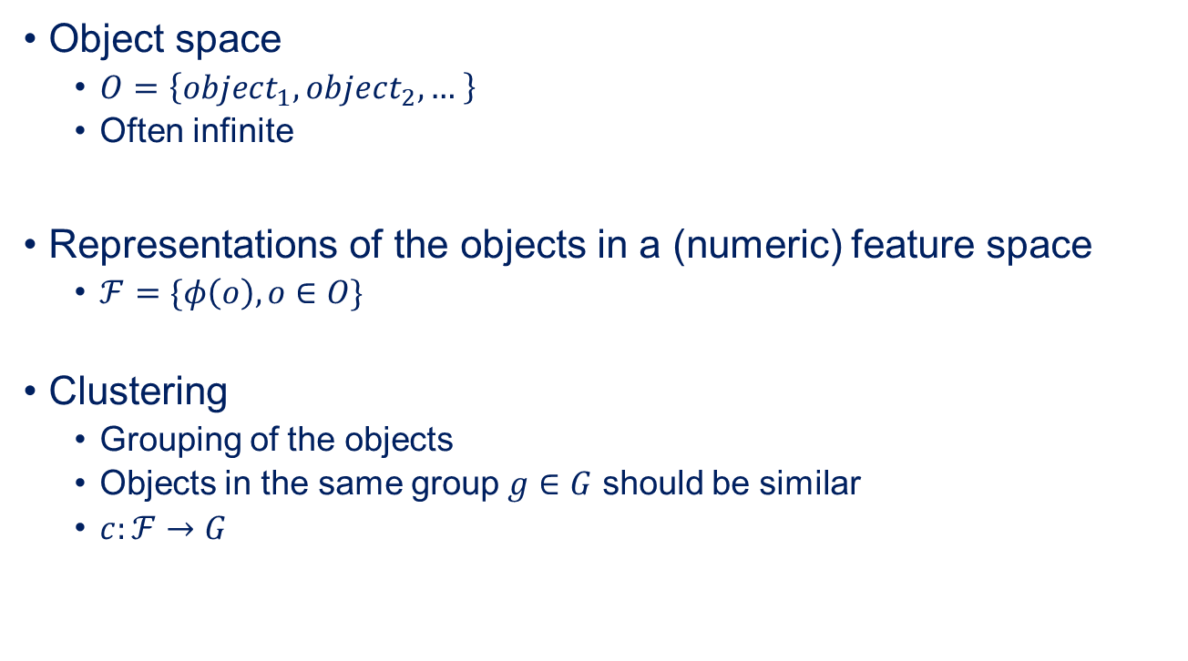
The Formal Problem
Object space
$O=\left\{object_{1},object_{2},… \right\}$
Often infinite
Representations of the objects in a (numeric) feature space
$ℱ=\{φ\left(o\right), o∈O\}$
Clustering
Grouping of the objects
Objects in the same group $g∈G$ should be similar
$c:ℱ→G$
How do you measure similarity?

Slide 6
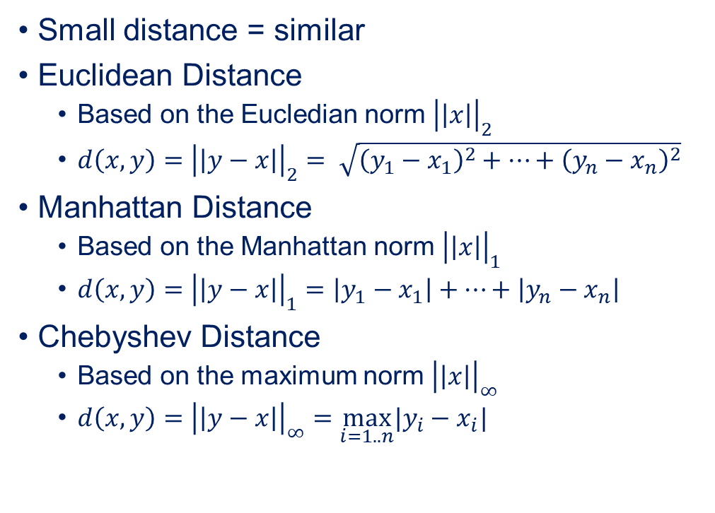
Measuring Similarity Distances
Small distance = similar
Euclidean Distance
Based on the Eucledian norm ${\left|\left|x\right|\right|}_{2}$
$d\left(x,y\right)={\left|\left|y−x\right|\right|}_{2}= \sqrt{{\left(y_{1}−x_{1}\right)}^{2}+…+{\left(y_{n}−x_{n}\right)}^{2}}$
Manhattan Distance
Based on the Manhattan norm ${\left|\left|x\right|\right|}_{1}$
$d\left(x,y\right)={\left|\left|y−x\right|\right|}_{1}=\left|y_{1}−x_{1}\right|+…+\left|y_{n}−x_{n}\right|$
Chebyshev Distance
Based on the maximum norm ${\left|\left|x\right|\right|}_{∞}$
$d\left(x,y\right)={\left|\left|y−x\right|\right|}_{∞}=\max_{i=1..n}|y_{i}−x_{i}|$

Slide 7
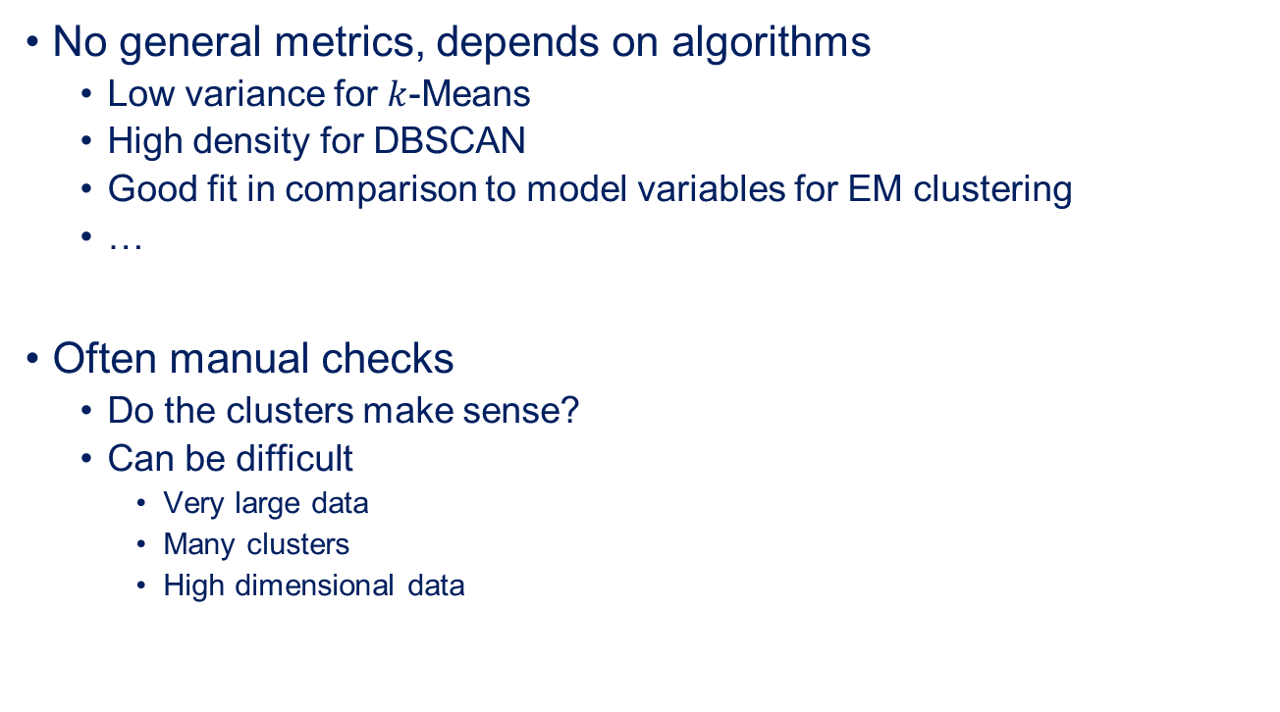
Evaluation of Clustering Results
No general metrics, depends on algorithms
Low variance for $k$-Means
High density for DBSCAN
Good fit in comparison to model variables for EM clustering
…
Often manual checks
Do the clusters make sense?
Can be difficult
Very large data
Many clusters
High dimensional data

Slide 8
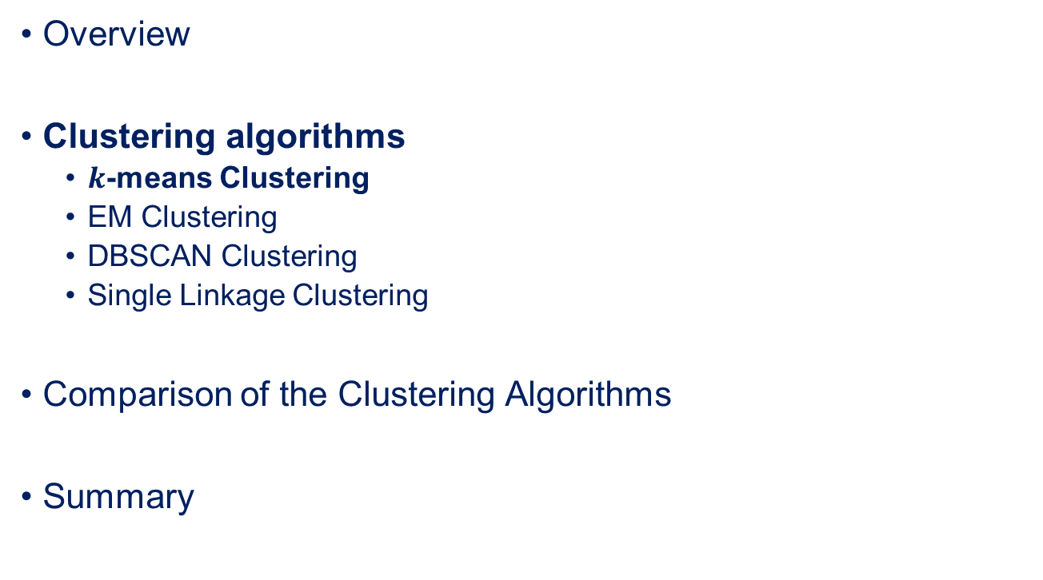
Outline
Overview
Clustering algorithms
$k$-means Clustering
EM Clustering
DBSCAN Clustering
Single Linkage Clustering
Comparison of the Clustering Algorithms
Summary

Slide 9
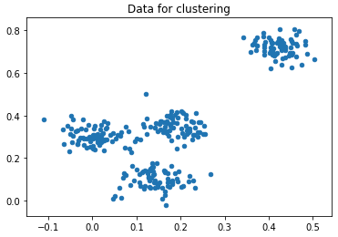
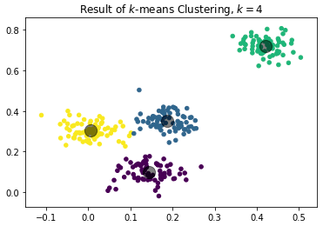

Idea Behind $k$–means Clustering
How do you get the centroids?
Clusters are described by their center
The centers are called centroid
Centroid-based clustering
Objects are assigned to the closests centroid

Slide 10
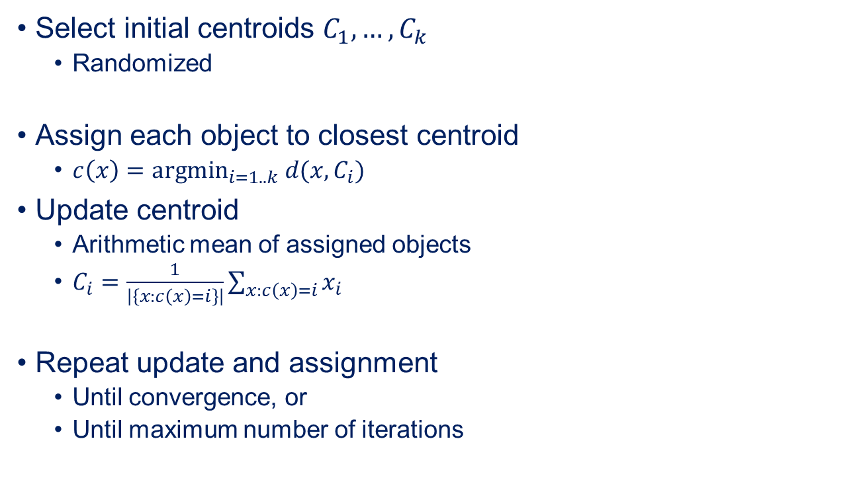
Simple Algorithm
Select initial centroids $C_{1},…, C_{k}$
Randomized
Assign each object to closest centroid
$c\left(x\right)={argmin}_{i=1..k} d(x,C_{i})$
Update centroid
Arithmetic mean of assigned objects
$C_{i}=\frac{1}{\left|\left\{x:c\left(x\right)=i\right\}\right|}\sum_{x:c\left(x\right)=i}{x_{i}}$
Repeat update and assignment
Until convergence, or
Until maximum number of iterations

Slide 11
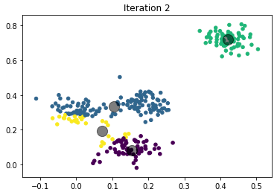
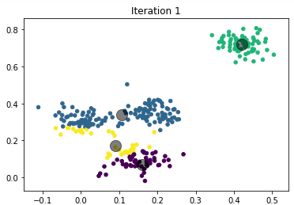
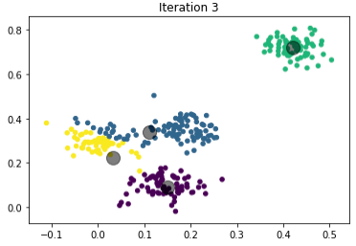
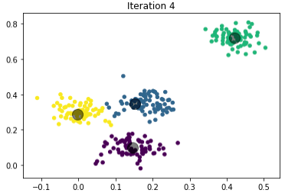

Visualization of the $k$–means Algorithm

Slide 12
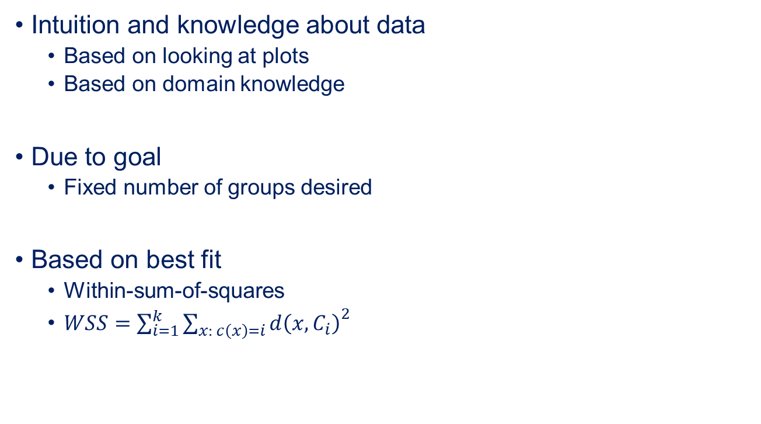

Selecting $k$
Intuition and knowledge about data
Based on looking at plots
Based on domain knowledge
Due to goal
Fixed number of groups desired
Based on best fit
Within-sum-of-squares
$WSS=\sum_{i=1}^{k}{{\sum_{x: c\left(x\right)=i}{d\left(x,C_{i}\right)}}^{2}}$

Slide 13
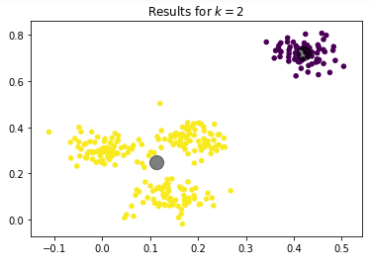
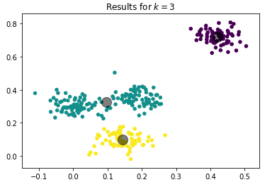
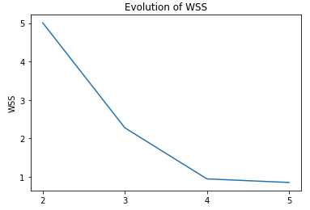
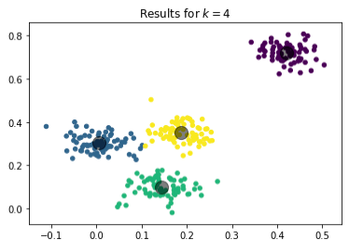
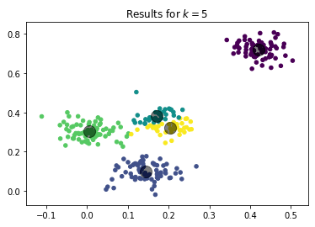

Results for $k=2, …, 5$
2, 3, and 4 all okay
→ use domain knowledge to decide
Big changes in slope (elbows) indicate potentially good values for k
Splits like these indicate too many clusters

Slide 14
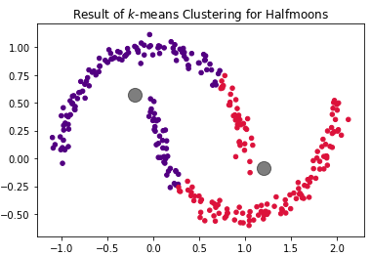
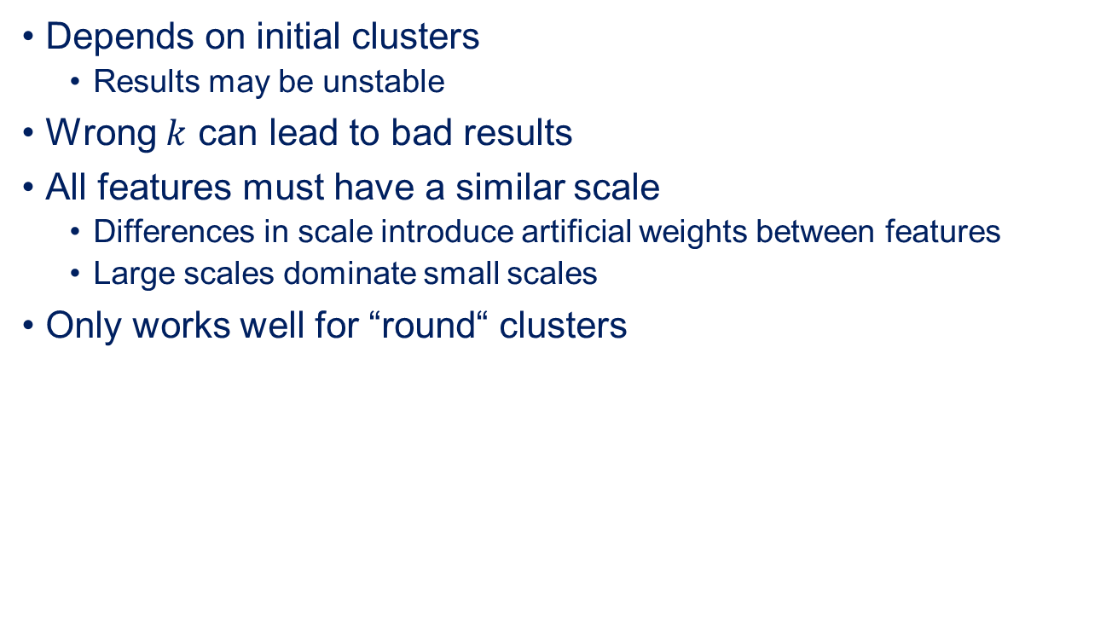

Problems of $k$-Means
Depends on initial clusters
Results may be unstable
Wrong $k$ can lead to bad results
All features must have a similar scale
Differences in scale introduce artificial weights between features
Large scales dominate small scales
Only works well for “round“ clusters

Slide 15
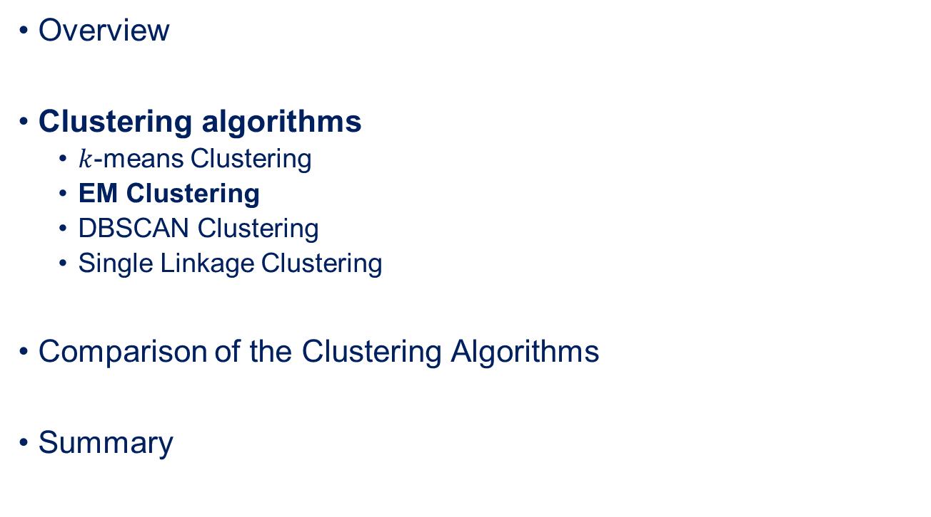
Outline
Overview
Clustering algorithms
$k$-means Clustering
EM Clustering
DBSCAN Clustering
Single Linkage Clustering
Comparison of the Clustering Algorithms
Summary

Slide 16
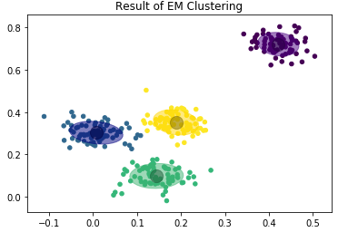
Idea Behind EM Clustering
How do you get the distributions?
Clusters are described by probability distributions
Usually normal distribution (“Gaussian Mixture Model“)
Distribution-based clustering
Objects are assigned to the “most likely“ cluster
Mean
Covariance

Slide 17

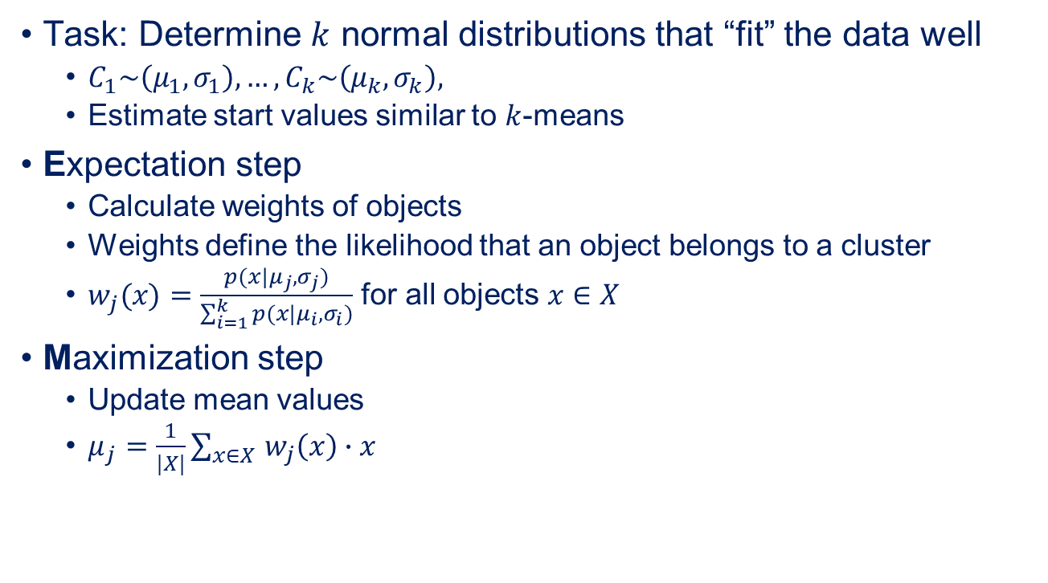
(Simplified!) EM Algorithm
Task: Determine $k$ normal distributions that “fit” the data well
$C_{1}\sim \left(μ_{1}, σ_{1}\right), …,C_{k}\sim \left(μ_{k}, σ_{k}\right),$
Estimate start values similar to $k$-means
Expectation step
Calculate weights of objects
Weights define the likelihood that an object belongs to a cluster
$w_{j}(x)=\frac{p(x|μ_{j}, σ_{j})}{\sum_{i=1}^{k}{p(x|μ_{i}, σ_{i})}}$ for all objects $x∈X$
Maximization step
Update mean values
$μ_{j}=\frac{1}{|X|}\sum_{x∈X }{w_{j}\left(x\right)∙x}$
WARNING:
This is a correct, but simplified version of the algorithm that ignores the update of the (co)variance.

Slide 18
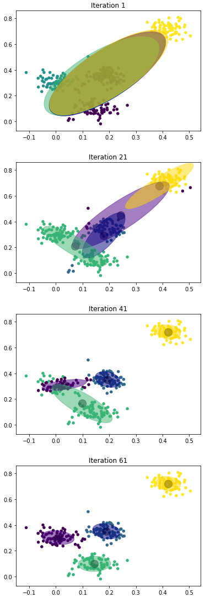
Visualization of the EM Algorithm

Slide 19
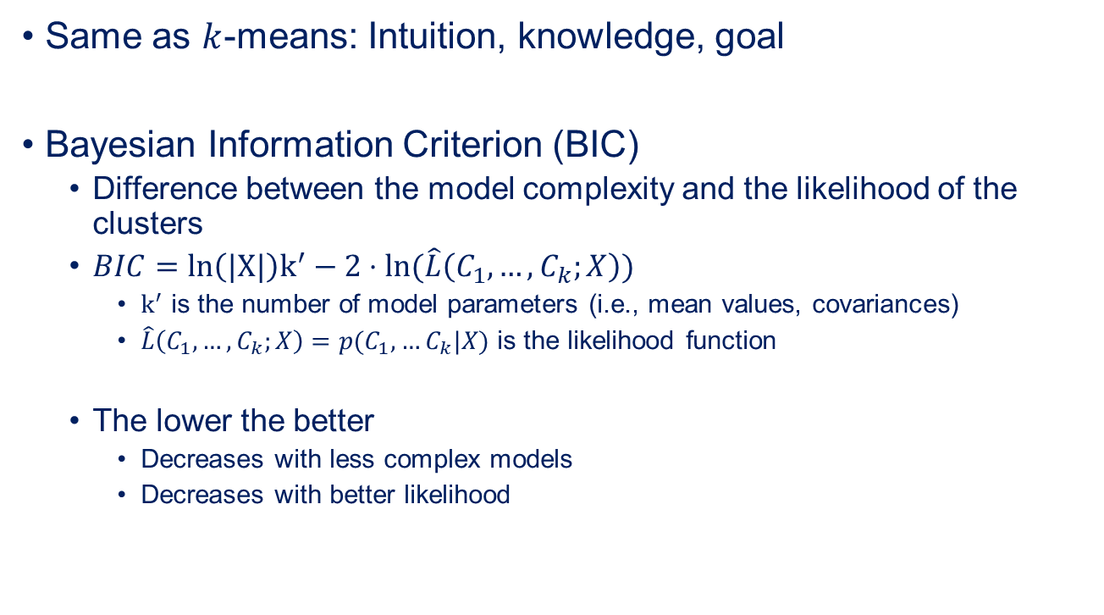
Selecting $k$
Same as $k$-means: Intuition, knowledge, goal
Bayesian Information Criterion (BIC)
Difference between the model complexity and the likelihood of the clusters
$BIC=ln\left(|X|\right)k^{′}−2⋅ln⁡(\hat{L}\left(C_{1},…,C_{k};X\right))$
$k^{′}$ is the number of model parameters (i.e., mean values, covariances)
$\hat{L}\left(C_{1},…,C_{k};X\right)=p(C_{1},…C_{k}|X)$ is the likelihood function
The lower the better
Decreases with less complex models
Decreases with better likelihood

Slide 20
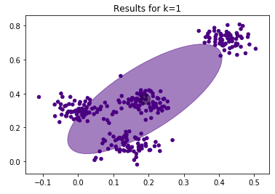
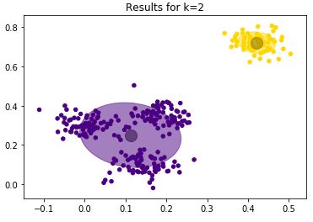
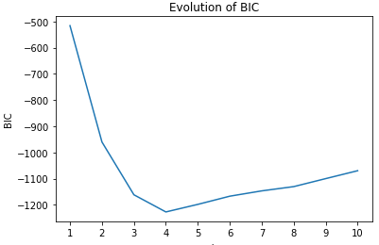
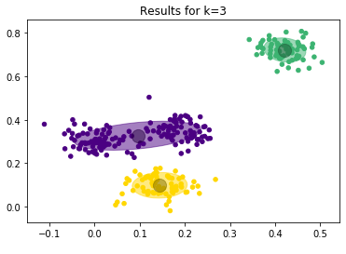
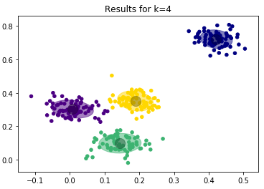

Results for $k=1, …,$4
Minimum = optimal ratio between model complexity and goodness of fit

Slide 21
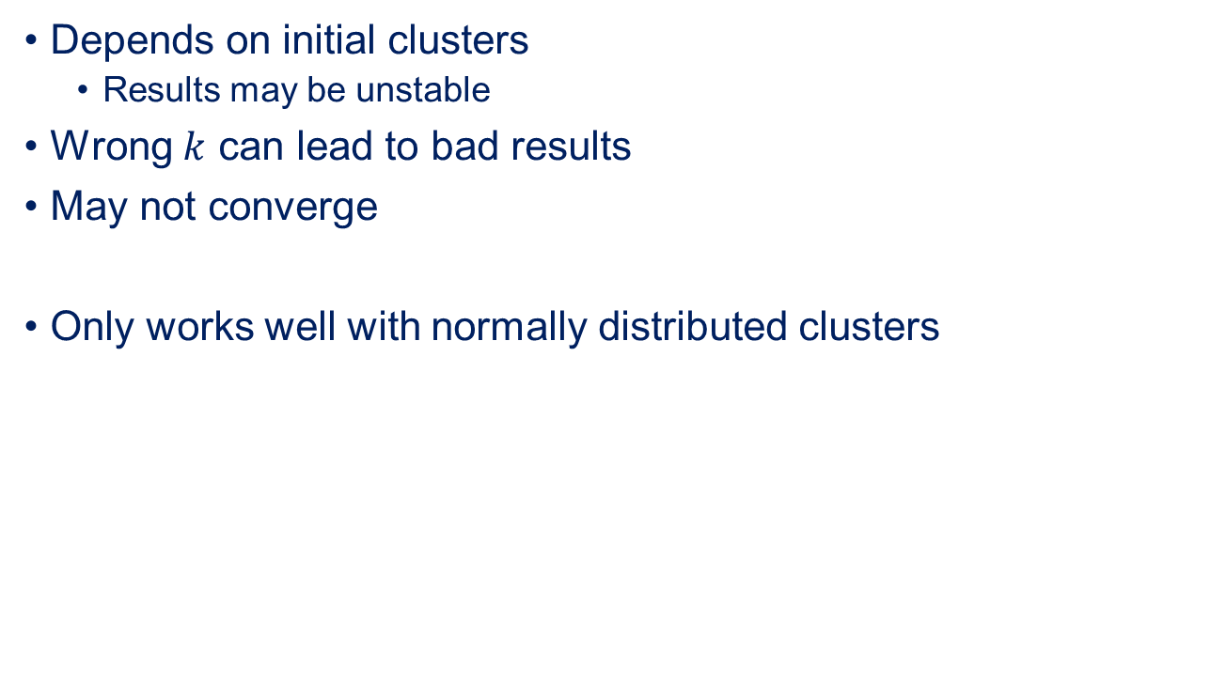
Problems of EM Clustering
Depends on initial clusters
Results may be unstable
Wrong $k$ can lead to bad results
May not converge
Only works well with normally distributed clusters

Slide 22

Outline
Overview
Clustering algorithms
$k$-means Clustering
EM Clustering
DBSCAN Clustering
Single Linkage Clustering
Comparison of the Clustering Algorithms
Summary

Slide 23
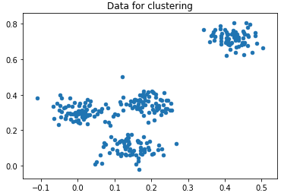
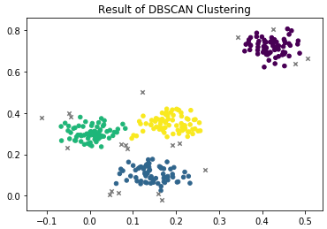
Idea behind DBSCAN
Clusters are described by other objects close by
Density-based clustering
Scan area around an object for other objects
If objects are found, they probably belong to the same group
If no objects are found, the object is probably noise
Noise

Slide 24
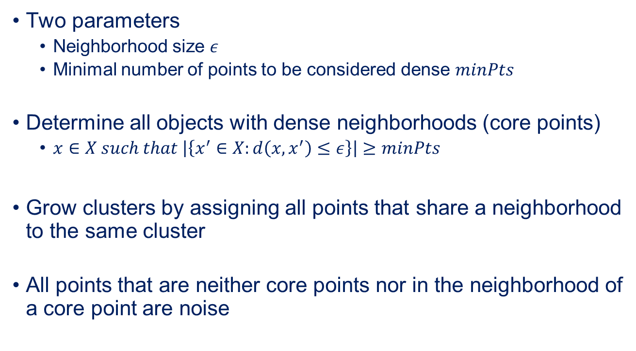
(Relatively) Simple Algorithm
Two parameters
Neighborhood size $ε$
Minimal number of points to be considered dense $minPts$
Determine all objects with dense neighborhoods (core points)
$x∈X such that \left|\left\{x^{′}∈X:d\left(x,x^{′}\right)≤ε\right\}\right|≥minPts$
Grow clusters by assigning all points that share a neighborhood to the same cluster
All points that are neither core points nor in the neighborhood of a core point are noise

Slide 25
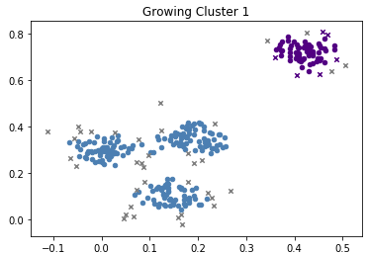
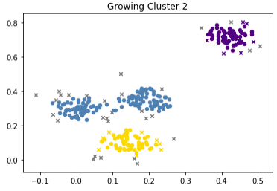
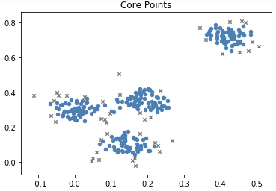
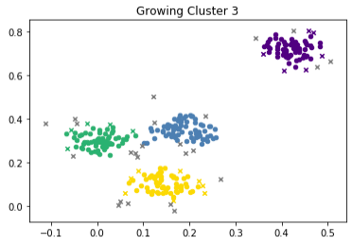
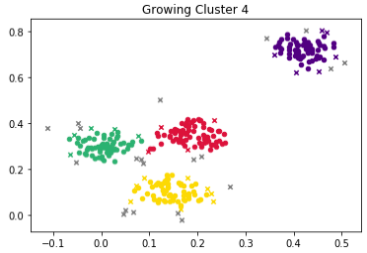
Visualization of the DBSCAN Algorithm

Slide 26
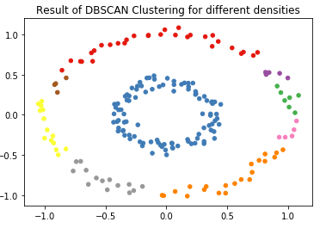
Problems of DBSCAN
All features must be in the same range
What if different clusters have different densities?
→ Main problem of DBSCAN!
This is also related to the size of the data
→ DBSCAN is very sensitive to sampling

Slide 27
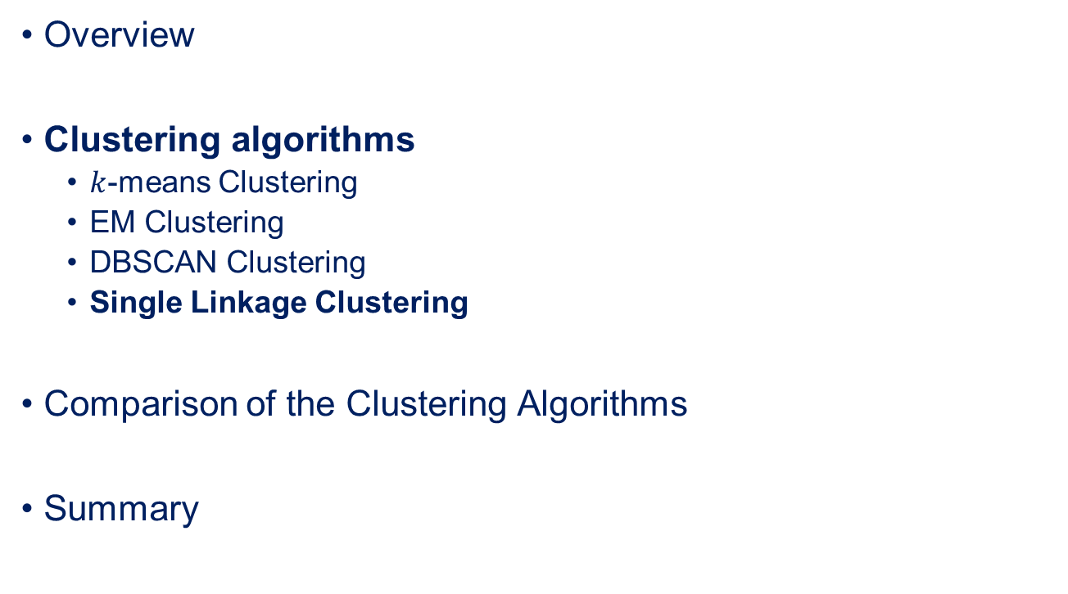
Outline
Overview
Clustering algorithms
$k$-means Clustering
EM Clustering
DBSCAN Clustering
Single Linkage Clustering
Comparison of the Clustering Algorithms
Summary

Slide 28
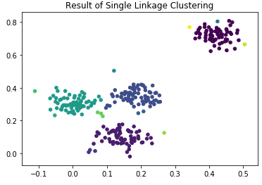
Idea behind Hierarchical Clustering
Clusters are described by hierarchies of similarity
Hierarchical clustering (also called connectivity-based clustering)
Find most similar pair of objects and establish link
“Nearest Neighbor Clustering“

Slide 29
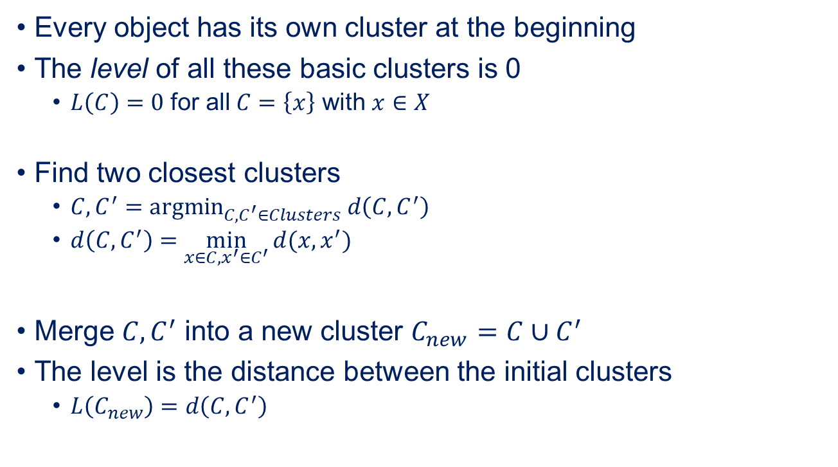
Simple Single Linkage Algorithm (SLINK)
Every object has its own cluster at the beginning
The level of all these basic clusters is 0
$L\left(C\right)=0$ for all $C=\left\{x\right\}$ with $x∈X$
Find two closest clusters
$C, C^{′}={argmin}_{C, C^{′}∈Clusters} d\left(C,C^{′}\right)$
$d\left(C,C^{′}\right)=\min_{x∈C, x^{′}∈C^{′}}{d(x,x^{′})}$
Merge $C, C^{′}$ into a new cluster $C_{new}=C∪C^{′}$
The level is the distance between the initial clusters
$L\left(C_{new}\right)=d\left(C,C^{′}\right)$

Slide 30
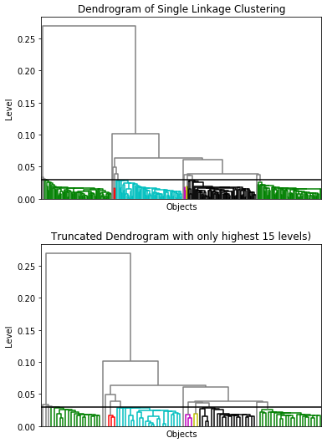
Dendrograms of Clustering
Visualizes clustering as a tree
Horizontal line: Merging of two clusters
Vertical line: Increase of the level due to merge
Cutoff for the “real“ clusters, must be chosen manually
Each object is a leaf node
Nodes that are subsequently merged 15 times are suppressed

Slide 31
Problems with Hierarchical Clustering
Often scales badly in terms of memory consumption
Standard algorithm requires square matrix of distances between all objects
All features must be in the same range
Different densities in different clusters may be problematic
Hard to find single cut-off
Can be solved by visual analysis of the dendrogram

Slide 32
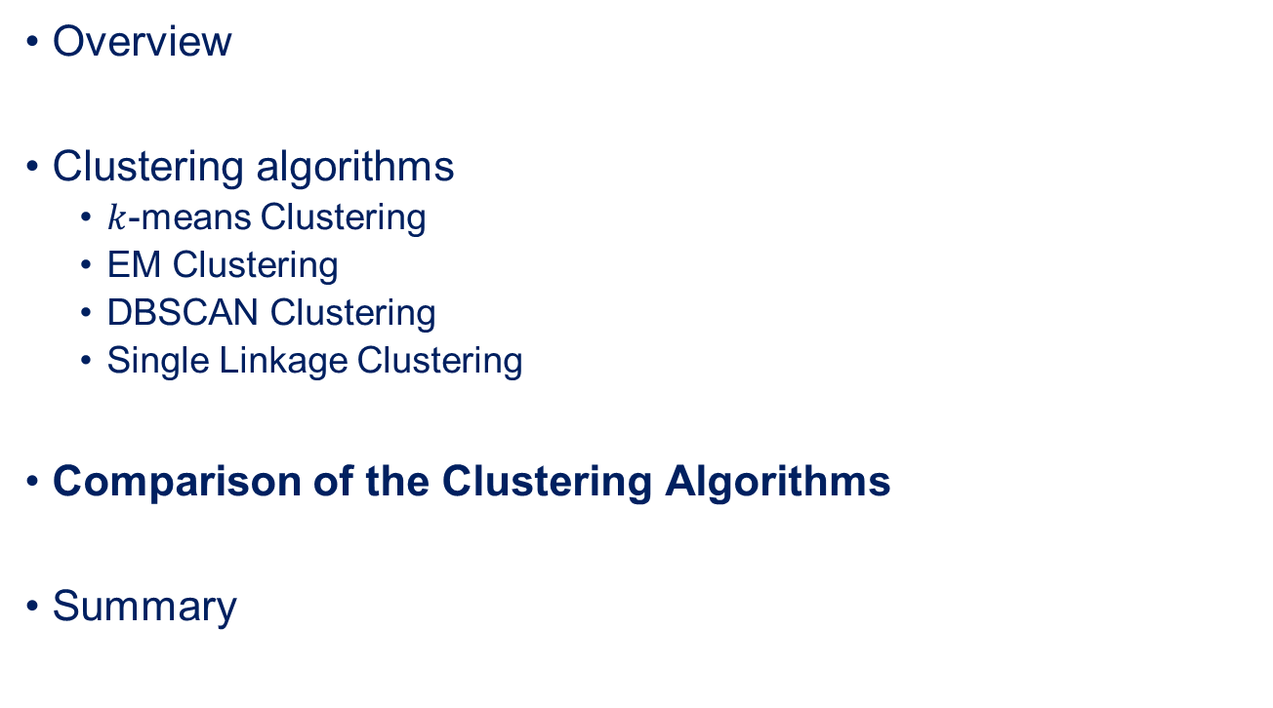
Outline
Overview
Clustering algorithms
$k$-means Clustering
EM Clustering
DBSCAN Clustering
Single Linkage Clustering
Comparison of the Clustering Algorithms
Summary

Slide 33
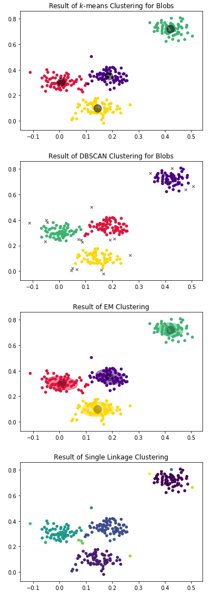
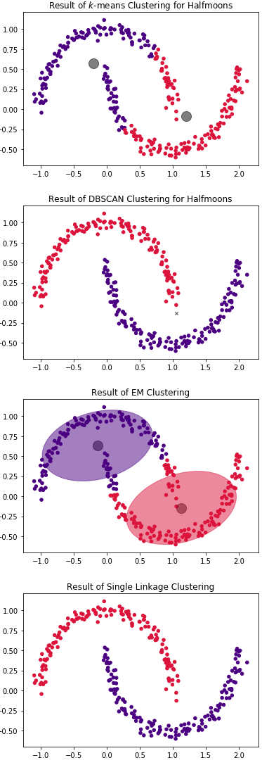
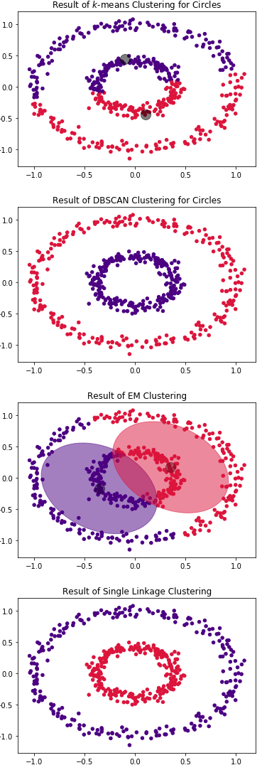
Comparison of Clusters

Slide 34
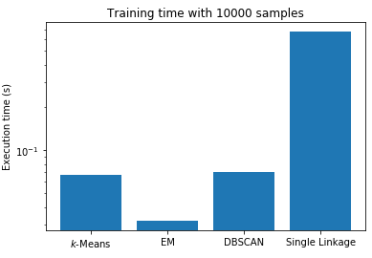
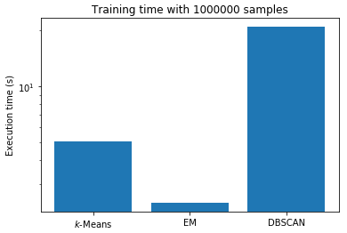
Comparison of Execution Times
Single linkage requires too much memory for larger clusters

Slide 35


Strengths and Weaknesses
 | Cluster number | Explanatory value | Concise representation | Categorical features | Missing features | Correlated features
𝑘-means | - | + | + | - | - | -
EM | 0 | + | + | - | - | 0
DBSCAN | + | - | - | - | - | -
SLINK | 0 | + | - | - | - | -
There are clustering algorithms for categorical data, e.g., $k$-modes

Slide 36
Summary
Clustering is concerned with the inference of groups for objects
Works well for numeric data but is often not well suited for categorical data
Scales are very important for most clustering algorithms
Different types of clustering algorithms
Centroid-based
Distribution-based
Density-based
Hierarchical / connectivity-based
Evaluation often difficult and requires manual intervention

