Slide 1
Chapter 08 Regression
Dr. Steffen Herbold
herbold@cs.uni-goettingen.de

Slide 2
Outline
Overview
Linear Regression Models
Comparison of Regression Models
Summary

Slide 3







Example of Regression
Fuel consumption
Regression
Top Speed

Slide 4
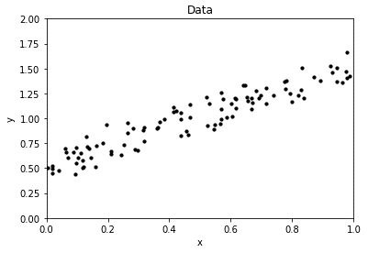
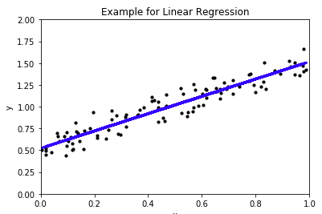
The General Problem
Regression

Slide 5
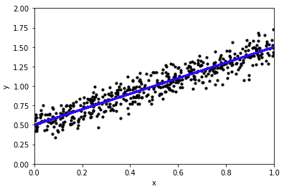
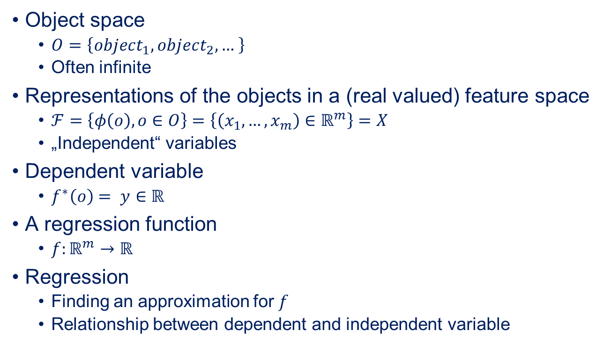
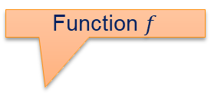
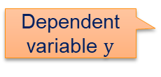
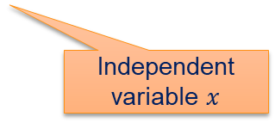
The Formal Problem
Object space
$O=\left\{object_{1},object_{2},… \right\}$
Often infinite
Representations of the objects in a (real valued) feature space
$ℱ=\left\{φ\left(o\right), o∈O\right\}=\left\{\left(x_{1},…,x_{m}\right)∈ℝ^{m}\right\}=X$
„Independent“ variables
Dependent variable
$f^{∗}\left(o\right)= y∈ℝ$
A regression function
$f:ℝ^{m}→ℝ$
Regression
Finding an approximation for $f$
Relationship between dependent and independent variable
Function $f$
Dependent variable $y$
Independent variable $x$

Slide 6

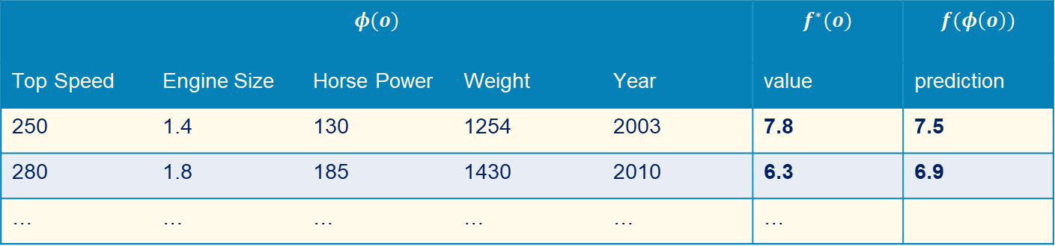

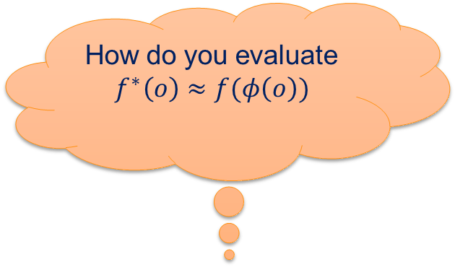
Quality of Regressions
How do you evaluate
$f^{∗}\left(o\right)≈f(φ\left(o\right))$
Goal: Approximation of the dependent variable
$f^{∗}\left(o\right)≈h(φ\left(o\right))$
→ Use Test Data
Structure is the same as training data
Apply approximated regression function
$$φ(o)$$ |  |  |  |  | $$f^{∗}(o)$$ | $$f(φ\left(o\right))$$
Top Speed | Engine Size | Horse Power | Weight | Year | value | prediction
250 | 1.4 | 130 | 1254 | 2003 | 7.8 | 7.5
280 | 1.8 | 185 | 1430 | 2010 | 6.3 | 6.9
… | … | … | … | … | …

Slide 7
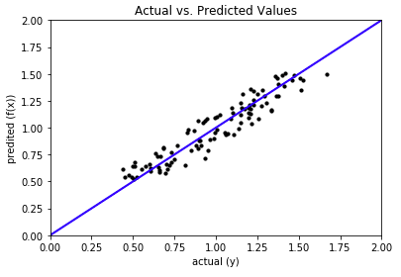

Visual Comparison
Perfect Prediction
→ Deviation from blue line as visual indicator for prediction quality
Good prediction. Data close to blue line, regular pattern of deviations
Allows insights into where predictions are good/bad

Slide 8
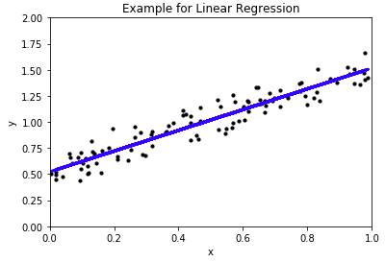
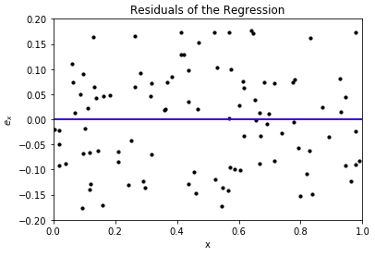

Residuals
Differences between predictions and actual values
$e_{x}=y−f(x)$

Slide 9
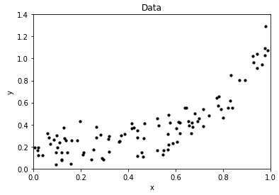
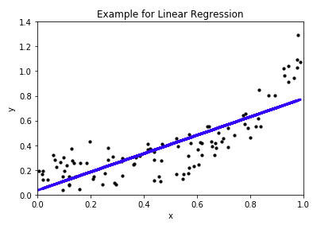
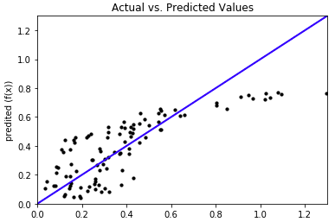
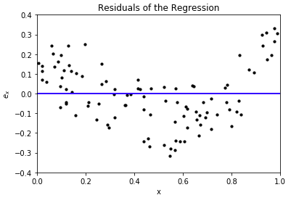
Visual Comparison of a Bad Fit

Slide 10
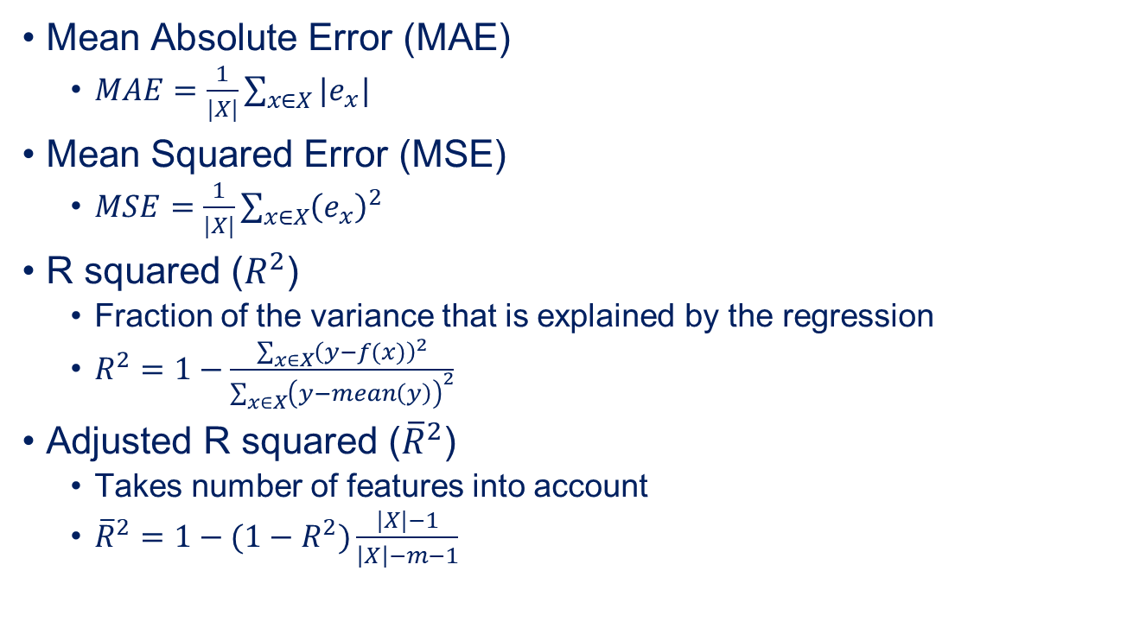
Measures for Regression Quality
Mean Absolute Error (MAE)
$MAE=\frac{1}{|X|}\sum_{x∈X}{|e_{x}|}$
Mean Squared Error (MSE)
$MSE=\frac{1}{|X|}\sum_{x∈X}{{\left(e_{x}\right)}^{2}}$
R squared ($R^{2}$)
Fraction of the variance that is explained by the regression
$R^{2}=1−\frac{\sum_{x∈X}{{\left(y−f(x)\right)}^{2}}}{\sum_{x∈X}{{\left(y−mean\left(y\right)\right)}^{2}}}$
Adjusted R squared (${\overline{R}}^{2}$)
Takes number of features into account
${\overline{R}}^{2}=1−(1−R^{2})\frac{|X|−1}{\left|X\right|−m−1}$

Slide 11
Outline
Overview
Linear Regression Models
Comparison of Regression Models
Summary

Slide 12
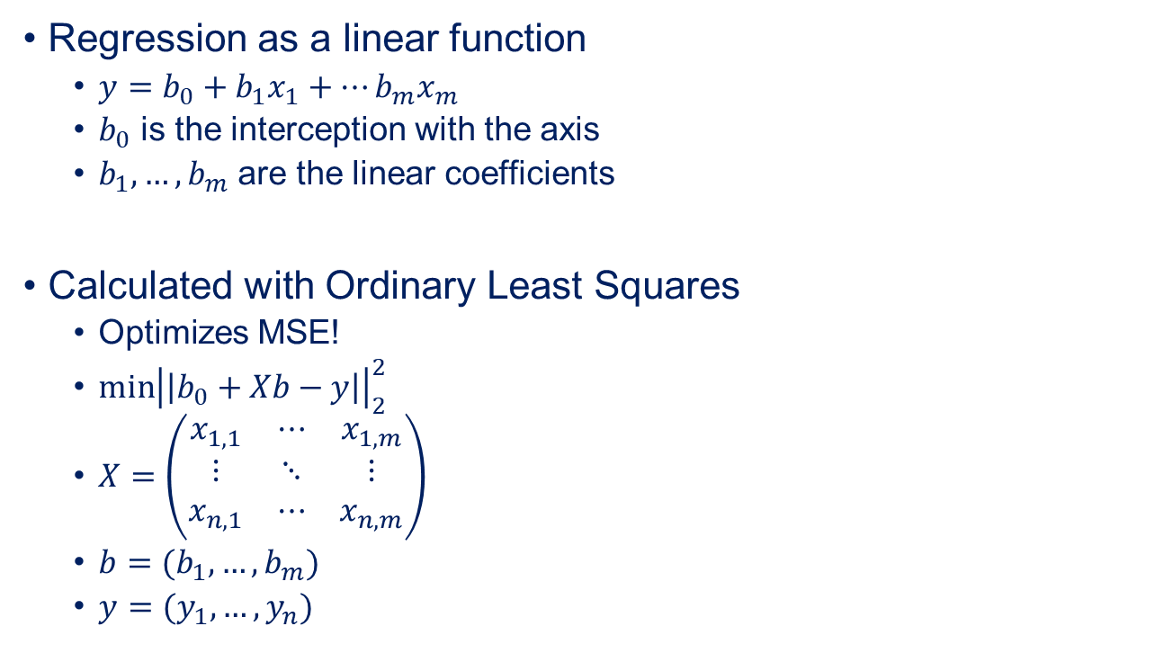
Linear Regression
Regression as a linear function
$y=b_{0}+b_{1}x_{1}+…b_{m}x_{m}$
$b_{0}$ is the interception with the axis
$b_{1},…, b_{m}$ are the linear coefficients
Calculated with Ordinary Least Squares
Optimizes MSE!
$\min{{\left|\left|b_{0}+Xb−y\right|\right|}_{2}^{2}}$
$X=\left(\begin{matrix}x_{1, 1} & ⋯ & x_{1, m} \\ ⋮ & ⋱ & ⋮ \\ x_{n,1} & ⋯ & x_{n,m}\end{matrix}\right)$
$b=(b_{1},…, b_{m})$
$y=(y_{1},…, y_{n})$
Square of Euclidean distance
$n$ is the number of instances in the training data

Slide 13

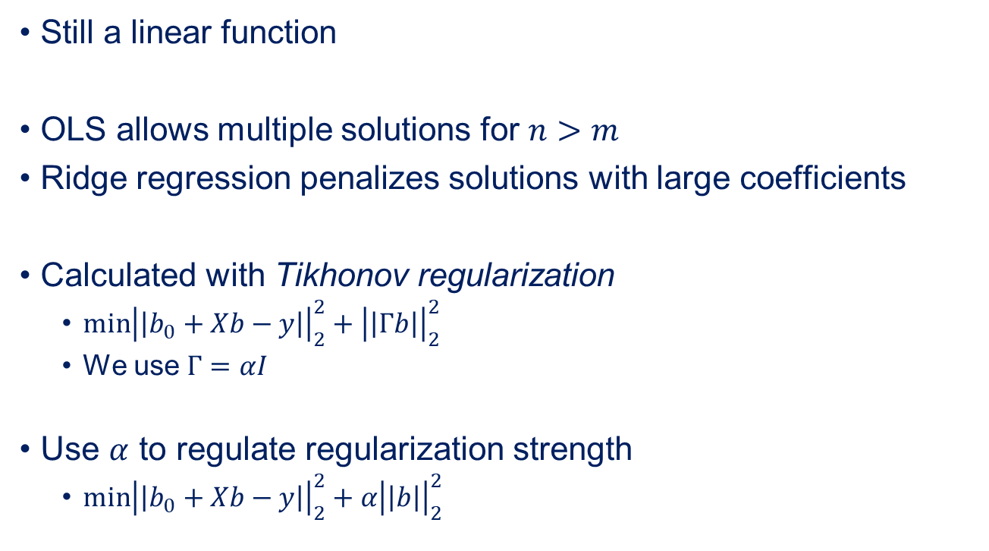
Ridge Regression
Still a linear function
OLS allows multiple solutions for $n>m$
Ridge regression penalizes solutions with large coefficients
Calculated with Tikhonov regularization
$\min{{\left|\left|b_{0}+Xb−y\right|\right|}_{2}^{2}+{\left|\left|Γb\right|\right|}_{2}^{2}}$
We use $Γ=αI$
Use $α$ to regulate regularization strength
$\min{{\left|\left|b_{0}+Xb−y\right|\right|}_{2}^{2}+{α\left|\left|b\right|\right|}_{2}^{2}}$
Regularization Term
Identity matrix

Slide 14

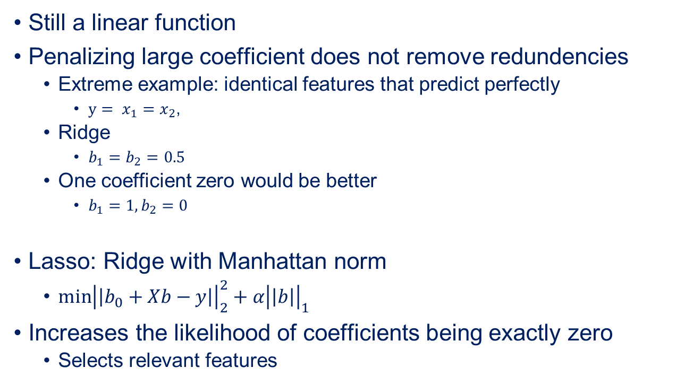
Lasso Regression
Still a linear function
Penalizing large coefficient does not remove redundencies
Extreme example: identical features that predict perfectly
$y= x_{1}=x_{2}$,
Ridge
$b_{1}=b_{2}=0.5$
One coefficient zero would be better
$b_{1}=1, b_{2}=0$
Lasso: Ridge with Manhattan norm
$\min{{\left|\left|b_{0}+Xb−y\right|\right|}_{2}^{2}+{α\left|\left|b\right|\right|}_{1}^{}}$
Increases the likelihood of coefficients being exactly zero
Selects relevant features

Slide 15
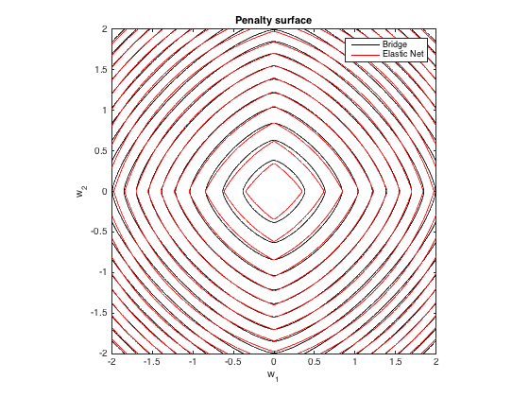
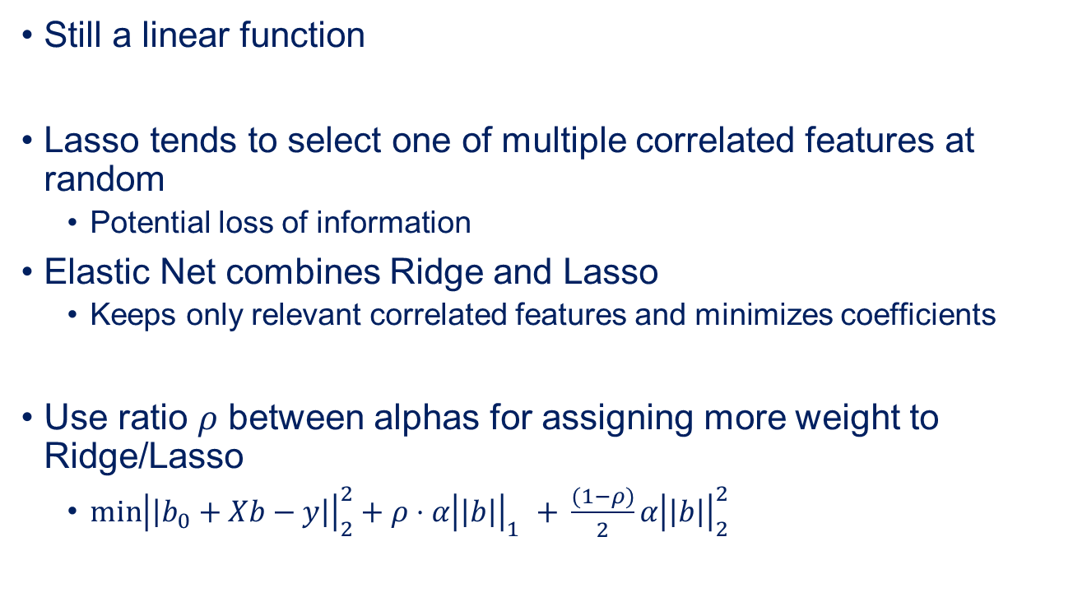
Elastic Net Regression
Still a linear function
Lasso tends to select one of multiple correlated features at random
Potential loss of information
Elastic Net combines Ridge and Lasso
Keeps only relevant correlated features and minimizes coefficients
Use ratio $ρ$ between alphas for assigning more weight to Ridge/Lasso
$\min{{\left|\left|b_{0}+Xb−y\right|\right|}_{2}^{2}+{ρ⋅α\left|\left|b\right|\right|}_{1}^{}+ }\frac{(1−ρ)}{2}α{\left|\left|b\right|\right|}_{2}^{2}$

Slide 16
Outline
Overview
Linear Regression Models
Comparison of Regression Models
Summary

Slide 17
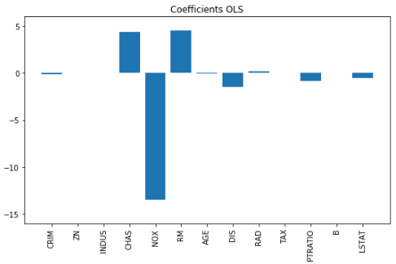
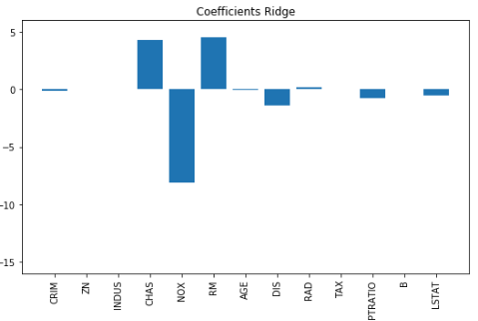
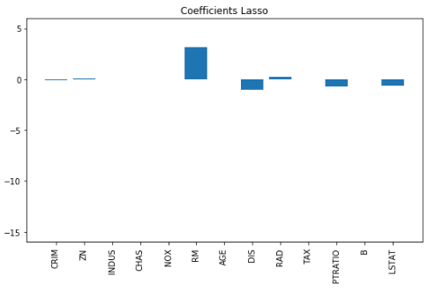
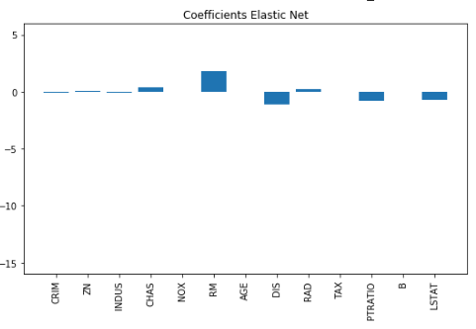
Comparison of Regression Models
Smaller coefficient values than OLS
Coefficient with previously highest value actually eliminated!
Smaller coefficient values than Lasso
All models trained with the same data and almost same performance

Slide 18
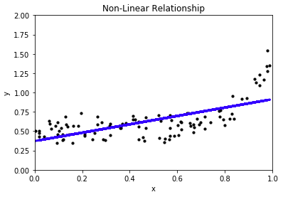
Non-linear Regression
Many relationships are not linear
Polynomial Regression
Support Vector Regression
Neural Networks

Slide 19
Outline
Overview
Linear Regression Models
Comparison of Regression Models
Summary

Slide 20
Summary
Regression finds relationships between independent and dependent variables
Linear regression as simple model often effective
Regularization can improve solutions
Lasso, Ridge, Elastic, …
Many non-linear approaches
Require care with the application
Overfitting can be very easy

