Slide 1
Chapter 11 Statistical Tests
Dr. Steffen Herbold
herbold@cs.uni-goettingen.de

Slide 2
Outline
Hypothesis Testing
Effect sizes
Confidence Intervals
Summary

Slide 3
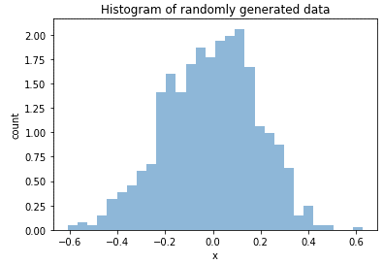

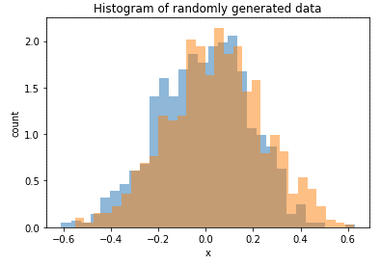
Reasons for Hypothesis Testing
Is this data normally distributed?
Do both populations have the same central tendency and/or variance?

Slide 4
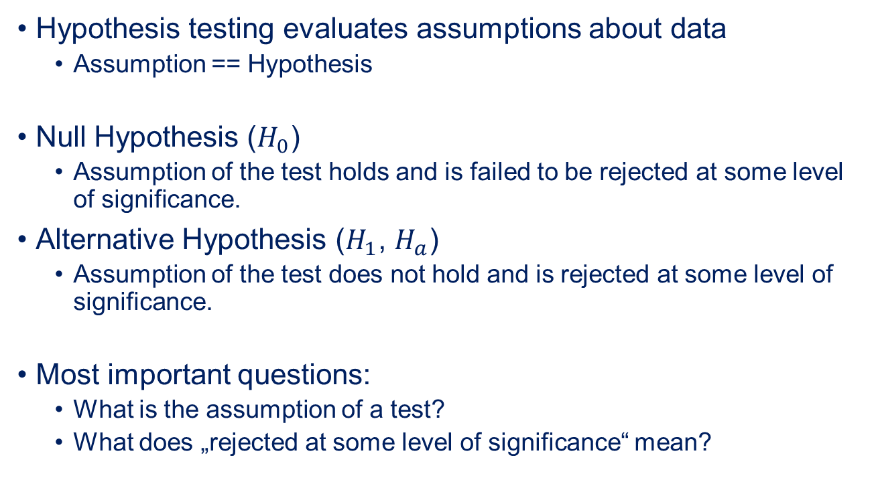
Null and Alternative Hypothesis
Hypothesis testing evaluates assumptions about data
Assumption == Hypothesis
Null Hypothesis ($H_{0}$)
Assumption of the test holds and is failed to be rejected at some level of significance.
Alternative Hypothesis ($H_{1}$, $H_{a}$)
Assumption of the test does not hold and is rejected at some level of significance.
Most important questions:
What is the assumption of a test?
What does „rejected at some level of significance“ mean?

Slide 5
P-Values
The probability of the observed data or more extreme data, given the null hypothesis is true.
Given the hypothesis, how likely is the data?
Not the same as given my data, how likely is the hypothesis!
Never use p-values as scores!
Calculated using the probability density function of a test statistic
Given the hypothesis, how likely is this statistical value about the data?

Slide 6
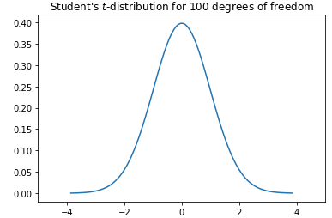

Student‘s $t$-Distribution
Test statistic used for estimating mean values for normally distributed data
Probability density function for the location of the deviation of a sample mean value from the real mean value
Roughly bell-shaped
Longer tails than normal distribution

Slide 7

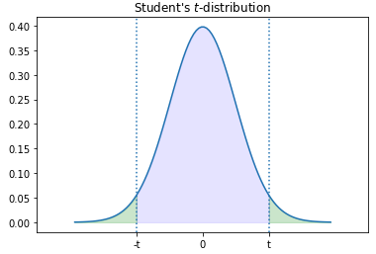

Example: Welch‘s t-Test
Also requires calculation of the degrees of freedom, which we omit here
Null Hypothesis
The means of two normally distributed populations $X_{1}$ and $X_{2}$ are equal.
$t$ statistic for Welch’s test:
$t= \frac{mean\left(X_{1}\right)−mean(X_{2})}{\sqrt{\frac{sd{\left(X_{1}\right)}^{2}}{N_{1}}+\frac{sd{\left(X_{2}\right)}^{2}}{N_{2}}}}$
Probability of the observed or more extreme data assuming the null hypothesis is true

Slide 8
Null hypotheses of important tests
Welch‘s t-test
The means of two normally distributed populations are equal
Shapiro-Wilk test
A population of 3 to 5000 independent samples is normally distributed
Kolmogorov-Smirnoff test
Two populations have the same probability distribution
Mann-Whitney-U Test / Wilcoxon-Ranksum-test
The values from one population dominate the values of another population (more or less difference of means/medians)
Levene‘s test
The variances of a group of populations are equal
ANOVA
The mean values of a group of populations are equal

Slide 9
Combinations of Tests
Example:
Are the mean values different?
Shapiro-Wilk test for normality
Both normal
At least one not normal
Welch‘s
t-test
Mann-Whitney
U-test

Slide 10
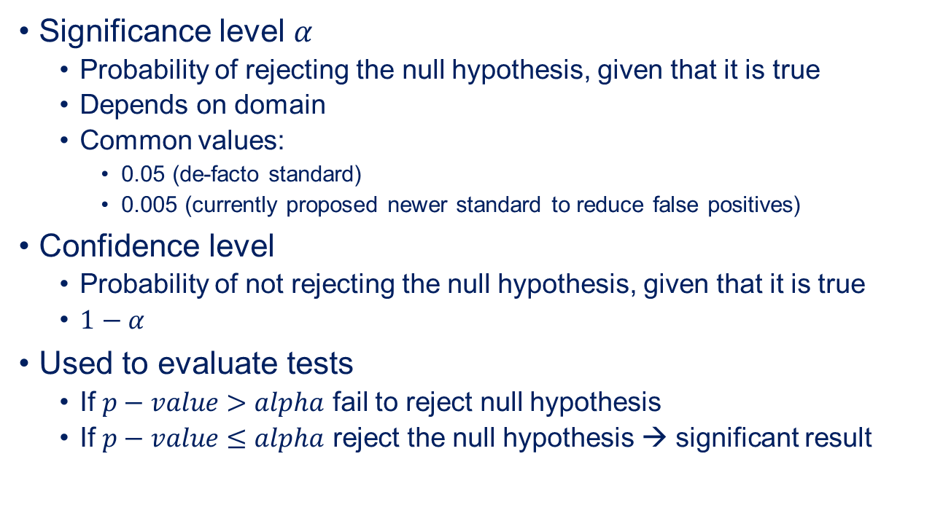
Significance and Confidence
Significance level $α$
Probability of rejecting the null hypothesis, given that it is true
Depends on domain
Common values:
0.05 (de-facto standard)
0.005 (currently proposed newer standard to reduce false positives)
Confidence level
Probability of not rejecting the null hypothesis, given that it is true
$1−α$
Used to evaluate tests
If $p−value>alpha$ fail to reject null hypothesis
If $p−value≤alpha$ reject the null hypothesis → significant result

Slide 11
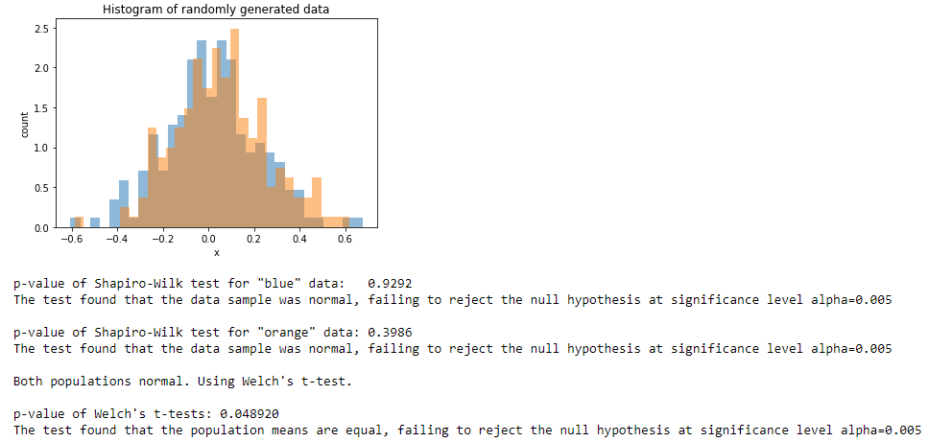
Example for running tests
“fail to reject” instead of “accept”

Slide 12
Problems with hypothesis testing
No binary results!
Results are probabilistic, i.e., you can reject/fail to reject the null hypothesis with a certain probability, but you cannot make binary claims.
Using p-values for scoring
p-values describe the likelihood of the data, given the hypothesis
Not the same as likelihood of hypothesis, given data!
Scoring makes no sense!
p-hacking
Re-running tests with different data until a desired result is found
Often inadvertent, e.g., due to subgroup analysis

Slide 13
Outline
Hypothesis Testing
Effect sizes
Confidence Intervals
Summary

Slide 14
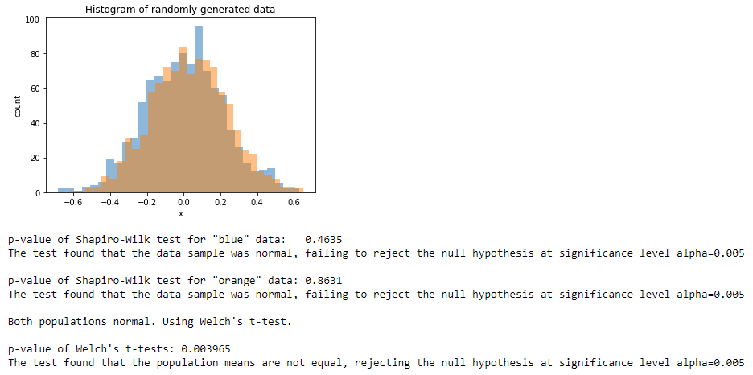

Significant $≠$ Important
Can we estimate the size of the difference?
Looks equal
Is probably different

Slide 15
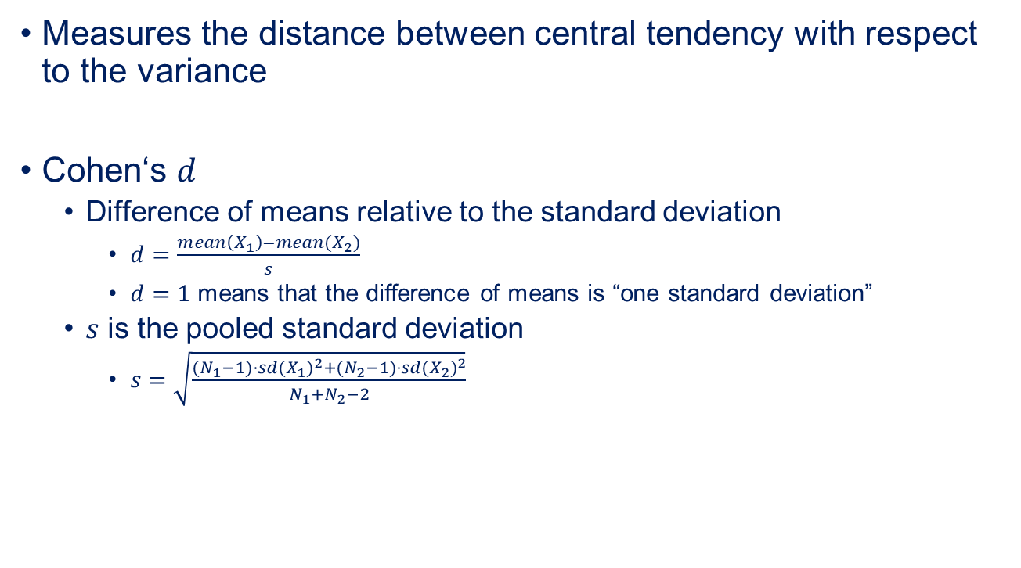

Effect size
There are also other measures like Hedges‘ $g^{∗}$, Glass’ $Δ$ that all use a similar concept
Measures the distance between central tendency with respect to the variance
Cohen‘s $d$
Difference of means relative to the standard deviation
$d=\frac{mean\left(X_{1}\right)−mean(X_{2})}{s}$
$d=1$ means that the difference of means is “one standard deviation”
$s$ is the pooled standard deviation
$s=\sqrt{\frac{{(N}_{1}−1)⋅{sd(X_{1})}^{2}+{(N}_{2}−1)⋅{sd(X_{2})}^{2}}{N_{1}+N_{2}−2}}$
Square root of the weighted mean of the variances
How do we know this is small?

Slide 16
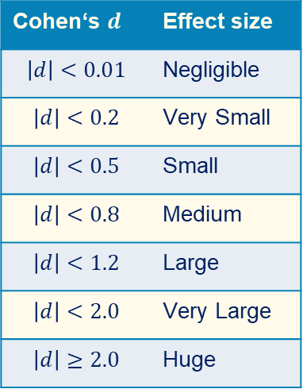
Interpretation of Effect Sizes
According to Cohen and Sawilowsky
Designed for social sciences
Should be used with care, but is broadly used in many domains
Cohen‘s $d$ | Effect size
$$\left|d\right|<0.01$$ | Negligible
$$\left|d\right|<0.2$$ | Very Small
$$\left|d\right|<0.5$$ | Small
$$\left|d\right|<0.8$$ | Medium
$$\left|d\right|<1.2$$ | Large
$$\left|d\right|<2.0$$ | Very Large
$$\left|d\right|≥2.0$$ | Huge

Slide 17
Outline
Hypothesis Testing
Effect sizes
Confidence Intervals
Summary

Slide 18
How accurate are estimations?
Example:
You have twenty different data sources.
You train on five of them and test on the other fifteen.
The mean value of the 15 test values is 0.83, the standard deviation is 0.13.
How accurate is the estimated mean value?

Slide 19
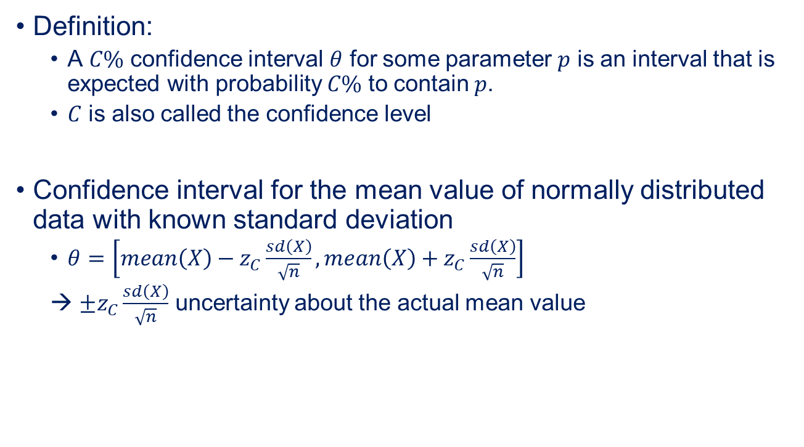

Confidence Intervals
We are assuming that everything is normally distributed. Similar formulas are available for non-normal data
Definition:
A $C\%$ confidence interval $θ$ for some parameter $p$ is an interval that is expected with probability $C\%$ to contain $p$.
$C$ is also called the confidence level
Confidence interval for the mean value of normally distributed data with known standard deviation
$θ=\left[mean\left(X\right)−z_{C}\frac{sd\left(X\right)}{\sqrt{n}},mean\left(X\right)+z_{C}\frac{sd\left(X\right)}{\sqrt{n}}\right]$
→ $±z_{C}\frac{sd\left(X\right)}{\sqrt{n}}$ uncertainty about the actual mean value
$$p$$

Slide 20
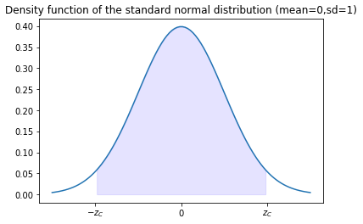


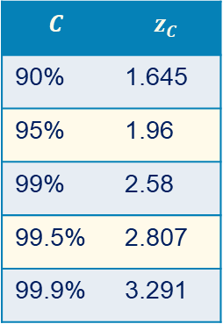

Explanation of $z_{C}$
Choosen such that $[−z_{C},z_{C}]$ is the $C\%$ confidence interval of the standard normal distribution
In practice: look it up in a table
$$C$$ | $$z_{C}$$
90% | 1.645
95% | 1.96
99% | 2.58
99.5% | 2.807
99.9% | 3.291
$C\%$ probability mass

Slide 21
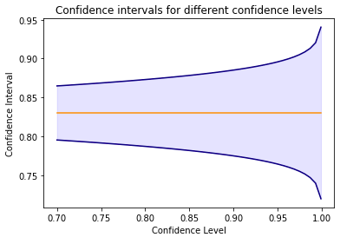
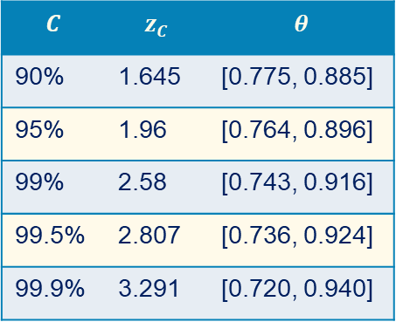
Example for Confidence Intervals
Example (repeated):
The mean value of the 15 test values is 0.83, the standard deviation is 0.13.
$$C$$ | $$z_{C}$$ | $$θ$$
90% | 1.645 | [0.775, 0.885]
95% | 1.96 | [0.764, 0.896]
99% | 2.58 | [0.743, 0.916]
99.5% | 2.807 | [0.736, 0.924]
99.9% | 3.291 | [0.720, 0.940]

Slide 22
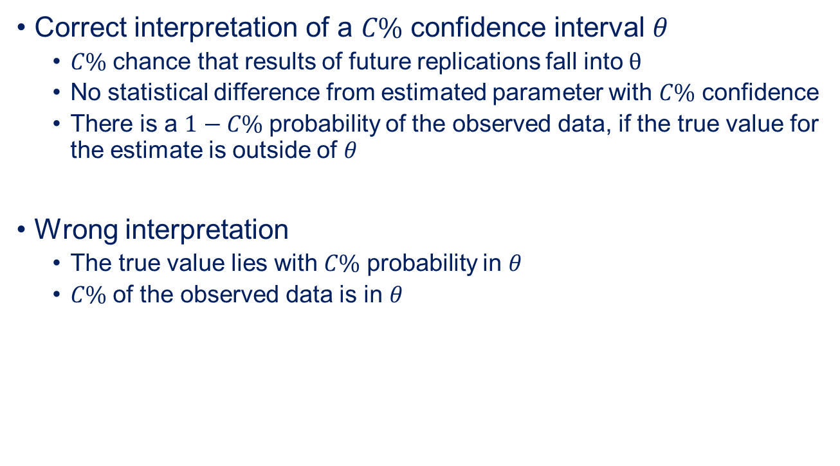
Interpretation of Confidence Intervals
Correct interpretation of a $C\%$ confidence interval $θ$
$C\%$ chance that results of future replications fall into $θ$
No statistical difference from estimated parameter with $C\%$ confidence
There is a $1−C\%$ probability of the observed data, if the true value for the estimate is outside of $θ$
Wrong interpretation
The true value lies with $C\%$ probability in $θ$
$C\%$ of the observed data is in $θ$

Slide 23
Outline
Hypothesis Testing
Effect sizes
Confidence Intervals
Summary

Slide 24
Summary
Hypothesis testing to evaluate significance of differences
Not significant → can be explained by random effects
Test results are probabilities, not binary true/false statements!
Effect sizes to evaluate strengths of significant differences
Confidence intervals to estimate accuracy of results
How stable are the results, if the experiment is repeated?
All of the above are often misused or interpreted wrongly!

