Slide 1
Chapter 12 Big Data with Map / Reduce
Dr. Steffen Herbold
herbold@cs.uni-goettingen.de

Slide 2
Outline
Overview
MapReduce
Apache Hadoop
Apache Spark
Summary

Slide 3
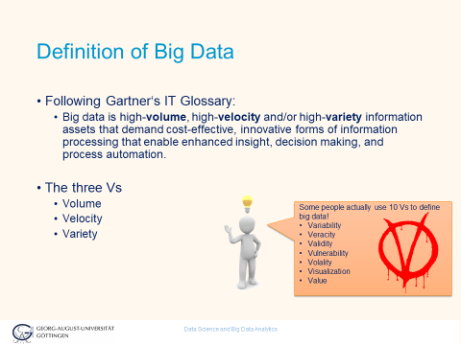
Repetition: Definition of Big Data
What are the innovative forms of information processing?

Slide 4
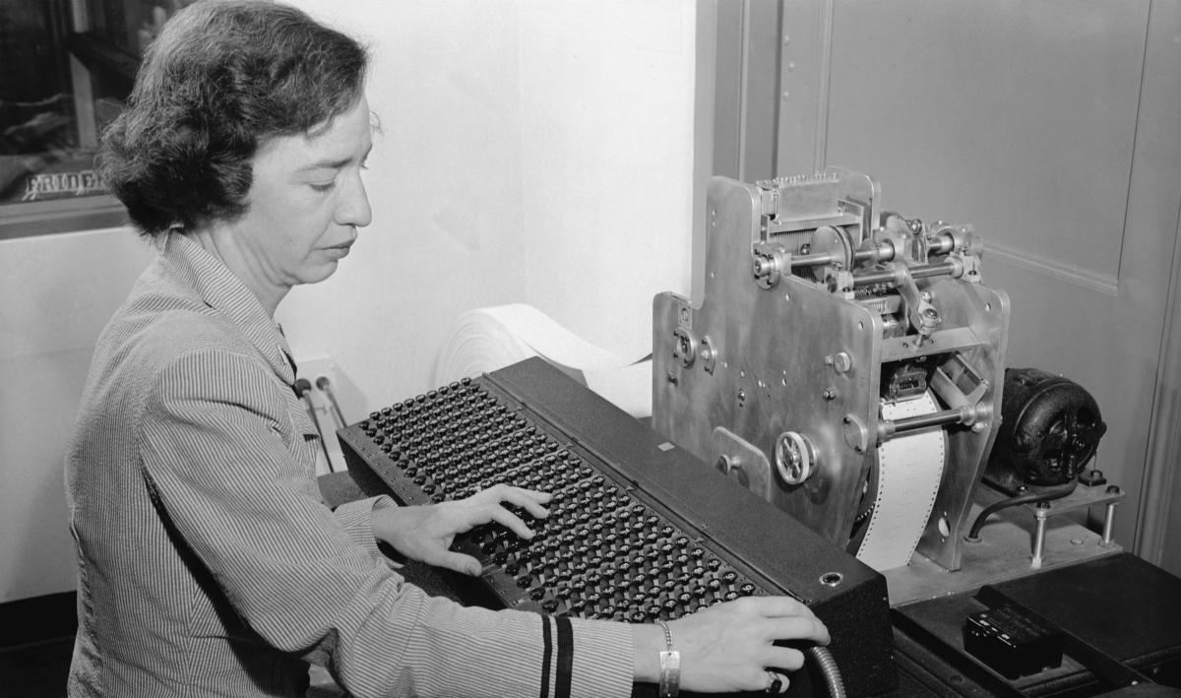
Parallelism is Mandatory
In pioneer days they used oxen for heavy pulling, and when one ox couldn't budge a log, they didn't try to grow a larger ox.
We shouldn't be trying for bigger computers, but for more systems of computers
– Grace Hopper

Slide 5

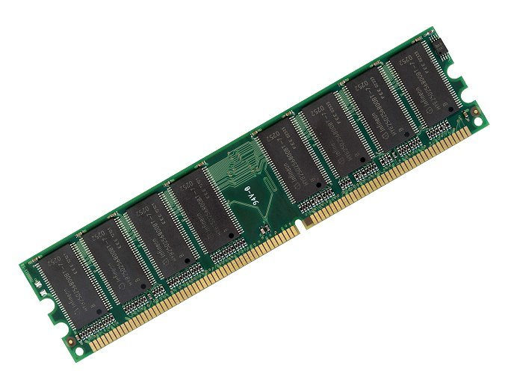
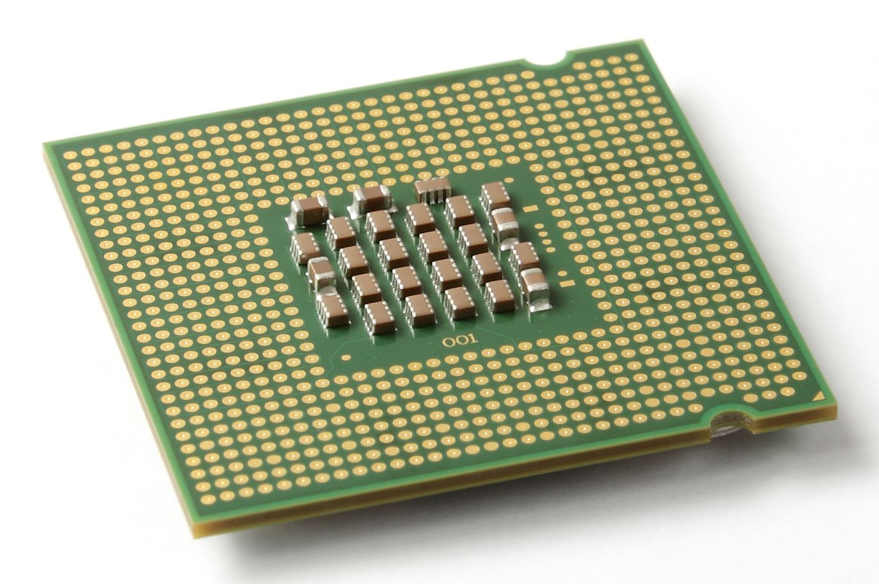




Parallel Programming Models
Message Passing
Independent tasks on local data
Tasks interact by exchanging messages
Shared memory
Tasks share common address space
Tasks interact by reading/writing in this space
Data parallelization
Tasks execute independent operations on partitions of data
Well suited for problems that are “embarrassingly parallel”

Slide 6


Traditional Infrastructures
Database or Storage Area Network (SAN)
Data storage
Compute Nodes
Compute cluster
…
Result / Insight

Slide 7
Message Passing / Shared Memory
Data storage
Each node may load complete data!
→ Does not scale
Compute cluster
…
Result / Insight

Slide 8
Data Parallelization
Data storage
Each node only loads partition
Scales better
Still requires transfering all data over the network
Compute cluster
…
Result / Insight

Slide 9


Data Locality as Solution
If moving data is the problem, stop moving the data!
Not supported by traditional clusters / infrastructures
Clusters for sharing CPUs, not storage
Storage made for IO, not computations

Slide 10


Core concept of Big Data Technologies
Parallelization
Data Locality
Compute Cluster with Distributed Storage
Our examples:
…

Slide 11
Outline
Overview
MapReduce
Apache Hadoop
Apache Spark
Summary

Slide 12
MapReduce
Programming model for data parallelization
Published in 2004 by Google
map() and reduce() functions for data processing
Based on transformations of key-value pairs
shuffle() function for arranging intermediate results
Distribution via master/worker paradigm
Supports high availability / recoverability
Discussed together with hadoop
Dean, Jeffrey, and Sanjay Ghemawat. "MapReduce: simplified data processing on large clusters." Communications of the ACM, 51.1 (2008): 107-113.

Slide 13
Overview of MapReduce
map()
shuffle()
reduce()
Key
Value
Initial pairs
<key1,value1>
Intermediate pairs
<key2,value2>
Pairs grouped
by key2
Results by key2

Slide 14
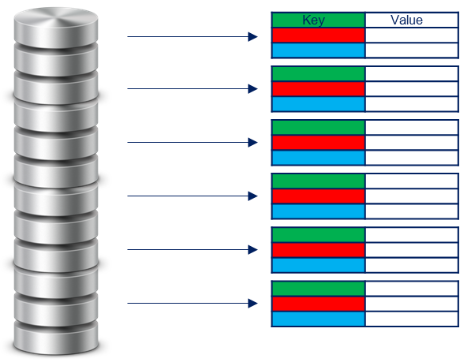
The map() Function
Concept from functional programming
Applies a function to every item in the input separately
map(fun, <key1,value1>) → list(<key2, value2>)
Functions are usually user-defined
Input keys and output keys can be different
Also different types
Output is a list, i.e., one mapping can have multiple outputs
All list elements must have same types
Data parallelization trivial
In the initial MapReduce implementation, all keys and values were strings, users where expected to convert the types if required as part of the map/reduce functions

Slide 15
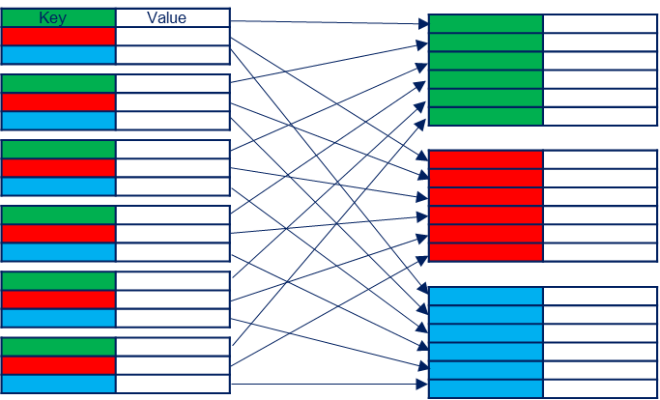
The shuffle() Function
Organize data by key
shuffle(list(<key2,value2>)) → list(<key2, list(value2)>)
Often includes sorting by key for efficiency
Shuffle does not wait for map() to finish
Once a <key2,value2> is available it can be shuffled
Reduces waiting times
Provided by the MapReduce framework
Can be overridden by users to optimize for use case

Slide 16
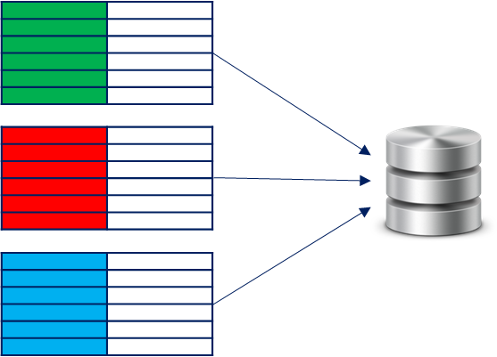
The reduce() Function
Related to fold from functional programming
Aggregates <key2,value2> pairs with the same key
Single value per key
Results in a list of values, one for each key
reduce(fun, list(<key2,list(value2)>)) → list(value3)
Functions are usually user defined

Slide 17
Parallelization with MapReduce
Input can be read in chunks
Parallelism for creation of initial key-value pairs
map() can be computed for each key-value pair independently
Parallelism potential only limited by amount of data
shuffle() can start working as soon as first key-value pair is processed
Limits waiting times
reduce() can run in parallel for different keys
Need not wait for map to complete
Can already start when all results for a key are available

Slide 18

Word Counts with MapReduce
This is the “Hello World” for MapReduce
What is your name?
The name is Bond, James Bond.
Our Data:
Initial <key1,value1> pairs:
<sentence1, “what is your name”>
<sentence2, “the name is bond james bond”>
map() function: emit <word,1> for each word in a sentence
<sentence1, “what is your name”>
→ <“what”,1>, <“is”,1>,<“your”,1>,<“name”,1>
<sentence2, “the name is bond james bond”>
→ <“the”, 1>,<“name”,1>,<“is”,1>,<“bond”,1>,<“james”,1>,<“bond”,1>
reduce() function: key concatenated with sum of values
<“what”, list(1)> → “what: 1”
<“bond”, list(1,1)> →”bond: 2”
…

Slide 19
Outline
Overview
MapReduce
Apache Hadoop
Apache Spark
Summary

Slide 20
Overview of Hadoop
Open-source implementation of MapReduce
Supported by all major cloud providers
Used by many large companies, e.g., Twitter, Facebook, Amazon, …
Hadoop
MapReduce
Others
Data Processing
YARN
Cluster resource management
HDFS
Distributed file system

Slide 21
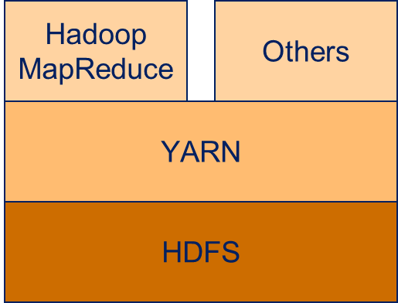
Hadoop Distributed File System (HDFS)
Core component of Hadoop
Goals of HDFS
High throughput instead of low latency
Support for large files and data sets
Moving computation instead of moving data (→ Data locality)
Resiliency against hardware failures
Uses a master/slave architecture

Slide 22

Overview of HDFS
Users
Access point for clients
Exposes file system operations
Organizes block creation / deletion / replication of DataNodes
Can have secondary NameNode to avoid single point of failure
NameNode
DataNodes
Stores blocks of data
Serves read/write requests
Perform computations on blocks

Slide 23





Example: Write File
Users
1. Create file
NameNode
2. Data stream for writing
7. Close and complete
File
6. Acknowledge
DataNodes
3. Write blocks
Blocks created by data stream
Replication level 2
→ Each block twice
4. Create replica
5. Acknowledge

Slide 24
Computing with Hadoop
HDFS „only“ distributed block storage
Each DataNode should also serve as compute node
Map / Reduce / Shuffle tasks
Ideally also general compute tasks
Each resource should only be used by one task
CPU cores
Memory
→ No overutilization
Resources should be used as efficiently as possible
→ No underutilization

Slide 25
YARN for Resource Management
Resource scheduler
Manages resources for different applications
Users
Resource Manager
NodeManager
NodeManager
NodeManager
Runs on DataNodes
Gets tasks from Resource Manager
Executes tasks on local resources

Slide 26

Running Applications with YARN
Users
Application
1. Submit
Resource Manager
2. Launch
Application
Master
5. Provide
resources
4.1. Allocate container
4.2. Allocate container
3. Request resources
NodeManager
NodeManager
NodeManager
Application
Application
Master
Application
6. Launch application in container
Called Container
Allocated by Resource Manager
Started by Application Master

Slide 27
Resource Requests
Send from Application Master to Resource Manager
Name of the resource
Can be used to select specific hosts or racks
Priority
Only within the application
Allows application to have an internal scheduler
Resource requirements
Memory
CPU cores
Number of containers
Resource Manager
4. Provide
Resources
3. Request
resources
NodeManager
Application
Master

Slide 28
Launching Containers
Executes parts of the application
For example, map, reduce, or shuffle tasks
Requires commands to start application
Environment configuration
E.g., environment variables of application call
Can access local resources
Binaries, HDFS files/blocks
NodeManager
NodeManager
Application
Master
Application
5. Launch application in container

Slide 29
MapReduce with Hadoop
Implementation of MapReduce on top of YARN
Users define applications as sequences of map/reduce tasks
Hadoop specifies as MRAppMaster YARN container
MRAppMaster manages execution of tasks
Two execution modes
Java applications
Streaming mode

Slide 30
Java Applications
MapReduce applications defined by Jobs programmatically
Job class used to
Specify input
Register mapper
Register reducer
Specify output
Mapper and reducer tasks defined by extending classes
Compiled Jar is submitted to resource manager for execution

Slide 31
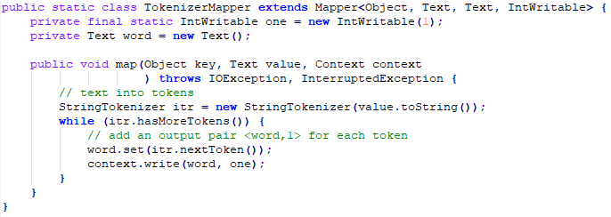
Example for a Mapper
Hadoop Mapper for Word Count example
Type of input value
Type of output key
Type of input key
Type of output value

Slide 32
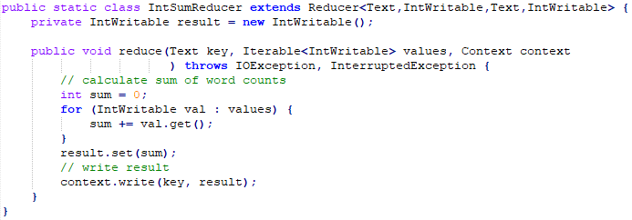
Example for a Reducer
Hadoop Reducer for the Word Count example
Type of input value
Type of output key
Type of input key
Type of output value

Slide 33
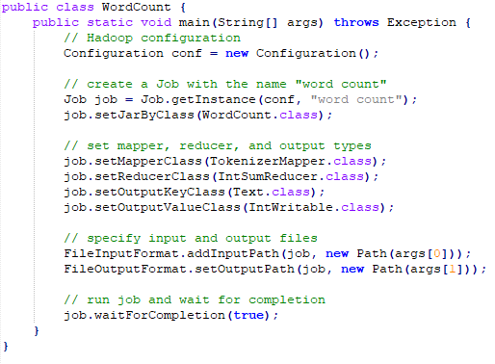
Example for a Job definition
Hadoop Job for the Word Count example
Reads file line by line

Slide 34




Execution of Word Count with Hadoop
Users
WordCount.jar
1. Submit
Resource Manager
2. Launch
Application
Master
NodeManager
DataNode
NodeManager
DataNode
NodeManager
DataNode
MRAppMaster

Slide 35
Execution of Word Count with Hadoop
Users
Resource Manager
5. Provide
resources
4.1. Allocate container for map
4.2. Allocate container for map
3. Request resources
for Map tasks
NodeManager
DataNode
NodeManager
DataNode
NodeManager
DataNode
WordCount
Map Task
MRAppMaster
WordCount
Map Task
7. Compute intermediary results
6. Launch Map tasks in container
7. Compute intermediary results

Slide 36
Execution of Word Count with Hadoop
Users
Resource Manager
9.1. Free container for map
9.2. Free container for map
8. Report tasks
as finished
NodeManager
DataNode
NodeManager
DataNode
NodeManager
DataNode
MRAppMaster

Slide 37
Execution of Word Count with Hadoop
Shuffle is an automated service running in the NodeManager
Users
Resource Manager
12. Provide
resources
11. Allocate container for reduce
10. Request resources
for Reduce tasks
15. Write output
NodeManager
DataNode
NodeManager
DataNode
NodeManager
DataNode
MRAppMaster
WordCount
Reduce Task
13. Launch Reduce tasks in container
14.2. Shuffle intermediary data
14.1. Shuffle intermediary data

Slide 38
Execution of Word Count with Hadoop
Users
Resource Manager
16. Report job
as finished
Node Manager
DataNode
Node Manager
DataNode
Node Manager
DataNode
MRAppMaster

Slide 39
Execution of Word Count with Hadoop
Users
Resource Manager
17.1. Free
App.
Master
17.1. Free container for reduce
NodeManager
DataNode
NodeManager
DataNode
NodeManager
DataNode

Slide 40
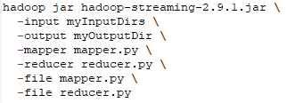
Streaming Mode of Hadoop
Provided Java Application that implements Hadoop MapReduce
Input and output by line-wise file processing
Same as the handler we showed in the word count example
Formats can be defined using command line parameters
Mapper/Reducer can be any executable application
Java Application that implements Hadoop MapReduce
Input and output locations
Executables used as mapper/reducer
Copies local files to compute nodes

Slide 41
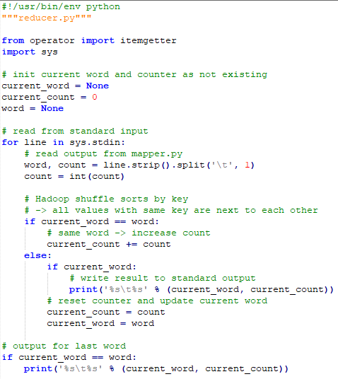
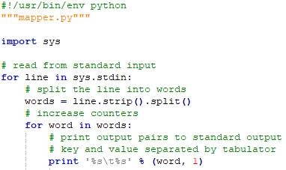
Word Count with Python

Slide 42
Additional Important Parts of Hadoop
Combiner
Reducer function that runs locally before shuffling the data to another node
Often same as reducer, but not always
Requires functions to be chainable / idempotent
Can reduce network traffic
Example:
Word count reducer can also be used as combiner
The shuffled pairs would not all have a count of 1 anymore, but the word counts of the data of that node
MapReduce Job History Server
Collects information about the history of MapReduce jobs
Log files, start/end times, job state
Can be used by users to see status ob their jobs

Slide 43
Limitations of Hadoop
Multiple Map and/or Reduce steps require multiple jobs
Can still be defined in a single Java file
Output of one job can be input of another job
Jobs can have dependencies, e.g., one waiting for the completion of other jobs
Dependencies must be modeled by the programmer
All communication between jobs via the file system
Bad for multiple computations on the same data, e.g., chained map functions

Slide 44
Outline
Overview
MapReduce
Apache Hadoop
Apache Spark
Summary

Slide 45
Apache Spark
Engine for large-scale data processing
Designed to resolve limitations of Hadoop for data analysis
Supports in-memory analysis
Good support for iterative algorithms
Supports arbitrary combinations of Map and Reduce tasks
Users do not need to care about specific jobs and their dependencies

Slide 46
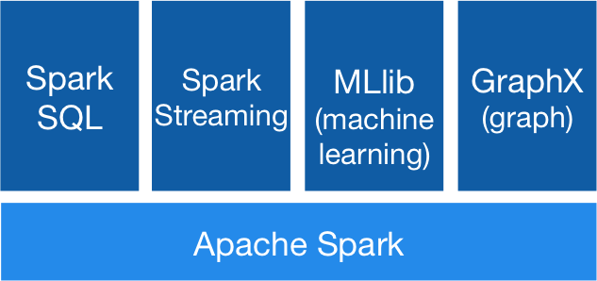
Spark Stack (I)
SparkSQL for SQL-like queries and data frame generation
Spark Streaming for live processing of streaming data

Slide 47
Spark Stack (II)
MLlib for machine learning algorithms
> 20 algorithms for clustering, regression, and classification
GraphX for graph algorithms

Slide 48
Data Structures used by Spark
Not a file system like Hadoop, instead two important in-memory data structures
Resilient Distributed Dataset (RDD)
Abstraction layer for data operations
Immutable partitions of elements
All elements in a RDD can be processed in parallel
Support map, reduce, filtering, user-defined functions, and persistence
Data frame
Higher abstraction built on RDDs
Similar to R / pandas data frames
Usually generated using the SparkSQL API

Slide 49
Infrastructures to Execute Apache Spark
Spark allows setup of clusters for computing
Not the standard way to use Spark
Compatible with many existing infrastructures instead
Computing
Hadoop/YARN and Apache Mesos
Storage
Hadoop/HDFS, Cassandra, HBase, MongoDB, …

Slide 50
Programming with Apache Spark
Natively implemented in Scala
JVM language with type inference and functional programming concepts
Also provides APIs for
Java
Python (PySpark)
R (SparkR)

Slide 51

Word Count with PySpark
flatMap can map input to multiple outputs
reduceByKey reduces the data set by merging (i.e. reducing) key-value pairs with the same key
Python lambda functions: anonymous function with parameters a,b that returns the result of the computation after the colon, i.e., a+b

Slide 52
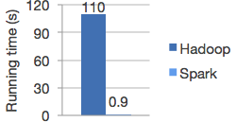
Two major differences to Hadoop
In-memory
RDDs and data frames are handled in-memory if possible
Vast speed-up
Example: Logistic Regression
Does not provide own distributed storage back-end

Slide 53
Spark Ecosystem
Different execution modes
Large open source community
Many technologies on top of Spark
https://spark-packages.org/
Still rapidly developing
Core concepts stable
2.4.0 release this fall
3.0.0 release planned for next year

Slide 54
Outline
Overview
MapReduce
Apache Hadoop
Apache Spark
Summary

Slide 55
Summary
Big data processing requires dedicated infrastructures
Moving data not feasible
Move computation to data
MapReduce as programming model for big data processing
Apache Hadoop as big data framework
HDFS distributed and reliable file system
YARN for resource management
Provides a MapReduce framework
Apache Spark for in-memory computations with big data
Compatible with different infrastructures, including Hadoop
Provides API for machine learning

