Slide 1
VGA Transpose and Edge Detection
Team 7 - Distance Learning Students
Bryce Williams - GTID: 903097901
Zachary Boe - GTID: 903124261
Gregory Walls - GTID: 903289298
Benjamin Sullins - GTID: 903232988

Slide 2



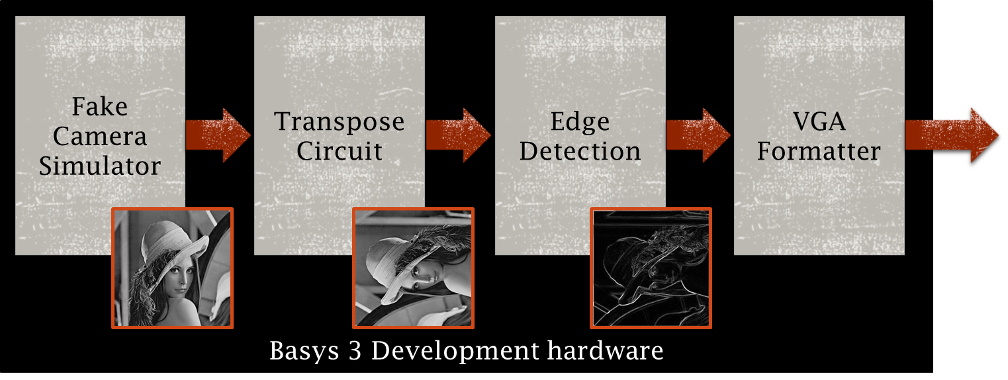
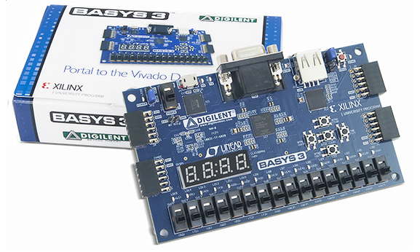

Project Overview
Completed Design Will Provide:
User Selectable Video Output Options
On/Off Transpose
On/Off Edge Detection
VGA Formatted Video Output
Internal VHDL Firmware
User DIP Switch Inputs
VGA Monitor
DIP Switch Inputs
VGA Connector/Cable
Basys 3 Board

Slide 3
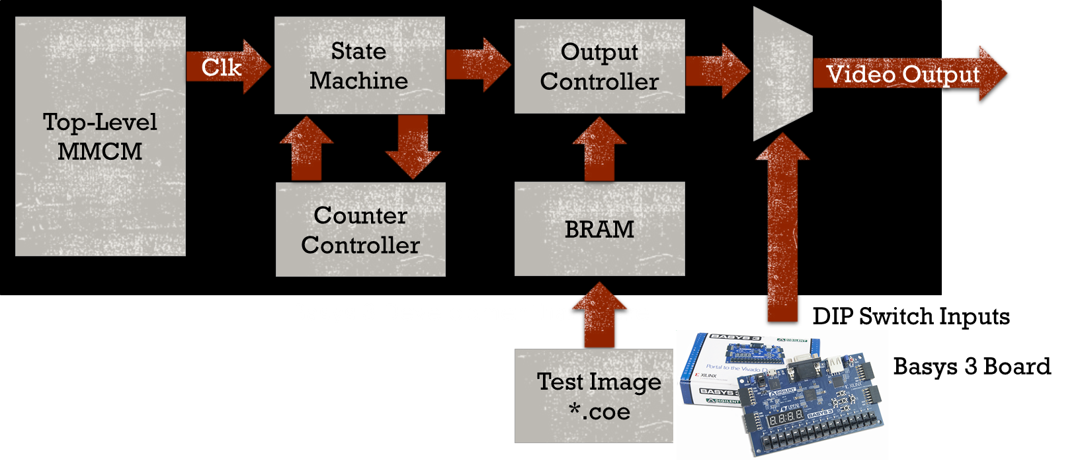


Chip Architecture/Memory Design
Fake Camera:
MMCM – Clock and Reset Provider
State Machine – Controls Frame Generation
Counter Controller – Controls Location Within Frame
Output Controller – Strobe/Data Generation
BRAM – Preloaded *.coe Test Image
Mux – User Selectable Output Selection
Notes: Top Level Generics Establish Output Frame Size, Frame Rate, Bit Depth
Transpose Circuit:
Counter Controller – Controls Location Within Frame
Output Controller – Outputs Pixel and Sync Data in VGA Compatible Format
BRAM – Memory Allocated for Buffering Images
Output Select – Switch Used to Select Either the Original Image or the Transpose Image

Slide 4
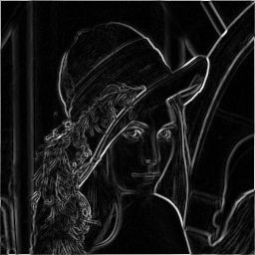
Chip Architecture/Memory Design
Edge Detection:
Streamed 8-bit Data Input
Two 3x3 Filters (Separable Matrix Configuration/Row-Column); Vertical and Horizontal Filter
Muxed Output Select: Original, Vertical, Horizontal, or Sum of Gradients Image (8-bit)
Dynamic Latency Compensation for Frame and Line Valid Signals
Two N-bit Block RAM Line Buffers (Feed both Vertical and Horizontal Images)
VGA Formatter:
MMCM – Clock and Reset Provider
BRAM – Serves as a clock domain crossing element
New incoming images overwrite the BRAM address space at incoming clock rate
Address space is read out according to VGA specs at clock rate corresponding to output resolution
Syncs – Counters are kept at VGA clock rate to determine correct timing and duration for sync signals
Clk
BRAM
VGAClk
Video
Video
HSync
VSync

Slide 5
Architectural Alternatives
Fake Camera:
Design Verified Operational At 100 MHz (System Clock)
Design Outputs Verified:
Horizontal Test Bars
Vertical Test Bars
Preloaded Test Image
Design Throughput Verified:
Valid Pixels : 160
Valid Lines : 120
Invalid Pixels: 16
Bit Depth : 8 (Monochrome)
Pixel Rate: 50 MHz
Slice Logic
Site Type |  | Used | Fixed | Available | Util%
Slice LUTs |  | 74 | 0 | 20800 | 0.36
 | LUT as Logic | 74 | 0 | 20800 | 0.36
 | LUT as Memory | 0 | 0 | 9600 | 0
Slice Registers |  | 77 | 0 | 41600 | 0.19
 | Register as Flip Flop | 77 | 0 | 41600 | 0.19
 | Register as Latch | 0 | 0 | 41600 | 0
F7 Muxes |  | 8 | 0 | 16300 | 0.05
F8 Muxes |  | 0 | 0 | 8150 | 0
Power
Total On-Chip Power (W) | 0.199
Dynamic (W) | 0.127
Device Static (W) | 0.072
Effective TJA (C/W) | 5
Max Ambient (C) | 84
Junction Temperature (C) | 26
Confidence Level | Low
Setting File | ---
Simulation Activity File | ---
Design Nets Matched | NA
Design Timing Summary
WNS(ns) | WHS(ns) | WPWS(ns)
13.938 | 0.06 | 3
Memory
Site Type | Used | Fixed | Available | Util%
Block RAM Tile | 5 | 0 | 50 | 10
RAMB36/FIFO* | 5 | 0 | 50 | 10
RAMB36E1 only | 5
RAMB18 | 0 | 0 | 100 | 0

Slide 6


Architectural Alternatives
Transpose Circuit:
An Entire Frame is Buffered Before Outputting the Image – This Ensures that the Necessary Pixels will be Available in BRAM for the Transpose Image Output
The Frame Dimensions are Retained for the Rectangular Transpose – The Extra Pixels are Cut Off on the Short Side of the Frame; the Empty Pixels on the Long Side of the Frame are Set to 0x00
Slice Logic
Site Type |  | Used | Fixed | Available | Util%
Slice LUTs |  | 131 | 0 | 20800 | 0.63
 | LUT as Logic | 131 | 0 | 20800 | 0.63
 | LUT as Memory | 0 | 0 | 9600 | 0.00
Slice Registers |  | 82 | 0 | 41600 | 0.20
 | Register as Flip Flop | 82 | 0 | 41600 | 0.20
 | Register as Latch | 0 | 0 | 41600 | 0.00
F7 Muxes |  | 8 | 0 | 16300 | 0.05
F8 Muxes |  | 0 | 0 | 8150 | 0.00
Power
Total On-Chip Power (W) | 0.079
Dynamic (W) | 0.009
Device Static (W) | 0.070
Effective TJA (C/W) | 5.0
Max Ambient (C) | 84.6
Junction Temperature (C) | 25.4
Confidence Level | Low
Setting File | ---
Simulation Activity File | ---
Design Nets Matched | NA
Design Timing Summary
WNS(ns) | WHS(ns) | WPWS(ns)
4.362 | 0.086 | 4.500
Memory
Site Type | Used | Fixed | Available | Util%
Block RAM Tile | 5 | 0 | 50 | 10.00
RAMB36/FIFO* | 5 | 0 | 50 | 10.00
RAMB36E1 only | 5
RAMB18 | 0 | 0 | 100 | 0.00

Slide 7
Architectural Alternatives
Edge Detection:
Current design uses 2x separable multiplier banks per filter with shared line buffers; reduces filter operation complexity and line buffers only required to be as wide as data samples
Alternatives include:
Single MCM filter block
Implements Full/Inseparable Matrix Operations; Increased filter operation complexity and BRAM Line Buffers require larger data widths
N-MCM filter block
Implements Full/Inseparable Matrix Operations; Increased filter operation complexity
Slice Logic
Site Type |  | Used | Fixed | Available | Util%
Slice LUTs |  | 231 |  | 20800
 | LUT as Logic | 198 |  | 20800
 | LUT as Memory | 33 |  | 9600
Slice Registers |  | 608 |  | 41600
 | Register as Flip Flop | 608 |  | 41600
 | Register as Latch | 0 |  | 41600
F7 Muxes |  | 0 |  | 16300
F8 Muxes |  | 0 |  | 8150
Power
Total On-Chip Power (W) | 6.964
Dynamic (W) | 6.861
Device Static (W) | 0.103
Effective TJA (C/W) | 5.0
Max Ambient (C) | 50.2
Junction Temperature (C) | 59.8
Confidence Level | Low
Setting File
Simulation Activity File
Design Nets Matched | NA
Memory
Site Type | Used | Fixed | Available | Util%
Block RAM Tile | 1 |  | 50
RAMB36/FIFO* | 0 |  | 50
RAMB36E1 only | 2
RAMB18 | 2 |  | 100

Slide 8
Architectural Alternatives
VGA Converter:
VGA Timings Are Set In Stone – No Alternatives Except Different Resolutions
Dual Frame Buffer
Eliminate Frame Flicker When Switching Frames
Suited More For Continuously Changing Frames (Video)
Would Require Dropping Information On The BRAM Input Side
Slice Logic
Site Type |  | Used | Fixed | Available | Util%
Slice LUTs |  | 168 | 0 | 20800 | 0.81
 | LUT as Logic | 168 | 0 | 20800 | 0.81
 | LUT as Memory | 0 | 0 | 9600
Slice Registers |  | 135 | 0 | 41600 | 0.32
 | Register as Flip Flop | 135 | 0 | 41600 | 0.32
 | Register as Latch |  | 0 | 41600 | 0
F7 Muxes |  | 8 | 0 | 16300 | 0.05
F8 Muxes |  | 0 | 0 | 8150 | 0
Power
Total On-Chip Power (W) | 0.199
Dynamic (W) | 0.127
Device Static (W) | 0.072
Effective TJA (C/W) | 5
Max Ambient (C) | 84
Junction Temperature (C) | 26
Confidence Level | Low
Setting File | ---
Simulation Activity File | ---
Design Nets Matched | NA
Design Timing Summary
WNS(ns) | WHS(ns) | WPWS(ns)
13.938 | 0.06 | 3
Memory
Site Type | Used | Fixed | Available | Util%
Block RAM Tile | 9 | 0 | 50 | 38
RAMB36/FIFO* | 9 | 0 | 50 | 38
RAMB36E1 only | 9
RAMB18 | 0 | 0 | 100 | 0

Slide 9


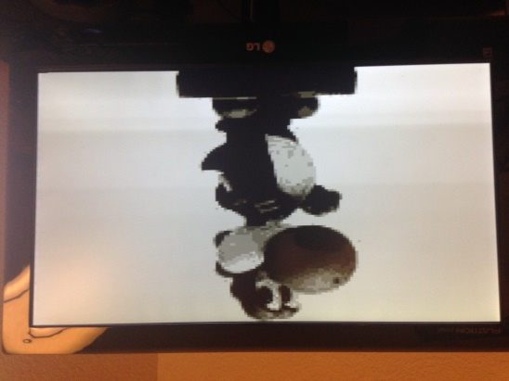
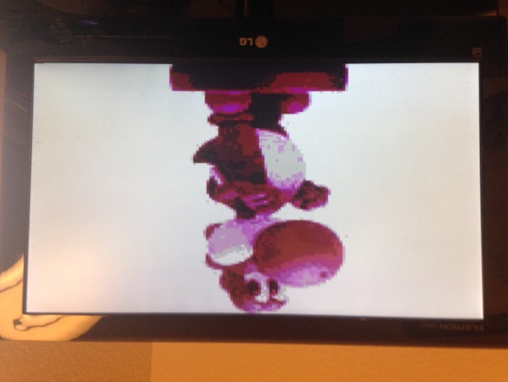




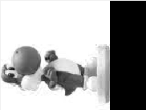
Final Design Review Plans
Fake Camera:
Generate Additional Preloaded Test Images for Verification (Right)
Actual Output Seen Below (Grayscale Yoshi.png)
Bonus: ColorMapping Circuit Completed (Pink Yoshi.png)
No Additional Plans Needed
Transpose Circuit:
MATLAB Simulation
Receive and Buffer Images from the Simulated Camera
Output the Original Image in VGA Format
Output the Transpose Image in VGA Format
Implement Output Select Switch
Minimize BRAM by Avoiding Invalid Address Values
No Additional Plans Needed

Slide 10


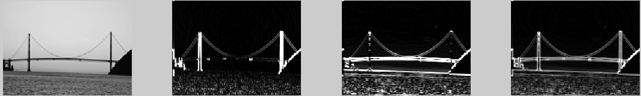
Final Design Review Plans
Edge Detection:
Resize And Integrate Line Buffers According To Final Decision On Image Width
All Objectives Completed; Refine Product As Needed
Actual Post-processed Simulation Results Seen To The Right
VGA Converter:
Generate Additional Test Patters To Verify Correct VGA Timings
Additional Debug To Eliminate Sporadic Issues
Code Cleanup

Slide 11
Schedule/Milestones
Description:
Work Assignments:
Project Abstract – Nov 2nd, 2017
Project PDR – Nov 12th, 2017
Project CDR – Nov 19th, 2017
Final Presentation – Nov, 30th 2017
Bryce Williams : Edge Detection
Zachary Boe : VGA Formatter
Gregory Walls : Transpose Circuit
Benjamin Sullins : Fake Camera Sim.
Milestones | Oct. 30th | Nov. 2nd | Nov. 12th | Nov. 19th | Nov. 25th | Nov. 30th
Requirements / Concept Design
Sub-Module Design Capture
Sub-Module Design Test and Peer Review
Sub-Module Integration
Project Abstract
Project PDR
Project CDR
Final Presentation
Legend: Complete Incomplete (Milestones – All Team Members)

Slide 12
Status/Risks Met
Fake Camera Simulator
Transpose Circuit
POC: Benjamin Sullins
100% Complete
Horizontal Test Pattern Complete
Vertical Test Pattern Complete
Preloaded Test Image Complete
All Tasks Verified In ISIM
POC: Gregory Walls
100% Complete
Output Original Image Complete
Output Transpose Image Complete
Output Select Switch Complete
BRAM Minimized
All Tasks Verified In ISIM
Edge Detection
VGA Formatter
MATLAB Algorithm Reference and Image Data Generator for VHDL Sim (Complete)
MATLAB Post-Processing Script (Complete)
Fully Implemented VHDL Sobel Filter with Output Select (Complete)
VHDL Simulation/Verification of Design (Complete)
POC: Zachary Boe
95% Complete
Horizontal Sync Complete
Vertical Sync Complete
BRAM Addressing Complete
Functional Verification In Process

