Slide 1
VGA Transpose and Edge Detection
Team 7 - Distance Learning Students
Bryce Williams - GTID: 903097901
Zachary Boe - GTID: 903124261
Gregory Walls - GTID: 903289298
Benjamin Sullins - GTID: 903232988

Slide 2

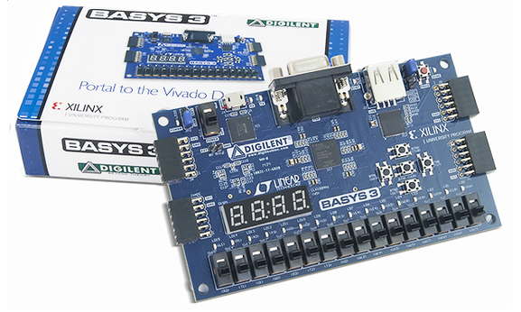
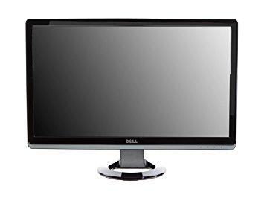

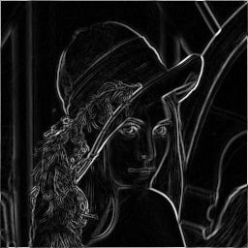

Project Overview
Description:
Develop A Processing System For Generating Synthetic Images, Transposing, Detecting Edges, and Displaying Video To A VGA Monitor.
Hardware Implemented On A Basys 3 Development Board
Firmware Written In VHDL Within Vivado 2017.2
Basys 3 Development hardware
Fake Camera Simulator
Transpose Circuit
Edge Detection
VGA Formatter

Slide 3


Subsystem Description
Fake Camera Simulator
Transpose Circuit
Generate Synthetic Video
Horizontal Ramp Test Pattern
Vertical Ramp Test Pattern
Pre-Loaded Cropped Image
Replicates Real-Life Camera Output
CameraLink Pixel Clock Rates - 50 MHz
Image Size – 160x120
Frame Rate – 50 Hz
Monochrome
Selectable Video Output
Non-Transposed
Transposed
Retains Input Video Format
Retains Input Video Frame Rate
Retains Input Video Pixel Clock Rate
Edge Detection
VGA Formatter
Selectable Video Output
Unfiltered
Edge Detection Filtered
Sobel Edge Detection
3x3 Kernel
Vertical and Horizontal Edge Detection
Retains Input Video Format
Retains Input Video Frame Rate
Retains Input Video Pixel Clock Rate
VGA Video Format Converter
Pixel Clock Rate - 25.175 MHz
Image Size - 640x480
Frame Rate – 60 Hz
Clock Domain Transferring
Image Up-scaling
Grayscale

Slide 4
Optimizations
Fake Camera Simulator
Transpose Circuit
Consolidate Individual Frame FVAL/LVAL Control Signal Generations To Single Module
Reduce Resource Utilization For Horizontal/Vertical Ramp Test Pattern Data Generation
Reduce Resource Utilization by shrinking the BRAM IP as much as possible
Edge Detection
VGA Formatter
Reduce Resource Utilization for Vertical and Horizontal Filters (Shared Line-Buffers)
Reduce Resource Utilization for Line-Buffers (IP BMG)
Single Frame BRAM Due To Mostly Static Images
Upscale Counters To Allow Input Frames Smaller By Powers Of 2

Slide 5
Timeline
Description:
Work Assignments:
Project Abstract – Nov 2nd, 2017
Project PDR – Nov 12th, 2017
Project CDR – Nov 19th, 2017
Final Presentation – Nov, 30th 2017
Bryce Williams : Edge Detection
Zachary Boe : VGA Formatter
Gregory Walls : Transpose Circuit
Benjamin Sullins : Fake Camera Sim.
Milestones | Oct. 30th | Nov. 2nd | Nov. 12th | Nov. 19th | Nov. 25th | Nov. 30th
Requirements / Concept Design
Sub-Module Design Capture
Sub-Module Design Test and Peer Review
Sub-Module Integration
Project Abstract
Project PDR
Project CDR
Final Presentation
Legend: Complete Incomplete (Milestones – All Team Members)

Slide 6
Risk Mitigation
Fake Camera Simulator
Transpose Circuit
Horizontal/Vertical Ramp Test Pattern Generation Simulated With Matlab
Pre-Loaded Cropped Image Simulated With Matlab
All Data Output Options Simulated With ISIM
ISIM Code Verification Using Synthetic Images
Use VGA Monitor to Visually Verify Correct Functionality
Edge Detection
VGA Formatter
Algorithm Implementation in MATLAB
MATLAB Generated Image Data for VHDL Simulation
MATLAB Post-Processing of VHDL Simulation Output Data
VGA Sync Signals Simulated With ISIM
VGA Monitor Output
Reference Digilent Basys3 GPIO Demo Project

Slide 7
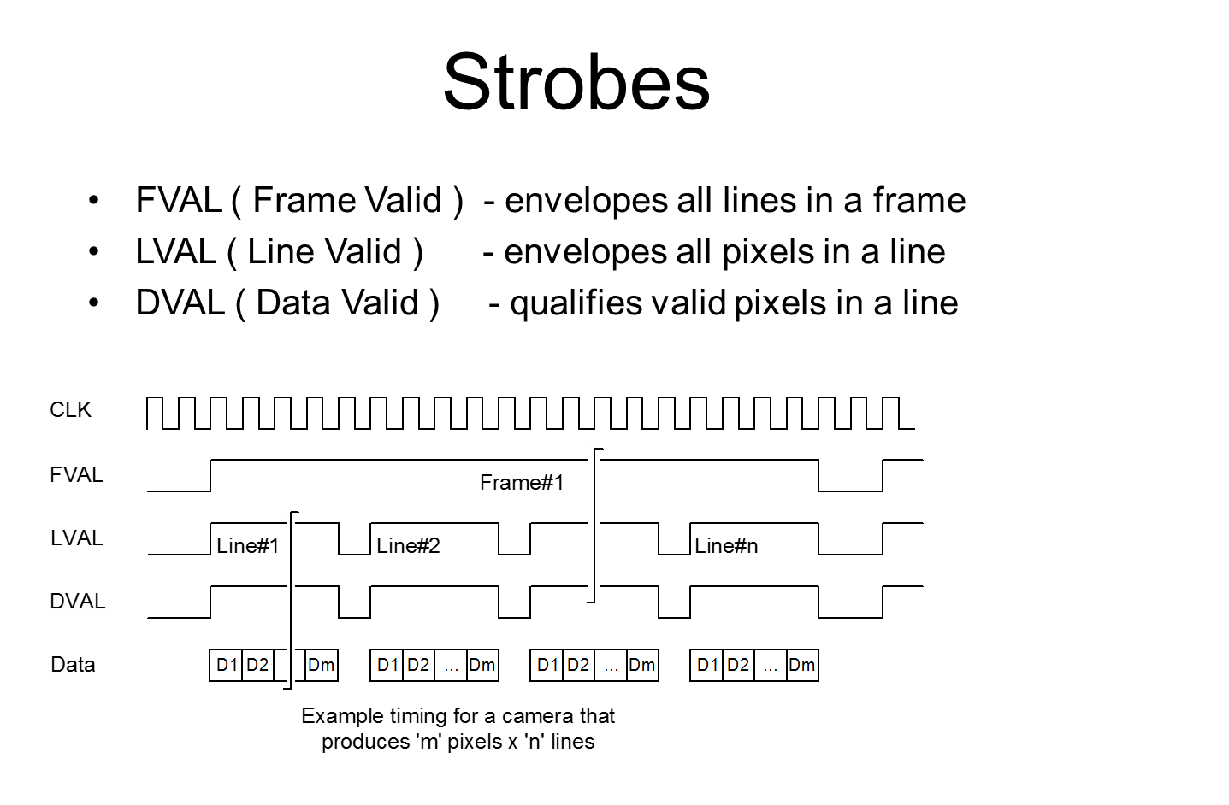
Prior Work
Fake Camera Simulator
CameraLink Standard
http://www.imagelabs.com/wp-content/uploads/2010/10/CameraLink5.pdf
Defines Commercial Video Transmission Standard Used By Large Varieties Of Cameras
Defines Allowable Pixel Clock Range 25-85 MHz
“Camera Link is a communication interface for vision applications. The interface extends the base technology of Channel Link to provide a specification more useful for vision applications.”
Frame Control Signals
https://www.imperx.com/wp-content/uploads/Member/Whitepapers/camera_link.ppt
Standard Framing Strobes Used For Video Output
Used Widespread Across Commercial Cameras
CameraLink Protocol Supported
“de Facto standard for high speed/high resolution imaging”
Test Pattern Options
https://www.xilinx.com/support/documentation/ip_documentation/v_tpg/v7_0/pg103-v-tpg.pdf
Describes Example Test Patterns
Generic Overview Of Test Pattern Generation
Generic Overview Of Frame Control Signals
“Test patterns can be used to evaluate and debug color, quality, edge, and motion performance, debug and assess video system color, quality, edge, and motion performance of a system, or stress the video processing to ensure proper functionality.

Slide 8
Prior Work – Cont.
Transpose Circuit
Transpose
https://www.mathworks.com/help/matlab/ref/transpose.html
Matlab Example Transpose
https://www.mathworks.com/help/images/ref/imrotate.html
Matlab Example Rotation (Transpose Example)
Edge Detection
Meyer-Baese, Uwe (2014). Digital Signal Processing with Field Programmable Gate Arrays, Fourth Edition. Berlin Heidelberg: Springer-Verlag
Image Processing Overview
2D HDL Filter Design and Architecture

Slide 9
Prior Work – Cont.
VGA Formatter
VGA Signal Timing
http://tinyvga.com/vga-timing
Numbers for Pixel Clock, Front Porch, Back Porch, and Sync Pulses
Polarity of Sync Pulses
VGA Theory
https://eewiki.net/pages/viewpage.action?pageId=15925278
https://en.wikipedia.org/wiki/Video_Graphics_Array
Rescan Timing
Color Depth
VGA HDL Reference (Different Resolution)
https://reference.digilentinc.com/learn/programmable-logic/tutorials/basys-3-general-io/start

Slide 10
Expected Results
Fake Camera Simulator
Transpose Circuit
Valid Pixels Per Line : 160
Invalid Pixels Per Line : 16
Valid Lines : 120
Pixel Clock : 50 MHz
Frame Rate : 50 Hz
Video Selection Changes Based On User DIP Switch Input
Switch Logic Low:
Original Image is Output
Switch Logic High:
Transpose Image is Output
Edge Detection
VGA Formatter
Latency: ~2*Line Width
Sample Rate: 1 cycle
Pixel Clock: 50 MHz
Frame Rate: 50 Hz
Output Select: Vertical/Horizontal/Sum
640x480 @60Hz Output Resolution
25.175 MHz Pixel Clock
Input Image Resolutions
640x480, 320x240, 160x120
Inputs Overwrite Image Buffer At Input Clock Rate
4 Bit Greyscale Output
Output From Image Buffer at Pixel Clock Rate

Slide 11
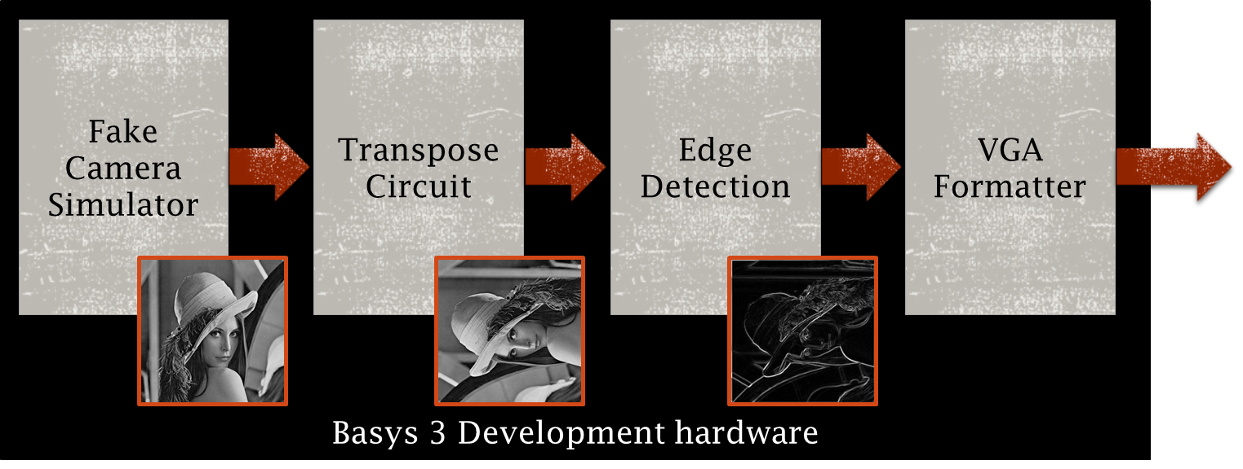
Expected Results
Completed Design Will Provide:
User Selectable Video Output Options
On/Off Transpose
On/Off Edge Detection
VGA Formatted Video Output
Internal VHDL Firmware
User DIP Switch Inputs
VGA Monitor
DIP Switch Inputs
VGA Connector/Cable
Basys 3 Board

