Slide 1
VGA Transpose and Edge Detection
Team 7 - Distance Learning Students
Bryce Williams - GTID: 903097901
Zachary Boe - GTID: 903124261
Gregory Walls - GTID: 903289298
Benjamin Sullins - GTID: 903232988

Slide 2



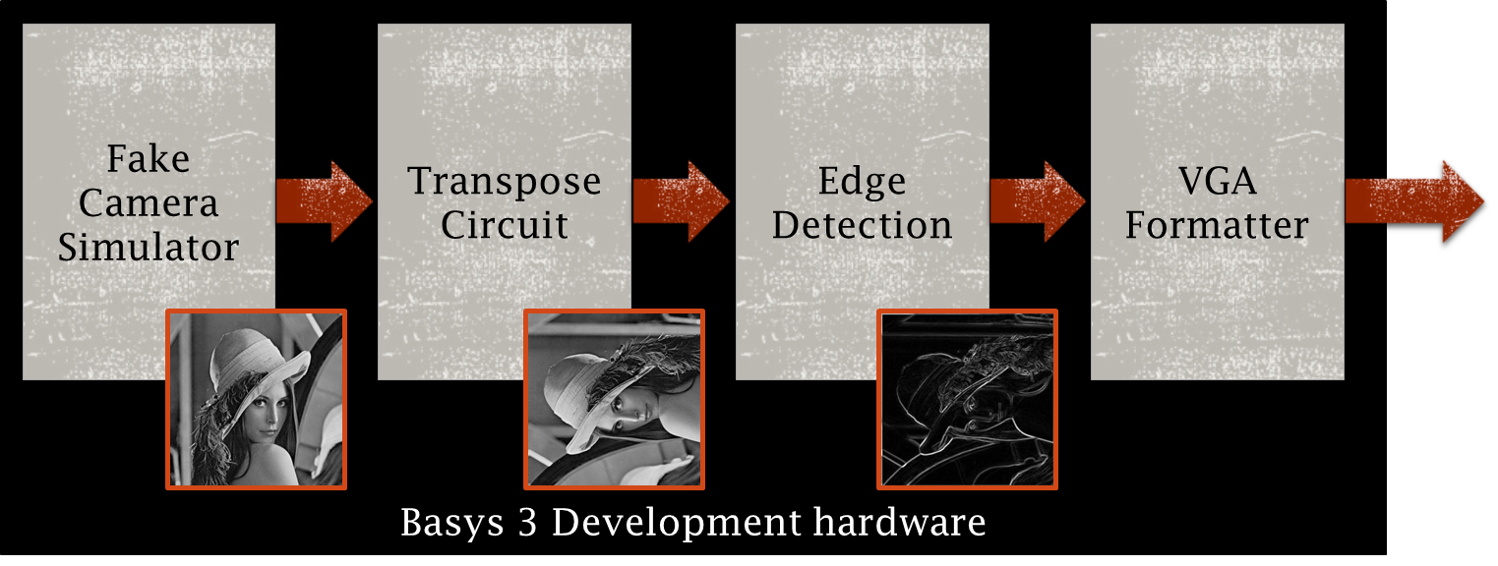
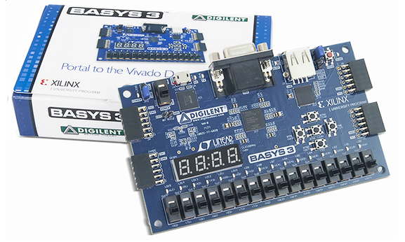

Project Overview
Completed Design Will Provide:
User Selectable Video Output Options
On/Off Transpose
On/Off Edge Detection
VGA Formatted Video Output
Internal VHDL Firmware
User DIP Switch Inputs
VGA Monitor
DIP Switch Inputs
VGA Connector/Cable
Basys 3 Board

Slide 3
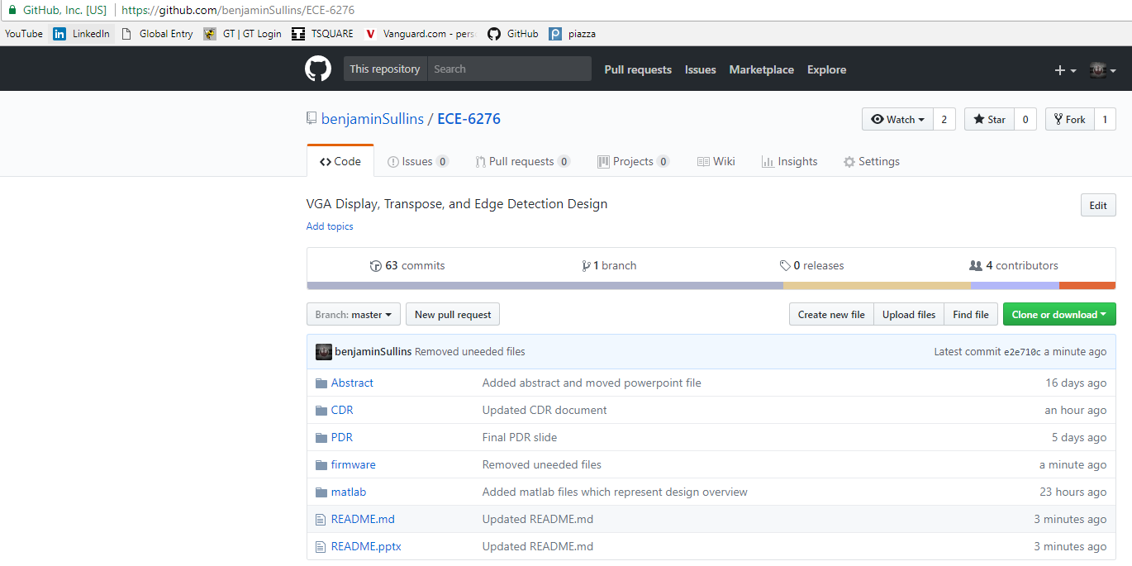
Git
This project is available online at the following GITHUB:
https://github.com/benjaminSullins/ECE-6276

Slide 4

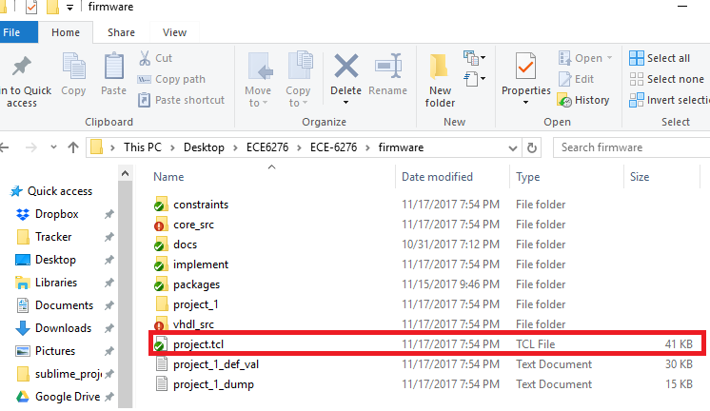

Overall Design
Fake Camera:
1) run "source project.tcl" within Vivado 2017.2 to open and create the project
2) Load Bitstreams located in the /implement folder
3) Toggle DIP Switches as found in the final report on page 2

