Slide 1
VGA Transpose and Edge Detection
Team 7 - Distance Learning Students
Bryce Williams - GTID: 903097901
Zachary Boe - GTID: 903124261
Gregory Walls - GTID: 903289298
Benjamin Sullins - GTID: 903232988

Slide 2



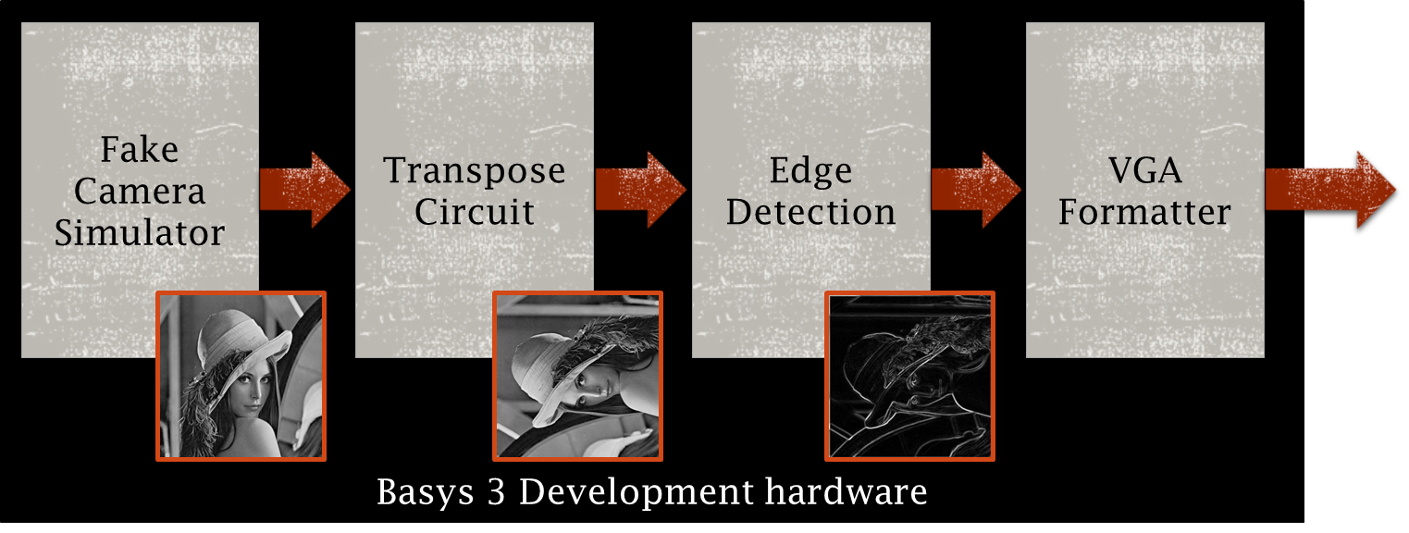
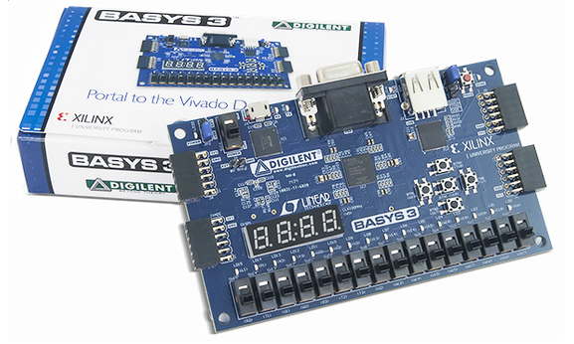

Project Overview
Completed Design Will Provide:
User Selectable Video Output Options
On/Off Transpose
On/Off Edge Detection
VGA Formatted Video Output
Internal VHDL Firmware
User DIP Switch Inputs
VGA Monitor
DIP Switch Inputs
VGA Connector/Cable
Basys 3 Board

Slide 3
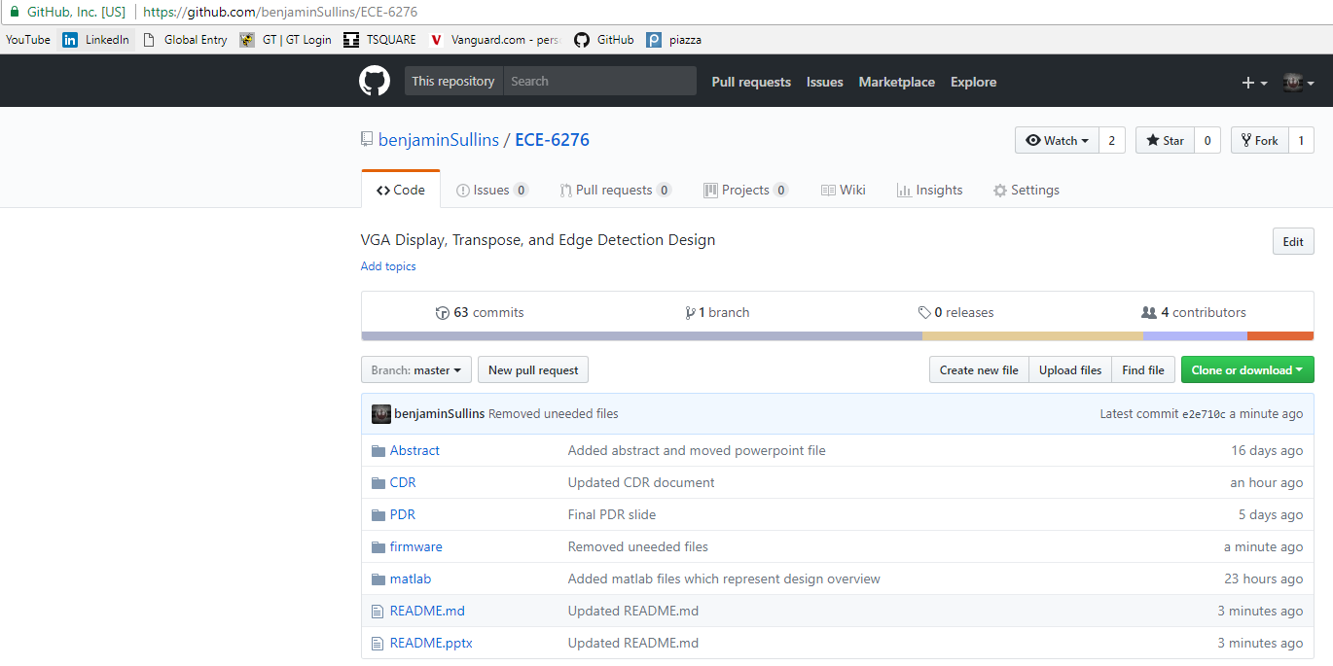
Git
This project is available online at the following GITHUB:
https://github.com/benjaminSullins/ECE-6276

Slide 4

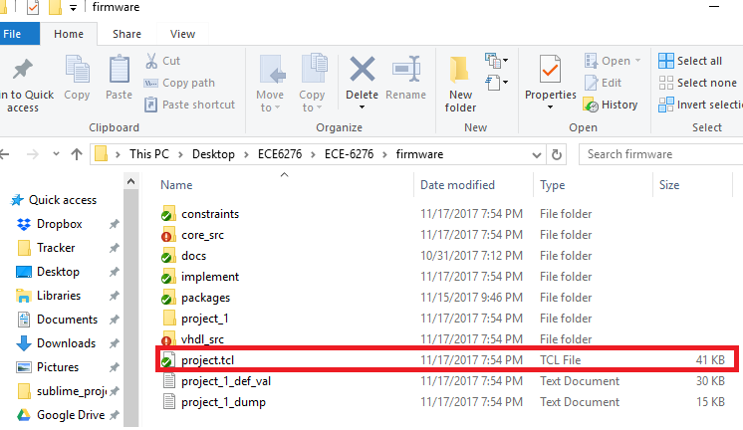

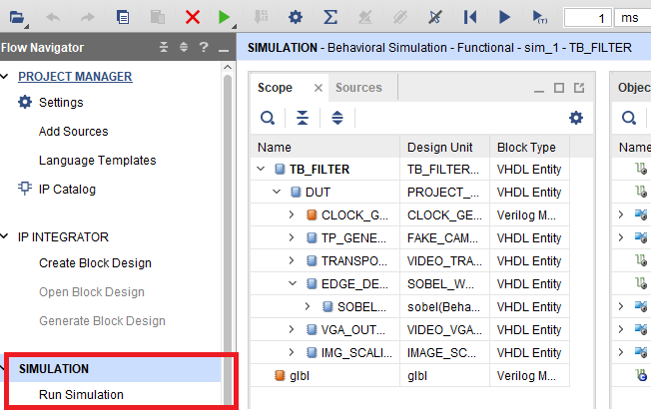
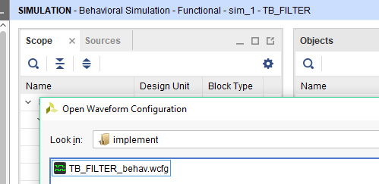
Fake Camera Simulator
Fake Camera:
1) run "source project.tcl" within Vivado 2017.2 to open and create the project
2) Run the Simulation
3) A Waveform should automatically open, otherwise open the one found in the implement/ folder

Slide 5
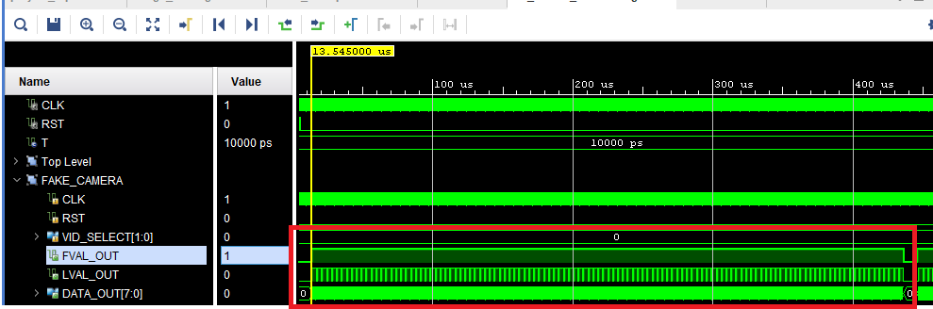
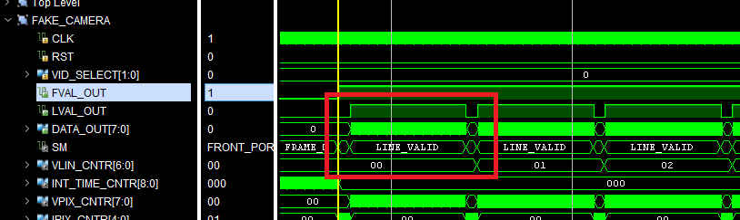
Fake Camera Simulator
Fake Camera:
4) The Fake Camera can be found in the Signal Lists.
5) Open the FKs Signal List and verify that a Horizontal Ramp and strobe (fval/flval) signals are toggling.
6) This confirms the operational behavior of the Fake Camera Simulator.

Slide 6
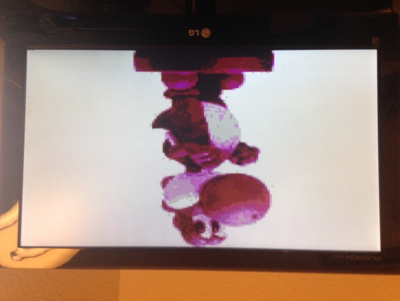
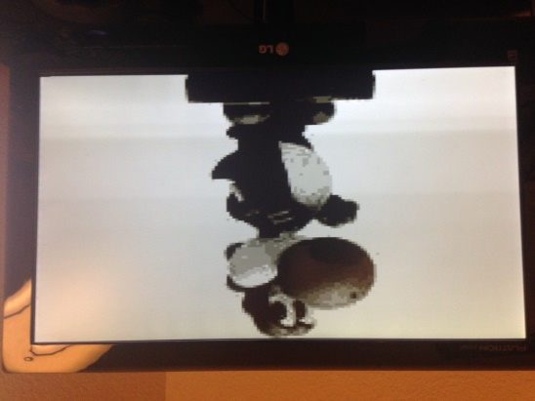
Fake Camera Simulator
Fake Camera:
Additional Matlab code examples can be found in the Matlab/ directory. Simply run the file to see expected outputs.
A bitstream is available in the implement/ directory for programming the Basys 3 Board.
The Basys 3 boards DIP Switches 0 & 1 control the output images
The Basys 3 boards DIP Switch 5 controls the colormap output
NOTE: The VGA is not completely functional, so some monitors may not be able to handle the unstable output.
Below are example outputs:

