Slide 1
VGA Transpose and Edge Detection
Team 7 - Distance Learning Students
Bryce Williams - GTID: 903097901
Zachary Boe - GTID: 903124261
Gregory Walls - GTID: 903289298
Benjamin Sullins - GTID: 903232988

Slide 2


Architectural Alternatives
Fake Camera:
Transpose:

Slide 3
Architectural Alternatives
Edge Detection:
VGA Formatter:

Slide 4




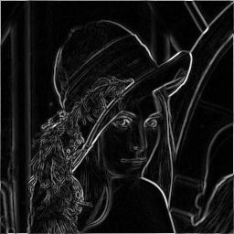
Chip Architecture
Fake Camera Simulator
Transpose Circuit
Edge Detection
VGA Formatter

Slide 5
Memory Design
Fake Camera Simulator
Transpose Circuit
Edge Detection
VGA Formatter

Slide 6
Remaining tasks
Fake Camera Simulator
Transpose Circuit
Edge Detection
VGA Formatter

Slide 7
Timeline
Description:
Work Assignments:
Project Abstract – Nov 2nd, 2017
Project PDR – Nov 12th, 2017
Project CDR – Nov 19th, 2017
Final Presentation – Nov, 30th 2017
Bryce Williams : Edge Detection
Zachary Boe : VGA Formatter
Gregory Walls : Transpose Circuit
Benjamin Sullins : Fake Camera Sim.
Milestones | Oct. 30th | Nov. 2nd | Nov. 12th | Nov. 19th | Nov. 25th | Nov. 30th
Requirements / Concept Design
Sub-Module Design Capture
Sub-Module Design Test and Peer Review
Sub-Module Integration
Project Abstract
Project PDR
Project CDR
Final Presentation
Legend: Complete Incomplete (Milestones – All Team Members)

Slide 8
Milestones
Fake Camera Simulator
Transpose Circuit
Edge Detection
VGA Formatter

Slide 9
Risks Met
Fake Camera Simulator
Transpose Circuit
Edge Detection
VGA Formatter

