Slide 1
VGA Transpose and Edge Detection
Team 7 - Distance Learning Students
Bryce Williams - GTID: 903097901
Zachary Boe -
Gregory Walls -
Benjamin Sullins - GTID: 903232988

Slide 2





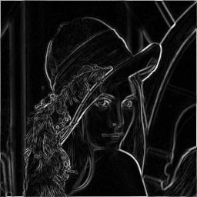

Optimizations
Fake Camera Simulator
Transpose Circuit
Consolidate Individual Frame FVAL/LVAL Control Signal Generations To Single Module
Reduce Resource Utilization For Horizontal/Vertical Ramp Test Pattern Data Generation
Edge Detection
VGA Formatter
Reduce Resource Utilization for Vertical and Horizontal Filters (Shared Line-Buffers)
Reduce Resource Utilization for Line-Buffers (IP BMG)

Slide 3
Risk Mitigation
Fake Camera Simulator
Transpose Circuit
Horizontal/Vertical Ramp Test Pattern Generation Simulated With Matlab
Pre-Loaded Cropped Image Simulated With Matlab
All Data Output Options Simulated With ISIM
Edge Detection
VGA Formatter
Algorithm Implementation in MATLAB
MATLAB Generated Image Data for VHDL Simulation
MATLAB Post-Processing of VHDL Simulation Output Data

Slide 4
Prior Work – Cont.
Transpose Circuit
Transpose
Edge Detection
Meyer-Baese, Uwe (2014). Digital Signal Processing with Field Programmable Gate Arrays, Fourth Edition. Berlin Heidelberg: Springer-Verlag
Image Processing Overview
2D HDL Filter Design and Architecture

Slide 5
Expected Results
Fake Camera Simulator
Transpose Circuit
Valid Pixels Per Line : 320
Invalid Pixels Per Line : 16
Valid Lines : 240
Pixel Clock : 50 MHz
Frame Rate : 50 Hz
Video Selection Changes Based On User DIP Switch Input
Edge Detection
VGA Formatter
Latency: ~2*Line Width
Sample Rate: 1 cycle
Pixel Clock: 50 MHz
Frame Rate: 50 Hz
Input/Output: 8-bits
Output Select: Vertical/Horizontal/Sum

