Slide 1
VGA-Transpose-Edge Detection Project
Bryce Williams
Gregory Walls
Zachary Boe
Benjamin Sullins

Slide 2
VGA-Transpose-Edge Detection Project
Fake Camera Simulator
Transpose
Circuit
Edge Detection Circuit
VGA Output
Circuit

Slide 3


Fake Camera Simulator
Video Select
Test Pattern Generator
Video
Video
Clk
Test Bench
Fake Camera Verification
Video Mux
Control Lines
Video
BRAM w/ Preloaded Image
Video
Video
Clk
Control Lines

Slide 4
Transpose Circuit
Output Select
Dual-Port BRAM for buffering video
and reading out
Test Bench
Transpose
Verification
BRAM Buffer
Readout Circuit
Video
Video
Video
Control Lines

Slide 5
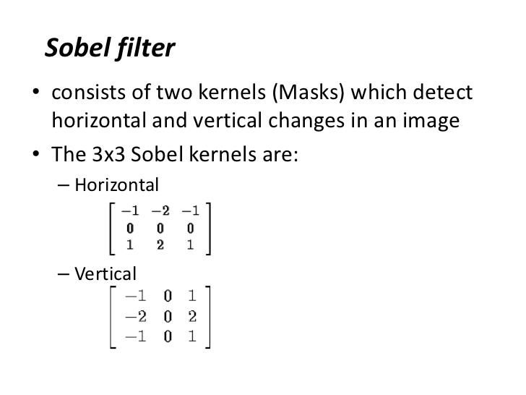
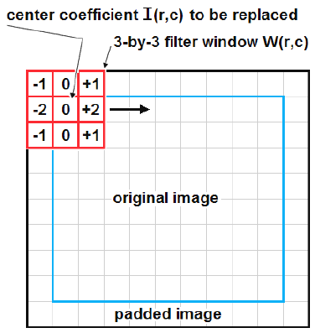

Edge Detection Circuit
Generate 3x3 Kernel by buffering lines
Video
BRAM Line Buffer
Apply Filter
BRAM Line Buffer
Test Bench
Edge Detection Verification
BRAM Line Buffer
BRAM Line Buffer
Video
Video

Slide 6
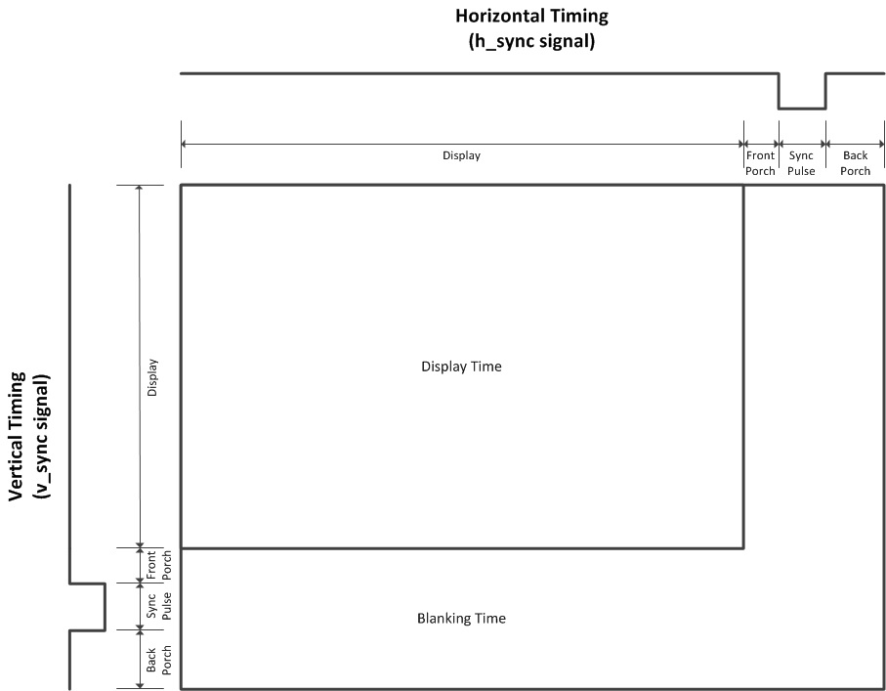
VGA Output Circuit
Retiming needed for adhering to
VGA Vesa timing standards
BRAM Buffer
Readout Circuit
Test Bench
VGA Output
Verification
Video
Video
Video
Control Lines

