Slide 1
UAV Interception
Hyeon Ki Jeong
Rish
Moe Alani
Eric
Ben Sullins

Slide 2

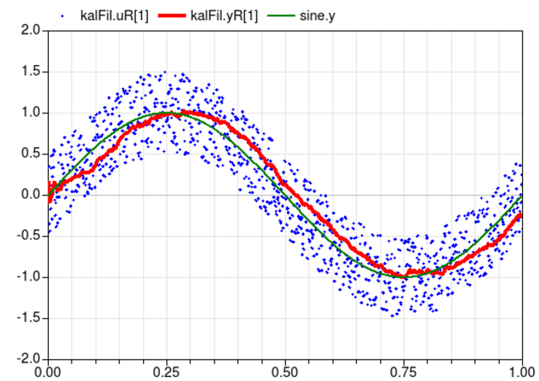
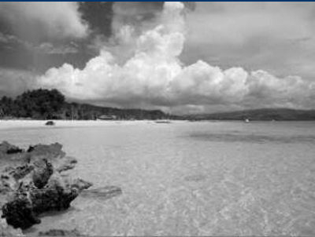
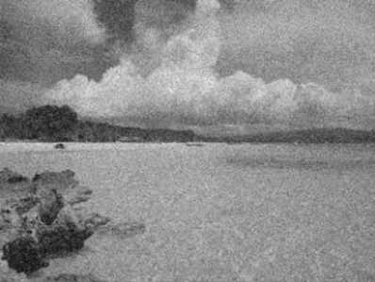
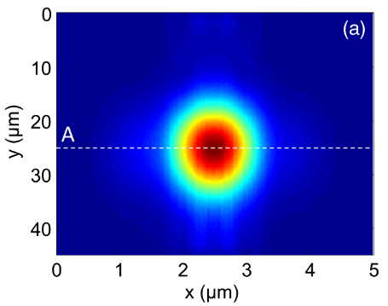
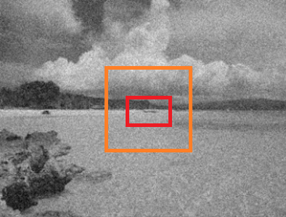
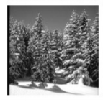
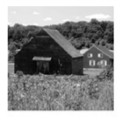
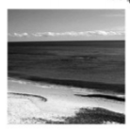
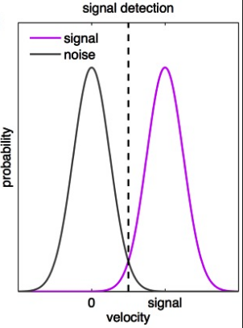
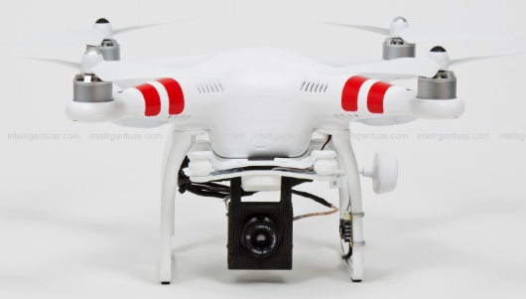
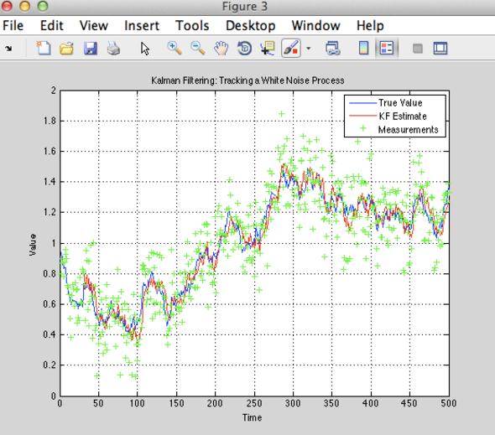
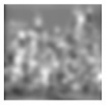
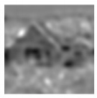
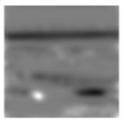
Design Roadmap - Simple on Top - Expansion on Bottom
Plans to Expand Once Simple Design Completed
Additions Available
Background Generation
Difficulty: 5
Target
Generation
Difficulty: 3
Maximum Likelihood Estimation
Difficulty: 8
Kalman Filter
Difficulty: 6

Slide 3
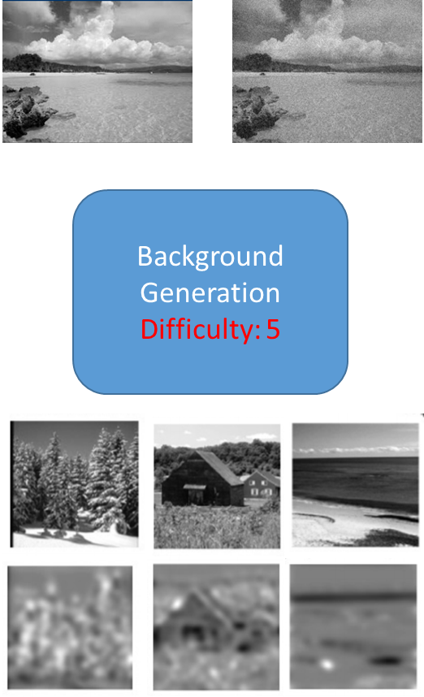
Background Generation
Step 1 (Simple Clutter):
Generate Gaussian Background Noise
Incorporate Flexibility for User Mods
Examples: See project example
Step 2 (Realistic Clutter):
Acquire Stock Images Online
Compute PSD
Inject Guassian Noise
https://www.mathworks.com/matlabcentral/fileexchange/23636-radially-averaged-power-spectrum-of-2d-real-valued-matrix/content/raPsd2d.m
https://www.cs.cmu.edu/~efros/courses/LBMV07/presentations/0208Gist.pdf

Slide 4
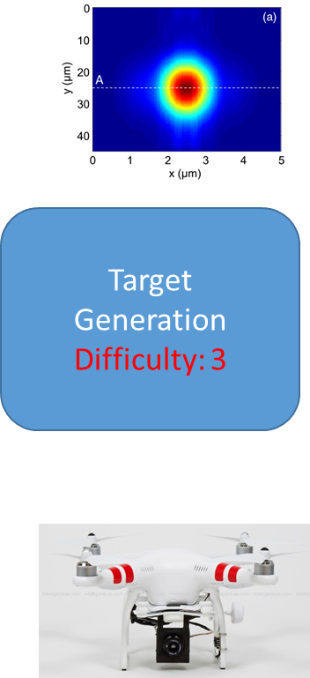
Target Generation
Step 1 (Simple Target):
Gaussian Target Generation
Target Motion Injection
Incorporate Flexibility for User Selection
Types of Motion
Speed and Other Motion Characteristics
Examples: See project example
Step 2 (Realistic Target):
UAV Model Generation
Missile Model Generation (TBD)

Slide 5
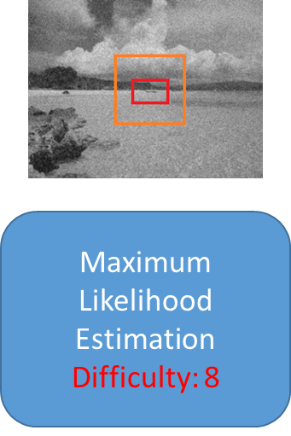
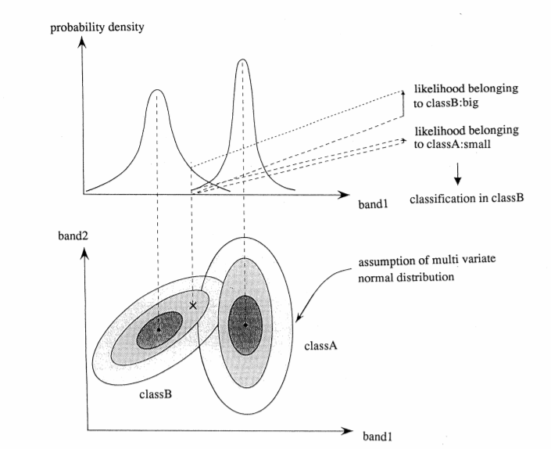
Maximum Likelihood Estimation
Step 1 (Background Estimation):
We’ll have two window regions. One surrounds the expected target location. The second bounds only background region. Understanding the underlying distribution allows up to disseminate between what is either.
https://en.wikipedia.org/wiki/Maximum_likelihood_estimation
https://pdfs.semanticscholar.org/1dc4/1278d777404050ac226b84942bc1a8864b73.pdf
https://www.coursera.org/learn/digital/lecture/CWoPV/maximum-likelihood-and-maximum-a-posteriori-estimation
http://www.jars1974.net/pdf/12_Chapter11.pdf (Page 221)
Step 2 (Target Estimation):
Similar to Background
Step 3 (Threshold Setting):
Methods for Establishing Good Thresholds
Incorporate Background and Target Data

Slide 6
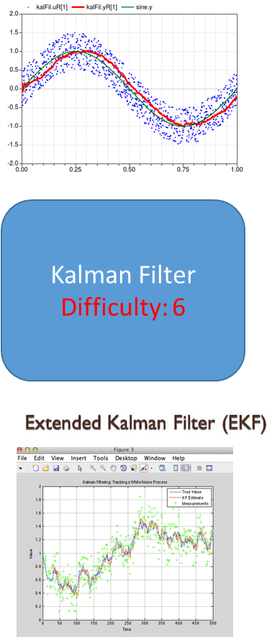
Kalman Filter
Step 1 (Simple KF):
Simple Design for Expecting Locations in Next Frame
https://www.mathworks.com/help/vision/examples/using-kalman-filter-for-object-tracking.html
https://www.youtube.com/watch?v=GBYW1j9lC1I
Code Provided in Link: http://studentdavestutorials.weebly.com/
https://classes.soe.ucsc.edu/cmpe264/Fall06/Lec15.pdf
Step 2 (Extended KF):
Develop Extended Method for More Complex Scenes
http://www.goddardconsulting.ca/simulink-extended-kalman-filter-tracking.html
https://ags.cs.uni-kl.de/fileadmin/inf_ags/opt-ss12/lec10_opt.pdf

