Slide 1

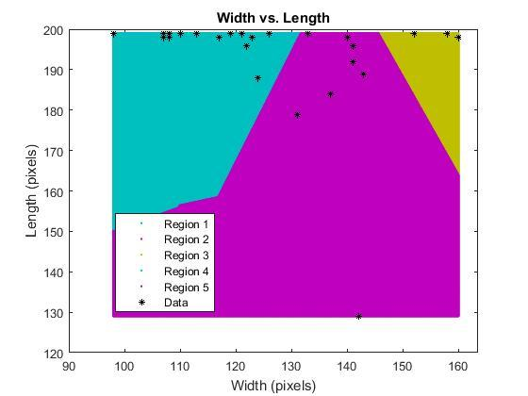
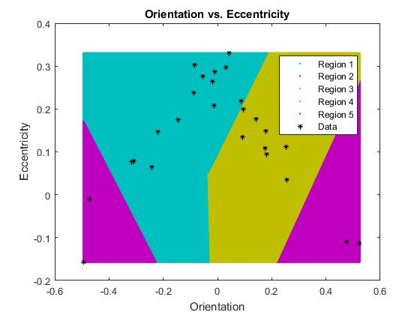
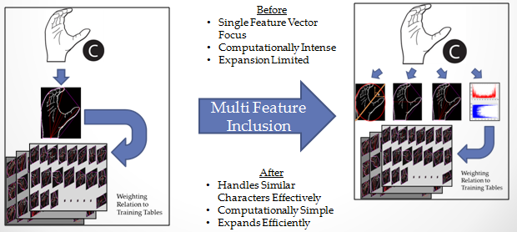
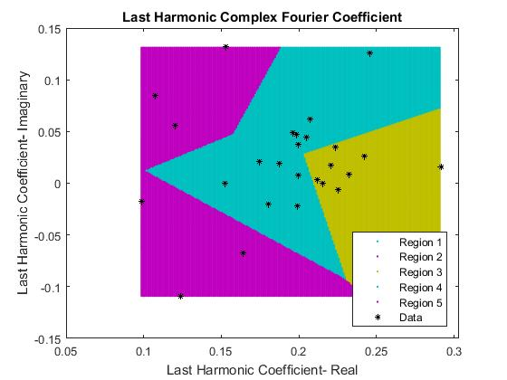
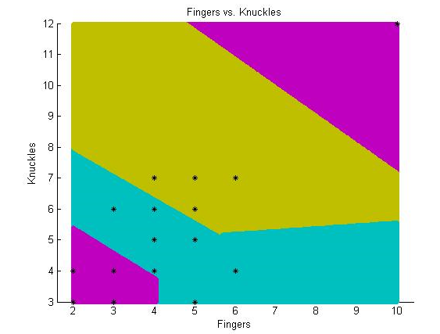
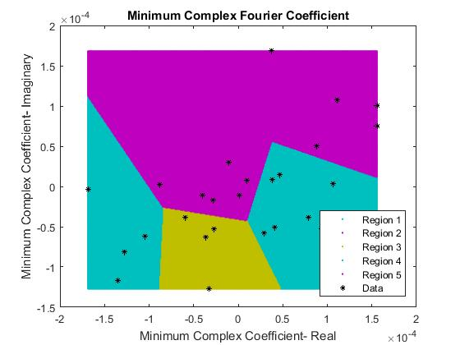
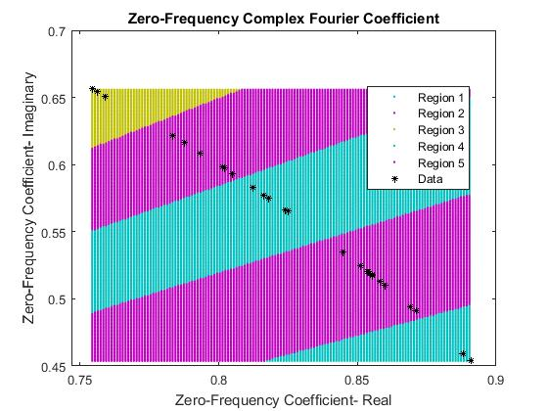
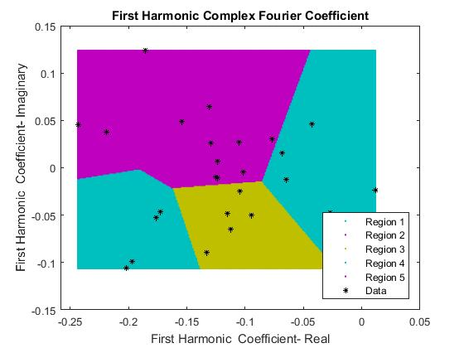

Sign Language Translation
Benjamin Sullins, Princess Irabor, Digital Image Processing ECE6258 ·
Abstract
Results
Contribution
The classification of alphabetical sign language characters and their translation to readable text is addressed in this paper. The system utilizes a single set of training images and a multitude of extracted feature vectors to aid in classifying a user-defined input sign language character. The extracted feature vectors include length, width, orientation, eccentricity, Fourier domain qualities, and fingertip segmentations. These feature vectors are coupled with a K-Means clustering algorithm to improve the efficiency and accuracy of the system. Each feature vector aids in narrowing down the classification possibilities to improve the overall character estimation results.
The resulting sign descriptors are shown:
Our System Integrates Multiple Feature Vectors for Improved Functionality
Spatial and Spectral properties for better classification of the Sign Image.
Complex Fourier Coefficients represented as Real spectrum Indicators..
It is recommended to tune the method for computing the curvature of the fingertip vector for better results.
The length and width properties can also be calculated from the centroid to increase discrimination capability.
.
Introduction
Sign language provides a means of communicating with others through a set of hand motions. Large portions of the population know little or none of the language, making communicating between two individuals cumbersome. A method of translating the sign language characters to readable text aids in bridging the communication gap between those individuals.
The significant obstacle in developing a system which can perform the language translation lies in the discrimination between multitudes of sign language characters. Previously designed systems focus on an element of the sign language character to help identify what character is being displayed. These elements translate into a feature vector which is pervasive across a number of sign language characters and can aid in discrimination. Some sign language character feature vectors are similar to other characters in the given set. This can introduces error into the discrimination process. The designer is often forced to find another feature vector which can improve the results.
Instead of finding alternative feature vectors through complicated design methods, a number of easily computed feature vectors can be used in unison to achieve similar results. This paper focuses on computing those simple feature vectors and showing their effectiveness in discriminating between sign language characters when used collectively.
Sign Language includes a vast number of characters. To reduce the complexity of the overall system, focus is given to the letters of the alphabet (A – Z). Extensions to the existing design can be made to include larger data sets that expand past the alphabet to something much larger.
Conclusion
This paper focused on the use of multiple feature vector selection and their use for discriminating between sign language characters. The feature vectors were not computationally challenging and could be used in unison to narrow down the selection process to greatly increase the estimation results of the system. The results show that using a multitude of easily computed vectors over a single, computationally-challenging feature vector is both viable and practical.
. Further work includes injecting real-world inputs in place of the synthetic images, compensation for orientation/angle errors on input images, and the addition of more feature vectors to aid in improving the discrimination estimation made by the overall system.
References
Methods
([1] Johannes Kilian, "Simple Image Analysis By Moments,". [Online]. Available: http://breckon.eu/toby/teaching/dip/opencv/
SimpleImageAnalysisbyMoments.pdf. Accessed: Nov. 27, 2016.
[2] Ruslan Kurdyumov and Phillip Ho Justin Ng, "Sign Language Classification Using Webcam Images. [Online]. Available: http://cs229.stanford.edu/proj 2011/KurdyumovHoNgSign
LanguageClassificationUsing WebcamImages.pdf. Accessed: Nov. 22, 2016.
[3] Erdem Yörük, Ender Konukoglu, and Bülent Sankur, "Shape-Based Hand Recognition. [Online]. Available: http://www.busim
.ee.boun.edu.tr/~sankur/SankurFolder/Shape-Based_Hand
_Recognition.pdf. Accessed: Nov. 24, 2016.
[4] Thiago R. Trigo and Sergio Roberto M. Pellegrino, "An Analysis of Features for Hand-Gesture Classification,". [Online]. Available: http://www2.ic.uff.br/iwssip2010/Proceedings/nav/
papers/paper_128.pdf. Accessed: Nov. 25, 2016.
[5] N. Mark, A. Alberto, Feature Extraction & Image Processing, Elsevier Linacre House, London, pp. 304, 12/1/2016.
Synthetic images of the letters of the English alphabet were collected and designated as the test image set . Image processing was performed on the test set to resize and convert to binary form. The sign descriptors are extracted from the binary image. The descriptors extracted include the length , width, orientation, eccentricity and selected Fourier coefficients. The length and width are used to distinguish between the elongation of the image in the vertical and horizontal direction. The orientation and eccentricity are derivations from the invariant inertial moments of the image. The orientation gives directional information of the sign regardless of the scale or rotational position of the sign. Similarly, the eccentricity indicates the roundness . The sign boundary is approximated as a curve in the complex plane and the discrete Fourier transform is obtained. The minimum complex Fourier coefficients and the coefficients of the zero frequency, first and maximum harmonic are selected as the spectral descriptors of the image. Other spatial and spectral features including fingertips and mean Fourier coefficients are also explored.
With the completion of all feature vector extractions, the data points are inputs to a K-Means clustering algorithm which identifies the closest training image feature vector that each feature vector aligns with. The maximum correlation amongst the estimated feature vectors to that of the training images determines the probable sign that was originally selected.
GRAPHICS:
Clearly label graph axes, be simple, and use colors that are easy to see against the background. Photos are a good way to draw attention to your poster. Be sure each photo has a caption that explains what the photo is showing and only use photos that illustrate your text. Photos should be high resolution (about 1200 x 1800 pixels or larger). Avoid web images unless they are of high resolution and okay for educational purposes. Images obtained from the web should include the source (credit). Avoid use of clip art unless there is no other image available.
TIP: Putting Boxes around your text sections
Add space between the edge of your box and the text inside. Right click or Ctrl – click on text box, go to ‘Format Shape’, then select ‘Text Box’ and make sure your ‘Internal Margins’ are between .2” and .4” for all sides.
** Performance goes here ***

