Slide 1
The First Signs of Knowing: Sign Language to Text
Princessosse Irabor
Benjamin Sullins

Slide 2
Overview
Problem Description
Methods and Ideas
Experimental Results
Contributions

Slide 3
Problem Description

Slide 4







The Problem
Small population understands Sign Language.
Becoming fluent could span 2-3 years
Classes
Learning Progression (2-3 years)
Notes:
Only a few million people understand Sign Language.

Slide 5




Solution Description
Convert Sign Language Images Into Readable Characters
Image Processing
Display

Slide 6
Methods and Ideas

Slide 7
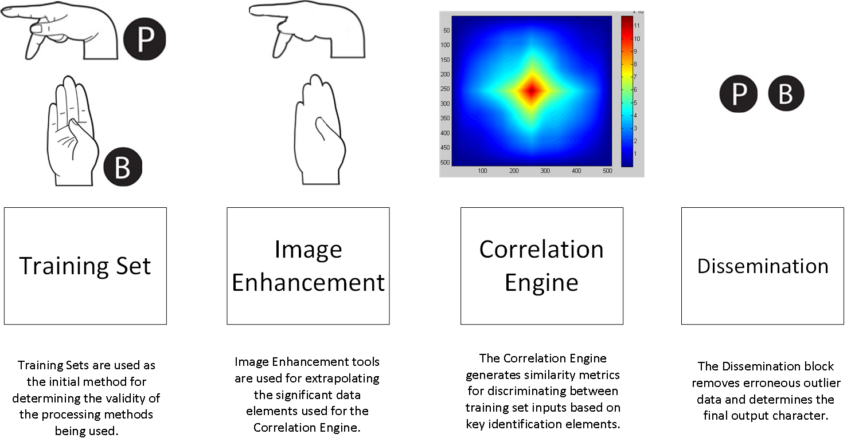
Technical Overview

Slide 8

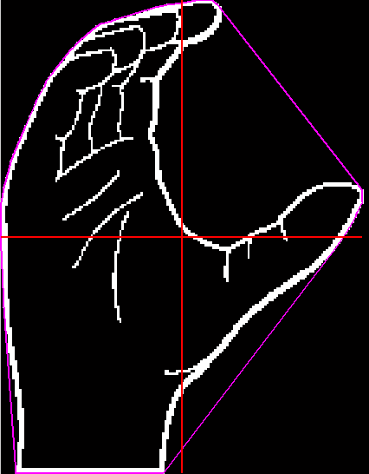
Feature Vectors
Length and Width
Length
Width
Length/Width Extraction

Slide 9
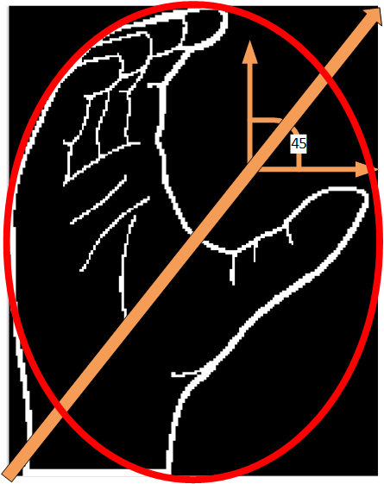
Feature Vectors
Orientation and Eccentricity
Eccentricity
Orientation
Orientation/Eccentricity Extraction

Slide 10
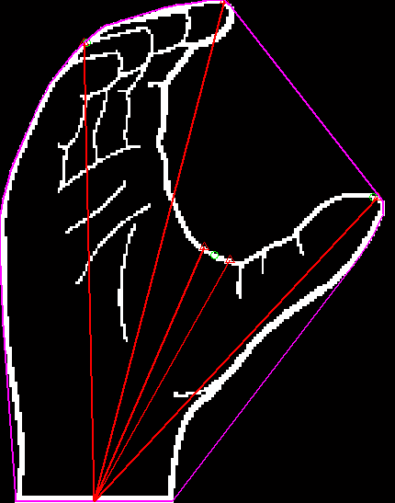
Feature Vectors
Fingertip Segmentation
Fingertip Segmentation
Fingertip Extraction

Slide 11
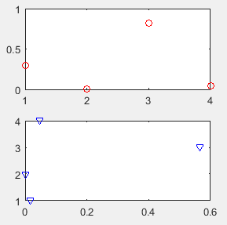
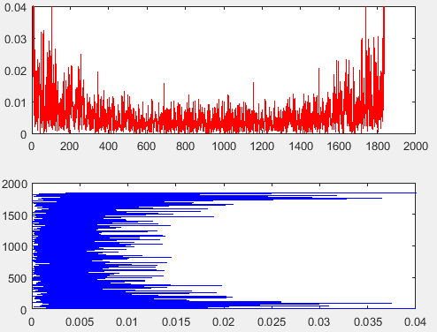
Feature Vectors
Fourier Components
Fourier Component Extraction

Slide 12
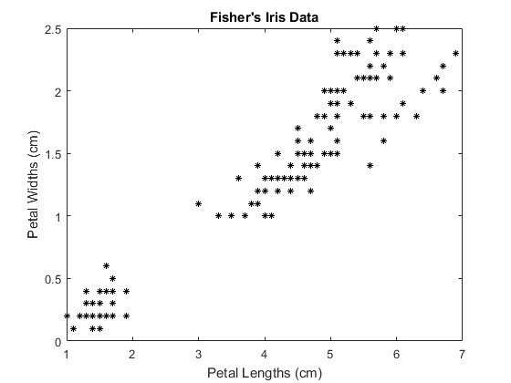
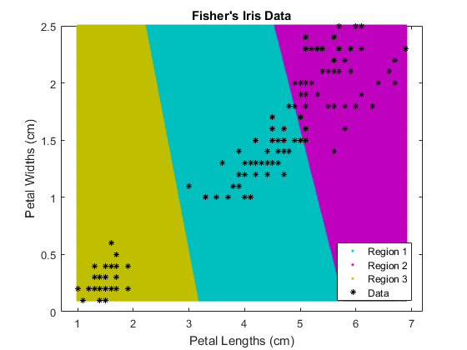
K-Means Clustering
Classify Select Feature Vector Similarities
Reduce Computation
Improve Dissemination
https://www.mathworks.com/help/stats/kmeans.html

Slide 13
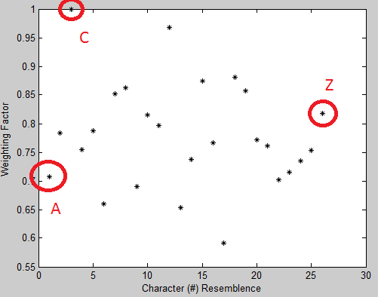

Dissemination
Correlate Feature Vector Clusters to Training Set Expectations
Generates Weighting Table
Feature Vector Cluster Weighting

Slide 14
Experimental Results

Slide 15
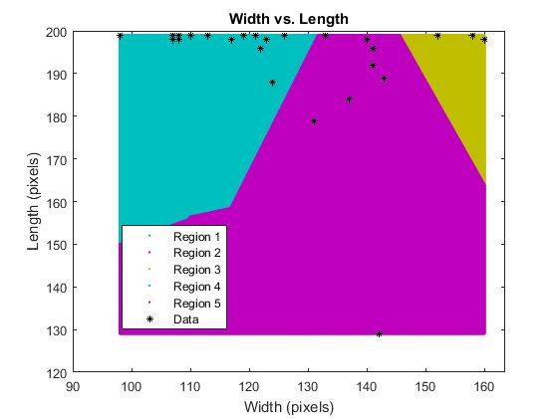
Sign Descriptors

Slide 16
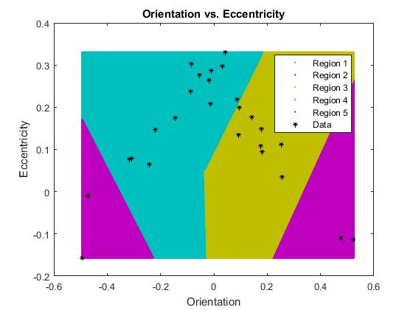
Sign Descriptors

Slide 17
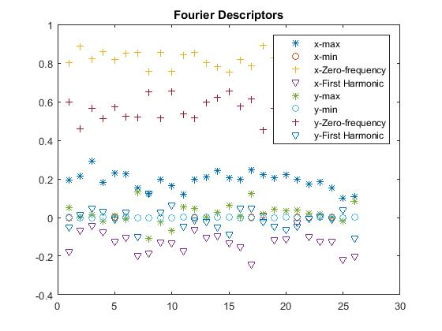
Sign Descriptors

Slide 18
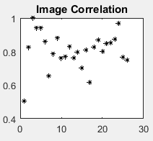
Correlation

Slide 19
Training Feature Vector

Slide 20
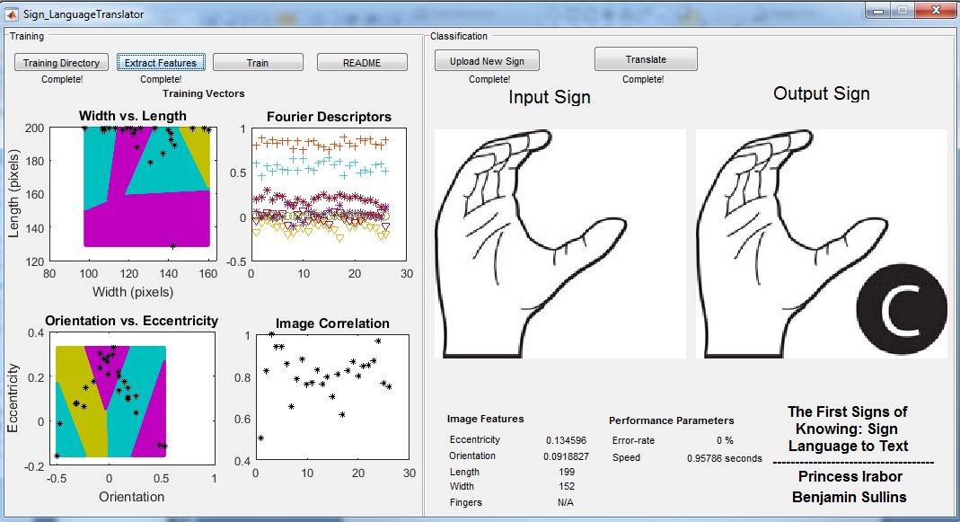
Sample Run
Notes:
Execution:0.9s

Slide 21
Contribution

Slide 22
Contributions
Process improve using key combination of sign descriptors.
Derivation of condensed Fourier representation of sign image.
Performance? Clustering?
Notes:
Only a few million people understand Sign Language.

Slide 23
Extra Slides

Slide 24
Technical Game Plan
Part 1
Computer Generated Inputs
Initial Algorithm Testing
Part 2
Real Image Inputs
Modified (Extended) Algorithms
Notes:
If we wanted to talk a little about “how” we are going to accomplish this task, we’d be speaking about our Technical Game Plan.
We’ll begin by accumulating a test set of synthetic images that can be found online.
These synthetic images will be the initial strain gauge on the algorithms developed and help in understanding the complexities of the problem.
We’ll then transition those synthetic images to real-world images from a camera. Part two will consist of modifying, or extending, the original algorithms to something which is more robust.

Slide 25
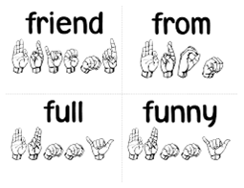
Technical Game Plan
Part 3 (Extra)
Heuristic Learning Algorithm
Part 4 (Extra)
Expand Allowable Inputs
Example: Words
Notes:
If time allows, we’ll expand upon our initial design.
Our first option is adding some heuristic processing to improve the overall robustness of the entire project.
The second option is expanding the input range from simple characters to words.

Slide 26
Technical Layout

Slide 27

Technical Layout Pt.1

Slide 28
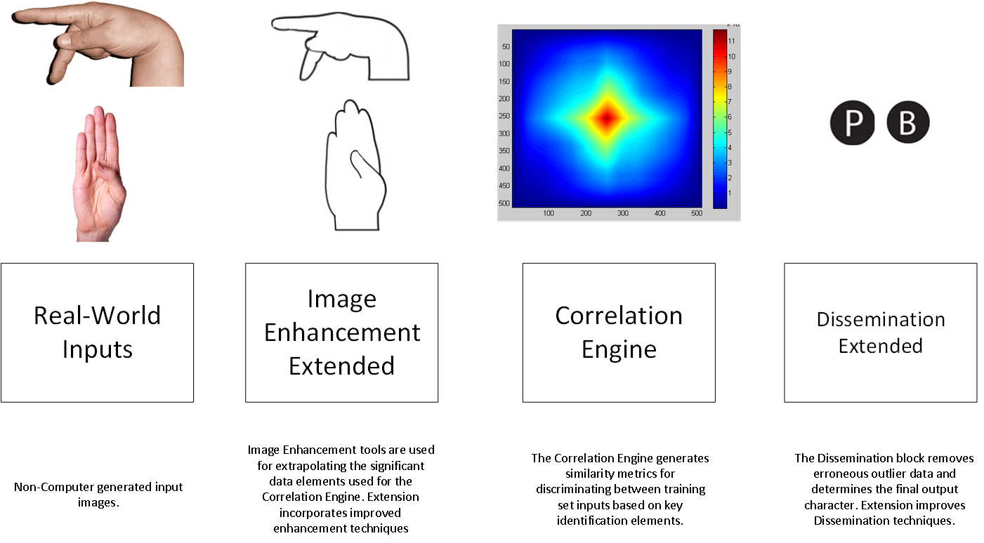
Technical Layout Pt.2

Slide 29
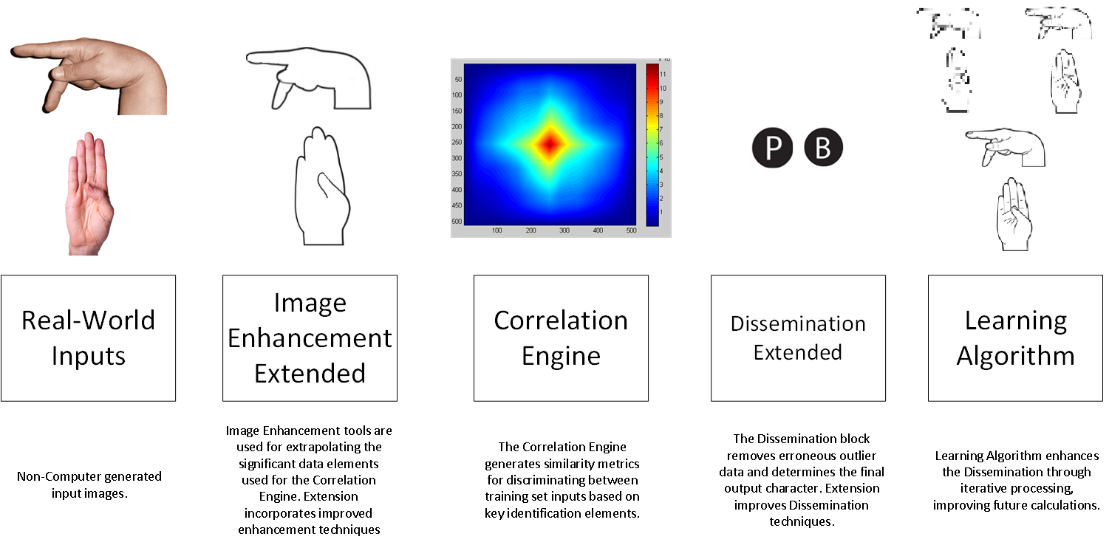
Technical Layout Extended Pt.3/4

Slide 30
Conclusion
Princessosse Irabor
Benjamin Sullins

Slide 31
Additional Slides

Slide 32
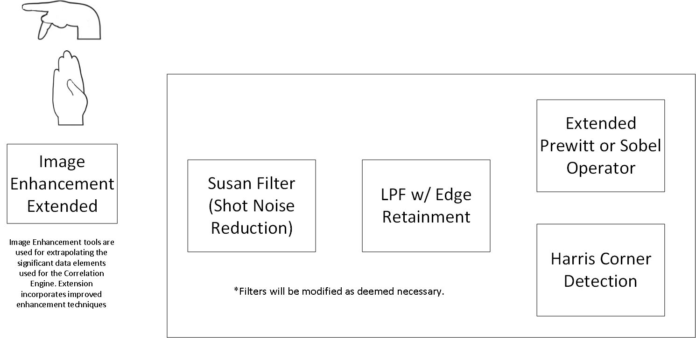
Image Enhancement

Slide 33
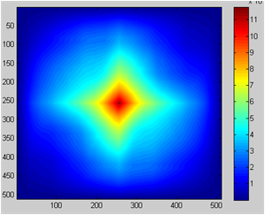
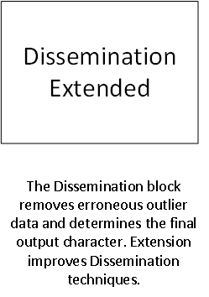
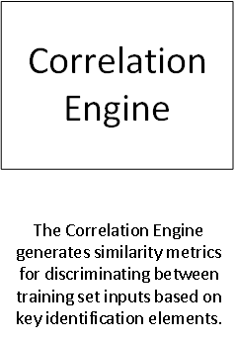

Correlation & Dissemination
Fast Cross-Correlation Algorithm Implementation
Multiple Input
Outlier Removal
Final Character Selection

Slide 34
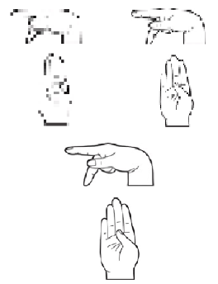
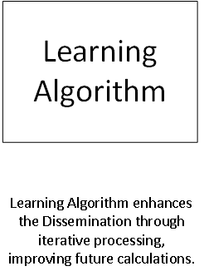
Extra: Learning Algorithm
Heuristic Algorithm
Iterative Based

