Slide 1
Predicting the nfl using logistic regression and machine Learning
Shane Terrillon
Benjamin Taubenblatt

Slide 2
Introduction:
Benjamin Taubenblatt
4th year student at McGill University
Major in Computer Science
Minor in Linguistics
Hometown: Pleasantville, NY, USA
Shane Terrillon
4th year student at McGill University
Major in Mathematics
Minor in Computer Science
Hometown: North Vancouver, BC, Canada

Slide 3
Goals
To create a model which could be used to predict the outcome of NFL matches.
To utilize characteristics of the sport to standardize most heavily weighted factors.
To have fun and learn about data science!

Slide 4
Training a Logistic Regression model
Hypothesis: The team which was playing best at half time would continue with that momentum to win the game.
We chose to use a logistic regression because it uses multiple input variables (score differential at half time, scaled team advantage (combination of QBR, pass rating, and previous years win percentage), and past season standings) and predicts binary outcomes (the winner of each game).
We used Excel for data cleaning and R for computation.
We used 70% of the data to train our predictive ML model and 30% to test it.

Slide 5
Results
We were able to predict game winners with 81% accuracy
We found that our SIMPLER model actually performed better than our more complex one (using a turn-over feature)
We were able to determine that although we were wrong 19% of the time, within that error, 28% of them went to overtime and our Mean Absolute Score Difference was 4.5 points (3/4s of a Touchdown)
Of the games we guessed incorrectly, on average we estimated their probability to be between 35%-65%, fairly close to our threshold probability…Aka very close to guessing right.

Slide 6
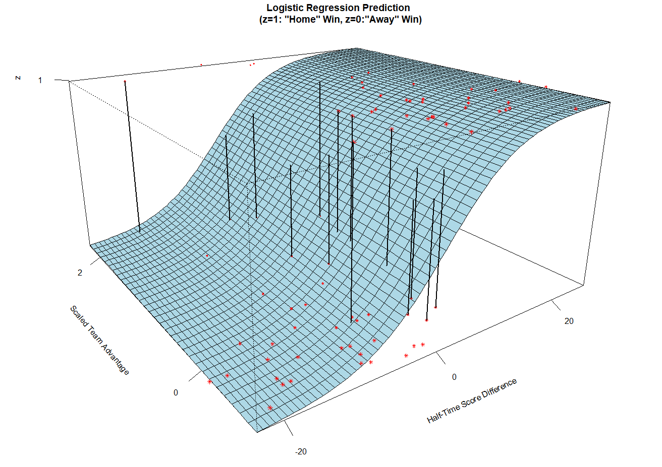

Slide 7
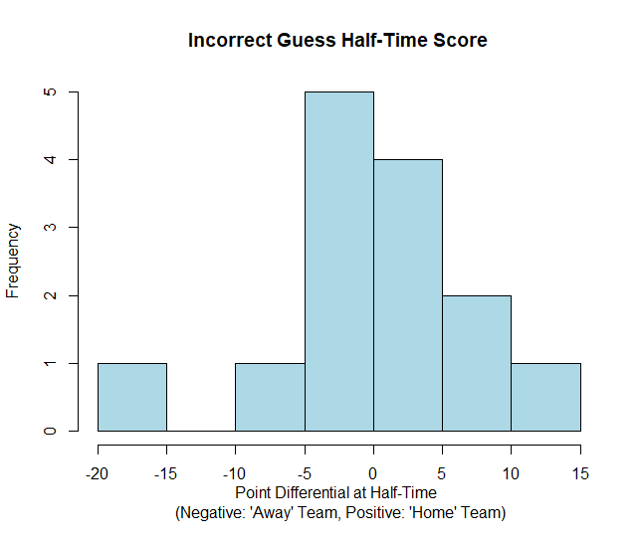

Slide 8
Usage
Betting at half time
Could help coaches with strategizing, as the majority of teams that were leading at half time won...Aka momentum during the first half is crucial to secure a win
Standardization of most heavily weighted features which determine a win in American Football

Slide 9
Looking forward
After producing our final Logistic Regression, we noticed a large amount of clustering between wrong guesses. In the future we would like to extend this model using Support Vector Machines (SVM) in order to possibly determine the cause of incorrect predictions.

Slide 10
Citations for alternate data
Quarterback Rate (QBR):
Outsiders, Football. “Football Outsiders.” Football Outsiders Everything, www.footballoutsiders.com/stats/qb2014.
Previous Year Season Stats (2014):
Pro-Football-Reference.com
https://www.pro-football-reference.com/years/2014/passing.htm

Slide 11
Thank you!

