Slide 1
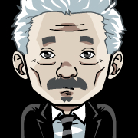


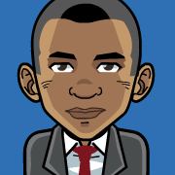
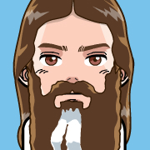

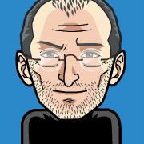
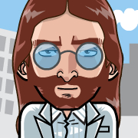

Computing subgroup coherence
Gathering individual subgroup preferences to compute
the constellational gravity in a social landscape.
AI Nugget presentation
As part of the exam in the Artificial Intelligence course with
Prof. Kurfess at the Munich University of Applied Sciences
in the summer semester 2015.
July 7th, 2015
Benjamin Aaron Degenhart
github.com/benjaminaaron/subgroups

Slide 2
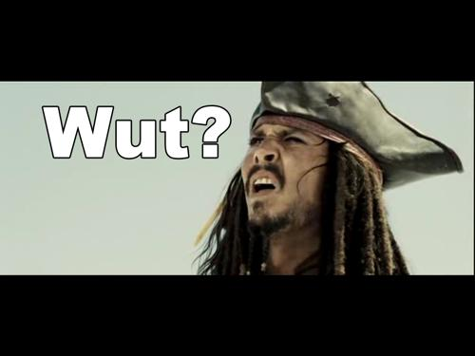
Computing subgroup coherence
Gathering individual subgroup preferences to compute
the constellational gravity in a social landscape.
?
??
?

Slide 3
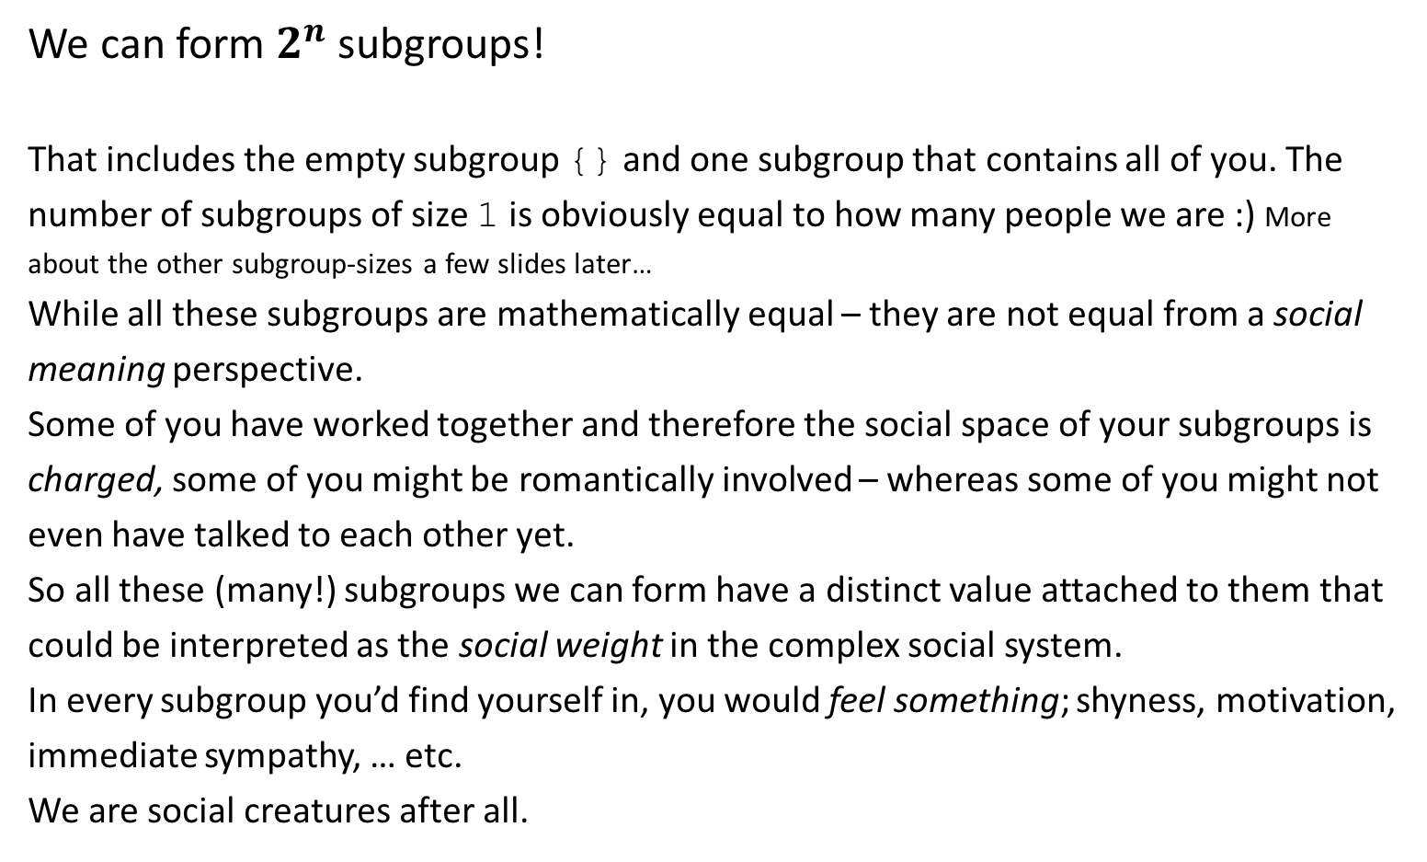
In this room…
We can form $2^{n}$ subgroups!
That includes the empty subgroup {} and one subgroup that contains all of you. The number of subgroups of size 1 is obviously equal to how many people we are :) More about the other subgroup-sizes a few slides later…
While all these subgroups are mathematically equal – they are not equal from a social meaning perspective.
Some of you have worked together and therefore the social space of your subgroups is charged, some of you might be romantically involved – whereas some of you might not even have talked to each other yet.
So all these (many!) subgroups we can form have a distinct value attached to them that could be interpreted as the social weight in the complex social system.
In every subgroup you’d find yourself in, you would feel something; shyness, motivation, immediate sympathy, … etc.
We are social creatures after all.

Slide 4
Experiment out of curiosity: solve mathematically what might otherwise be a cumbersome and heated social process:
split the whole group into smaller teams that work together on a project.
Can cause insights as well as resistance.
Besides math, the topic might best be situated in cognitive science and psychology.

Slide 5
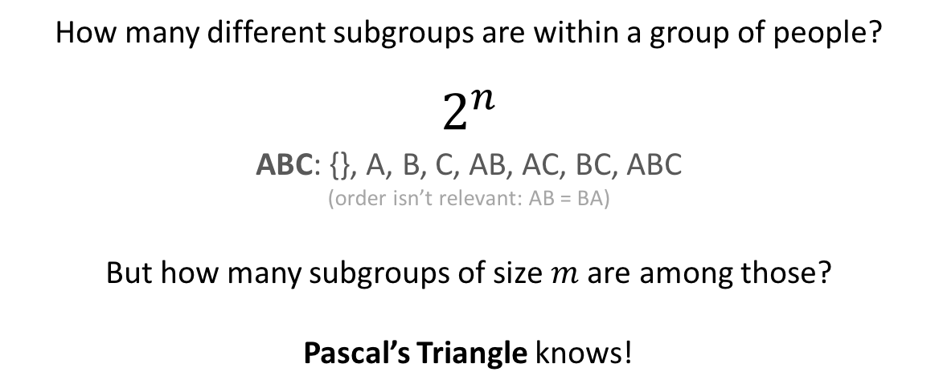
How many different subgroups are within a group of people?
$$2^{n}$$
ABC: {}, A, B, C, AB, AC, BC, ABC
(order isn’t relevant: AB = BA)
But how many subgroups of size $m$ are among those?
Pascal’s Triangle knows!
n |  |  |  |  |  |  |  |  |  |  |  |  |  |  |  |  |  |  |  |  | ∑
0 |  |  |  |  |  |  |  |  |  | 1 |  |  |  |  |  |  |  |  |  |  | 1
1 |  |  |  |  |  |  |  |  |  | 1 | 1 |  |  |  |  |  |  |  |  |  | 2
2 |  |  |  |  |  |  |  |  | 1 | 2 |  | 1 |  |  |  |  |  |  |  |  | 4
3 |  |  |  |  |  |  |  | 1 | 3 |  | 3 |  | 1 |  |  |  |  |  |  |  | 8
4 |  |  |  |  |  |  | 1 | 4 |  | 6 |  | 4 |  | 1 |  |  |  |  |  |  | 16
5 |  |  |  |  |  | 1 | 5 |  | 10 |  | 10 |  | 5 |  | 1 |  |  |  |  |  | 32
6 |  |  |  |  | 1 | 6 |  | 15 |  | 20 |  | 15 |  | 6 |  | 1 |  |  |  |  | 64
7 |  |  |  | 1 | 7 |  | 21 |  | 35 |  | 35 |  | 21 |  | 7 |  | 1 |  |  |  | 128
8 |  |  | 1 | 8 |  | 28 |  | 56 |  | 70 |  | 56 |  | 28 |  | 8 |  | 1 |  |  | 256
9 |  | 1 | 9 |  | 36 |  | 84 |  | 126 |  | 126 |  | 84 |  | 36 |  | 9 |  | 1 |  | 512
 |  | 0 | 1 |  | 2 |  | 3 |  | 4 |  | 5 |  | 6 |  | 7 |  | 8 |  | 9
For instance: a group of 9 people can form 512 different subgroups. 36 of those are of size 2.
That‘s how many unique handshakes can take place within that group.

Slide 6
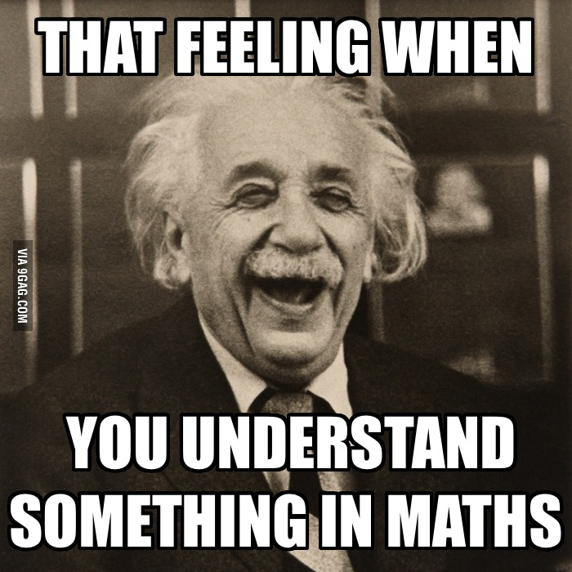
How to generate subgroups?
Binary counting!
ABCD
0 : 0000 : {}
1 : 0001 : D
2 : 0010 : C
3 : 0011 : CD
4 : 0100 : B
5 : 0101 : BD
6 : 0110 : BC
7 : 0111 : BCD
8 : 1000 : A
9 : 1001 : AD
10 : 1010 : AC
11 : 1011 : ACD
12 : 1100 : AB
13 : 1101 : ABD
14 : 1110 : ABC
15 : 1111 : ABCD

Slide 7
jesus
steve
katy
john
albert
obama
hermione
albert
harry
jesus / steve / jesus steve / katy / jesus katy / katy steve / jesus katy steve / john / jesus john / john steve / jesus john steve / john katy / jesus john katy / john katy steve / jesus john katy steve / charlie / charlie jesus / charlie steve / charlie jesus steve / charlie katy / charlie jesus katy / charlie katy steve / charlie jesus katy steve / charlie john / charlie jesus john / charlie john steve / charlie jesus john steve / charlie john katy / charlie jesus john katy / charlie john katy steve / charlie jesus john katy steve / obama / jesus obama / obama steve / jesus obama steve / katy obama / jesus katy obama / katy obama steve / jesus katy obama steve / john obama / jesus john obama / john obama steve / jesus john obama steve / john katy obama / jesus john katy obama / john katy obama steve / jesus john katy obama steve / charlie obama / charlie jesus obama / charlie obama steve / charlie jesus obama steve / charlie katy obama / charlie jesus katy obama / charlie katy obama steve / charlie jesus katy obama steve / charlie john obama / charlie jesus john obama / charlie john obama steve / charlie jesus john obama steve / charlie john katy obama / charlie jesus john katy obama / charlie john katy obama steve / charlie jesus john katy obama steve / hermione / hermione jesus / hermione steve / hermione jesus steve / hermione katy / hermione jesus katy / hermione katy steve / hermione jesus katy steve / hermione john / hermione jesus john / hermione john steve / hermione jesus john steve / hermione john katy / hermione jesus john katy / hermione john katy steve / hermione jesus john katy steve / charlie hermione / charlie hermione jesus / charlie hermione steve / charlie hermione jesus steve / charlie hermione katy / charlie hermione jesus katy / charlie hermione katy steve / charlie hermione jesus katy steve / charlie hermione john / charlie hermione jesus john / charlie hermione john steve / charlie hermione jesus john steve / charlie hermione john katy / charlie hermione jesus john katy / charlie hermione john katy steve / charlie hermione jesus john katy steve / hermione obama / hermione jesus obama / hermione obama steve / hermione jesus obama steve / hermione katy obama / hermione jesus katy obama / hermione katy obama steve / hermione jesus katy obama steve / hermione john obama / hermione jesus john obama / hermione john obama steve / hermione jesus john obama steve / hermione john katy obama / hermione jesus john katy obama / hermione john katy obama steve / hermione jesus john katy obama steve / charlie hermione obama / charlie hermione jesus obama / charlie hermione obama steve / charlie hermione jesus obama steve / charlie hermione katy obama / charlie hermione jesus katy obama / charlie hermione katy obama steve / charlie hermione jesus katy obama steve / charlie hermione john obama / charlie hermione jesus john obama / charlie hermione john obama steve / charlie hermione jesus john obama steve / charlie hermione john katy obama / charlie hermione jesus john katy obama / charlie hermione john katy obama steve / charlie hermione jesus john katy obama steve / albert / albert jesus / albert steve / albert jesus steve / albert katy / albert jesus katy / albert katy steve / albert jesus katy steve / albert john / albert jesus john / albert john steve / albert jesus john steve / albert john katy / albert jesus john katy / albert john katy steve / albert jesus john katy steve / albert charlie / albert charlie jesus / albert charlie steve / albert charlie jesus steve / albert charlie katy / albert charlie jesus katy / albert charlie katy steve / albert charlie jesus katy steve / albert charlie john / albert charlie jesus john / albert charlie john steve / albert charlie jesus john steve / albert charlie john katy / albert charlie jesus john katy / albert charlie john katy steve / albert charlie jesus john katy steve / albert obama / albert jesus obama / albert obama steve / albert jesus obama steve / albert katy obama / albert jesus katy obama / albert katy obama steve / albert jesus katy obama steve / albert john obama / albert jesus john obama / albert john obama steve / albert jesus john obama steve / albert john katy obama / albert jesus john katy obama / albert john katy obama steve / albert jesus john katy obama steve / albert charlie obama / albert charlie jesus obama / albert charlie obama steve / albert charlie jesus obama steve / albert charlie katy obama / albert charlie jesus katy obama / albert charlie katy obama steve / albert charlie jesus katy obama steve / albert charlie john obama / albert charlie jesus john obama / albert charlie john obama steve / albert charlie jesus john obama steve / albert charlie john katy obama / albert charlie jesus john katy obama / albert charlie john katy obama steve / albert charlie jesus john katy obama steve / albert hermione / albert hermione jesus / albert hermione steve / albert hermione jesus steve / albert hermione katy / albert hermione jesus katy / albert hermione katy steve / albert hermione jesus katy steve / albert hermione john / albert hermione jesus john / albert hermione john steve / albert hermione jesus john steve / albert hermione john katy / albert hermione jesus john katy / albert hermione john katy steve / albert hermione jesus john katy steve / albert charlie hermione / albert charlie hermione jesus / albert charlie hermione steve / albert charlie hermione jesus steve / albert charlie hermione katy / albert charlie hermione jesus katy / albert charlie hermione katy steve / albert charlie hermione jesus katy steve / albert charlie hermione john / albert charlie hermione jesus john / albert charlie hermione john steve / albert charlie hermione jesus john steve / albert charlie hermione john katy / albert charlie hermione jesus john katy / albert charlie hermione john katy steve / albert charlie hermione jesus john katy steve / albert hermione obama / albert hermione jesus obama / albert hermione obama steve / albert hermione jesus obama steve / albert hermione katy obama / albert hermione jesus katy obama / albert hermione katy obama steve / albert hermione jesus katy obama steve / albert hermione john obama / albert hermione jesus john obama / albert hermione john obama steve / albert hermione jesus john obama steve / albert hermione john katy obama / albert hermione jesus john katy obama / albert hermione john katy obama steve / albert hermione jesus john katy obama steve / albert charlie hermione obama / albert charlie hermione jesus obama / albert charlie hermione obama steve / albert charlie hermione jesus obama steve / albert charlie hermione katy obama / albert charlie hermione jesus katy obama / albert charlie hermione katy obama steve / albert charlie hermione jesus katy obama steve / albert charlie hermione john obama / albert charlie hermione jesus john obama / albert charlie hermione john obama steve / albert charlie hermione jesus john obama steve / albert charlie hermione john katy obama / albert charlie hermione jesus john katy obama / albert charlie hermione john katy obama steve / albert charlie hermione jesus john katy obama steve / harry / harry jesus / harry steve / harry jesus steve / harry katy / harry jesus katy / harry katy steve / harry jesus katy steve / harry john / harry jesus john / harry john steve / harry jesus john steve / harry john katy / harry jesus john katy / harry john katy steve / harry jesus john katy steve / charlie harry / charlie harry jesus / charlie harry steve / charlie harry jesus steve / charlie harry katy / charlie harry jesus katy / charlie harry katy steve / charlie harry jesus katy steve / charlie harry john / charlie harry jesus john / charlie harry john steve / charlie harry jesus john steve / charlie harry john katy / charlie harry jesus john katy / charlie harry john katy steve / charlie harry jesus john katy steve / harry obama / harry jesus obama / harry obama steve / harry jesus obama steve / harry katy obama / harry jesus katy obama / harry katy obama steve / harry jesus katy obama steve / harry john obama / harry jesus john obama / harry john obama steve / harry jesus john obama steve / harry john katy obama / harry jesus john katy obama / harry john katy obama steve / harry jesus john katy obama steve / charlie harry obama / charlie harry jesus obama / charlie harry obama steve / charlie harry jesus obama steve / charlie harry katy obama / charlie harry jesus katy obama / charlie harry katy obama steve / charlie harry jesus katy obama steve / charlie harry john obama / charlie harry jesus john obama / charlie harry john obama steve / charlie harry jesus john obama steve / charlie harry john katy obama / charlie harry jesus john katy obama / charlie harry john katy obama steve / charlie harry jesus john katy obama steve / harry hermione / harry hermione jesus / harry hermione steve / harry hermione jesus steve / harry hermione katy / harry hermione jesus katy / harry hermione katy steve / harry hermione jesus katy steve / harry hermione john / harry hermione jesus john / harry hermione john steve / harry hermione jesus john steve / harry hermione john katy / harry hermione jesus john katy / harry hermione john katy steve / harry hermione jesus john katy steve / charlie harry hermione / charlie harry hermione jesus / charlie harry hermione steve / charlie harry hermione jesus steve / charlie harry hermione katy / charlie harry hermione jesus katy / charlie harry hermione katy steve / charlie harry hermione jesus katy steve / charlie harry hermione john / charlie harry hermione jesus john / charlie harry hermione john steve / charlie harry hermione jesus john steve / charlie harry hermione john katy / charlie harry hermione jesus john katy / charlie harry hermione john katy steve / charlie harry hermione jesus john katy steve / harry hermione obama / harry hermione jesus obama / harry hermione obama steve / harry hermione jesus obama steve / harry hermione katy obama / harry hermione jesus katy obama / harry hermione katy obama steve / harry hermione jesus katy obama steve / harry hermione john obama / harry hermione jesus john obama / harry hermione john obama steve / harry hermione jesus john obama steve / harry hermione john katy obama / harry hermione jesus john katy obama / harry hermione john katy obama steve / harry hermione jesus john katy obama steve / charlie harry hermione obama / charlie harry hermione jesus obama / charlie harry hermione obama steve / charlie harry hermione jesus obama steve / charlie harry hermione katy obama / charlie harry hermione jesus katy obama / charlie harry hermione katy obama steve / charlie harry hermione jesus katy obama steve / charlie harry hermione john obama / charlie harry hermione jesus john obama / charlie harry hermione john obama steve / charlie harry hermione jesus john obama steve / charlie harry hermione john katy obama / charlie harry hermione jesus john katy obama / charlie harry hermione john katy obama steve / charlie harry hermione jesus john katy obama steve / albert harry / albert harry jesus / albert harry steve / albert harry jesus steve / albert harry katy / albert harry jesus katy / albert harry katy steve / albert harry jesus katy steve / albert harry john / albert harry jesus john / albert harry john steve / albert harry jesus john steve / albert harry john katy / albert harry jesus john katy / albert harry john katy steve / albert harry jesus john katy steve / albert charlie harry / albert charlie harry jesus / albert charlie harry steve / albert charlie harry jesus steve / albert charlie harry katy / albert charlie harry jesus katy / albert charlie harry katy steve / albert charlie harry jesus katy steve / albert charlie harry john / albert charlie harry jesus john / albert charlie harry john steve / albert charlie harry jesus john steve / albert charlie harry john katy / albert charlie harry jesus john katy / albert charlie harry john katy steve / albert charlie harry jesus john katy steve / albert harry obama / albert harry jesus obama / albert harry obama steve / albert harry jesus obama steve / albert harry katy obama / albert harry jesus katy obama / albert harry katy obama steve / albert harry jesus katy obama steve / albert harry john obama / albert harry jesus john obama / albert harry john obama steve / albert harry jesus john obama steve / albert harry john katy obama / albert harry jesus john katy obama / albert harry john katy obama steve / albert harry jesus john katy obama steve / albert charlie harry obama / albert charlie harry jesus obama / albert charlie harry obama steve / albert charlie harry jesus obama steve / albert charlie harry katy obama / albert charlie harry jesus katy obama / albert charlie harry katy obama steve / albert charlie harry jesus katy obama steve / albert charlie harry john obama / albert charlie harry jesus john obama / albert charlie harry john obama steve / albert charlie harry jesus john obama steve / albert charlie harry john katy obama / albert charlie harry jesus john katy obama / albert charlie harry john katy obama steve / albert charlie harry jesus john katy obama steve / albert harry hermione / albert harry hermione jesus / albert harry hermione steve / albert harry hermione jesus steve / albert harry hermione katy / albert harry hermione jesus katy / albert harry hermione katy steve / albert harry hermione jesus katy steve / albert harry hermione john / albert harry hermione jesus john / albert harry hermione john steve / albert harry hermione jesus john steve / albert harry hermione john katy / albert harry hermione jesus john katy / albert harry hermione john katy steve / albert harry hermione jesus john katy steve / albert charlie harry hermione / albert charlie harry hermione jesus / albert charlie harry hermione steve / albert charlie harry hermione jesus steve / albert charlie harry hermione katy / albert charlie harry hermione jesus katy / albert charlie harry hermione katy steve / albert charlie harry hermione jesus katy steve / albert charlie harry hermione john / albert charlie harry hermione jesus john / albert charlie harry hermione john steve / albert charlie harry hermione jesus john steve / albert charlie harry hermione john katy / albert charlie harry hermione jesus john katy / albert charlie harry hermione john katy steve / albert charlie harry hermione jesus john katy steve / albert harry hermione obama / albert harry hermione jesus obama / albert harry hermione obama steve / albert harry hermione jesus obama steve / albert harry hermione katy obama / albert harry hermione jesus katy obama / albert harry hermione katy obama steve / albert harry hermione jesus katy obama steve / albert harry hermione john obama / albert harry hermione jesus john obama / albert harry hermione john obama steve / albert harry hermione jesus john obama steve / albert harry hermione john katy obama / albert harry hermione jesus john katy obama / albert harry hermione john katy obama steve / albert harry hermione jesus john katy obama steve / albert charlie harry hermione obama / albert charlie harry hermione jesus obama / albert charlie harry hermione obama steve / albert charlie harry hermione jesus obama steve / albert charlie harry hermione katy obama / albert charlie harry hermione jesus katy obama / albert charlie harry hermione katy obama steve / albert charlie harry hermione jesus katy obama steve / albert charlie harry hermione john obama / albert charlie harry hermione jesus john obama / albert charlie harry hermione john obama steve / albert charlie harry hermione jesus john obama steve / albert charlie harry hermione john katy obama / albert charlie harry hermione jesus john katy obama / albert charlie harry hermione john katy obama steve / albert charlie harry hermione jesus john katy obama steve
code (Node.js) at: github.com/benjaminaaron/subgroups
faces from www.faceyourmanga.com/fymworld.php#popular

Slide 8
Now let’s start the process of collecting the social input for the algorithm.
Ask every member to call their favourite subgroup into the middle and record the names.
Favourite in a sense who (s)he would most like to work together with on a project for instance.

Slide 9
chosen subgroups
information about topology of social landscape is in those subgroups: “social input” for the algorithm
jesus john harry albert
steve charlie hermione
katy obama albert harry jesus
john steve charlie
charlie albert katy john
obama jesus harry
hermione harry
albert harry jesus katy
harry obama steve hermione charlie

Slide 10
jesus / john / jesus john / harry / harry jesus / harry john / harry jesus john / albert / albert jesus / albert john / albert jesus john / albert harry / albert harry jesus / albert harry john / albert harry jesus john / steve / charlie / charlie steve / hermione / hermione steve / charlie hermione / charlie hermione steve / katy / obama / katy obama / albert / albert katy / albert obama / albert katy obama / harry / harry katy / harry obama / harry katy obama / albert harry / albert harry katy / albert harry obama / albert harry katy obama / jesus / jesus katy / jesus obama / jesus katy obama / albert jesus / albert jesus katy / albert jesus obama / albert jesus katy obama / harry jesus / harry jesus katy / harry jesus obama / harry jesus katy obama / albert harry jesus / albert harry jesus katy / albert harry jesus obama / albert harry jesus katy obama / john / steve / john steve / charlie / charlie john / charlie steve / charlie john steve / charlie / albert / albert charlie / katy / charlie katy / albert katy / albert charlie katy / john / charlie john / albert john / albert charlie john / john katy / charlie john katy / albert john katy / albert charlie john katy / obama / jesus / jesus obama / harry / harry obama / harry jesus / harry jesus obama / hermione / harry / harry hermione / albert / harry / albert harry / jesus / albert jesus / harry jesus / albert harry jesus / katy / albert katy / harry katy / albert harry katy / jesus katy / albert jesus katy / harry jesus katy / albert harry jesus katy / harry / obama / harry obama / steve / harry steve / obama steve / harry obama steve / hermione / harry hermione / hermione obama / harry hermione obama / hermione steve / harry hermione steve / hermione obama steve / harry hermione obama steve / charlie / charlie harry / charlie obama / charlie harry obama / charlie steve / charlie harry steve / charlie obama steve / charlie harry obama steve / charlie hermione / charlie harry hermione / charlie hermione obama / charlie harry hermione obama / charlie hermione steve / charlie harry hermione steve / charlie hermione obama steve / charlie harry hermione obama steve
9: 3: albert harry jesus
8: 4: harry jesus
8: 2: albert harry jesus katy
6: 2: charlie hermione steve
6: 6: harry
6: 3: albert harry
6: 2: albert harry katy
6: 2: harry jesus obama
6: 3: charlie steve
6: 3: harry obama
6: 2: harry jesus katy
6: 3: albert jesus
6: 3: albert katy
6: 2: albert jesus katy
5: 1: charlie harry hermione obama steve
…
jesus john harry albert
steve charlie hermione
katy obama albert harry jesus
john steve charlie
charlie albert katy john
obama jesus harry
hermione harry
albert harry jesus katy
harry obama steve hermione charlie
generate subsubgroups
count & rank
$$rank=occurence∗subsubgroupsize$$
Idea: reward strong bonds between large subsubgroups.
Other ranking-schemes possible.
For instance subsubgroups containing the respective subgroup-caller could get a bonus.

Slide 11
9
8
8
6
6
9: 3: albert harry jesus
8: 4: harry jesus
8: 2: albert harry jesus katy
6: 2: charlie hermione steve
6: 6: harry
6: 3: albert harry
6: 2: albert harry katy
6: 2: harry jesus obama
6: 3: charlie steve
6: 3: harry obama
6: 2: harry jesus katy
6: 3: albert jesus
6: 3: albert katy
6: 2: albert jesus katy
5: 1: charlie harry hermione obama steve
…
…

Slide 12
9
8
8
6
6
Ok, so what?
Obviously in this arbitrary example you don’t feel anything personally.
But if this would be a group you are part of – you would feel something.
Next step?
If the task is to form subgroups for a project for instance - compute the best possible overall configuration depending on the group-size parameters:
3 groups of 3
2 groups of size 4 and 5
3 groups of size 2 and one of size 3
…
…

Slide 13
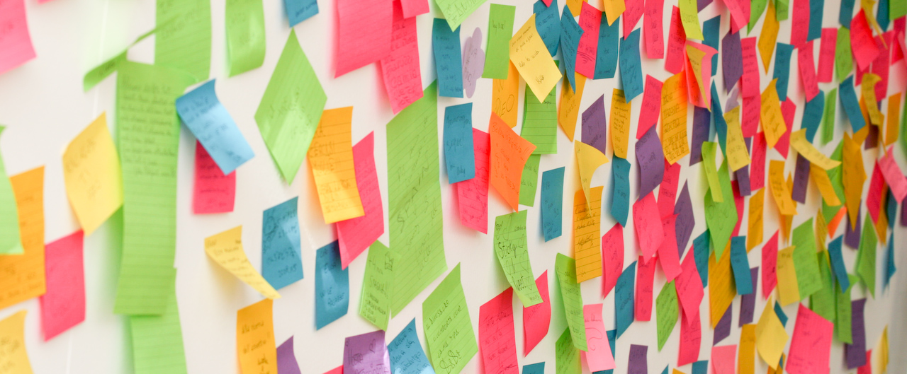
Possible applications
music playlists
ice-cream combinations
crowdsourcing categorization-schemes e.g. for Post-its after a brainstorm
CV analysis
…
anything you have a shared pool of entitities and the intelligence in question goes into the assembly of a selection and/or the combination of selections that arise from this shared pool
Heuristics
Yes, definitely! Brute force hits a computational limit pretty fast.

Slide 14
Thanks for your attention.
Questions?
Suggestions for a better title? Please??
github.com/benjaminaaron/subgroups

