Slide 1
BMORE SAVE

Slide 2
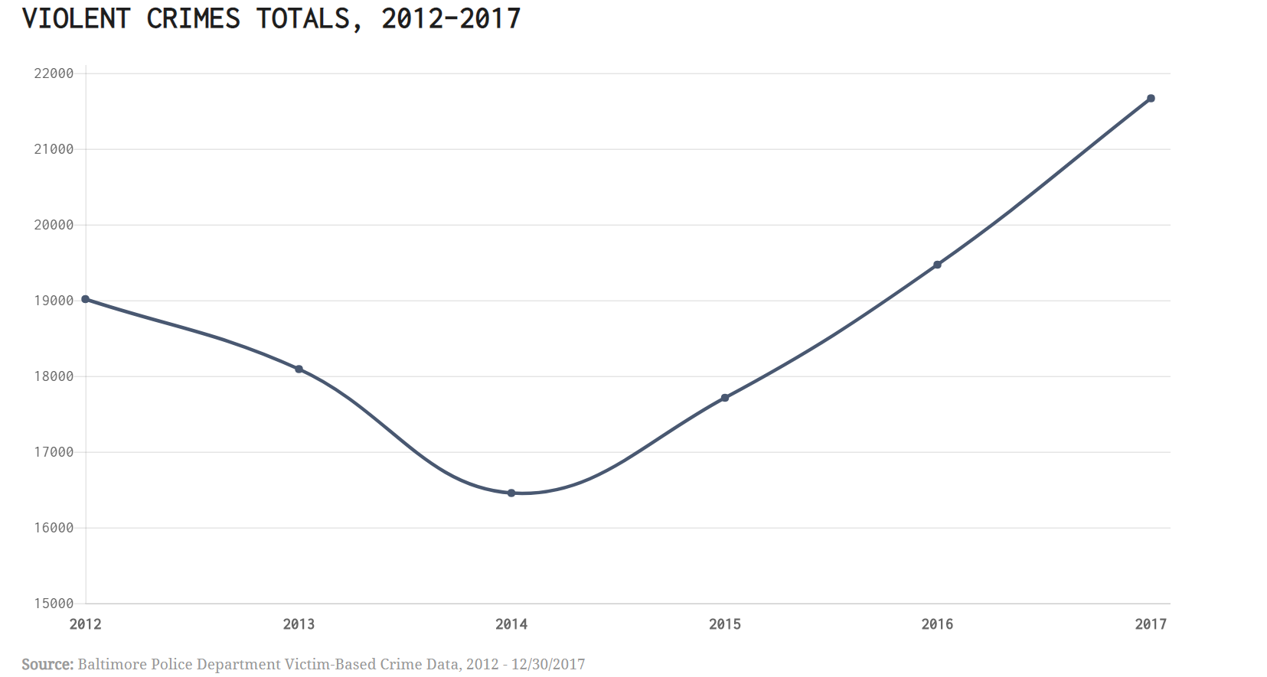
Problem
According to USA Today, Baltimore is the most dangerous city in the country

Slide 3
Objective
Make software that, given a point of start (A) and a destination (B), outputs the safest route between A and B
It outputs instructions for travel and a visual map displaying both the safest route (in green) and the dangerous routes to be avoided.
We used the city of Baltimore data on victim-based crime at each location.

Slide 4
How it Works Stage 1: Database
CRIME CATEGORIES
4: Murder, sexual assault, abduction, human trafficking and terrorism
3: Assault, drug trafficking and armed robbery and other violence-related incidents
2: Non-violent robberies, vandalism, invasion
1: Drug possession, domestic abuse, DUI
We used a database with all the victim-related crimes in Baltimore area since 2011 and their locations
The crimes were categorized according to severity and impact to travelers.
Only data that had geographic coordinates and a description of the crime were kept:
15713 datapoints

Slide 5
Stage 2: Processing
Given initial position A and desired position B, we calculate the possible routes.
We keep only routes that are at most 2 times slower than the fastest route.
We determine the safety of the routes by analyzing the proximity and severity of the nearest 1% of crimes (157 data) to each point in the route.
For example:
Given a route with points x, y, and z
We determine the safety of the route by analyzing the nearest 153 crimes to each route point
After that, we can define which route is safest (while still time efficient).

Slide 6
Stage 3: Display
Map display all analyzed routes
Safest route is green
Dangerous routes are shades of red
Together with the map, the program outputs the directions of the safest rote for the ser to follow

Slide 7
Example: Going from Homewood Campus to Medical Campus
---------------- SAFEST DIRECTIONS ---------------
Start out going south on N Charles St toward Art Museum Dr.
Turn right onto Art Museum Dr.
Art Museum Dr becomes N Howard St.
Turn left onto W 28th St.
Turn right onto Saint Paul St/MD-139.
Turn left onto E 25th St.
Turn slight right onto N Wolfe St.
Turn right onto E Madison St.
1710 E MADISON ST is on the right.

