Slide 1
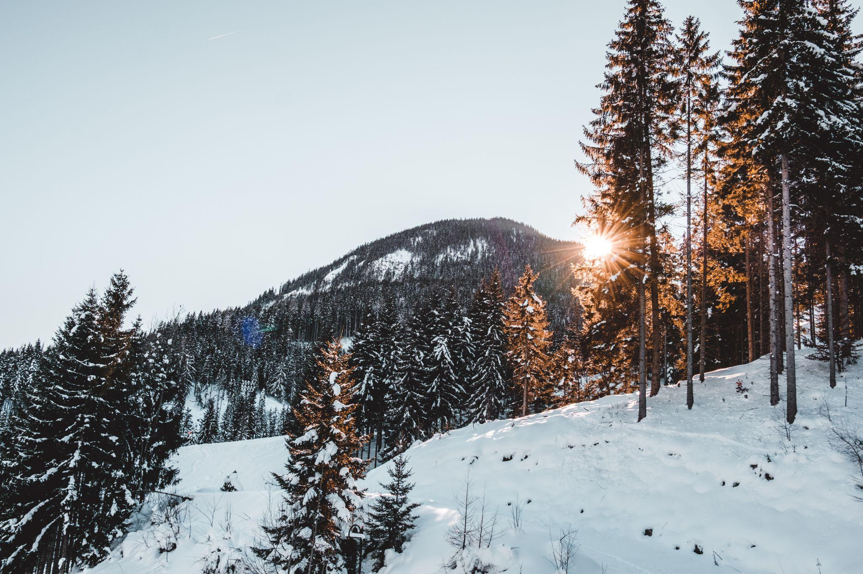
Big Mountain Resort Pricing Strategy
By Ben Bellman
Image by Leroy Filon

Slide 2

Problem Identification:
How can Big Mountain Resort adapt its ticket pricing strategy by capturing the full value of its diverse infrastructure, product and natural offerings relative to its competitors in order to increase profitability by ~ $3 million ?
Image by GrafVishenka
https://www.istockphoto.com/vector/set-of-trendy-vector-ski-pass-template-design-gm584863988-100206407

Slide 3
Recommendations and Key Findings:
Key Finding: Model showed BM’s features justifies ticket prices closer to $95 rather than the current $81.
Of the 4 proposed scenarios we recommend scenario 2, which is to add another chair lift, adding a run and increasing the vertical drop by 150 feet.
Scenario 1 is also a possibility to explore.

Slide 4
Modeling Results and Analysis - The Analysis
We compared Big Mountain to over 276 ski resorts across > 30 states.
Explored over 36 different parameters on Weekend ticket prices.
BS Weekend Ticket Prices were at $81, average of other resorts was $64
Developed a model to evaluate which features influence ticket price.
Our model was able to predict price with a Mean Absolute Error of ~9$.

Slide 5
Modeling Results and Analysis (1)
Models explored were linear regression and random-forest, chose the latter as performed better in predicting the mean.
8 variables of interest which influenced price:
Vertical Drop
Snow Making
Total Chairs
Fast Quads
Runs
Longest Run
Trams
Skiable Terrain

Slide 6
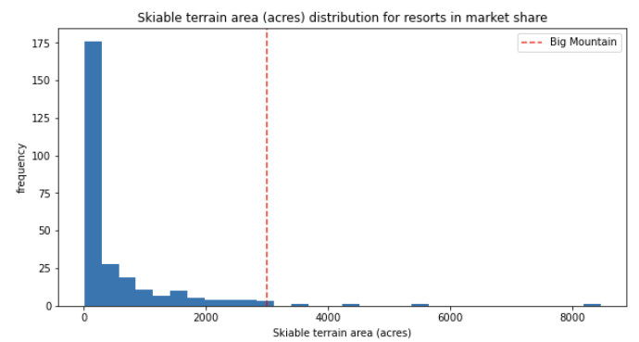
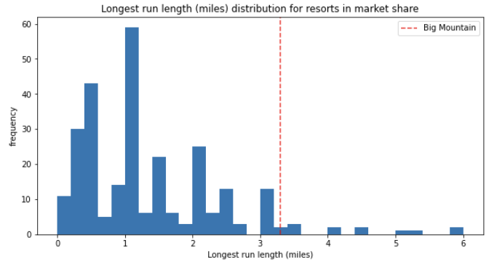
Modeling Results - Big Mountain vs Competition

Slide 7
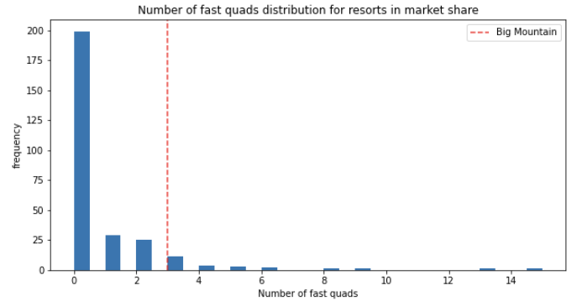
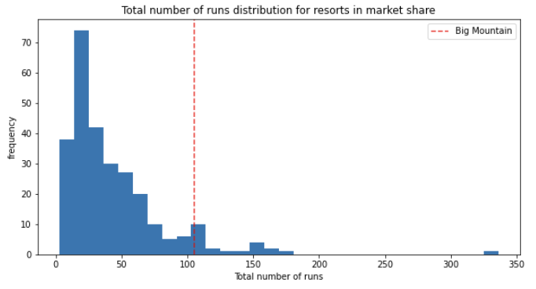
Modeling Results - Big Mountain vs Competition

Slide 8
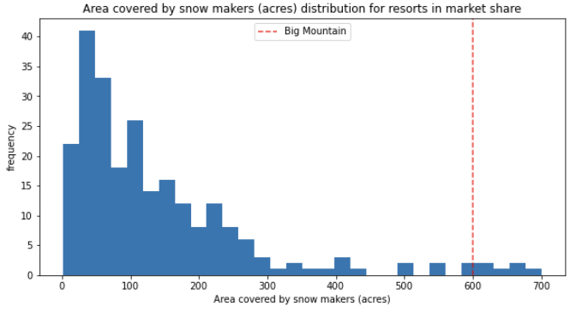
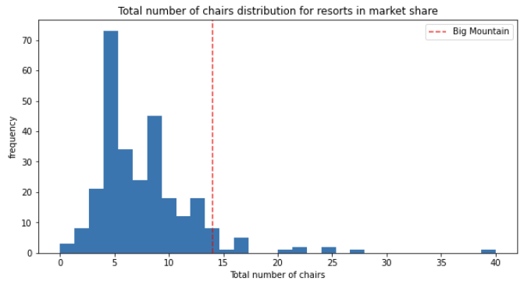
Modeling Results - Big Mountain vs Competition

Slide 9
Modeling Results - Scenario Analysis Results
Scenario 1: Closing down up to 10 of the least used runs.
Result: Supports reduction of prices up to $3 for ticket prices if 10 runs are closed. 5 is what would be recommended.
Scenario 2: Increase the vertical drop + additional chairlift
Result: Supports an increase in ticket prices of $1.99, raising revenues by $3.47 million.
Scenario 3: Scenario 2 + 2 acres of snow making cover
Result: Same as scenario 2 but will have increased costs with snow making cover.
Scenario 4: Increase the longest run by 0.2 miles
Result: No effect on ticket prices

Slide 10
Summary and Conclusion
We developed a model which can have future use to make decisis
Limitations of the model include:
E
E
E
Conclusion: Based on the results of the model, we recommend that . Should BMS adapt only

