Slide 1
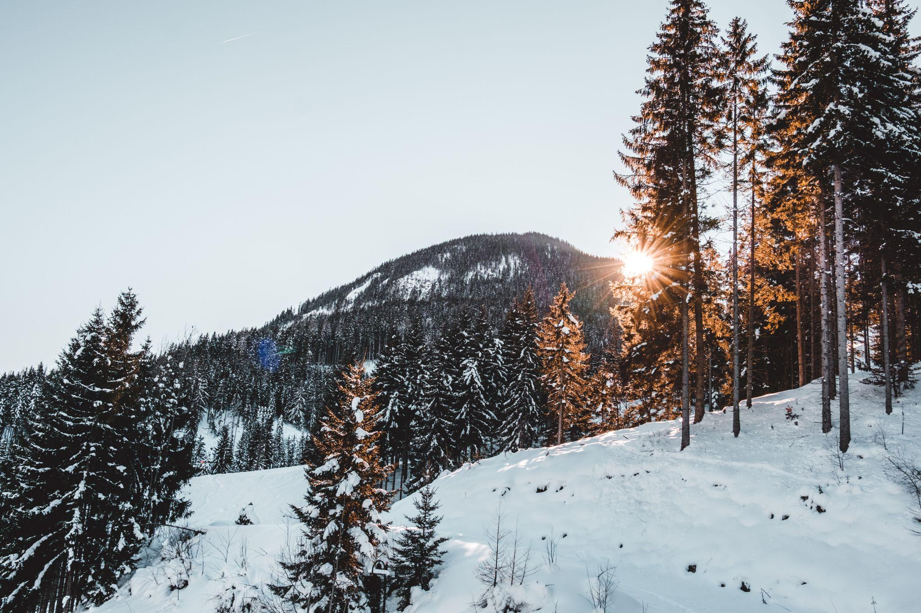
Big Mountain Resort Pricing Strategy
By Ben Bellman
Image by Leroy Filon

Slide 2

Problem Identification:
How can Big Mountain Resort adapt its ticket pricing strategy by capturing the full value of its diverse infrastructure, product and natural offerings relative to its competitors in order to increase profitability by ~ $3 million ?
Image by GrafVishenka
https://www.istockphoto.com/vector/set-of-trendy-vector-ski-pass-template-design-gm584863988-100206407

Slide 3
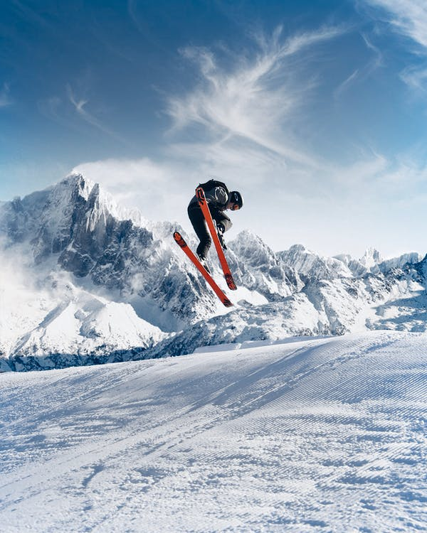
Recommendations and Key Findings:
Key Finding: Model showed BM’s features justifies ticket prices closer to $95 rather than the current $81.
Scenario Analysis Results:
We recommend scenario 2, which is to add another chair lift, adding a run and increasing the vertical drop by 150 feet.
Scenario 1 is also a possibility to explore with more cost data.
Image by Melvin Wahlin
https://www.pexels.com/photo/photo-of-person-skiing-on-snowfield-2433353/

Slide 4
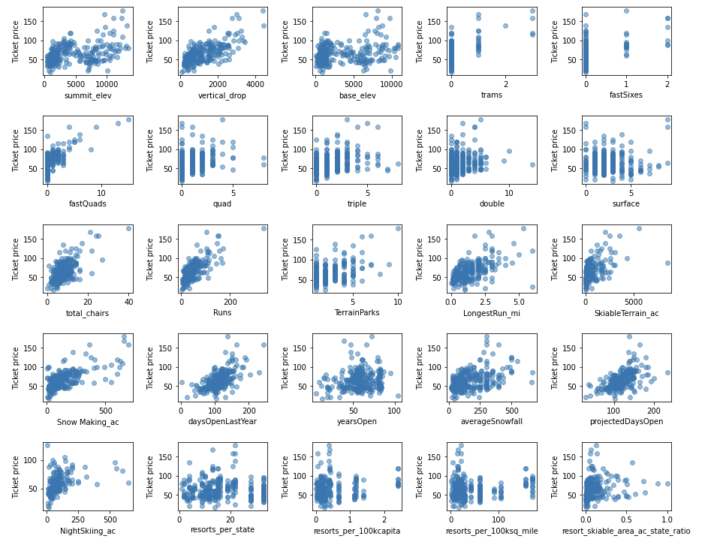
Modeling Results and Analysis - The Analysis
Compared BM to 276 resorts across > 30 states.
Explored 36 variables on Weekend ticket prices.
BS Weekend Ticket Prices stand at $81.
Average of other resorts prices was $64.
Assumptions:
- Receiving 350,000 visitors.
- Each visitor skis for 5 days on average.
Developed a model to evaluate which features influence ticket price.
Scatterplot of variables explored that could influence price.

Slide 5
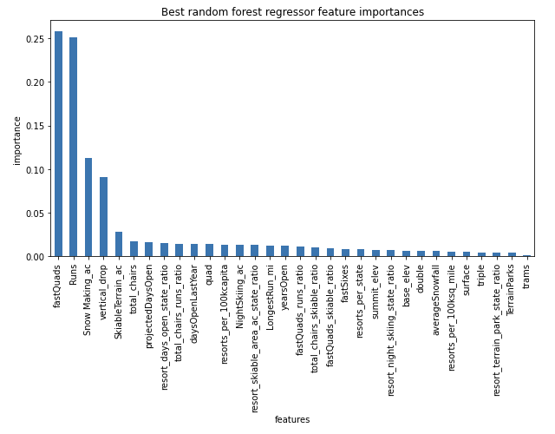
Modeling Results and Analysis – Methods and Variables
Models explored were linear regression and random-forest.
Chose the latter; performed better in predicting the mean.
Variables which influenced price the most (8):
Vertical Drop
Snow Making
Total Chairs
Fast Quads
Runs
Longest Run
Trams
Skiable Terrain
Our model was able to predict price with a Mean Absolute Error of ~$9.
Key Features which influenced Price in the Random Forest Model

Slide 6
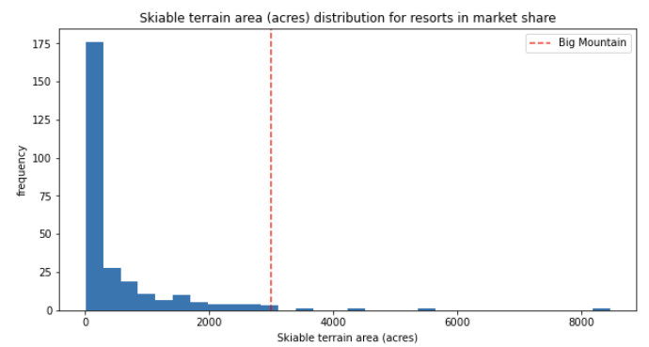
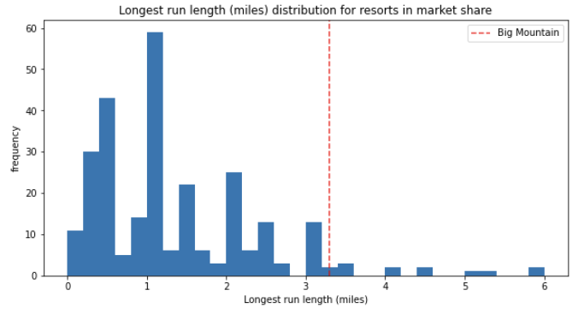
Modeling Results - Big Mountain vs. Competition

Slide 7
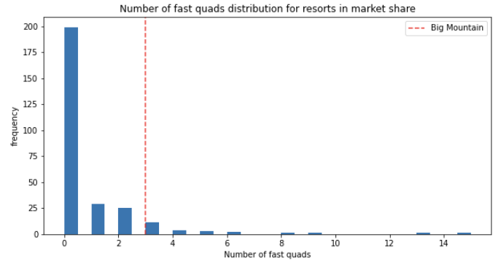
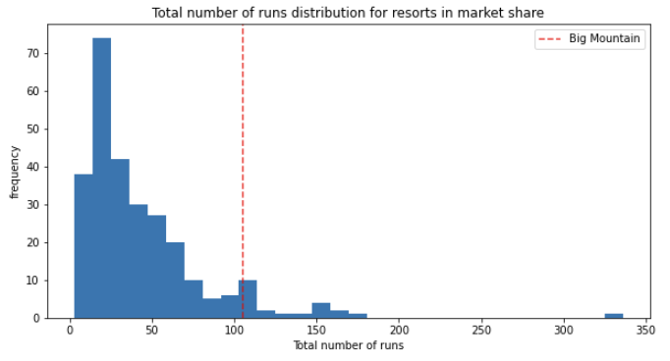
Modeling Results - Big Mountain vs. Competition

Slide 8
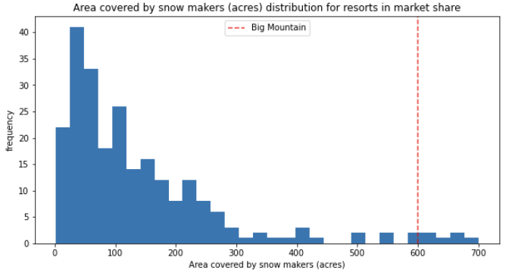
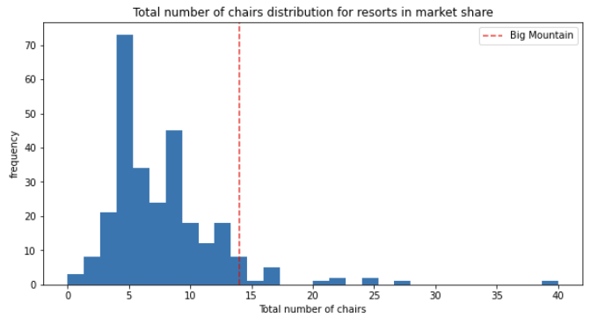
Modeling Results - Big Mountain vs. Competition

Slide 9
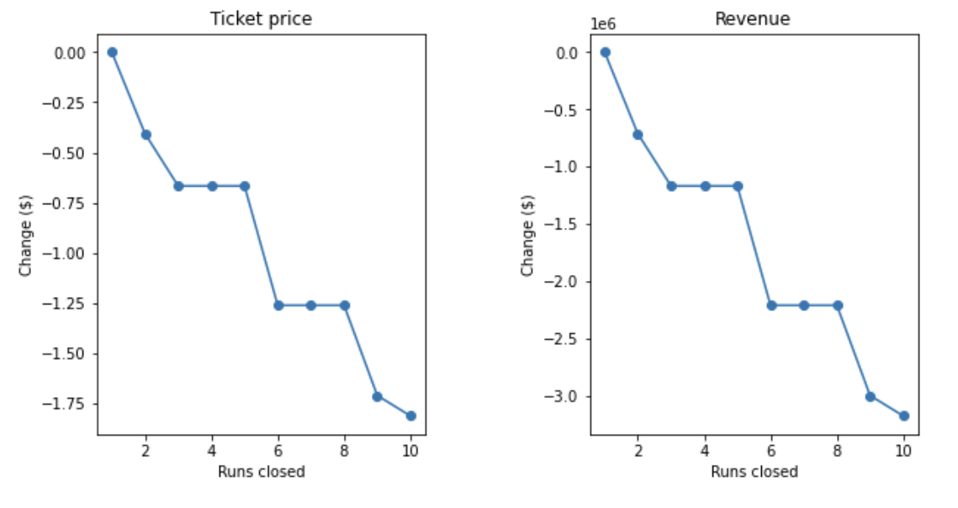
Modeling Results - Scenario Analysis Results
Scenario 1: Closing down up to 10 of the least used runs.
Result: Supports reduction of prices up to $3 for ticket prices if 10 runs are closed. 5 is what would be recommended.
Scenario 2: Increase the vertical drop + additional chairlift
Result: Supports an increase in ticket prices of $1.99, raising revenues by $3.47 million.
Scenario 3: Scenario 2 + 2 acres of snow making cover
Result: Same as scenario 2 but will have increased costs with snow making cover.
Scenario 4: Increase the longest run by 0.2 miles
Result: No effect on ticket prices
Scenario 1 Modelling Results

Slide 10
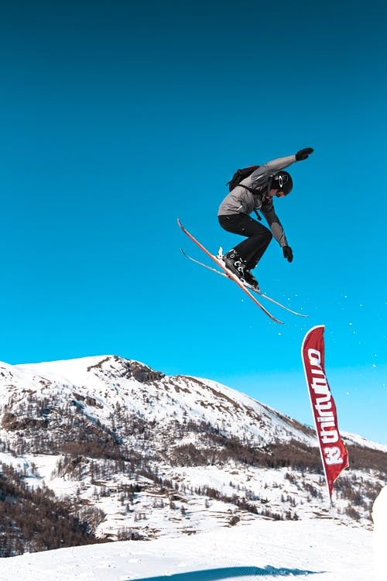
Summary and Conclusion
Conclusion: Model suggests BM’s features support ticket prices at around $95.
Scenarios:
Scenario 2 will be able to support a change of ticket price of $1.99 and generate additional revenue of $3.4 million.
Scenario 1 would need operation cost data.
Limitations of the model:
Missing Operation Cost data.
Conduct Surveys to find skiiers preferences.
Elasticity of demand for ticket prices.
Image by Melvin Wahlin
https://www.pexels.com/photo/man-doing-snow-ski-blade-tricks-on-air-2433356/

