Slide 1
CSE271 – Project #2
By: Benjamin Bowser

Slide 2
Design & Programming Decisions
Boolean 2D 8x8 array for queens and also Buttons. True = Queen placed. Button array used to change queen location on the board when using Tip.
Helped keep track of what was placed where and change board
Used labels with GridLayout to space the numbers on the side of the board to look neat.
5 total classes – Divided mostly to keep the program from becoming excessively long

Slide 3
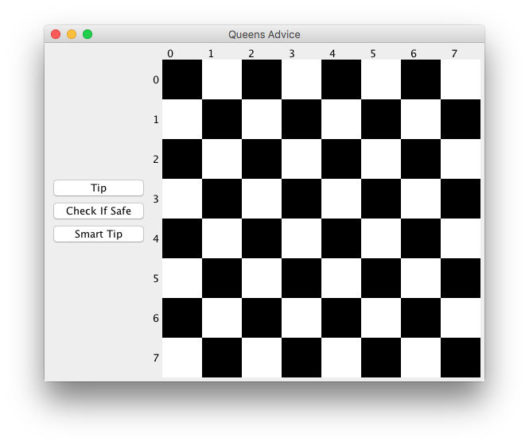

Slide 4

Challenges Encountered
Getting the proper icon on my board to disappear when using the ”Check if Valid” button. Sometimes the icon would go away, but usually it would stay.
Flipped x and y coordinates in 2D array
The queens icon I used was large (several inches) so sizing it down was necessary.
Proper positioning with my panels was difficult due to the use of nested panels
At one point the board took over 10 seconds to appear in the panel

Slide 5
Things I Learned
Always start assignments early, even if it’s only the basics
Sometimes you will get busy with other work or get stuck on a part.
JPanels do not always work the way you want them to
Layouts were very difficult, nested panels.
There are so many different ways to do large assignments with coding.
Talking pseudocode with others can be very difficult on these projects.

Slide 6
Interesting Parts of my Project
To keep track of the board, each space was 50x50px. In another class, I had a switch statement to convert these x and y coordinates into easy to understand coordinates, from 0-7.
When the tip button found no more working suggestions, I made a dialog box appear with a custom message.
Used for loops to check if queens were safe

Slide 7
