Slide 1
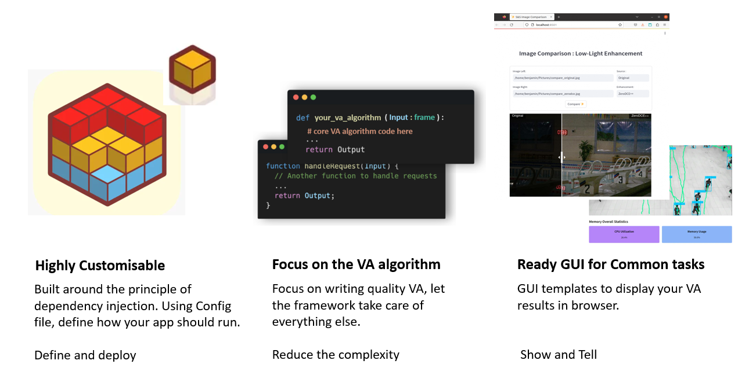
Highly Customisable
MicroCore framework provides the components you need to build a microservice, configurable using a .yaml file.
Customize and deploy.
Focus on the Core
Your algorithm/model is the core of the microservice. Let MicroCore take care of everything else.
Reduce the complexity
Ready GUI to interact
MicroCore scans your code and build a GUI Dashboard to interact with your model
Quick to demonstrate your app

