Slide 1
Using Self-Organizing Maps to generate encodings for CMMs
Benjamin Gorman
Supervisor: Simon O’Keefe

Slide 2
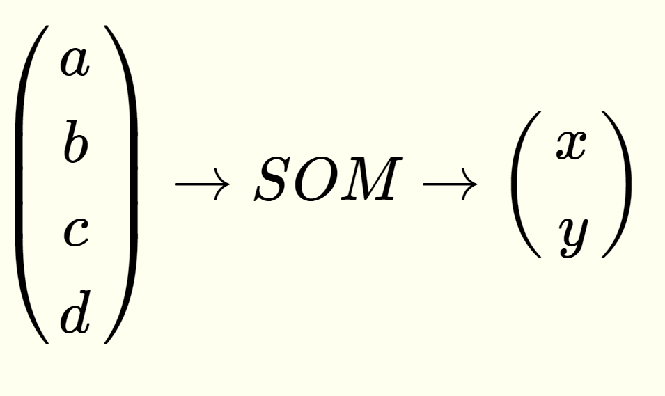
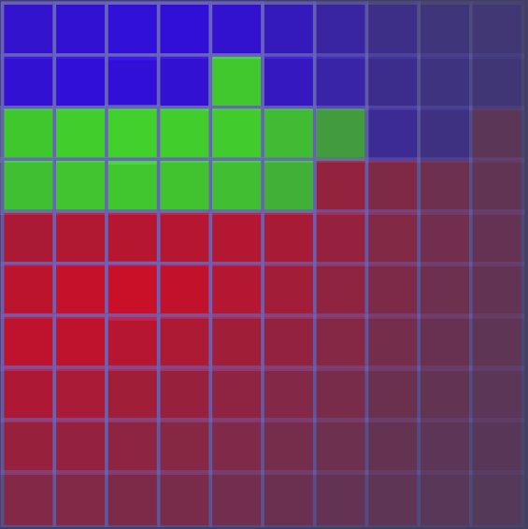
Input data
High dimensional
Self-organizing map
Low dimensional representation
Correlation matrix memory
Encoding

Slide 3
Input data
High dimensional
Self-organizing map
Low dimensional representation
Correlation matrix memory
Encoding

Slide 4
Self Organizing Maps
a.k.a SOM
Consists of a grid of neurons
Square or hexagonal grids are most common
A SOM converts high-dimensional data into low dimensions (usually 2D)

Slide 5

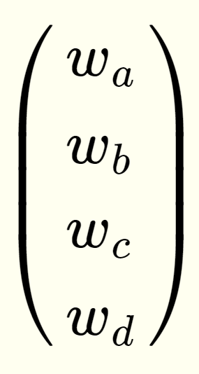
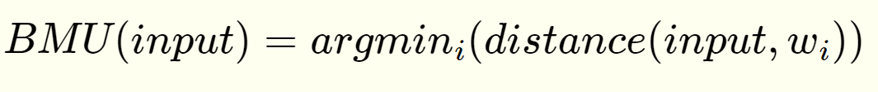
Self Organizing Maps
Every neuron has a weight vector with the same size as the input data
New inputs are classified by finding the neuron with the best matching weight vector
This is called the Best-Matching-Unit or BMU

Slide 6

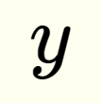
Self Organizing Maps
The position of the BMU provides the 2D output from the SOM
BMU

Slide 7
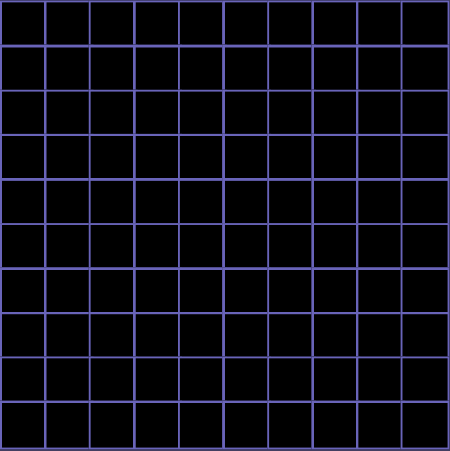
Self Organizing Maps – Training Process
Initialize all weight vectors to random or constant values
For each training input:
Find the BMU
BMU

Slide 8
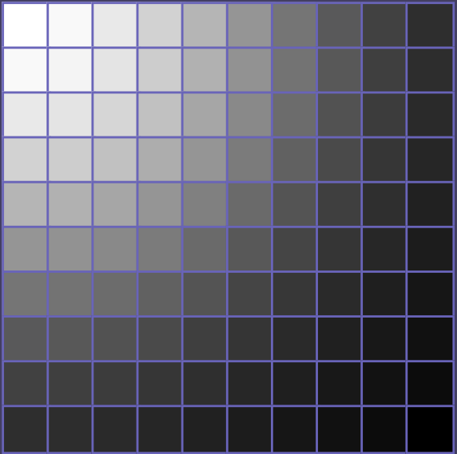
Self Organizing Maps – Training Process
Initialize all weight vectors to random or constant values
For each training input:
Find the BMU
Update the weight vectors of all neurons in the neighbourhood to move them towards the given input
BMU

Slide 9
Self Organizing Maps – Training Process
Initialize all weight vectors to random or constant values
For each training input:
Find the BMU
Update the weight vectors of all neurons in the neighbourhood to move them towards the given input
Decrease the learning rate and the size of the neighbourhood over time
BMU

Slide 10
Self Organizing Maps – Training Process
Training typically has 2 stages
‘Broad’ phase
~1000 iterations
High learning rate (~10%)
Large neighbourhood size
‘Narrow’ phase
500 * (number of neurons) iterations
Low learning rate (~1%)
Small neighbourhood size
BMU

Slide 11
Self Organizing Maps – Training Process
Training typically has 2 stages
‘Broad’ phase
~1000 iterations
High learning rate (~10%)
Large neighbourhood size
‘Narrow’ phase
500 * (number of neurons) iterations
Low learning rate (~1%)
Small neighbourhood size
BMU

Slide 12
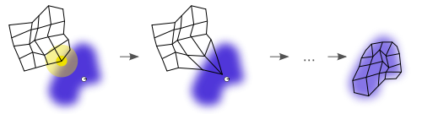
Self Organizing Maps – Training Process
Input data
Weight vectors of SOM

Slide 13
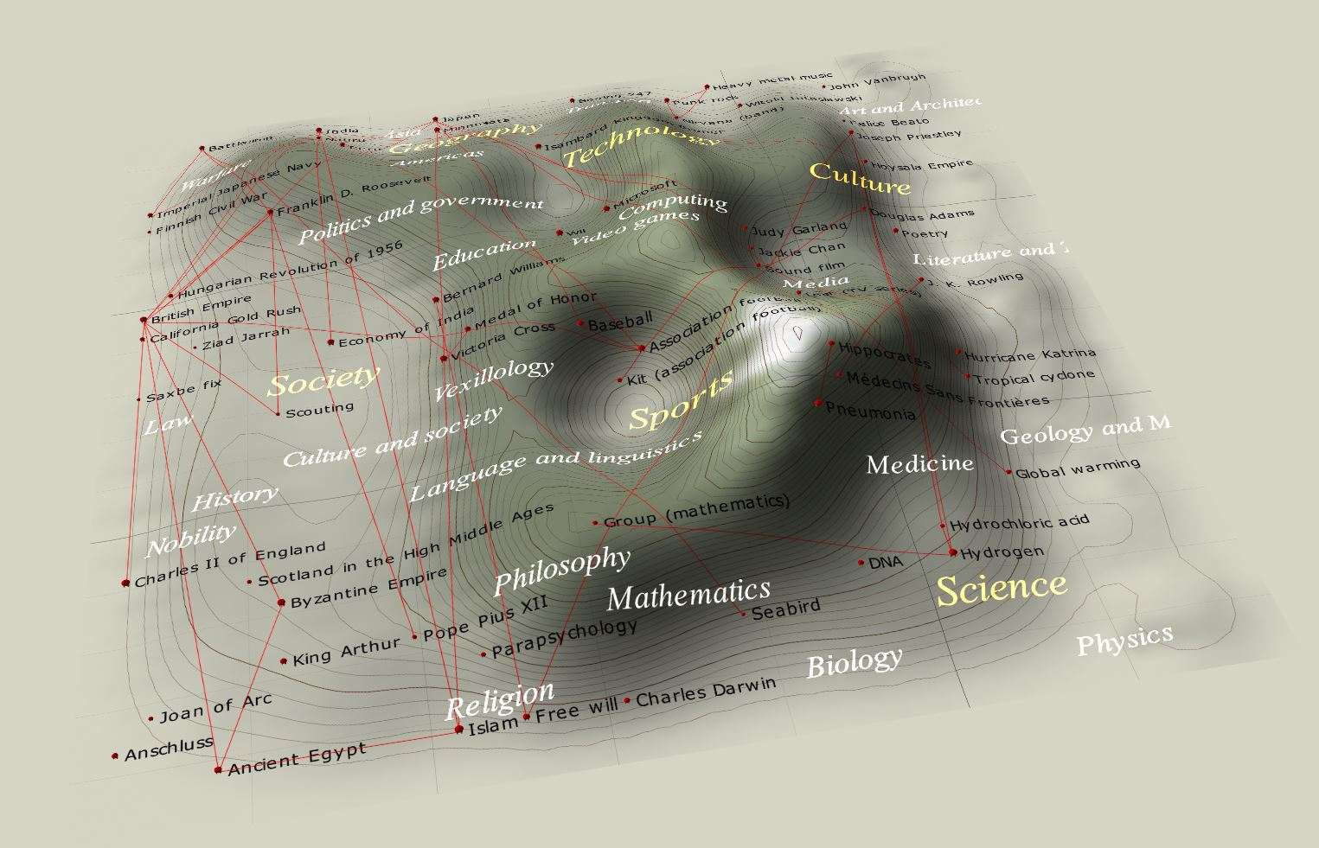
Self Organizing Maps - Applications

Slide 14
Self Organizing Maps - Applications
This SOM was trained on the iris data set
The 3 colours represent the 3 different species of iris
The strongest colours represent the centre of the distribution across the map, for each class (not r.g.b values)
Iris-virginica
Iris-virsicolor
Iris-setosa

Slide 15
Input data
High dimensional
Self-organizing map
Low dimensional representation
Correlation matrix memory
Encoding

Slide 16
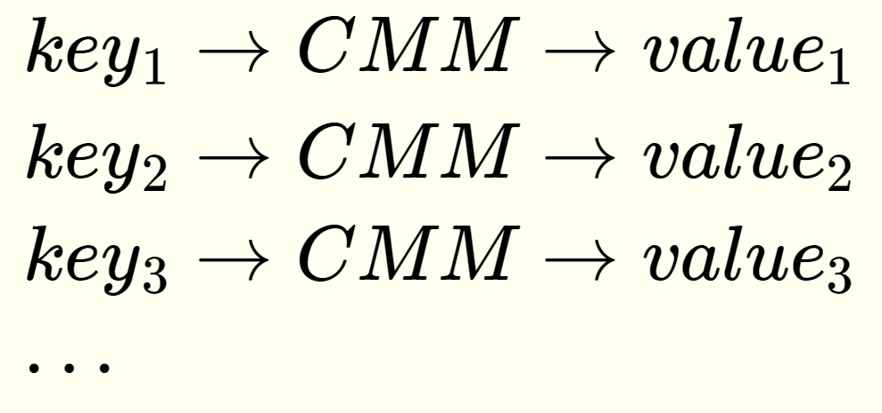
Correlation Matrix Memories
a.k.a. CMM
A CMM is a type of associative memory
i.e. it stores (key, value) pairs
0 | 1 | 0 | 1 | 1 | 0 | 1 | 1 | 1 | 0 | 1 | 1
1 | 1 | 0 | 0 | 0 | 1 | 1 | 0 | 1 | 1 | 1 | 0
1 | 0 | 1 | 0 | 1 | 1 | 1 | 0 | 0 | 1 | 1 | 0
1 | 0 | 1 | 0 | 1 | 1 | 1 | 0 | 0 | 0 | 0 | 1
1 | 0 | 1 | 1 | 0 | 1 | 1 | 0 | 1 | 1 | 1 | 1
1 | 0 | 1 | 1 | 1 | 1 | 1 | 1 | 1 | 0 | 0 | 0
1 | 1 | 0 | 1 | 0 | 1 | 1 | 1 | 0 | 1 | 1 | 0
1 | 1 | 1 | 1 | 0 | 0 | 0 | 0 | 0 | 0 | 1 | 1
1 | 1 | 0 | 0 | 1 | 1 | 0 | 0 | 1 | 1 | 0 | 0
1 | 1 | 0 | 0 | 1 | 1 | 1 | 0 | 0 | 1 | 1 | 0
0 | 0 | 1 | 1 | 1 | 0 | 0 | 1 | 1 | 0 | 0 | 1
1 | 0 | 0 | 1 | 0 | 0 | 1 | 0 | 0 | 0 | 0 | 1

Slide 17
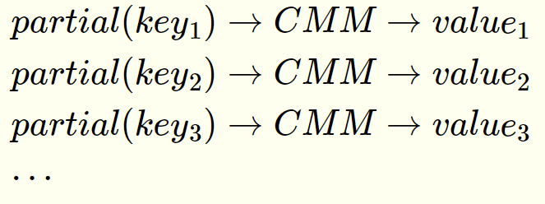
Correlation Matrix Memories
Unique property: value lookup given a partial key
0 | 1 | 0 | 1 | 1 | 0 | 1 | 1 | 1 | 0 | 1 | 1
1 | 1 | 0 | 0 | 0 | 1 | 1 | 0 | 1 | 1 | 1 | 0
1 | 0 | 1 | 0 | 1 | 1 | 1 | 0 | 0 | 1 | 1 | 0
1 | 0 | 1 | 0 | 1 | 1 | 1 | 0 | 0 | 0 | 0 | 1
1 | 0 | 1 | 1 | 0 | 1 | 1 | 0 | 1 | 1 | 1 | 1
1 | 0 | 1 | 1 | 1 | 1 | 1 | 1 | 1 | 0 | 0 | 0
1 | 1 | 0 | 1 | 0 | 1 | 1 | 1 | 0 | 1 | 1 | 0
1 | 1 | 1 | 1 | 0 | 0 | 0 | 0 | 0 | 0 | 1 | 1
1 | 1 | 0 | 0 | 1 | 1 | 0 | 0 | 1 | 1 | 0 | 0
1 | 1 | 0 | 0 | 1 | 1 | 1 | 0 | 0 | 1 | 1 | 0
0 | 0 | 1 | 1 | 1 | 0 | 0 | 1 | 1 | 0 | 0 | 1
1 | 0 | 0 | 1 | 0 | 0 | 1 | 0 | 0 | 0 | 0 | 1

Slide 18
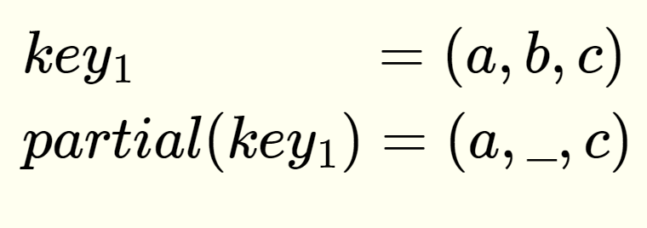
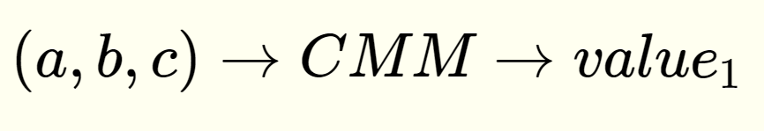
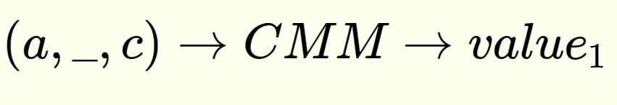
Correlation Matrix Memories
Unique property: value lookup given a partial key

Slide 19
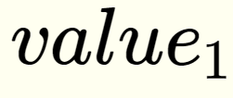
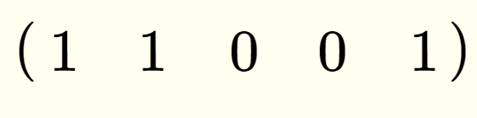
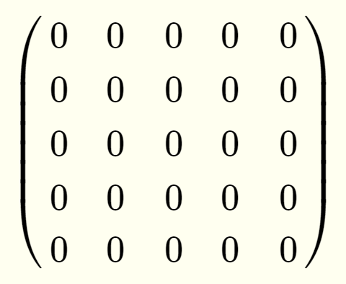
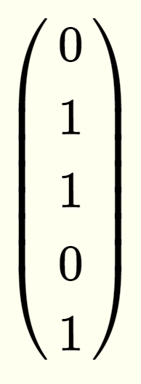
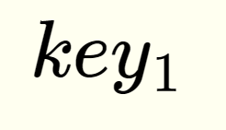
Correlation Matrix Memories - Training
Initialize empty matrix

Slide 20
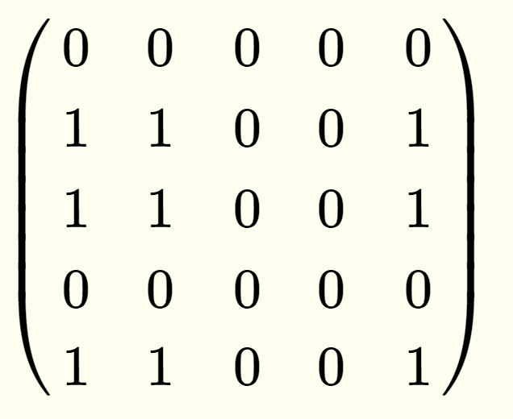
Correlation Matrix Memories - Training
Initialize empty matrix

Slide 21
Correlation Matrix Memories - Training
+

Slide 22
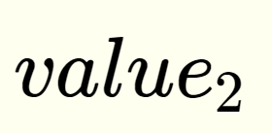
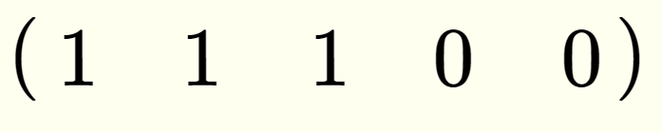
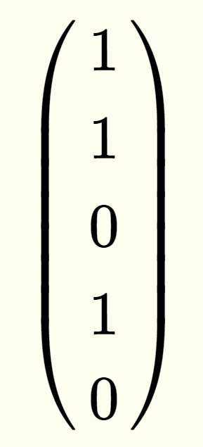

Correlation Matrix Memories - Training

Slide 23
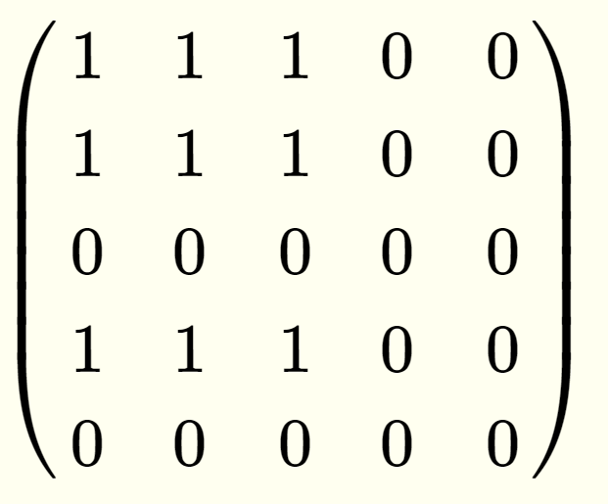
Correlation Matrix Memories - Training

Slide 24
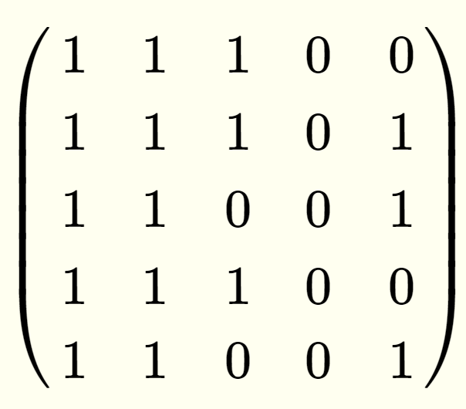
Correlation Matrix Memories - Training
+

Slide 25
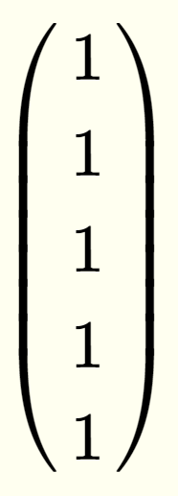
Correlation Matrix Memories - Training
=

