Slide 1



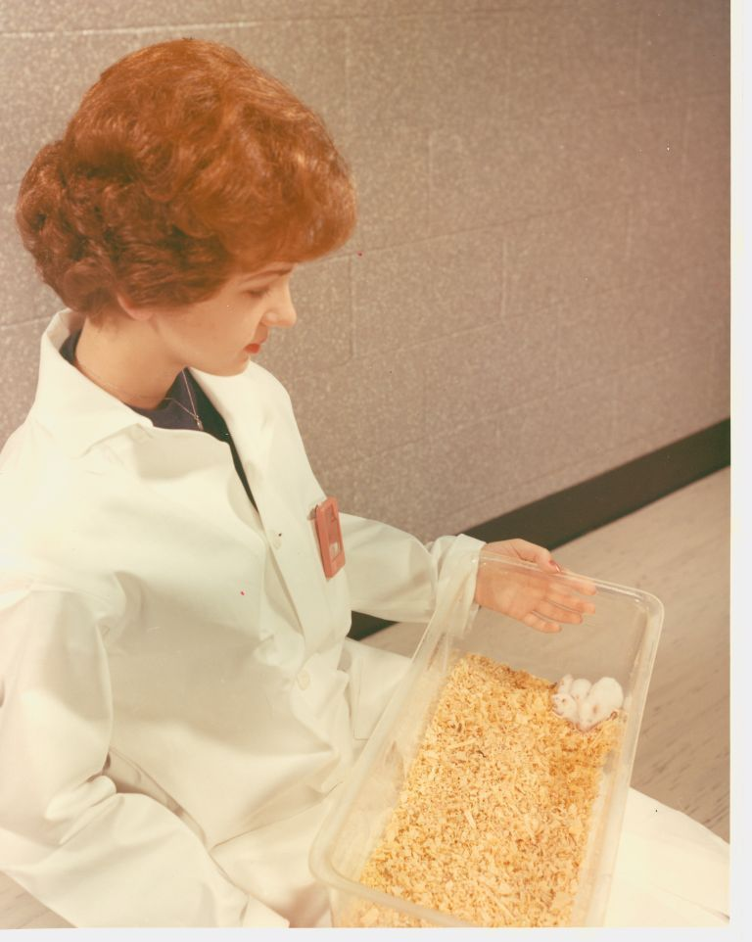
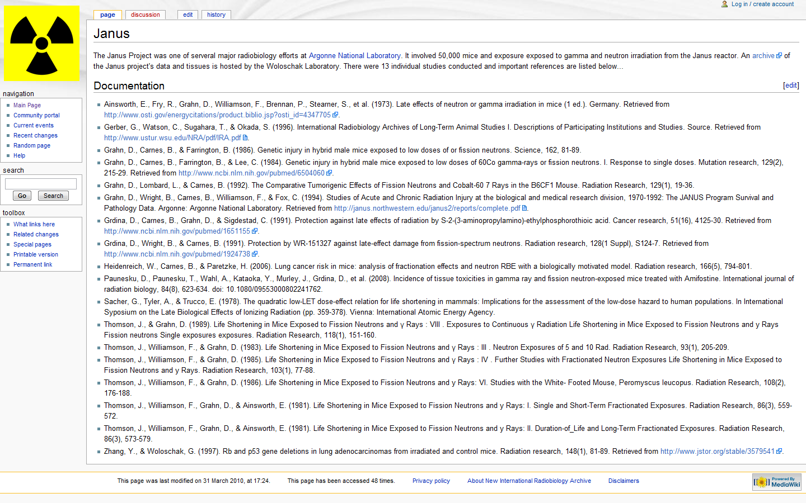
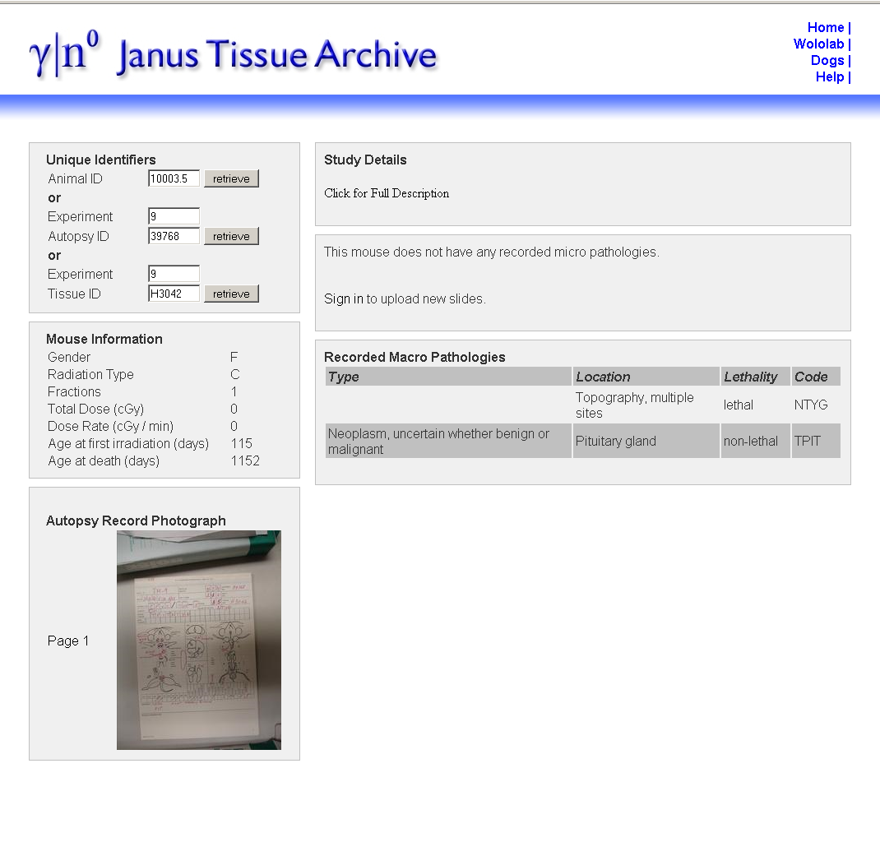
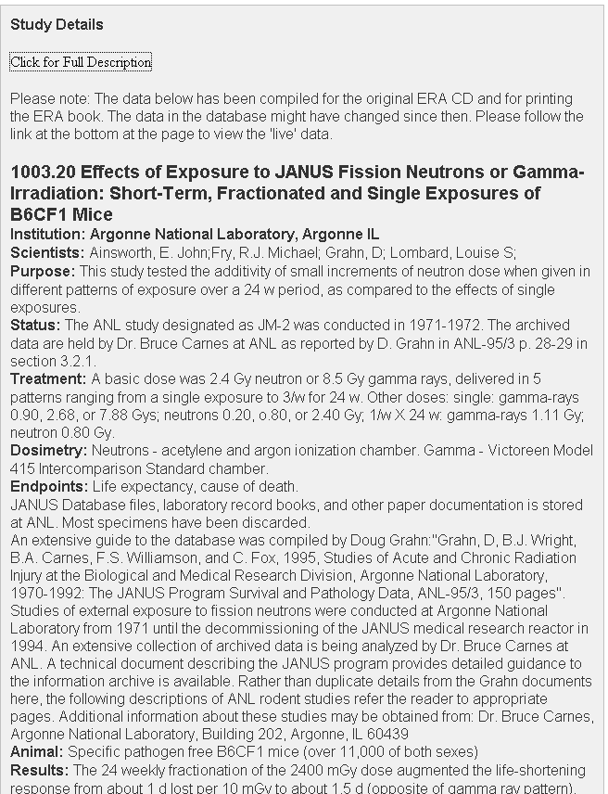
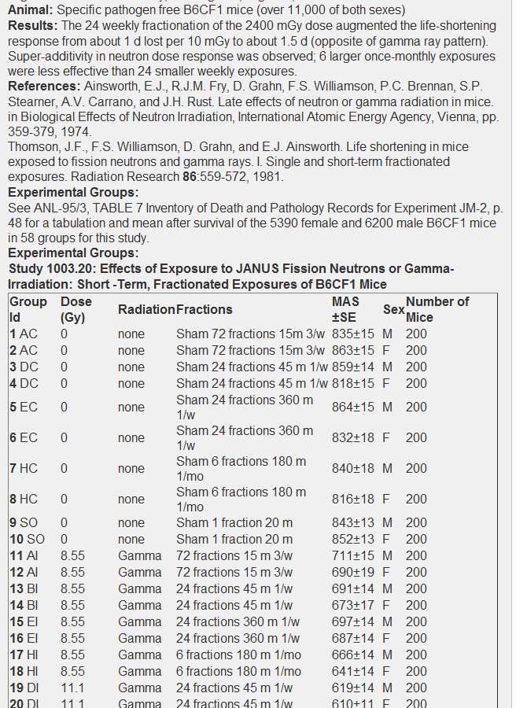
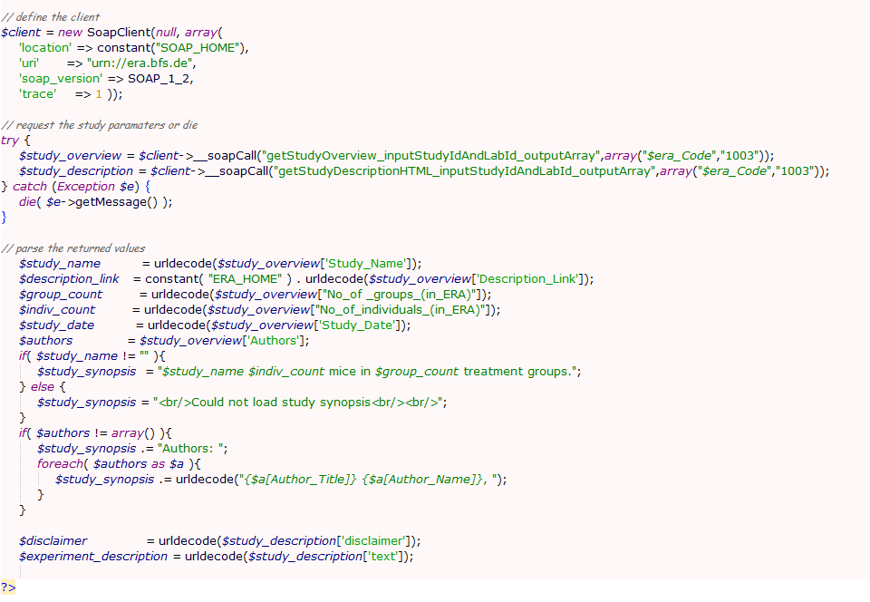
Automated Data Sharing between the Janus and ERA radiobiology Archives
Benjamin Haley¹, Michael Gruenberger², Tatijana Paunesku¹, Paul Schofield²,
and Gayle Woloschak¹
Departments of Radiation Oncology, Radiology, and Cell and Molecular Biology,
Feinberg School of Medicine, Northwestern University, Chicago, IL 60611
2. Department of Physiology, Biology, and Neuroscience, University of Cambridge, Cambridge, UK.
Abstract
The European Radiobiology Archive
More than 200 radiobiology megastudies were conducted in the second half of the 20th century. The data and samples generated from these studies are unparalleled in scope and unlikely to be reproduced. Archival efforts focused on disseminating the results and tissues generated by these studies have been underway for the past 20 years under the oversight of researchers from America, Europe, and Japan. The Woloschak laboratory hosts one of the largest sets of radiobiological mouse studies ever conducted, the Janus studies, which involved more than 49,000 mice. The European Radiobiology Archives (ERA) has built the largest single repository of radiobiology data soon to be available on the web. These two large archives both contain unique data about the Janus studies that is more valuable when integrated. To facilitate this integration without modifying each groups underlying databases, both the Janus Archive and the ERA have developed web data services. These data services allow the hosting servers to request information from one another. The result of this effort is that the Janus archive can retrieve experiment description information from the ERA's archive, while the ERA's archive can receive pathological and demographic information for specific mice from the Janus archive. This architecture will allow improvements to the archive’s records to be reflected on both sites without the need to update both of them. As a useful side benefit, these same web services can be employed by any researcher to retrieve annotated data from the archives for statistical purposes or other forms of redistribution.
The European Radiobiology Archive (ERA) has built the single largest repository of radiobiology studies in the world with more than 100 radiobiology studies from Europe, America, and Japan. These studies cover a wide range of model organisms and radioactive treatments. When the ERA’s website is made public, it will be searchable by many study parameters, including the type of treatment, institution, and model organism. The results will include the experimental parameters, and a break down of the various treatment groups involved in each study.
The ERA does not necessarily support individual treatment records for each animal that was involved in a study. This is because the records collected for each animal are heterogeneous and difficult to build into a central schema. Rather than developing specific reports for the Janus experiments, the ERA has been able to request these parameters from the web services developed by the Janus archives.
Fig 1.
Donna Daniel holding a litter of mice at the animal quarters of Argonne National Laboratory’s Division of Biological and Medical Research where the Janus Experiments were conducted.
Fig 2.
Janus documentation page from the NiRA wiki hosted at northwestern (janus.northwestern.edu/nira).
Data Sharing
The Janus Experiments
Both the Janus and ERA radiobiology archives have developed web services to allow remote access to their data. The Simple Object Access protocol (SOAP) is used to deliver data to clients. SOAP can be used to deliver arbitrarily large amounts of annotated data quickly. Clients that use SOAP services to access data will automatically access the newest versions of such data. For these reasons, the SOAP protocol represents a useful tool to combine the results of large data sets without combining their underlying data. This is advantageous because updates made to underlying data are immediately integrated into the websites of any client that accesses them through SOAP. In the case of the Janus and ERA archives, any additional modifications to the study or animal descriptions that arise from a better understanding of the archive materials will be immediately reflected on both sites.
SOAP client requests only require a scripting language and some basic commands to set up (fig 5). A well documented service can utilized in hours by an experienced programmer, much faster than the time that it takes to keep two data sets synchronized. Therefore, providing web services through SOAP represents a versatile solution to providing data between servers.
The Janus Mouse Experiments consisted of 11 major radiobiology studies performed on over 49,000 animals (fig 1). They were conducted at Argonne National Laboratory between 1969 and 1992 and centered around the Janus reactor, capable of delivering both gamma and neutron irradiation. The 11 studies focused on the effects of acute, fractionated, protracted, and low-dose exposures and the efficacy of radioprotectors on B6CF1 mice and some White-Footed field mice (Peromyscus leucopus). Cumulative gamma ray doses ranged from 90 - 5111 cGy throughout the experiments and neutron doses ranged from 1–470 cGy. Pathological reports were prepared for 32,000 mice and histopathological data was collected for 19,000 (Grahn, Lombard, & Carnes, 1992). Many tissues were preserved in paraffin, including the lung, liver, spleen, kidney, heart, and any tissues with gross lesions.
Most published results from the Janus Experiments focus on the life shortening effects of radiation, tumorigenesis, and hematological failures. However a second generation of research, spurred by archival efforts to distribute the original data has characterized male/female differences in radiation response, tissue specific effects, and applied molecular biology techniques to preserved tumor samples.
The best synopsis of the Janus program’s experimental procedures, conditions, aims, and initial results is found in the Janus Program Report developed for the DOE (Grahn, Wright, Carnes, Williamson, & Fox, 1994).
CONCLUSIONS
The construction of data services combined with personal communications between archivists can bring value to archives with overlapping data by allowing that data to be shared. Sharing data prevents redundant work and allows improvements in the data to be reflected in multiple archives. In our case, the Janus archive now hosts more complete experimental details associated to each animal while the ERA’s archive now contains results for individual mice.
The Janus Archive
Fig 3
Results page for a single mouse in the Janus Archive. Shows demographics, pathological results, and a picture of the original autopsy report.
ACKNOWLEDGEMENTS
The observational data generated by the Janus Mouse Experiments is searchable through the Janus archive hosted at Northwestern University (janus.northwestern.edu). This archive can be searched by pathological, treatment, and demographic data collected on the mice. It contains scans of mouse autopsy reports and a form to request paraffin embedded tissues generated by these experiments.
The paraffin embedded tissues are still viable for protein and short nucleic acid fragment analysis. Decades after embedding, these tissues can still be used for a variety of immunohistochemistry techniques including western blot as well as molecular biology techniques (Zhang & Woloschak, 1997).
Documentation for the Janus archive is organized on the Janus website and through the recently deployed New International Radiobiology Archive (NIRA) wiki at (fig 2). The European Radiobiology Archive (ERA) also maintains and updates study descriptions for each of the studies involved in the Janus Experiments. The unique study data hosted by the ERA is now delivered to the Janus archive through their web services. (fig s 3-5).
This research was supported by the United States Department of Energy grants No. DE-FG02-04er63920, DE-FG02-05ER64086, and DE-FG02-05ER64100/A000.
a)
REFERENCES
b)
1. Grahn, D., Wright, B., Carnes, B., Williamson, F., & Fox, C. (1994). Studies of Acute and Chronic Radiation Injury at the biological and medical research division, 1970-1992: The JANUS Program Survival and Pathology Data. Argonne: Argonne National Laboratory. Retrieved from http://janus.northwestern.edu/janus2/reports/complete.pdf.
2. Grahn, D., Lombard, L., & Carnes, B. (1992). The Comparative Tumorigenic Effects of Fission Neutrons and Cobalt-60 7 Rays in the B6CF1 Mouse. Radiation Research, 129(1), 19-36.
3. Zhang, Y., & Woloschak, G. (1997). Rb and p53 gene deletions in lung adenocarcinomas from irradiated and control mice. Radiation research, 148(1), 81-89. Retrieved from http://www.jstor.org/stable/3579541.
4. Woloschak, G. (n.d.). Janus Archives. Retrieved from http://janus.northwestern.edu/.
c)
Fig 5.
Partial image of the experimental description for the mouse from fig3. These results are delivered to the Janus archive through the ERA’s SOAP services.
Fig 4.
Client side code for a Soap Call to the ERA in php. a) The era server is defined and b) a request is made to the ERA server’s SOAP functions getStudyOverview and getStudyDescriptionHTML. c) The returned results are parsed so that they can be printed as seen in fig 5.

