Slide 1
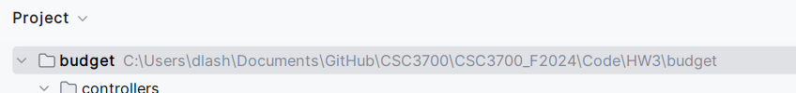
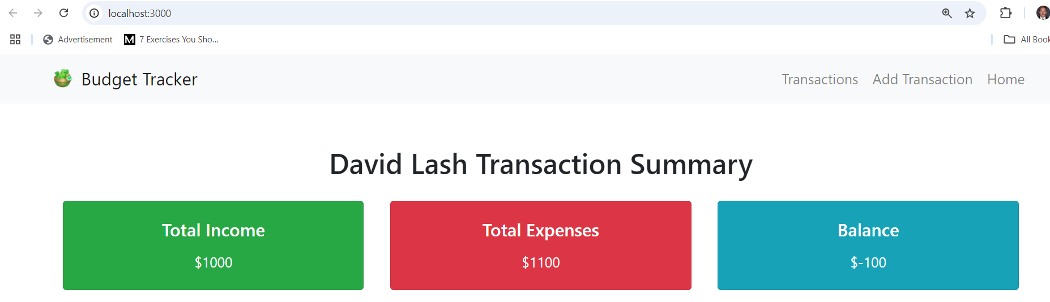
Budget Tracker app
Create a node.js/express/handlebars site to enable a user to manage a personal budget. User will be able to add edit and delete transactions.
Each transaction will include a date, amount, type (income or expense), description, and category.
The home page will support a summary of the total income, expenses and balance for all transactions in the database

Slide 2
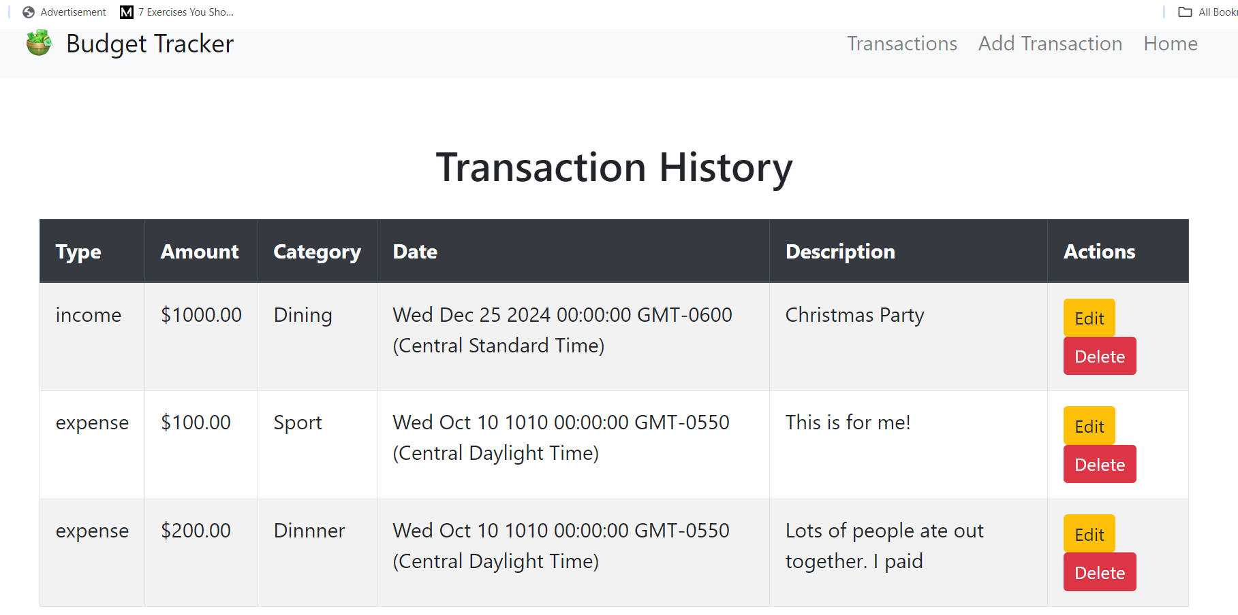
Clicking transactions will show this page with each transaction the user has added with edit and delete buttons for each line –

Slide 3
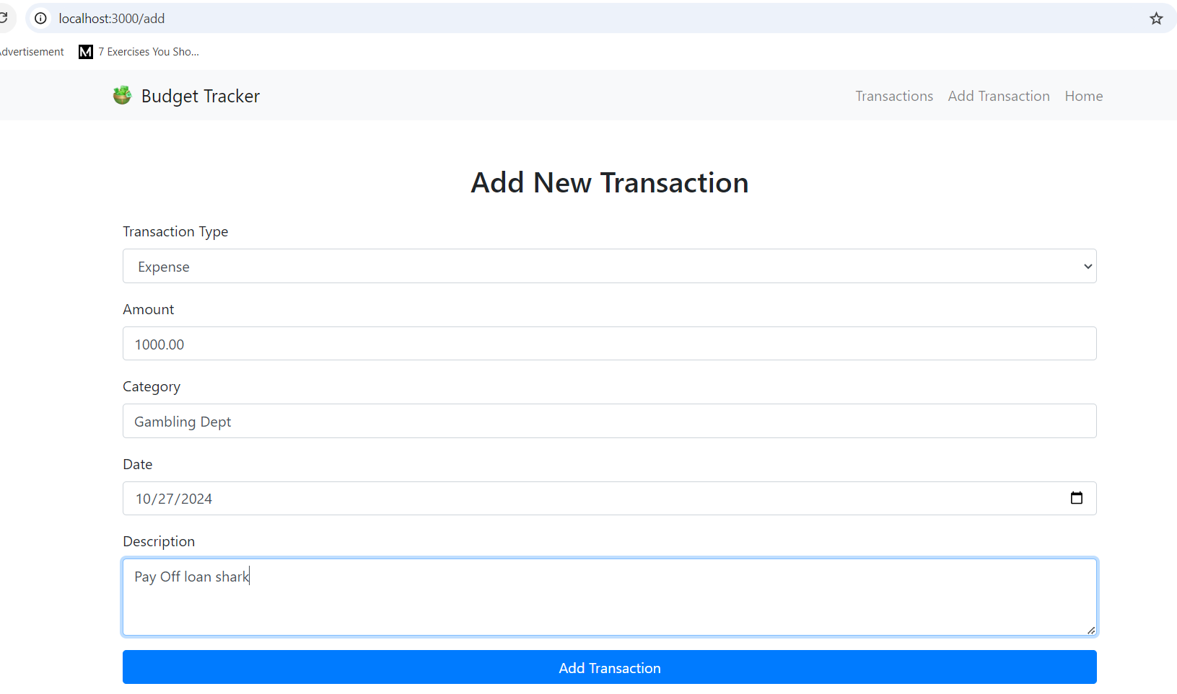
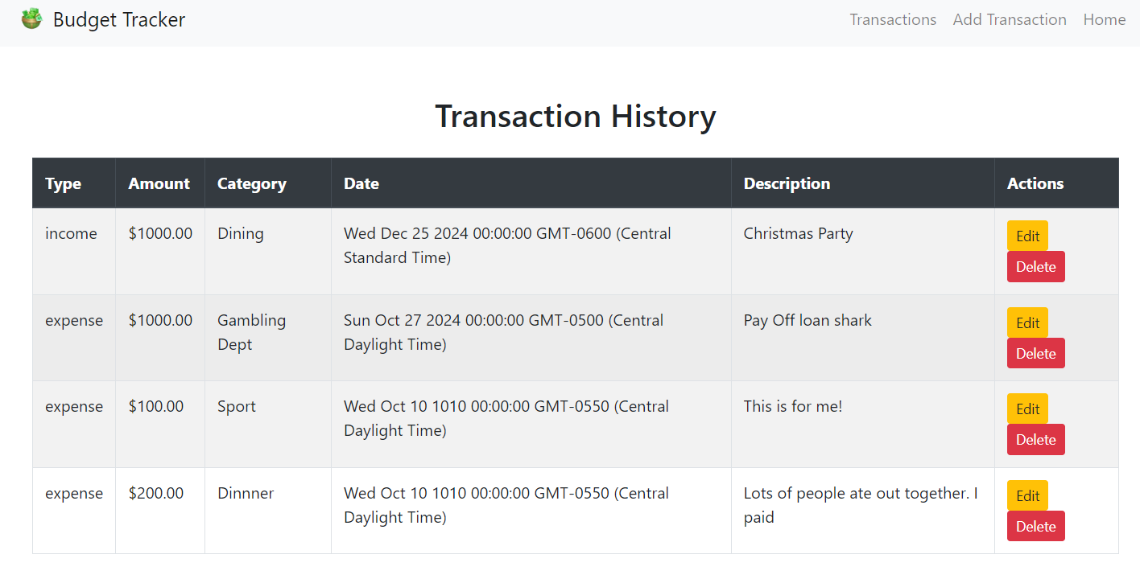
Clicking add will go to /add and allow user to enter transaction information on save to DB and then show all the transactions

Slide 4
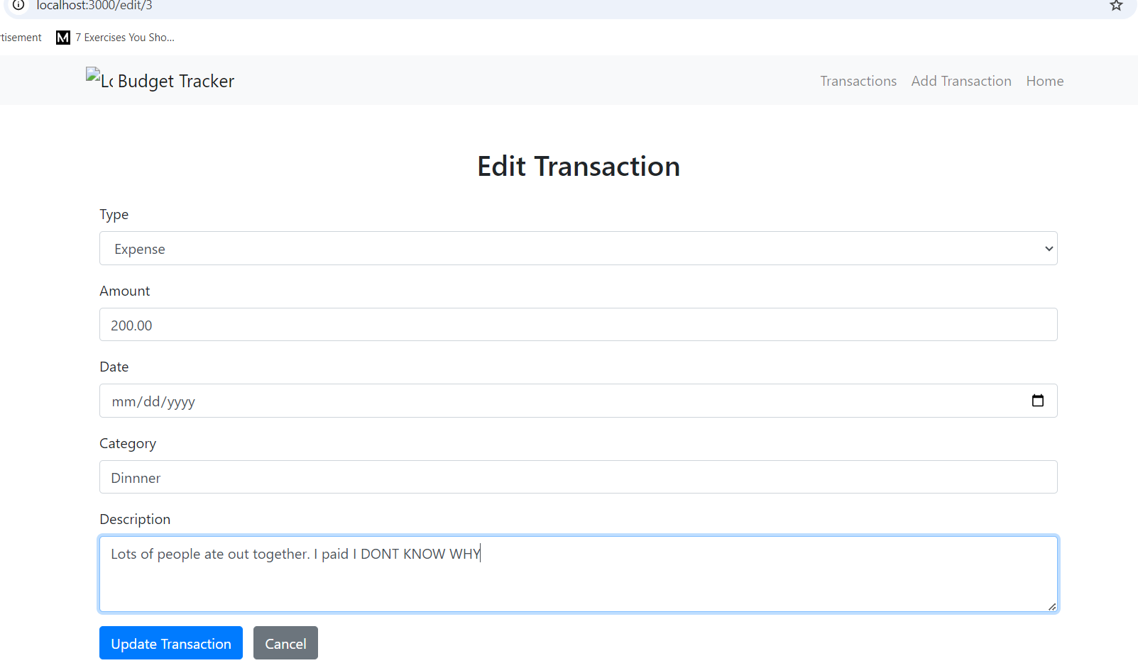
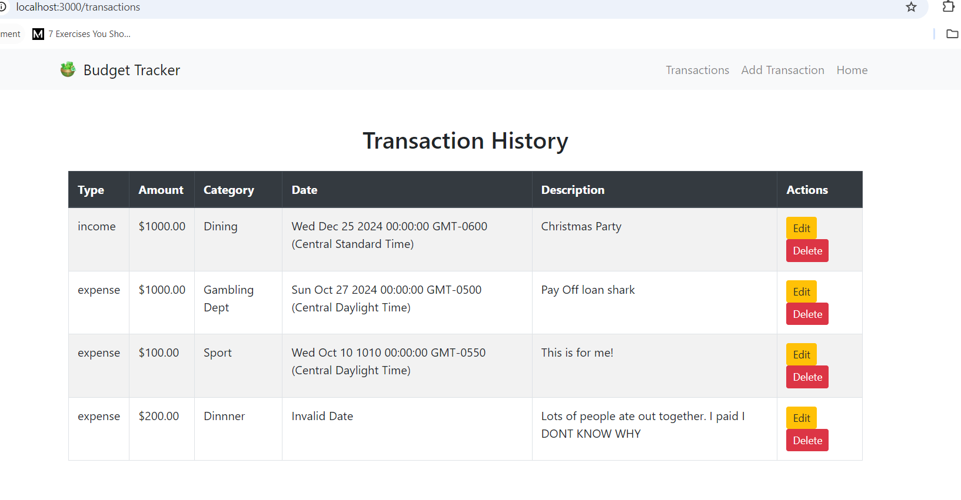
Clicking edit will got to edit/:id show previously set items and enable the user to change them. On save go back to /transactions
and show all transactions

Slide 5
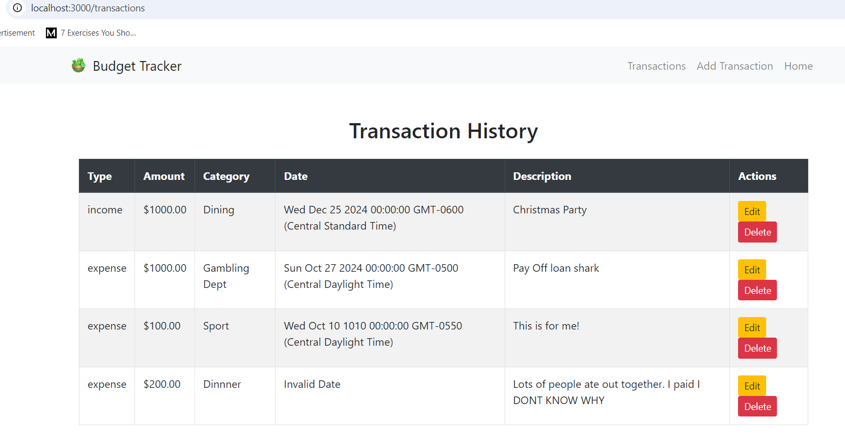
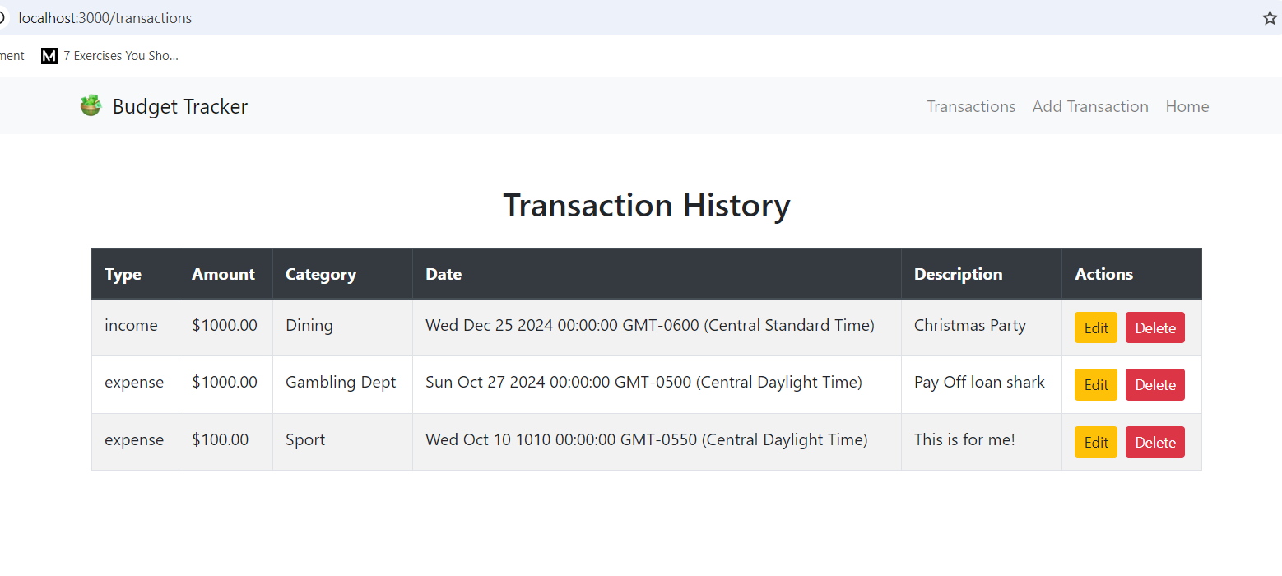
On delete … remove the transaction and reshow all the transactions

Slide 6
If at any time the user click home .. .
show the up-to-date totals from the database

Slide 7
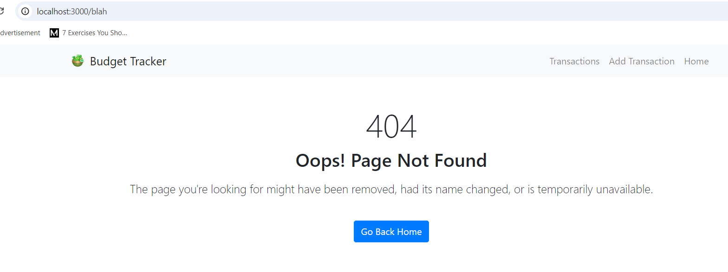
Page not found should be nice and neat with a back button for home

Slide 8
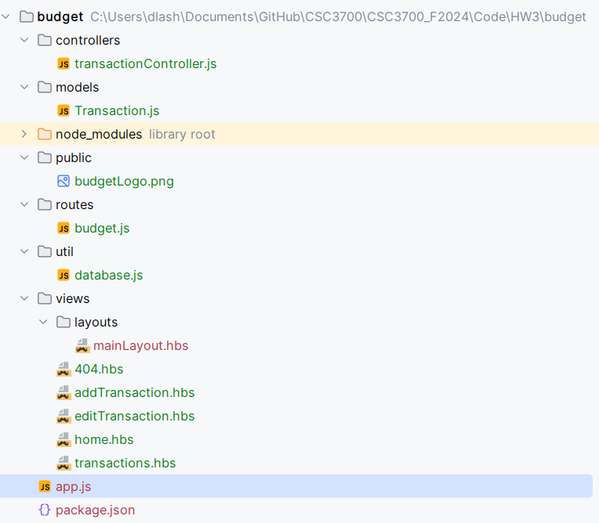
Notes
Here is the structure you need to support
This png file will be on the brightspace
This is the database.js we used in class
Use a layouts page with bootstrap
You will need a
404.Hbs for page not found
Add and edit
Home for totals
transactions

Slide 9
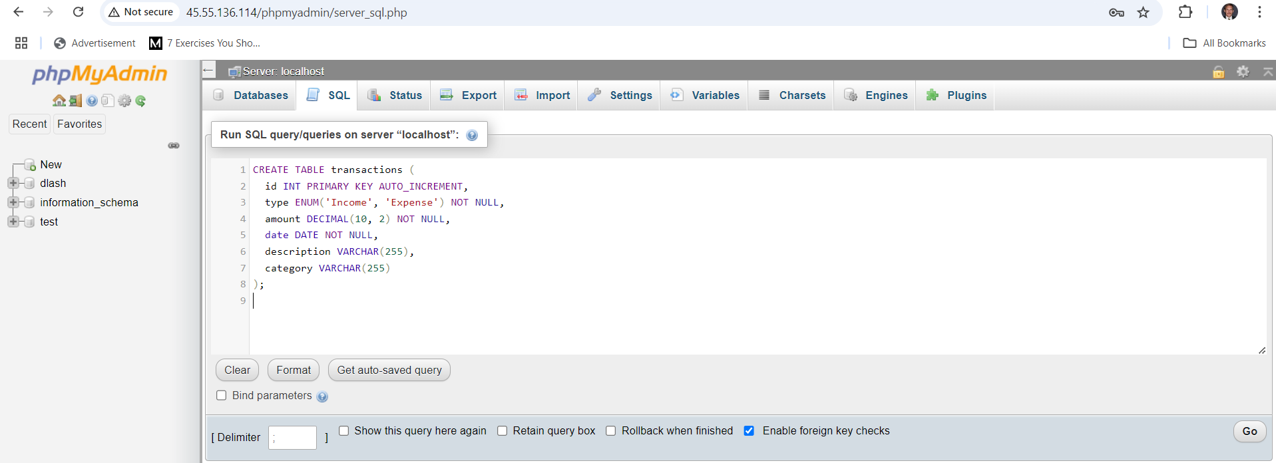

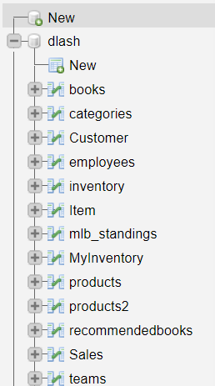
Personal database
You need to use your personal database to create this table
CREATE TABLE transactions (
id INT PRIMARY KEY AUTO_INCREMENT,
type ENUM('Income', 'Expense') NOT NULL,
amount DECIMAL(10, 2) NOT NULL,
date DATE NOT NULL,
description VARCHAR(255),
category VARCHAR(255)
);
Run this command to set up your database table
Use this table
Log into your DB via http://45.55.136.114/phpmyadmin
Click your database on the left
On the SQL tab enter the command can click ‘Go’

Slide 10
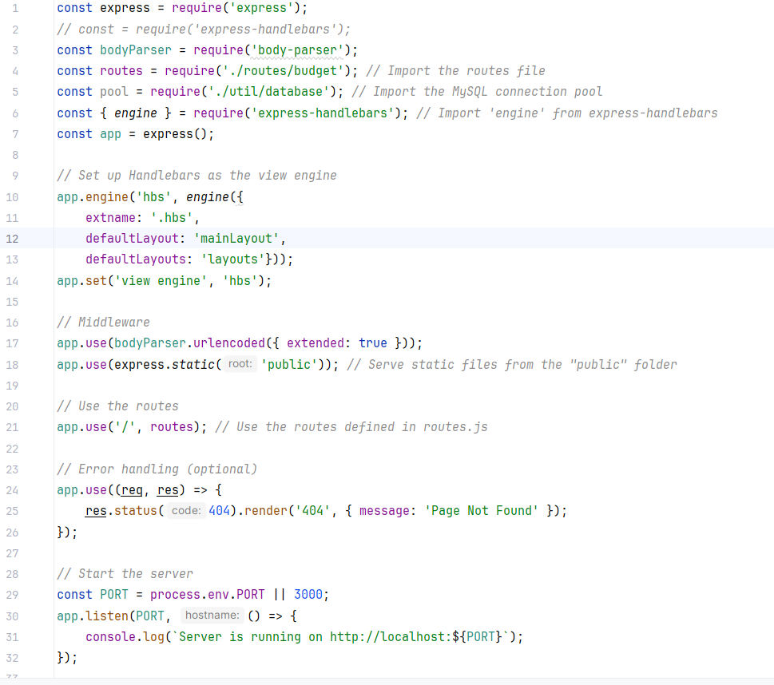
Use the following app.js to set this application up
(available on brightspace)

Slide 11
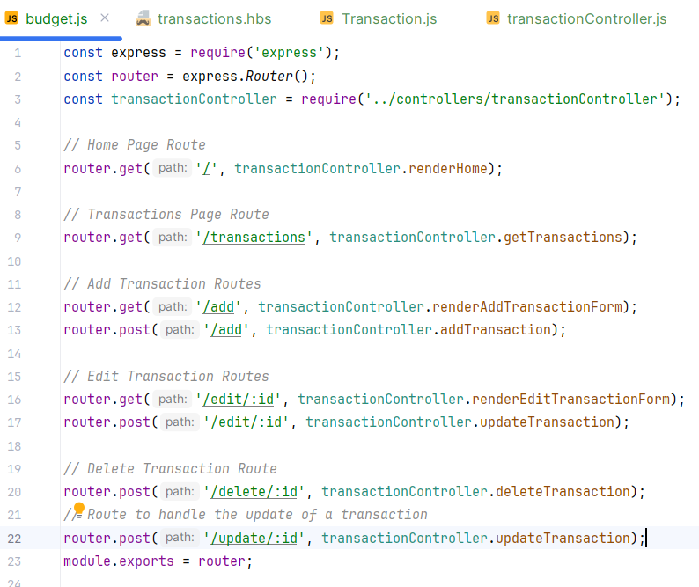
Use these routes
Use the following routes.js to set this application up
(available on brightspace)

Slide 12
Controller starter code
Inside controllers/transactionController.js need to define each of these route logic
const Transaction = require('../models/Transaction');
exports.renderHome = async (req, res) => { /* ... */ };
exports.renderAddTransaction = (req, res) => { /* ... */ };
exports.addTransaction = async (req, res) => { /* ... */ };
exports.renderEditTransaction = async (req, res) => { /* ... */ };
exports.updateTransaction = async (req, res) => { /* ... */ };
exports.deleteTransaction = async (req, res) => { /* ... */ };

Slide 13
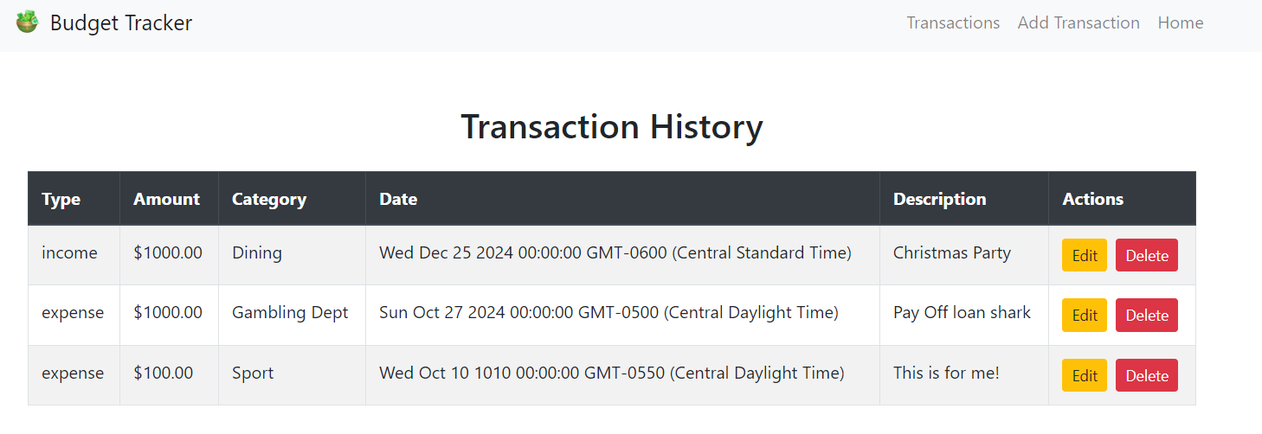
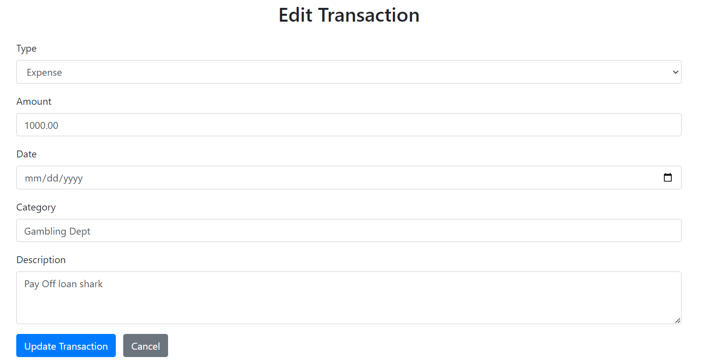
Notes on the UI
US Must be the clean and use bootstrap … your name here
notice the consistent navs and striped tables
forms line up nicely

Slide 14
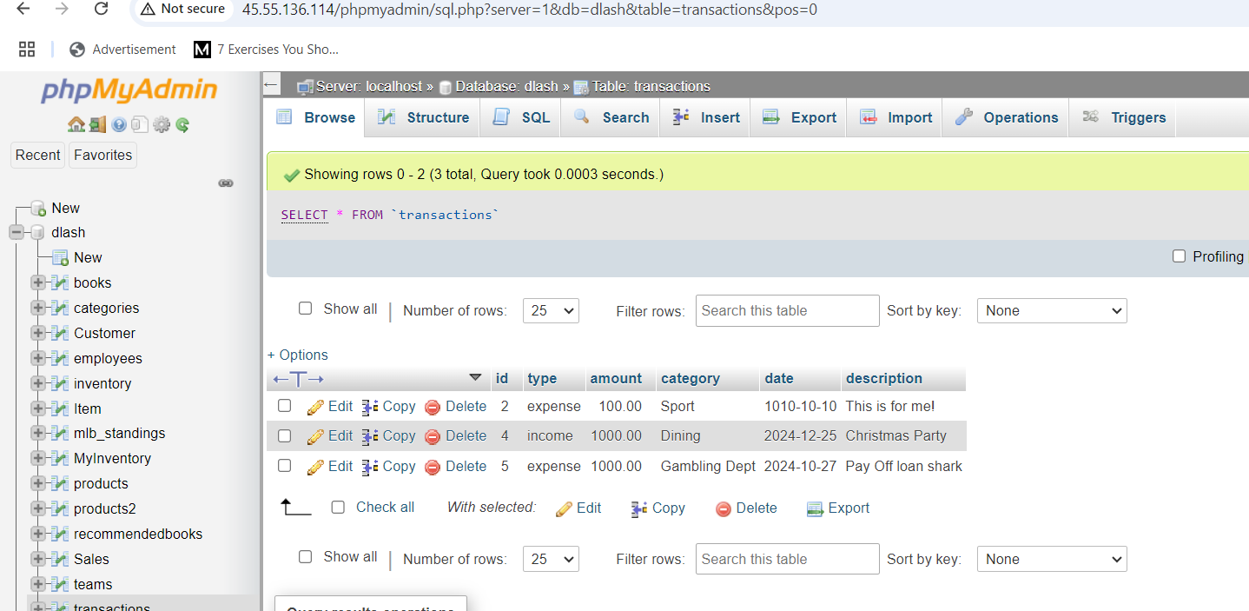
What to hand in
A single word document with these screens shots LABELED!
a. home screen -> Insert home screen w/ totals non zero
b. add -> insert add transaction screen
c. /transactions -> insert transaction screen
d. /edit/:is -> insert edit screen
e. delete and then show screen of item deleted
f. a screen shot of your transaction table browse
(from phpMyAdmin)
g. a short description of challenges and learnings from this
homework
2. All of your code (NOT NODE MODULES) in 1 zip file

Slide 15
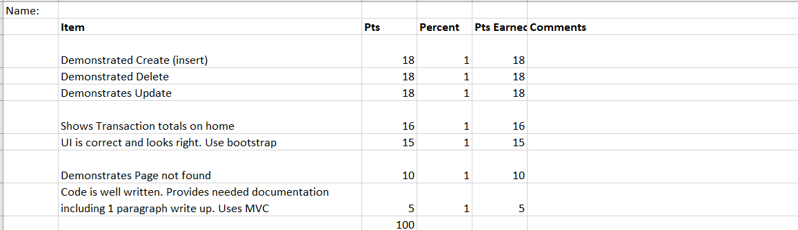
Rubric

