Slide 1
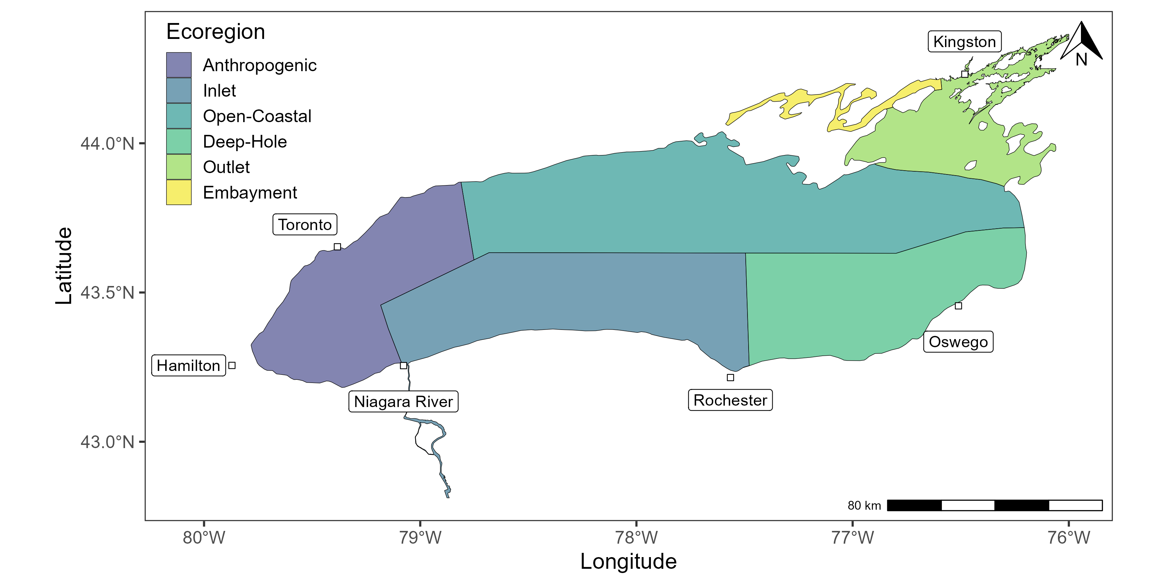
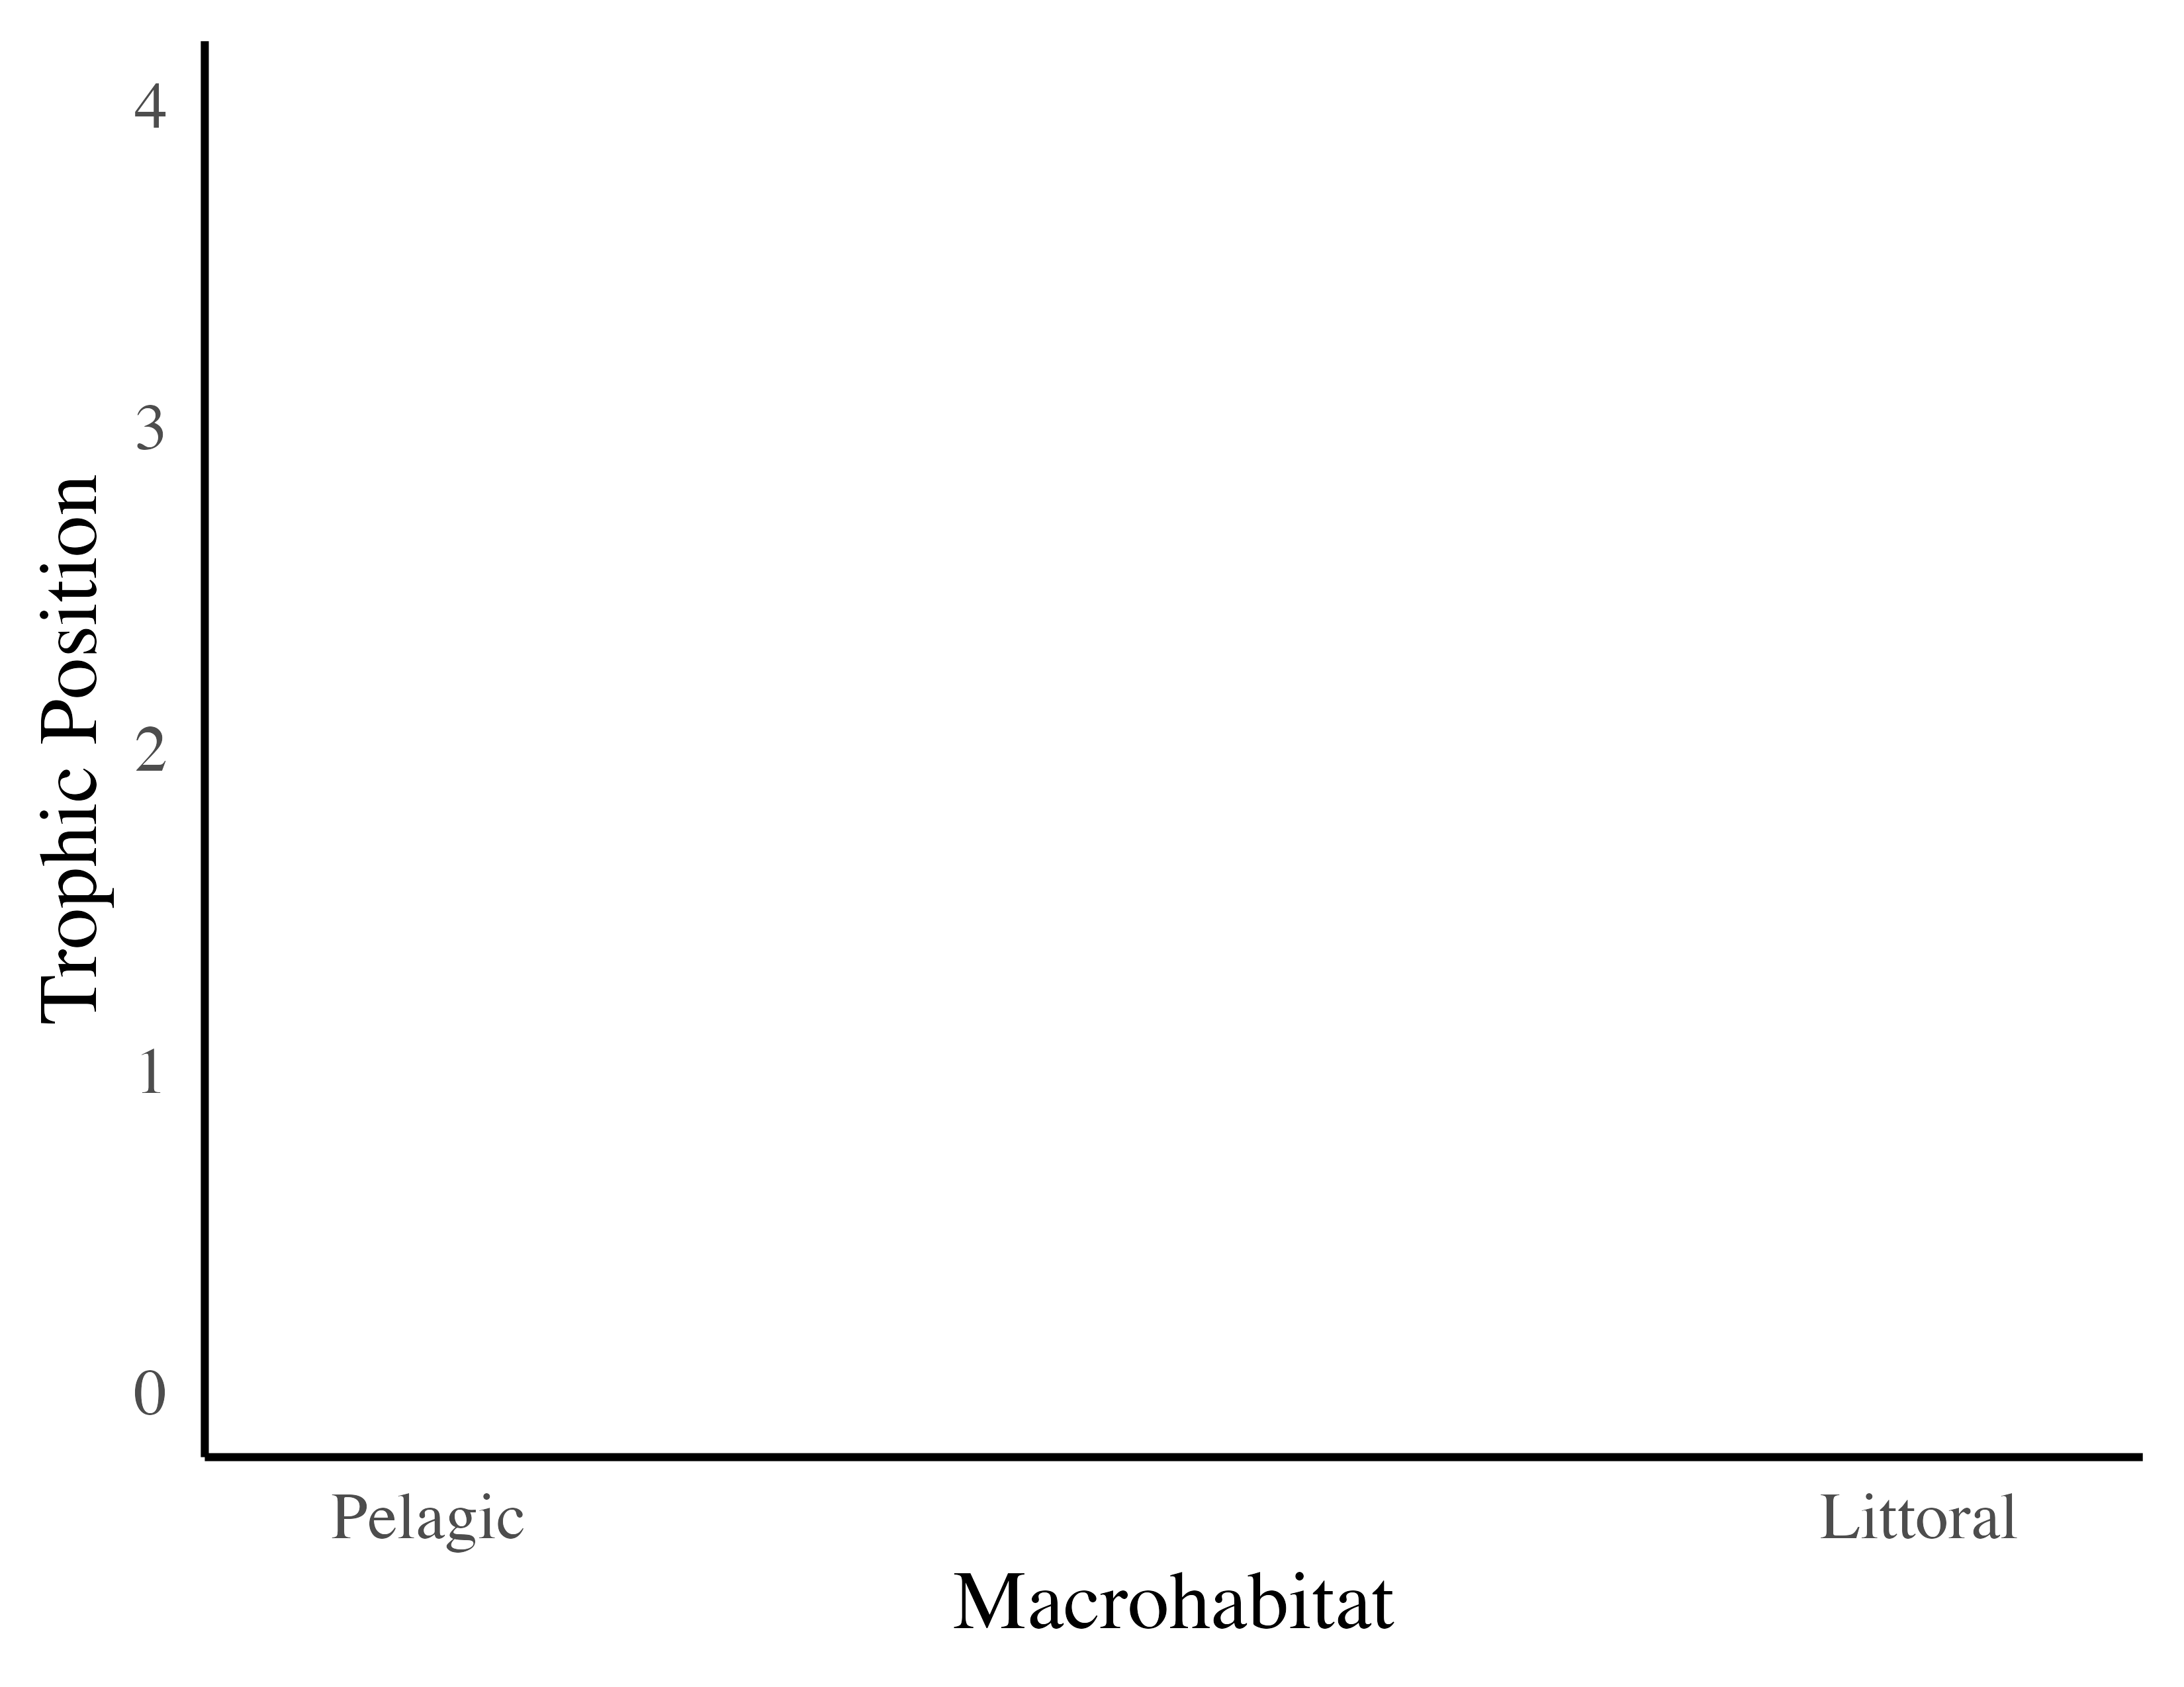
Isotopes of more mobile species (e.g., Lake Trout) will be less distinct and reflect a combination of local processes (e.g., nutrient levels) that are associated with each ecoregion.
Isotopes of less mobile species (e.g., Round Goby) will be more distinct and reflect local processes (e.g., anthropogenic disturbances) that are associated with each ecoregion.
Ecoregion Characteristics
 | Anthropogenic | Inlet | Open-Coastal | Deep-Hole | Outlet | Embayment
Nutrients | Eutrophic | Mesotrophic | Mesotrophic | Mesotrophic | Eutrophic | Eutrophic
Depth (m) | 79.3 ± 0.2 (max 153 ) | 122.9 ± 0.3 (max 192) | 71.2 ± 0.2 (max 190) | 125.8 ± 0.4 (max 235) | 20.6 ± 0.1 (max 54) | 15 ± 0.1 (max 53)
Species Composition | warm/cool/cold | warm/cool/cold | cool/cold | cool/cold | warm/cool/cold | warm/cool/cold
Other | High levels habitat disturbances; Industrial waste | Inflow of the Niagara River; Industrial waste | Ecologically similar to other Laurentian Great Lakes; lower levels of human disturbances | Lower nutrient levels; lower levels of human disturbances | An ecological combination of all of the other ecoregions | High levels of habitat disturbances; Drains large agricultural watershed
Food Web Structures:
High habitat disturbances
Low habitat disturbances

Slide 2
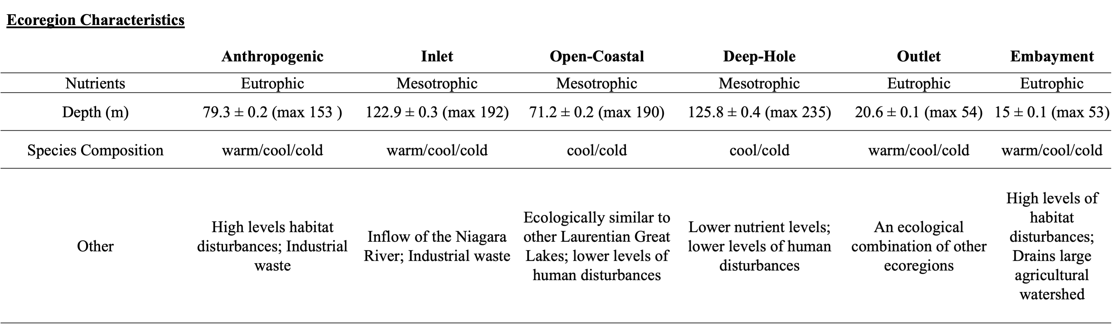
Isotopes of more mobile species (e.g., Lake Trout) will be less distinct and reflect a combination of local processes (e.g., nutrient levels) that are associated with each ecoregion.
Isotopes of less mobile species (e.g., Round Goby) will be more distinct and reflect local processes (e.g., anthropogenic disturbances) that are associated with each ecoregion.
Food Web Structures:
High habitat disturbances
Low habitat disturbances

