Slide 1
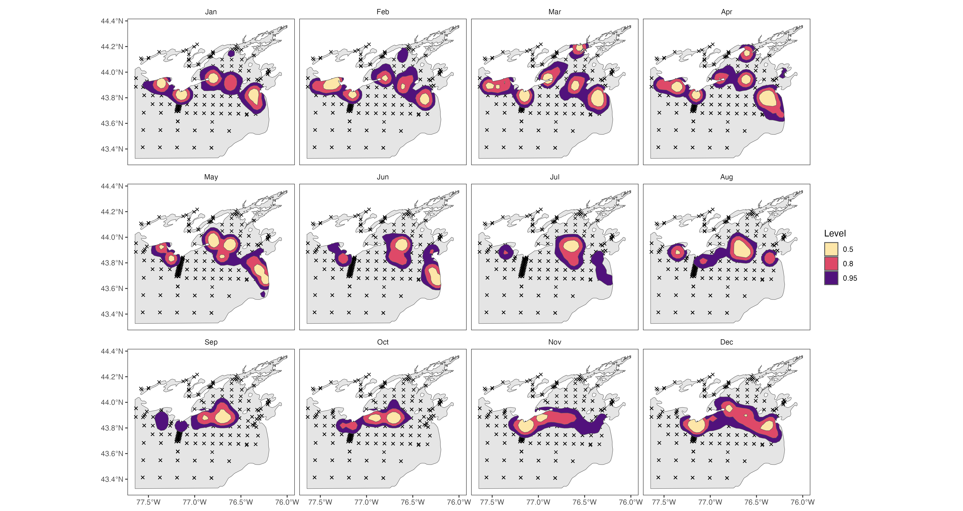
Kernal Densities for Lake Whitefish

Slide 2
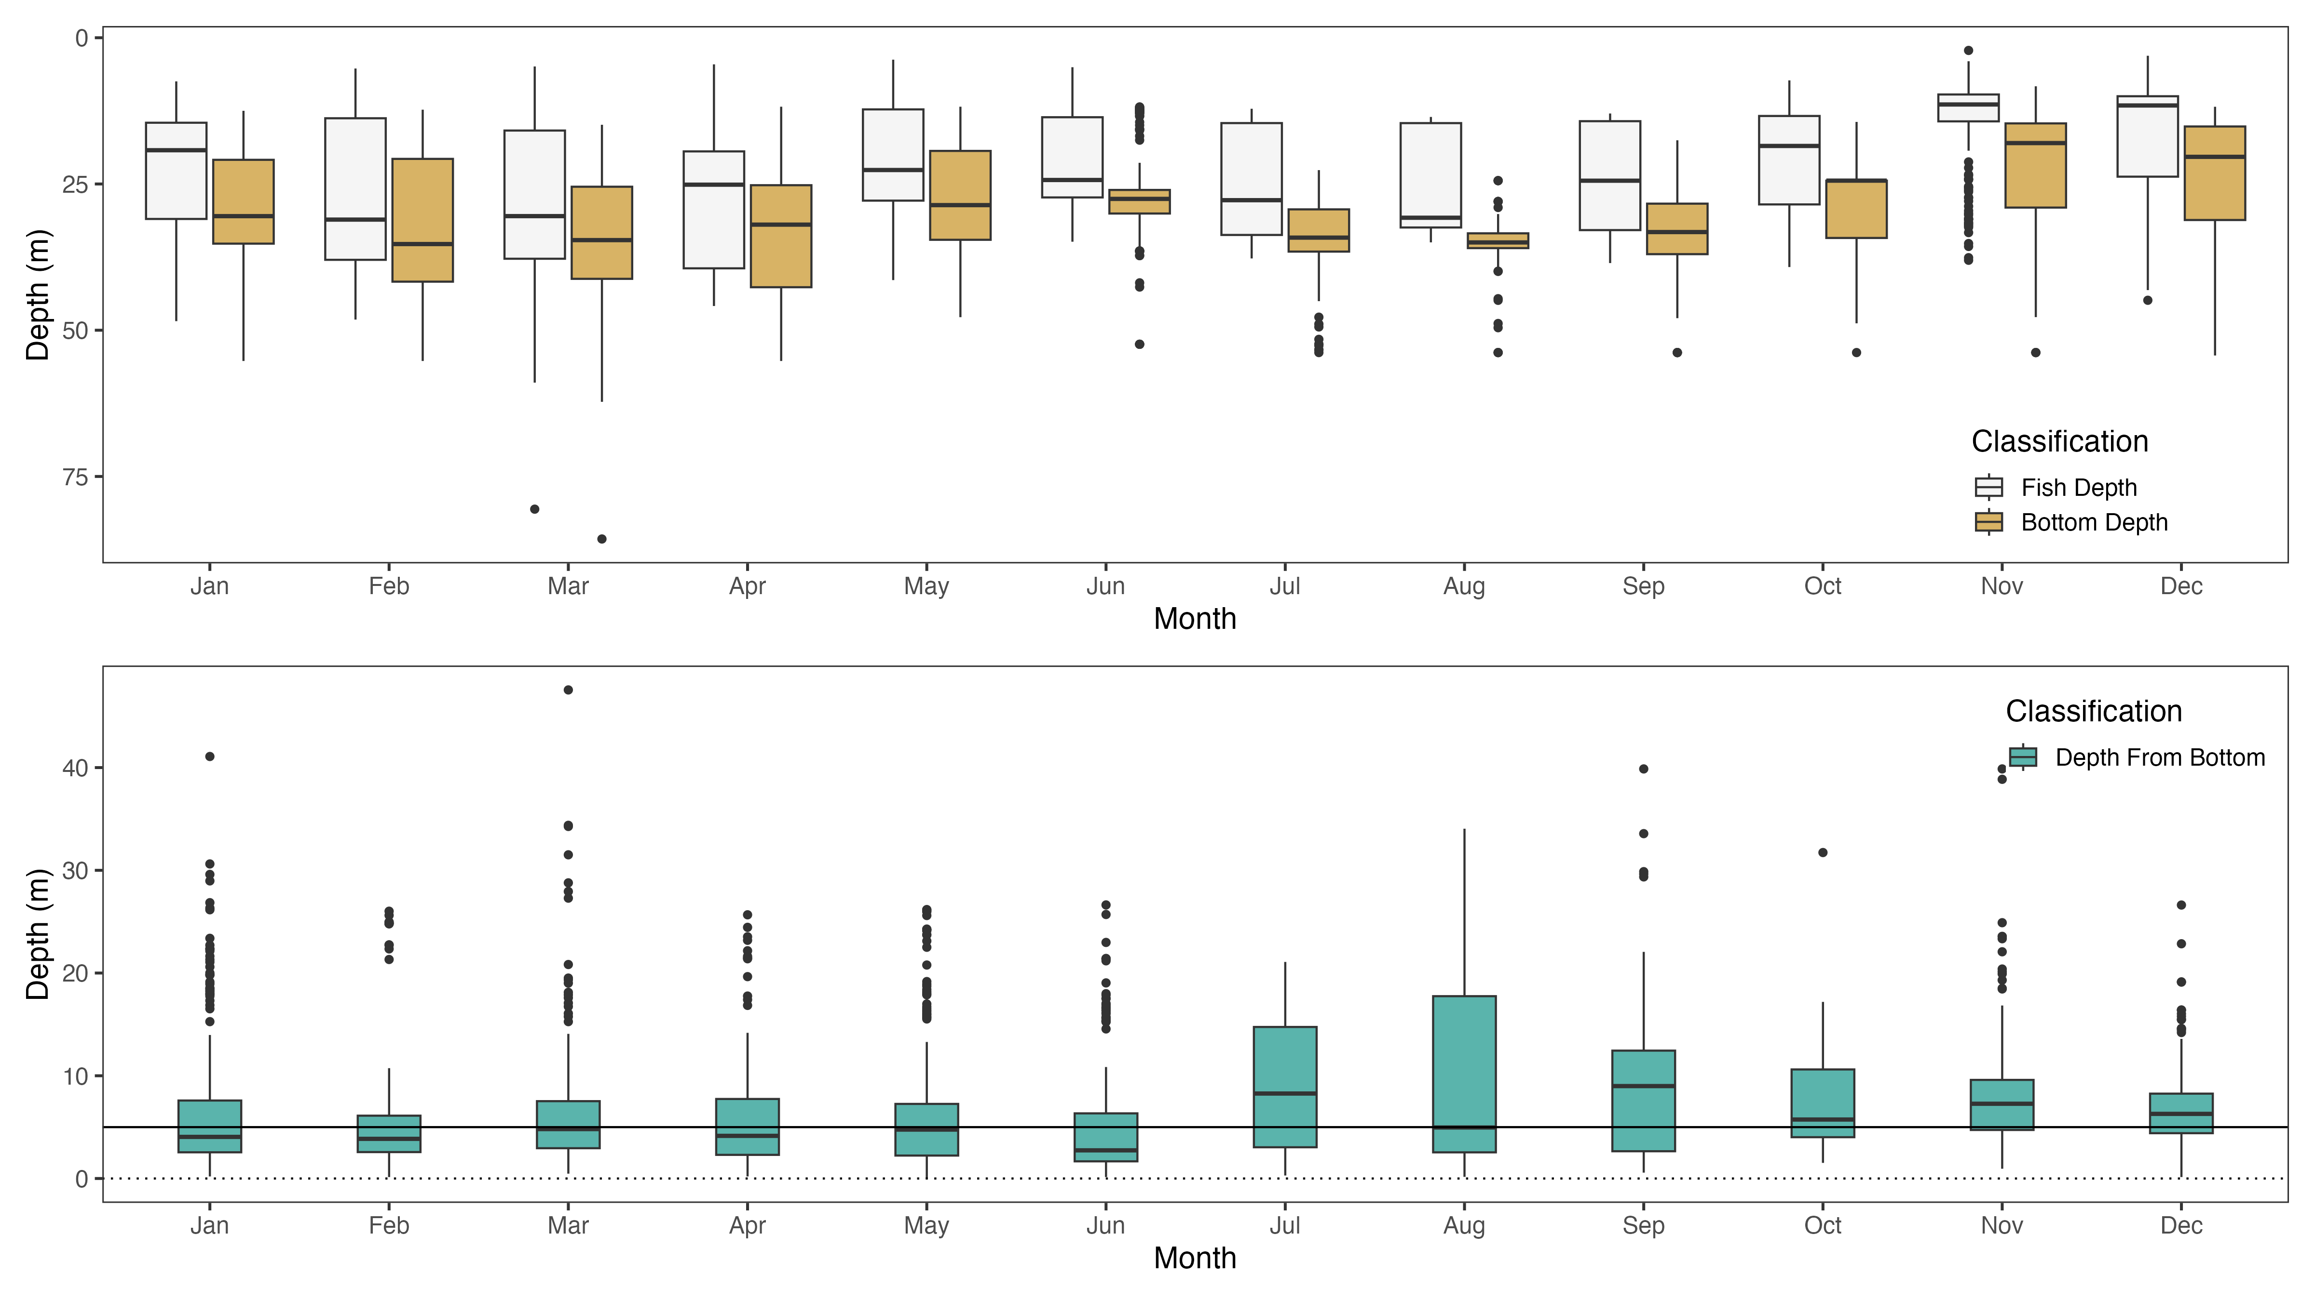
Lake Whitefish – Depth Use
Pelagic
Benthic

