Slide 1
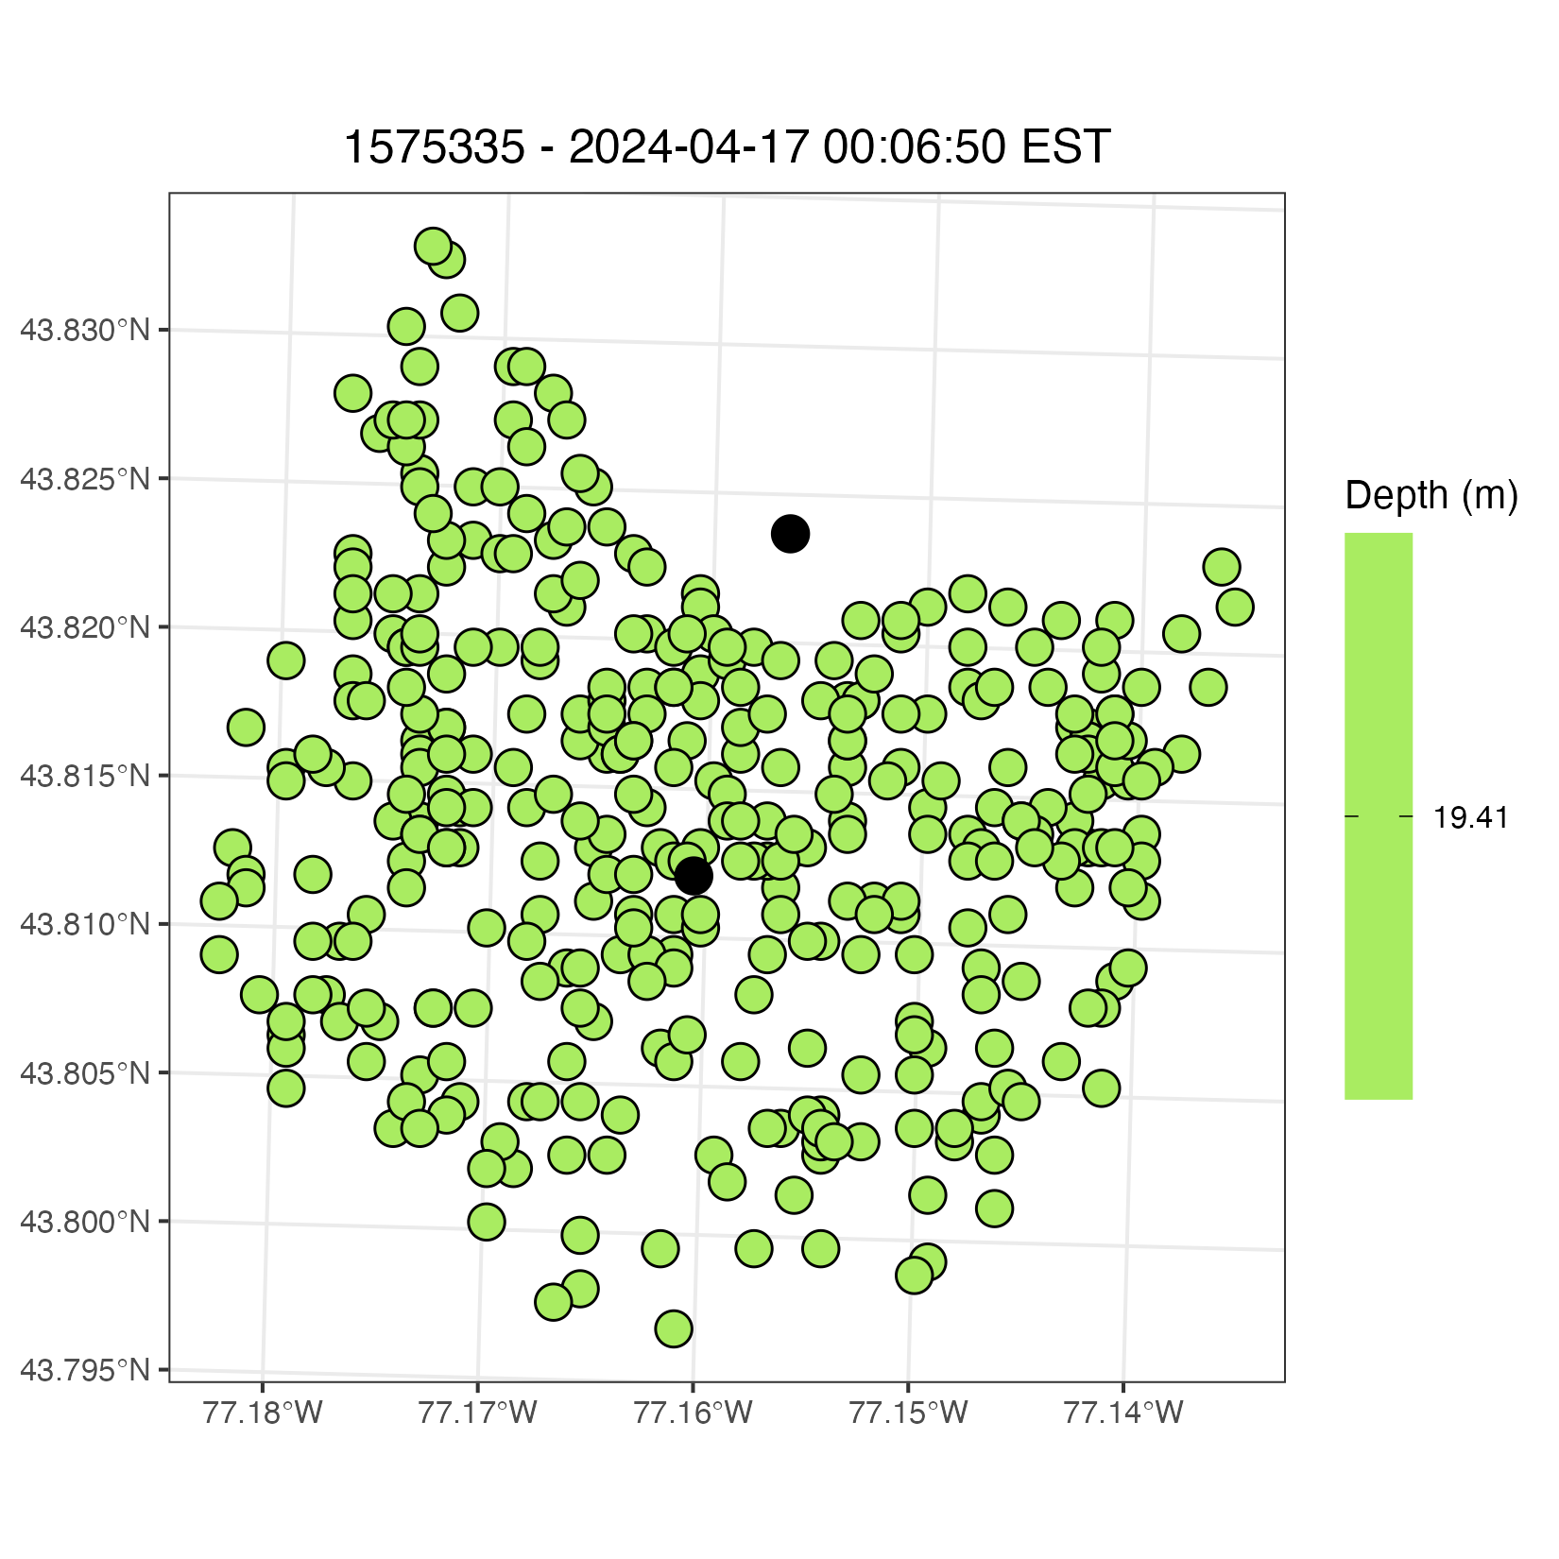
Detection for 1 fish on Point Peter Line – Blackdots represent receivers – green dots are where the fish could be – it had a depth of 19.41 m – the fish’s location is based on an equally spaced grid but could be randomly sampled

Slide 2
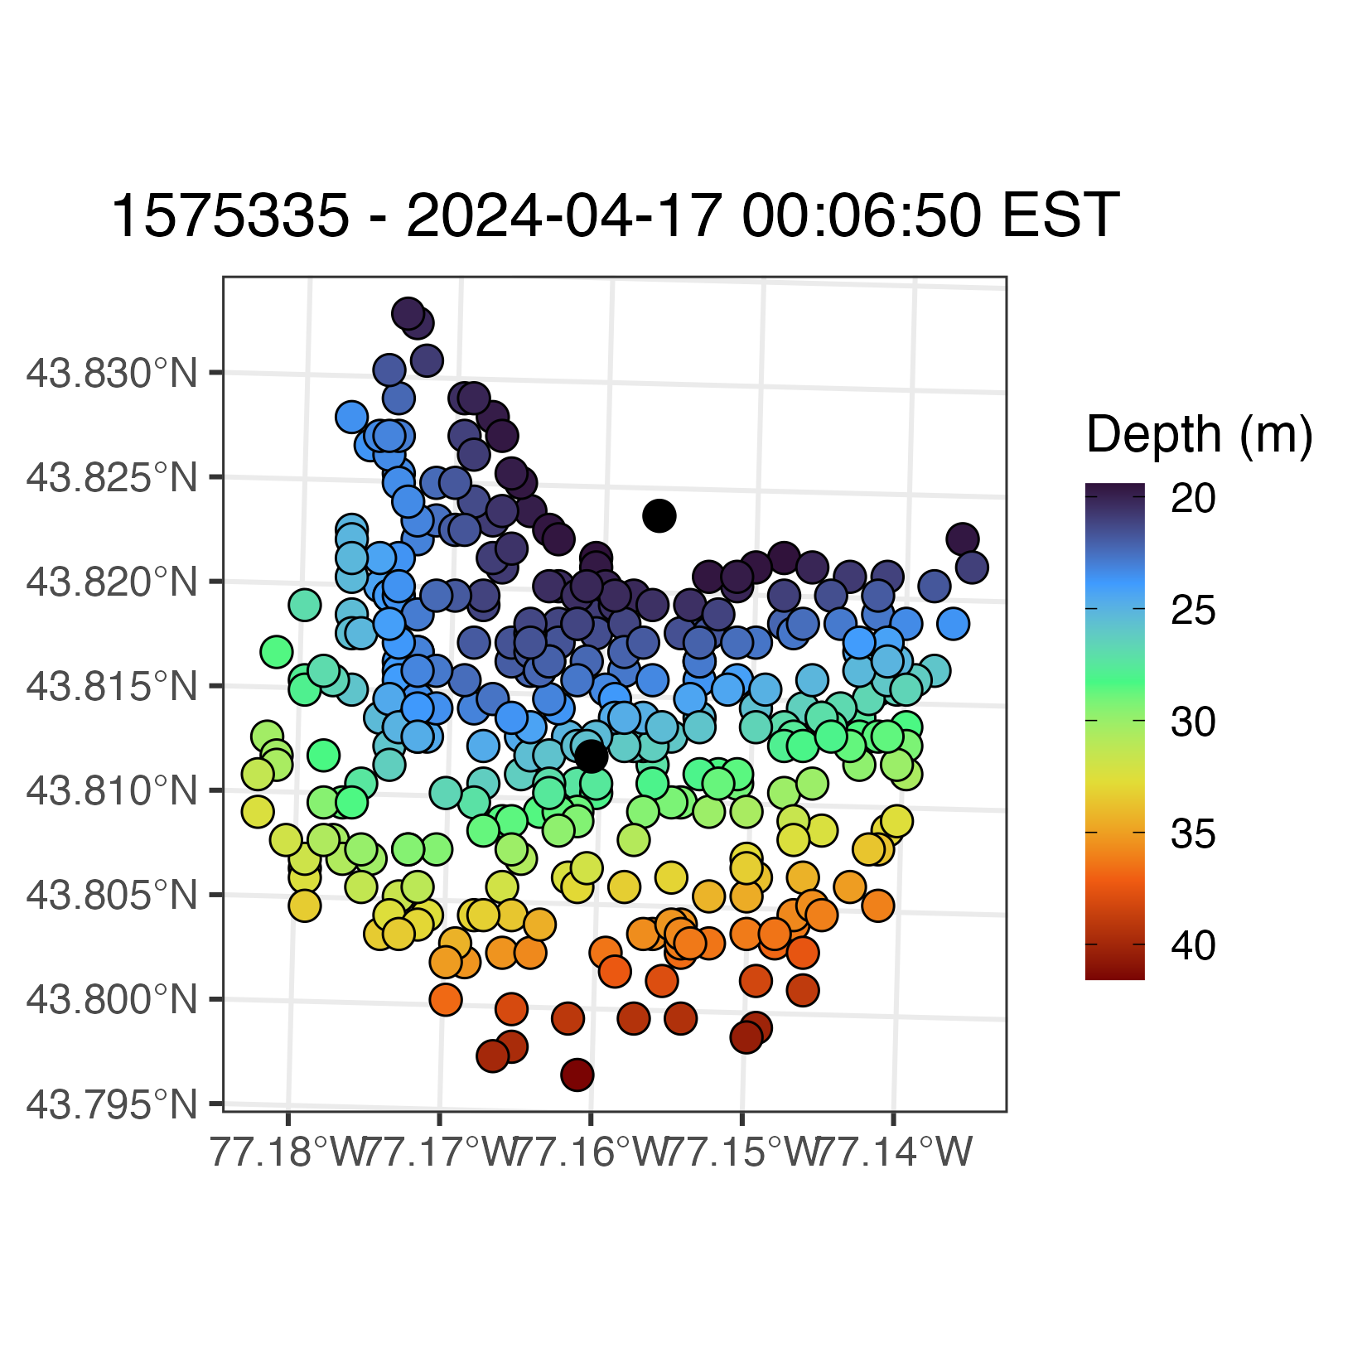
Bathymetry of the lake given the potential location of the fish.

Slide 3
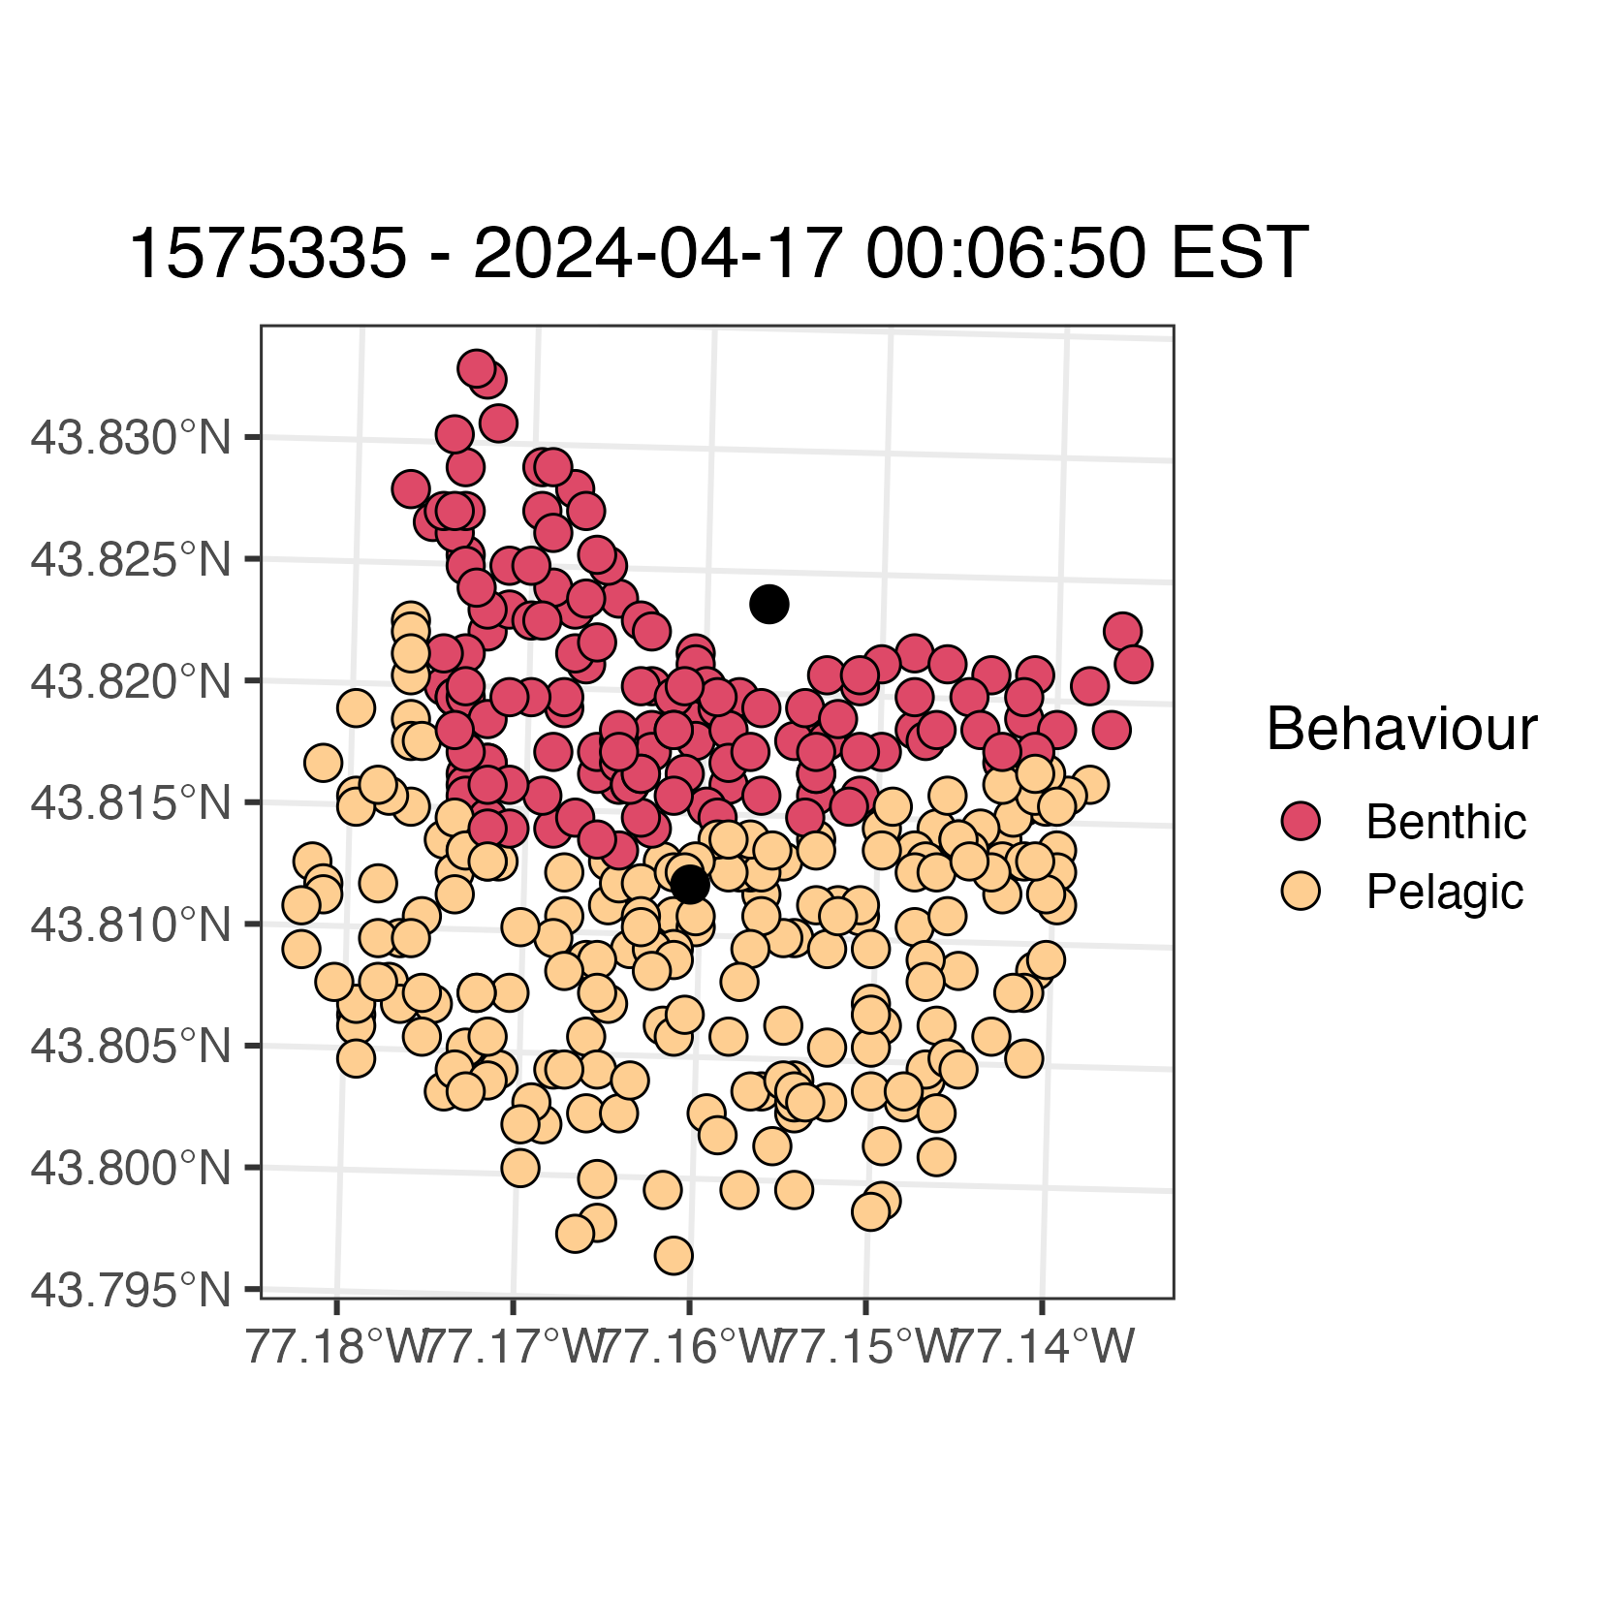
Given the bathymetry and fish’s depth we can classify the fish to be either benthic or pelagic at the given grided locations – again I can easily do this process for random points within the receiver range.

Slide 4
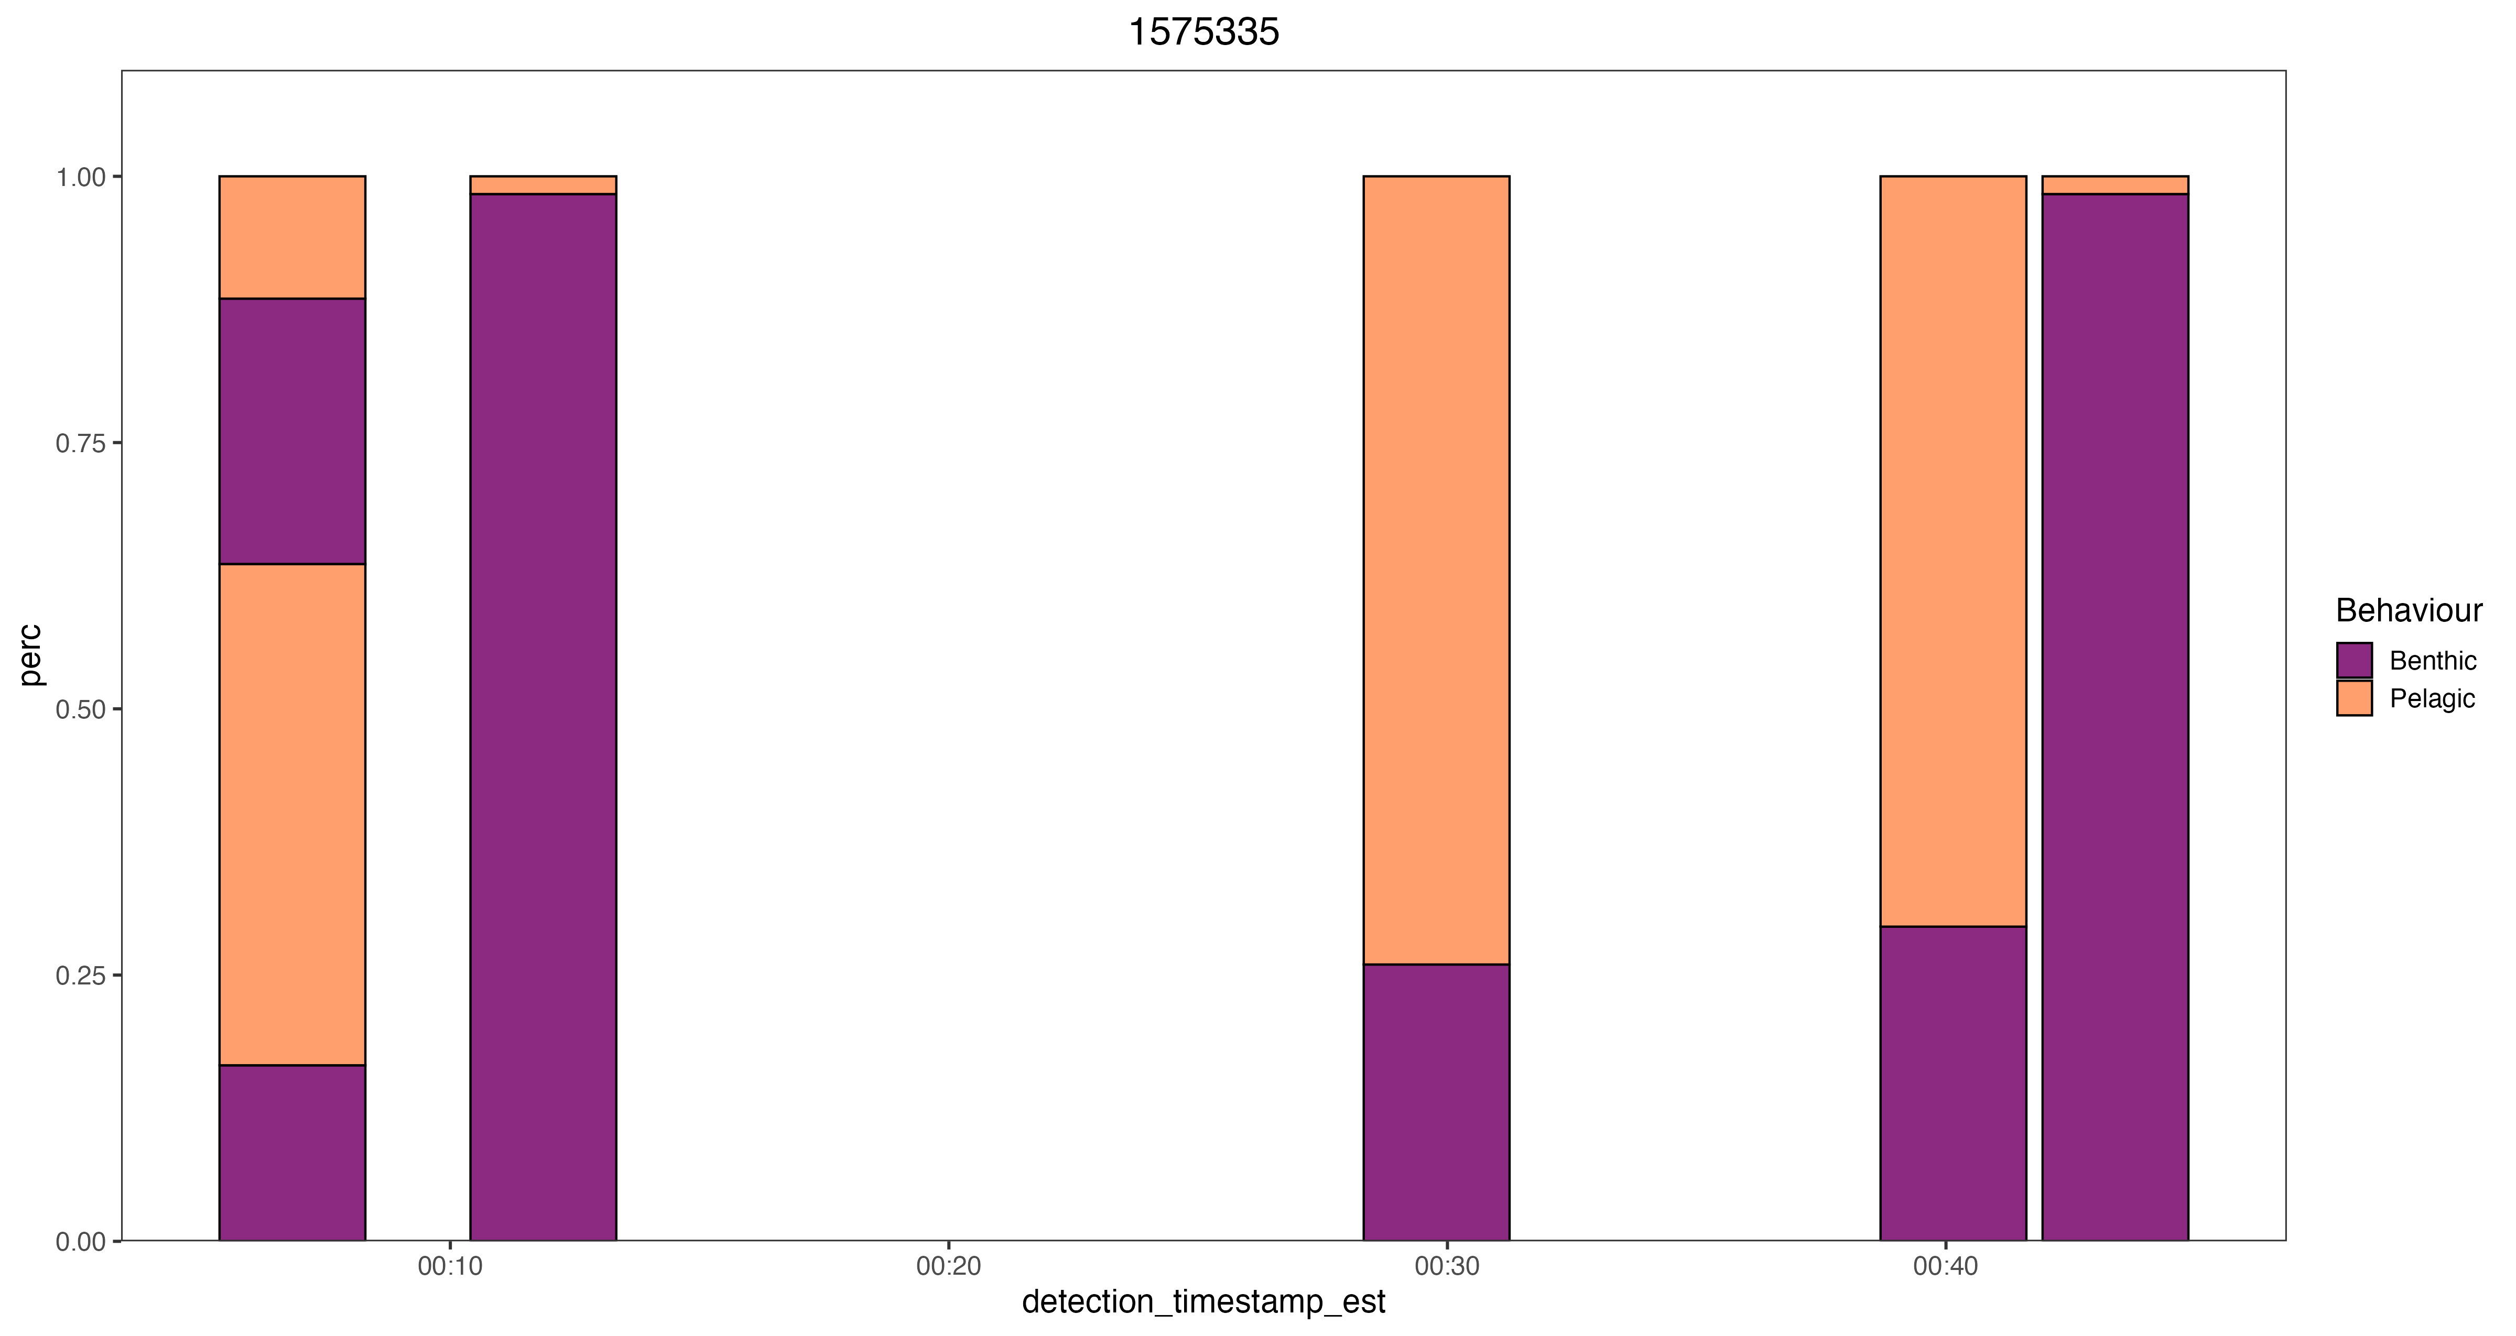
Example of 5 detections including the one used above – total percentage is from 0-1.
PPW-008
PPW-008
PPW-008
PPW-004
PPW - 006
PPW - 006
PPW - 008
PPW - 008

Slide 5
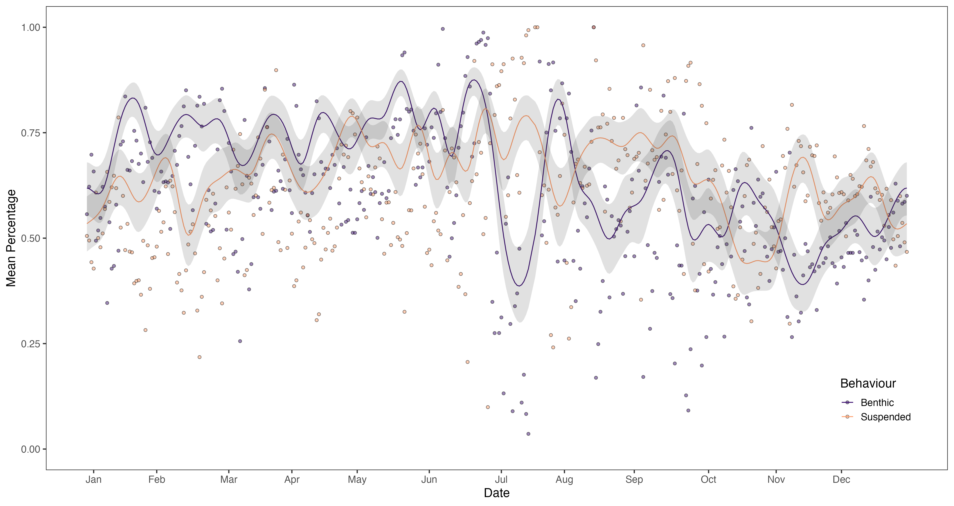
From there I have taken the average for each fish given each day it was detected, can go more fine scale than this – The model figure, is mean percentage with a response of day of year, benthic or pelagic, and a random effect of fish id. The points are the mean regardless of individual – This overall analysis can change as right now I’m not sure I find it all that informative or at least the way I’m presenting it as it right now the Daily percentage a fish could be benthic or pelagic. Sorry for the inconsistencies in the labelling of things.

Slide 6
If I do this for each detection and each fish I get the following

